Slide 1
Session 2 - Question 2
⏱ TIME
A developer is building a web application that uses Amazon API Gateway. The developer wants to maintain different environments for development (dev) and production (prod) workloads. The API will be backed by an AWS Lambda function with two aliases: one for dev and one for prod. How can the developer maintain these environments with the LEAST amount of configuration?
A
Create a REST API for each environment. Integrate the APIs with the corresponding dev and prod aliases of the Lambda function. Deploy the APIs to their respective stages. Access the APIs by using the stage URLs.
B
Create one REST API. Integrate the API with the Lambda function by using a stage variable in place of an alias. Deploy the API to two different stages: dev and prod. Create a stage variable in each stage with different aliases as the values. Access the API by using the different stage URLs.
C
Create one REST API. Integrate the API with the dev alias of the Lambda function. Deploy the API to the dev environment. Configure a canary release deployment for the prod environment where the canary will integrate with the Lambda prod alias.
D
Create one REST API. Integrate the API with the prod alias of the Lambda function. Deploy the API to the prod environment. Configure a canary release deployment for the dev environment where the canary will integrate with the Lambda dev alias

Slide 2
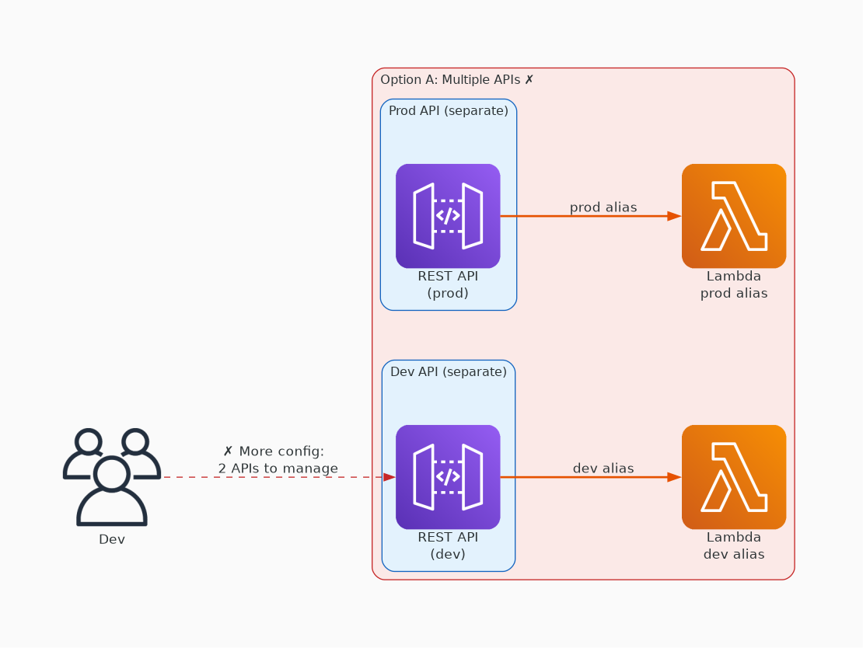
✗ INCORRECT
Option A: Create a REST API for each environment. Integrate the APIs with the corresponding dev and prod aliases of the Lambda function. Deploy the APIs to their respective stages. Access the APIs by using the stage URLs.
Why this is incorrect:
• Very similar to A, but has a REST API for each environment.
• B offers less configuration, so it’s a better answer.

Slide 3
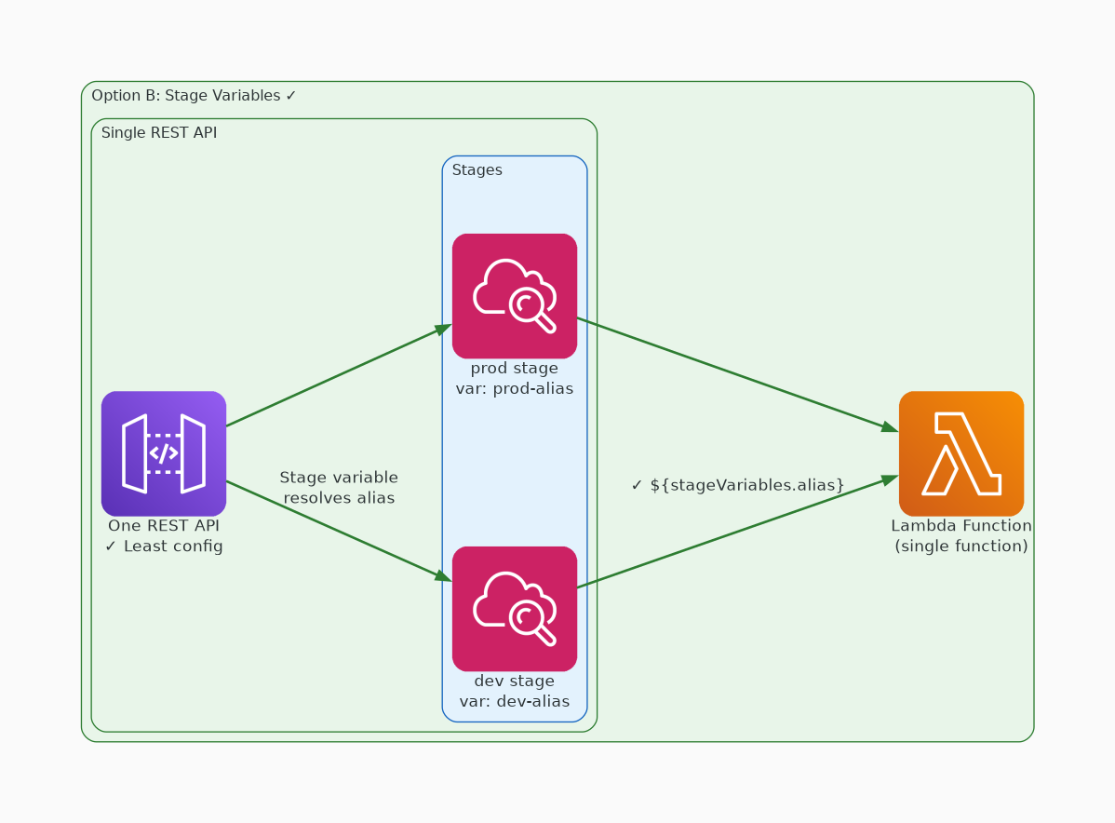
✓ CORRECT
Option B: Create one REST API. Integrate the API with the Lambda function by using a stage variable in place of an alias. Deploy the API to two different stages: dev and prod. Create a stage variable in each stage with different aliases as the values. Access the API by using the different stage URLs.
Why this is correct:
• With deployment stages in Amazon API Gateway, you can manage multiple release stages for each API.
• You can configure stage variables so that an API deployment stage can interact with different backend endpoints.
• You can use API Gateway stage variables to reference a single AWS Lambda function with multiple versions and aliases

Slide 4
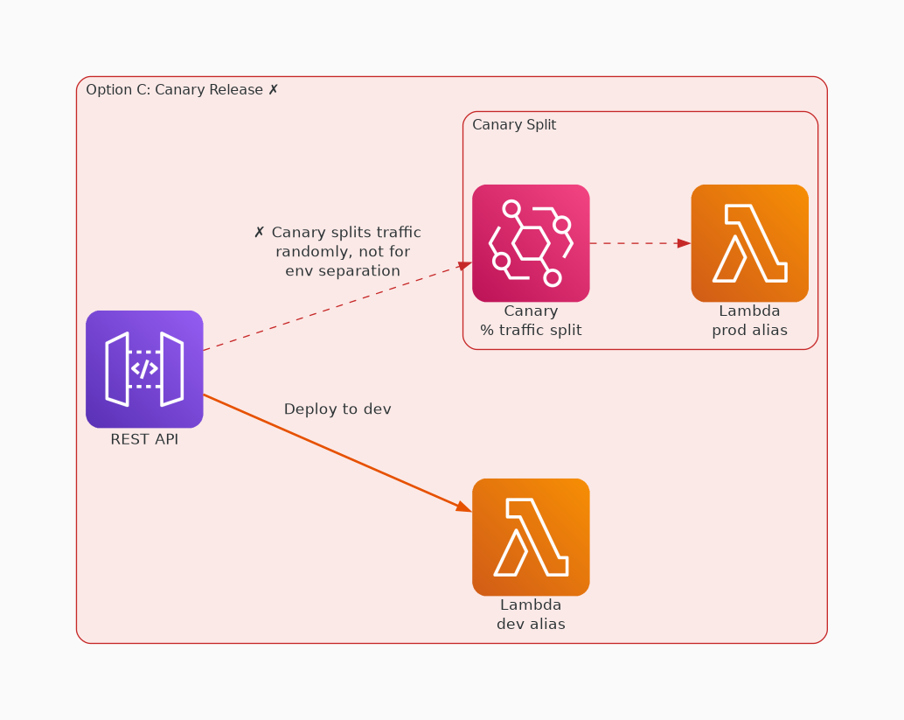
✗ INCORRECT
Option C: Create one REST API. Integrate the API with the dev alias of the Lambda function. Deploy the API to the dev environment. Configure a canary release deployment for the prod environment where the canary will integrate with the Lambda prod alias.
Why this is incorrect:
• No explanation provided

Slide 5
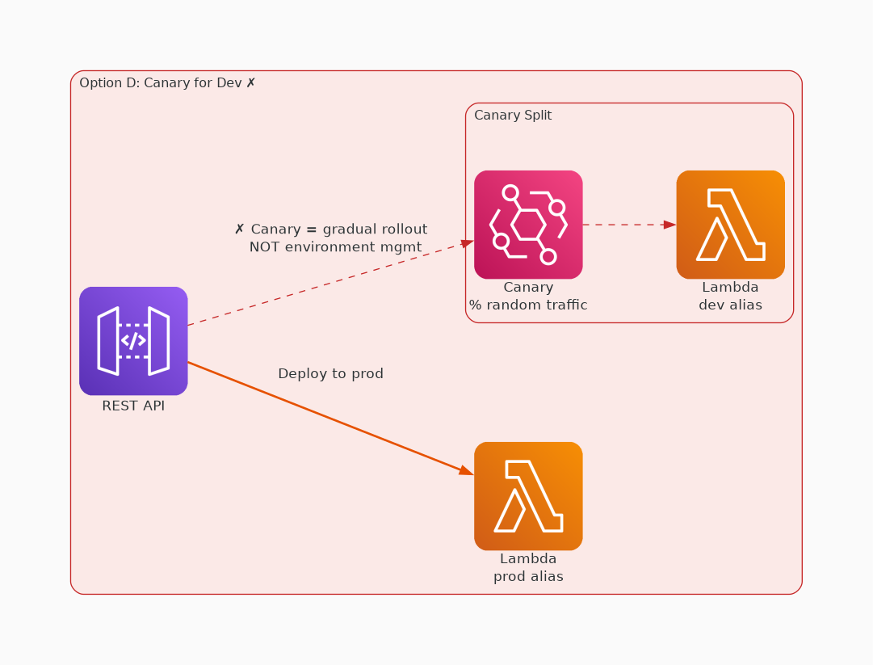
✗ INCORRECT
Option D: Create one REST API. Integrate the API with the prod alias of the Lambda function. Deploy the API to the prod environment. Configure a canary release deployment for the dev environment where the canary will integrate with the Lambda dev alias
Why this is incorrect:
• C & D are both incorrect because in a canary release deployment, total API traffic is separated at random into a production release and a canary release with a pre-configured ratio.
• Typically, the canary release receives a small percentage of API traffic and the production release takes up the rest.
• The updated API features are only visible to API traffic through the canary.
• This is not the best way to manage separate dev and prod environments, compared to B

