Slide 1
Session 2 - Question 3
⏱ TIME
A developer writes an AWS Lambda function in Java that calls a third-party API by using an API key. The developer must keep the API key encrypted and secure from casual observation. The API key can change over time. How can the developer meet these requirements in the MOST operationally efficient manner?
A
Hard-coding parameters within any code is not a good practice. Lambda function artifacts are not stored with encryption
B
Amazon EBS volumes can be mounted by Amazon EC2 instances, but not by Lambda functions.
C
While this solution provides a minor improvement over hard-coding parameters, co-packaging parameter values in a deploym
D
Parameter Store allows for easy externalization of parameters, such as an API key. The secure string option provides for

Slide 2
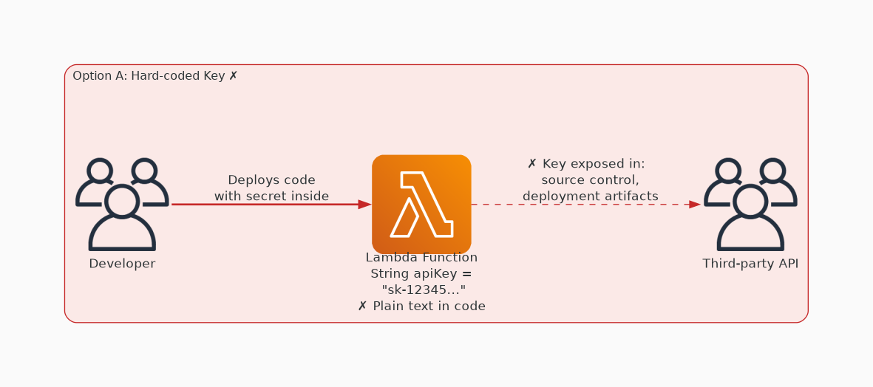
✗ INCORRECT
Option A: Hard-coding parameters within any code is not a good practice. Lambda function artifacts are not sto
Why this is incorrect:
• Hard-coding parameters within any code is not a good practice.
• Lambda function artifacts are not stored with encryption at rest.
• While the Java code is compiled and not visible from the Lambda console, the source code is not compiled and still carries the values without encryption.
• Any changes to parameter values would require code modification, rebuilding, and re-deployment, which would not be operationally efficient.

Slide 3
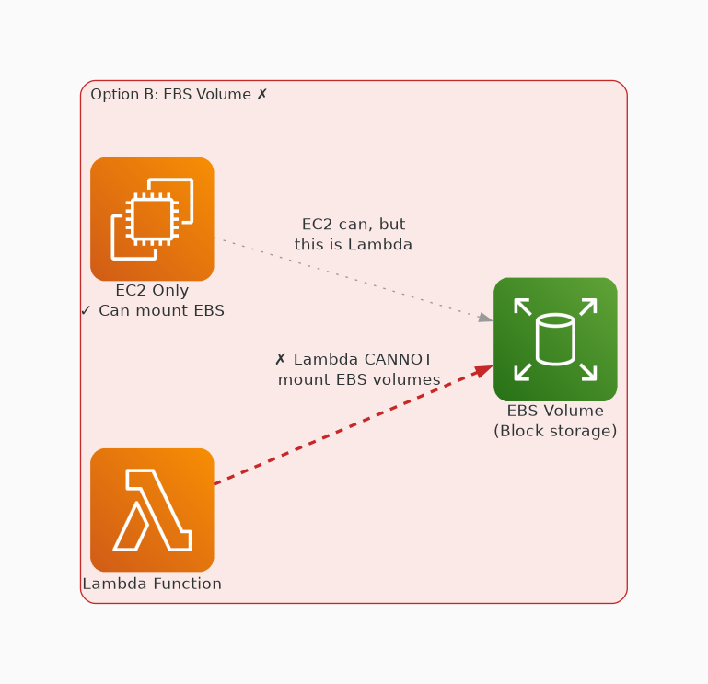
✗ INCORRECT
Option B: Amazon EBS volumes can be mounted by Amazon EC2 instances, but not by Lambda functions.
Why this is incorrect:
• Amazon EBS volumes can be mounted by Amazon EC2 instances, but not by Lambda functions.

Slide 4
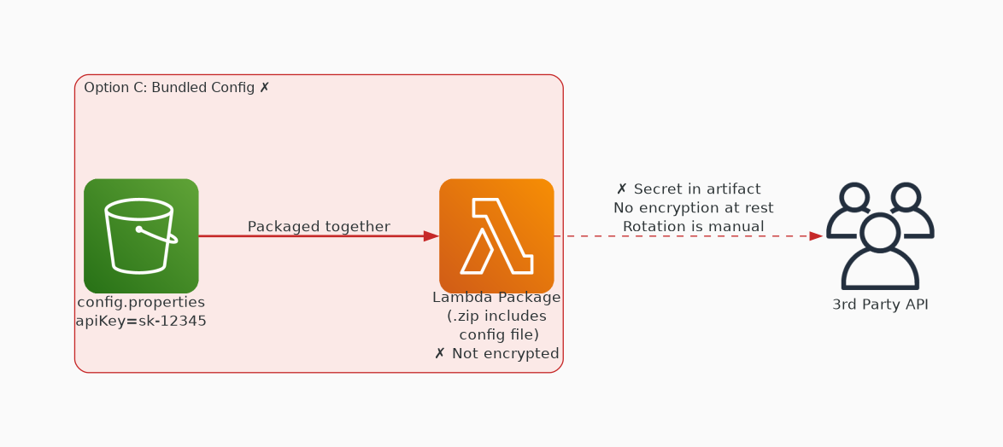
✗ INCORRECT
Option C: While this solution provides a minor improvement over hard-coding parameters, co-packaging parameter
Why this is incorrect:
• While this solution provides a minor improvement over hard-coding parameters, co-packaging parameter values in a deployment artifact is not a Lambda function best practice.
• Lambda function artifacts are not stored with encryption at rest.
• While the Java artifact, including the property file, is compiled and not visible in the Lambda console, the source code is not compiled and still carries the values without encryption.
• Any changes to parameter values would require property file modification, rebuilding, and re-deployment, which is not operationally efficient.

Slide 5
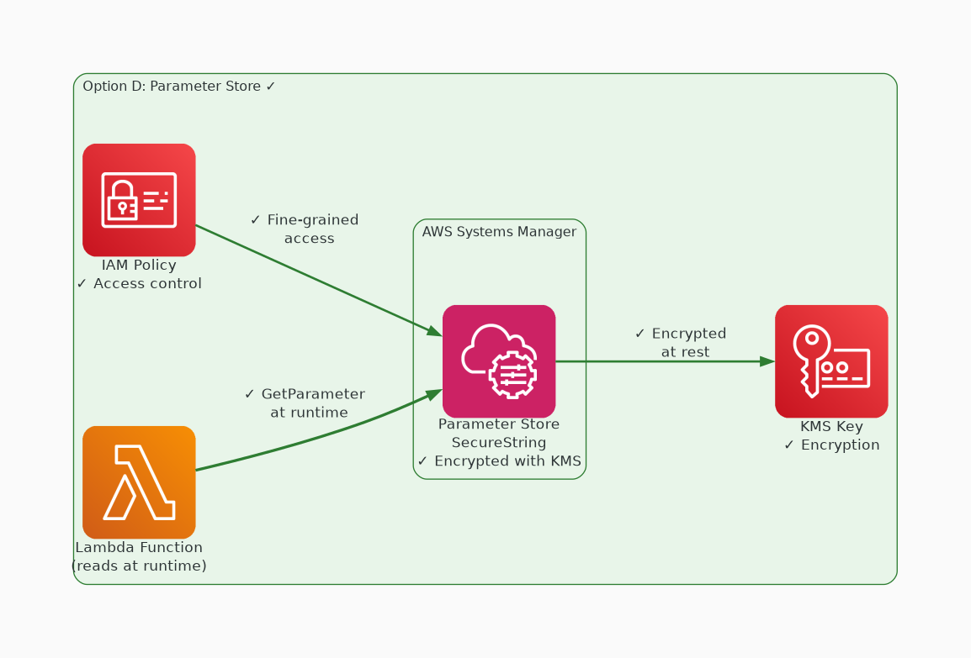
✓ CORRECT
Option D: Parameter Store allows for easy externalization of parameters, such as an API key. The secure string
Why this is correct:
• Parameter Store allows for easy externalization of parameters, such as an API key.
• The secure string option provides for data security by keeping the value encrypted at rest.
• Authorized access to the parameter is governed by IAM permissions.
• Parameter values can be easily changed by authorized principals at any time without requiring a re-deployment of the function, although the function would require intelligence to re-read the parameter values.

