Slide 1
Session 3 - Question 1
⏱ TIME
A developer configures AWS CodeDeploy to install an application on Amazon EC2 instances in an Amazon EC2 Auto Scaling group. Where should the developer place the appspec.yml file?
A
To deploy an application on EC2 instances, the appspec.yml file must be placed in the root of the directory structure of
B
The contents of the appspec.yml file can be directly added into the CodeDeploy console only when an AWS Lambda applicati
C
The .ebextensions folder is used to perform advanced configuration of an AWS Elastic Beanstalk application. This scenari
D
The appspec.yml file must be placed in the bundle with the application's source code.

Slide 2
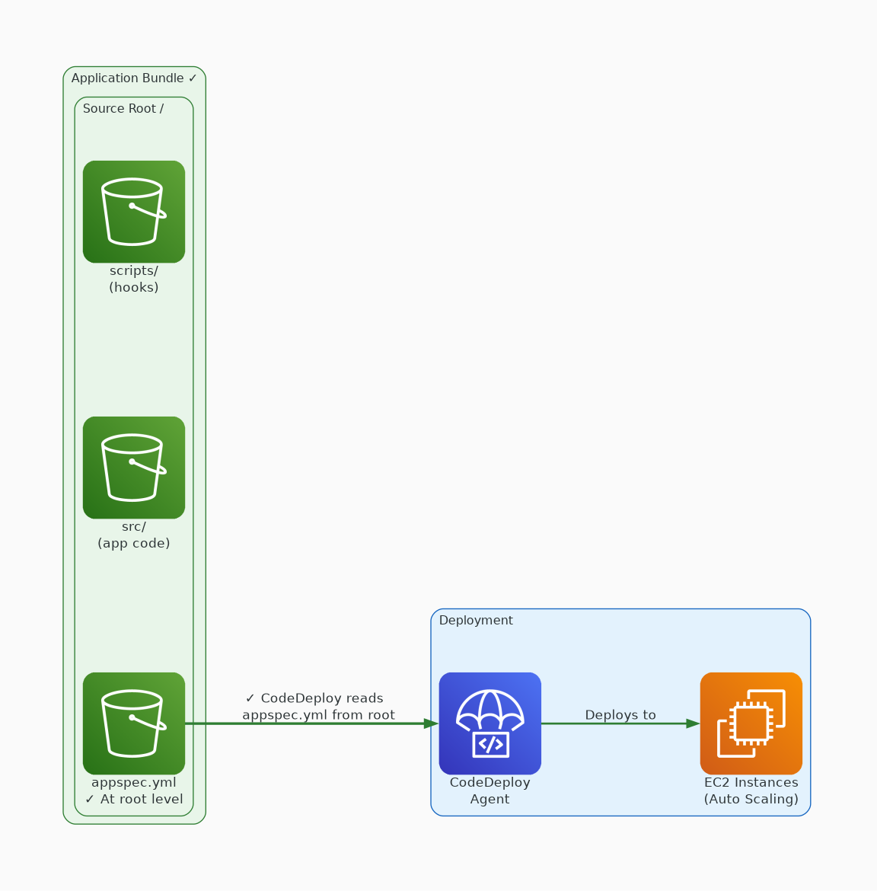
✓ CORRECT
Option A: To deploy an application on EC2 instances, the appspec.yml file must be placed in the root of the di
Why this is correct:
• To deploy an application on EC2 instances, the appspec.
• yml file must be placed in the root of the directory structure of an application's source code.

Slide 3
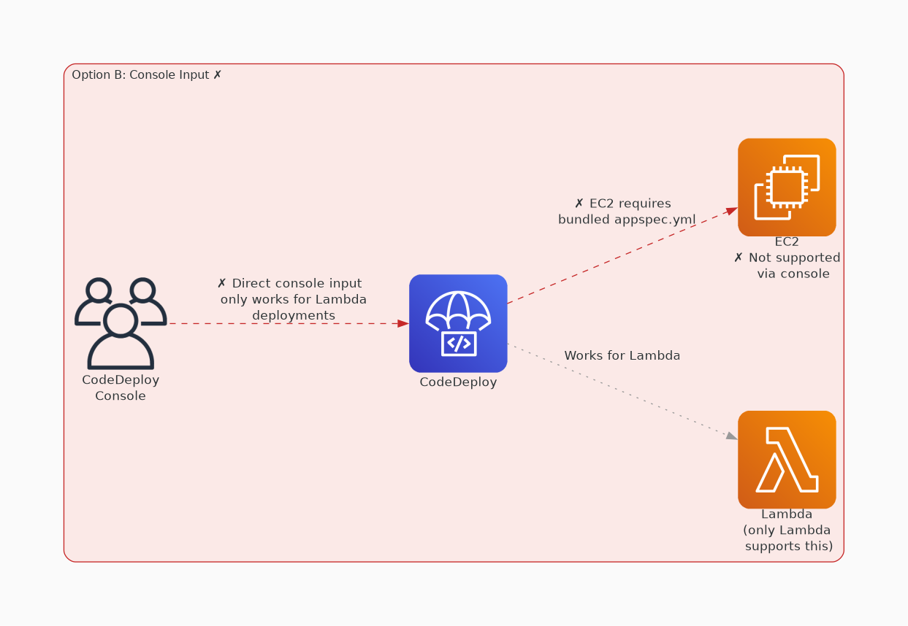
✗ INCORRECT
Option B: The contents of the appspec.yml file can be directly added into the CodeDeploy console only when an
Why this is incorrect:
• The contents of the appspec.
• yml file can be directly added into the CodeDeploy console only when an AWS Lambda application deployment is created.
• This scenario is not using Lambda, so the CodeDeploy console is not a valid option.

Slide 4
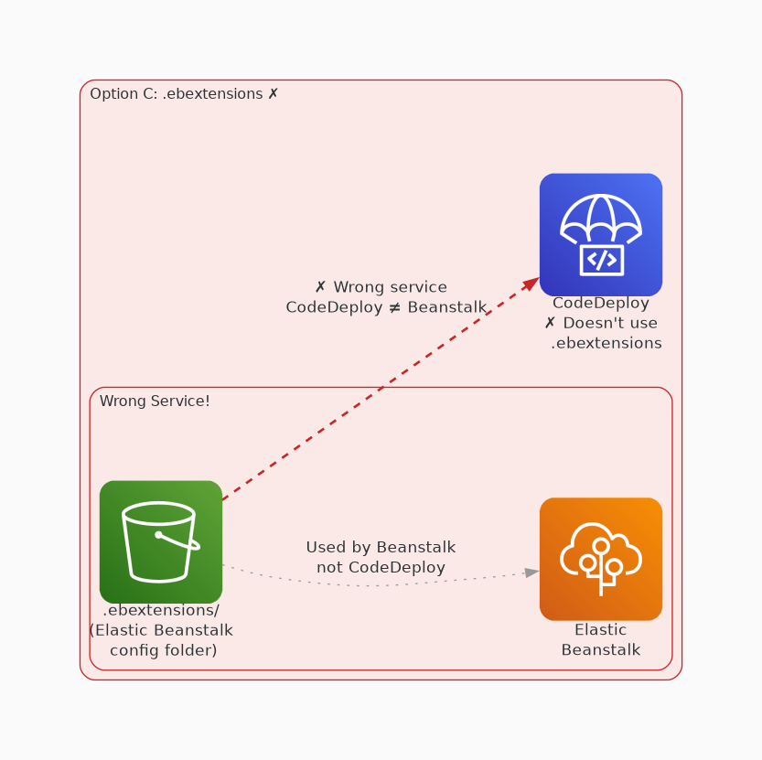
✗ INCORRECT
Option C: The .ebextensions folder is used to perform advanced configuration of an AWS Elastic Beanstalk appli
Why this is incorrect:
• The .ebextensions folder is used to perform advanced configuration of an AWS Elastic Beanstalk application.
• This scenario is not using Elastic Beanstalk, so the . ebextensions folder is not a valid option.
• For more information about configuring Elastic Beanstalk with the .
• ebextensions folder, see Advanced environment customization with configuration files (. ebextensions).

Slide 5
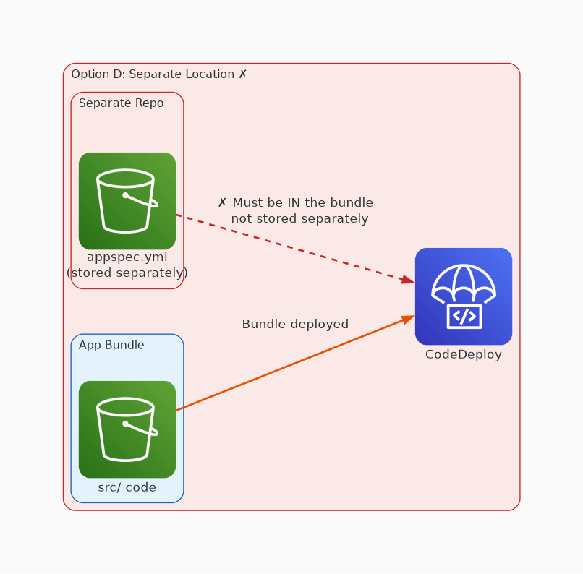
✗ INCORRECT
Option D: The appspec.yml file must be placed in the bundle with the application's source code.
Why this is incorrect:
• The appspec.yml file must be placed in the bundle with the application's source code.

