Slide 1
Session 3 - Question 2
⏱ TIME
A company is developing a Python application that submits data to an Amazon DynamoDB table. The company requires client-side encryption of specific data items and end-to-end protection for the encrypted data in transit and at rest. Which combination of steps will meet the requirement to encrypt specific data items? (Select TWO.)
A
When you configure the DynamoDB Encryption Client to use AWS KMS, the DynamoDB Encryption Client uses a KMS key that is
B
When you configure the DynamoDB Encryption Client to use AWS KMS, the DynamoDB Encryption Client uses a KMS key that is
C
The DynamoDB Encryption Client provides end-to-end protection for your data in transit and at rest. You can encrypt sele
D
You can use this method for server-side encryption at rest. This solution does not meet the requirement for client-side
E
You can use this method for server-side encryption at rest. This solution does not meet the requirement for client-side

Slide 2
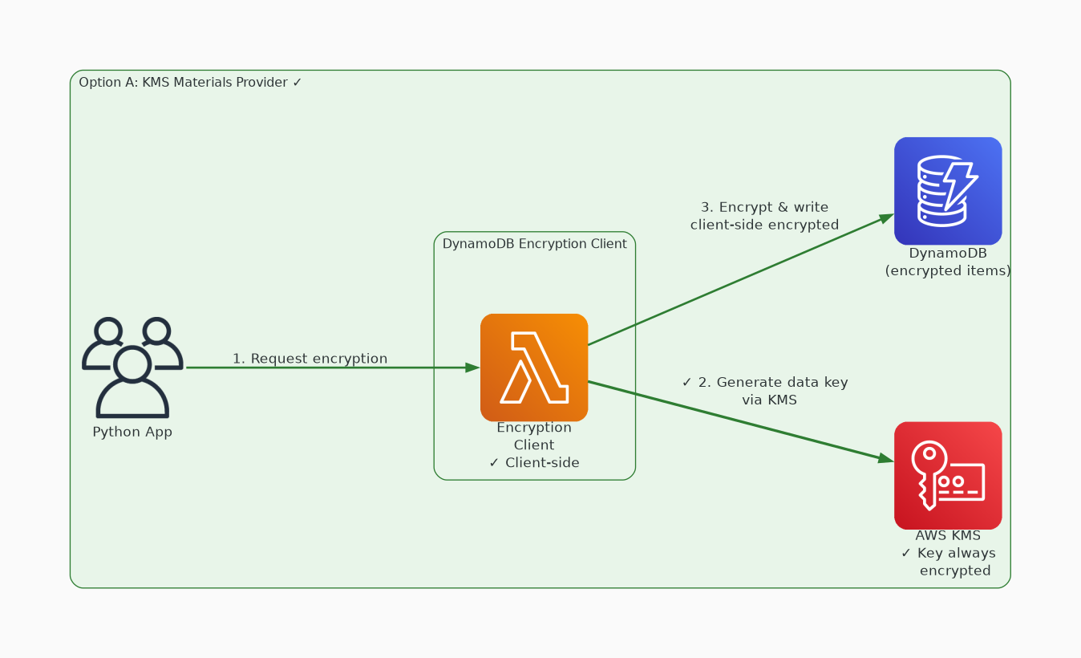
✓ CORRECT
Option A: When you configure the DynamoDB Encryption Client to use AWS KMS, the DynamoDB Encryption Client use
Why this is correct:
• When you configure the DynamoDB Encryption Client to use AWS KMS, the DynamoDB Encryption Client uses a KMS key that is always encrypted when the key is used outside of AWS KMS.
• This cryptographic materials provider returns a unique encryption key and a signing key for every table item.
• This method of encryption uses a symmetric KMS key.

Slide 3
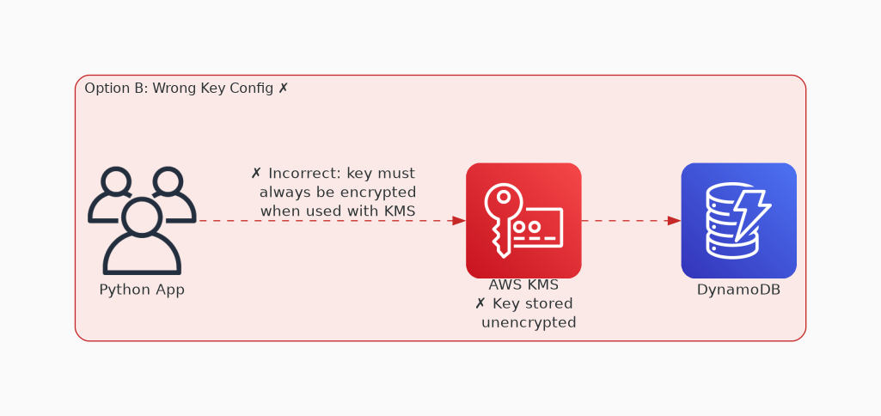
✗ INCORRECT
Option B: When you configure the DynamoDB Encryption Client to use AWS KMS, the DynamoDB Encryption Client use
Why this is incorrect:
• When you configure the DynamoDB Encryption Client to use AWS KMS, the DynamoDB Encryption Client uses a KMS key that is always encrypted when the key is used outside of AWS KMS.
• This cryptographic materials provider returns a unique encryption key and a signing key for every table item.
• This method of encryption would require a symmetric KMS key, not an asymmetric key.

Slide 4
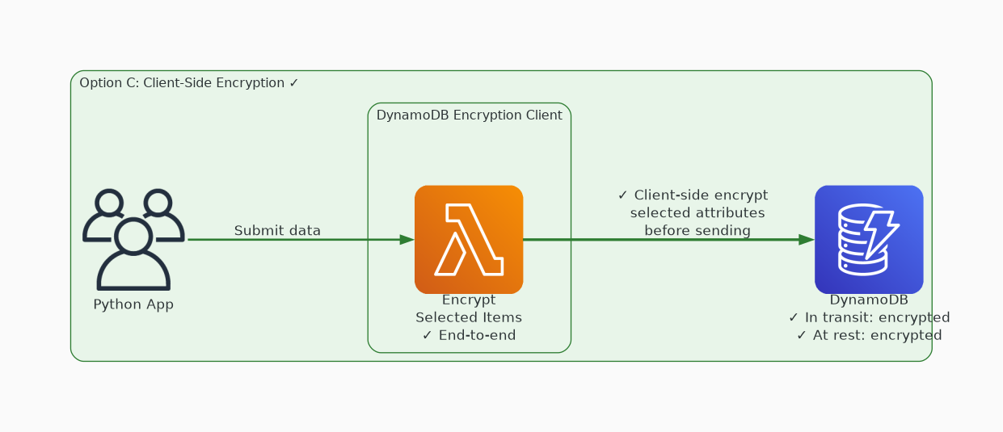
✓ CORRECT
Option C: The DynamoDB Encryption Client provides end-to-end protection for your data in transit and at rest.
Why this is correct:
• The DynamoDB Encryption Client provides end-to-end protection for your data in transit and at rest.
• You can encrypt selected items or attribute values in a table.

Slide 5
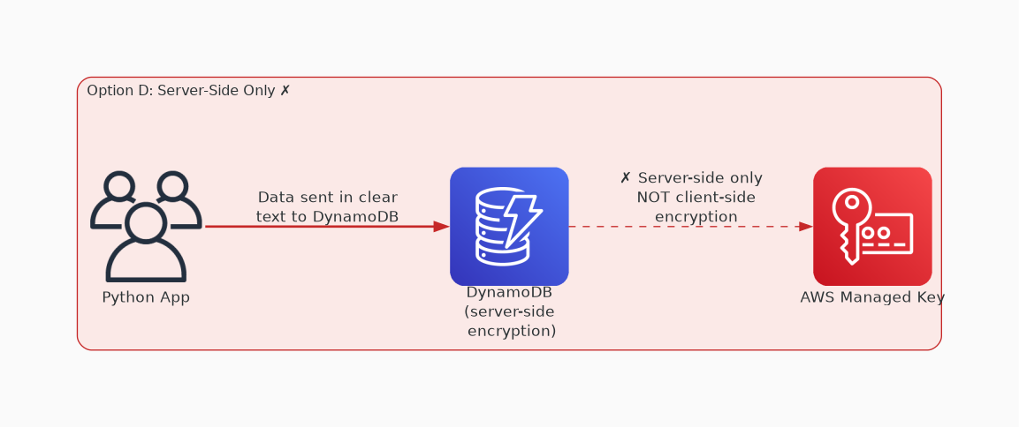
✗ INCORRECT
Option D: You can use this method for server-side encryption at rest. This solution does not meet the requirem
Why this is incorrect:
• You can use this method for server-side encryption at rest.
• This solution does not meet the requirement for client-side encryption.

Slide 6
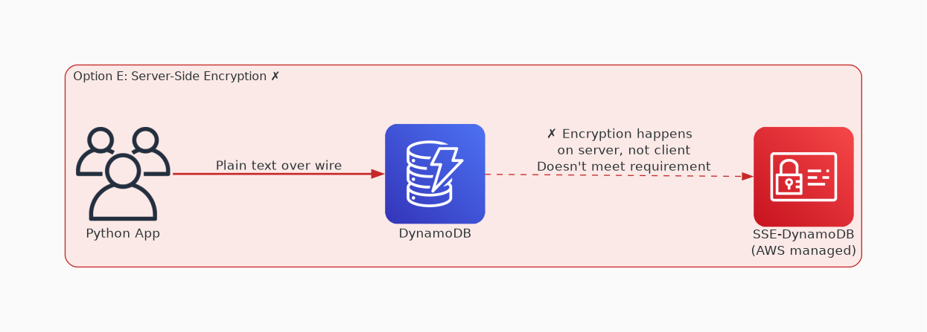
✗ INCORRECT
Option E: You can use this method for server-side encryption at rest. This solution does not meet the requirem
Why this is incorrect:
• You can use this method for server-side encryption at rest.
• This solution does not meet the requirement for client-side encryption.

