Slide 1
Session 3 - Question 3
⏱ TIME
A developer uses the AWS SDK for C++ to retrieve data from an Amazon DynamoDB table. The data is sometimes retrieved using a known key, and sometimes the key is not known, resulting in multiple items being returned. The developer wants to ensure the code returns only one item when retrieving data without keys. Which DynamoDB setting will meet these requirements?
A
The parallel scan operation can logically divide a table into multiple segments, with multiple application workers scann
B
A filter expression applies additional matching criteria to limit the items returned. This expression does not provide a
C
Set the limit parameter to 1 to set the maximum number of items that need to be retrieved with a DynamoDB scan operation
D
The page-size parameter will determine the number of items returned in each page of a query. This method is only relevan

Slide 2
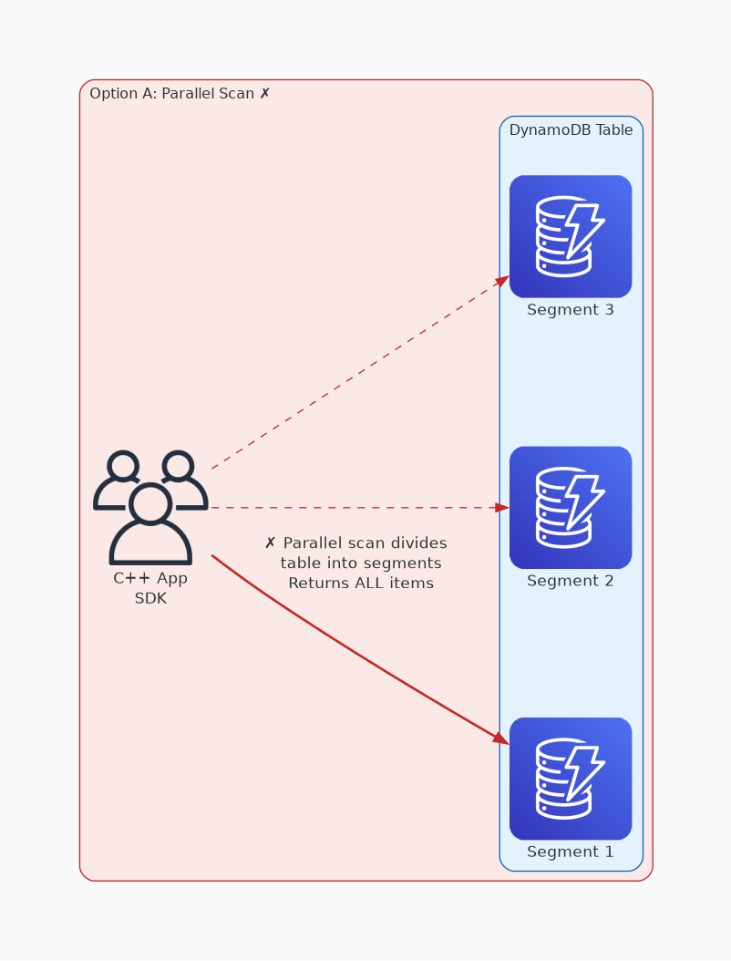
✗ INCORRECT
Option A: The parallel scan operation can logically divide a table into multiple segments, with multiple appli
Why this is incorrect:
• The parallel scan operation can logically divide a table into multiple segments, with multiple application workers scanning the segments in parallel.
• Parallel scan returns the same number of results as an ordinary scan, except the results can be returned more quickly.
• Parallel scan does not limit the number of items returned.

Slide 3
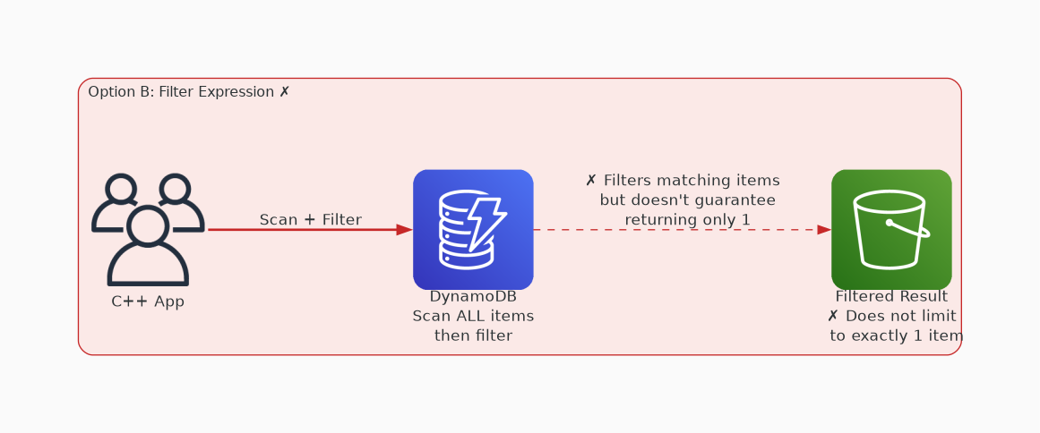
✗ INCORRECT
Option B: A filter expression applies additional matching criteria to limit the items returned. This expressio
Why this is incorrect:
• A filter expression applies additional matching criteria to limit the items returned.
• This expression does not provide a specific limit on the number of items returned.

Slide 4
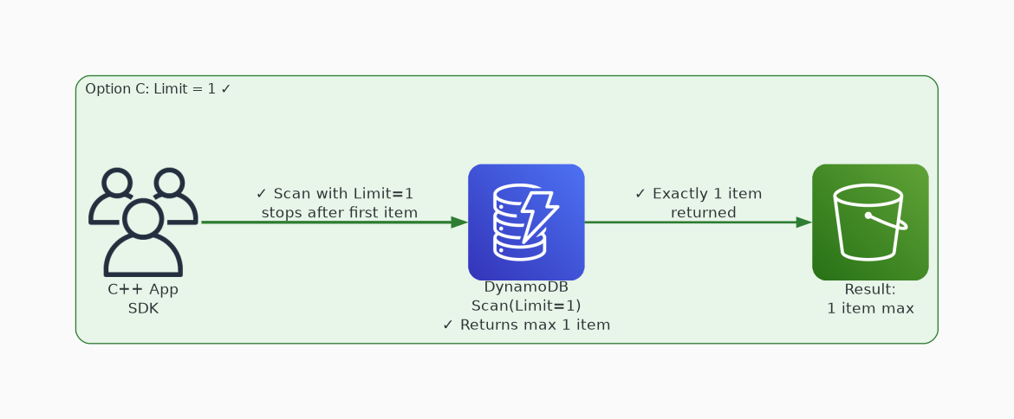
✓ CORRECT
Option C: Set the limit parameter to 1 to set the maximum number of items that need to be retrieved with a Dyn
Why this is correct:
• Set the limit parameter to 1 to set the maximum number of items that need to be retrieved with a DynamoDB scan operation.

Slide 5
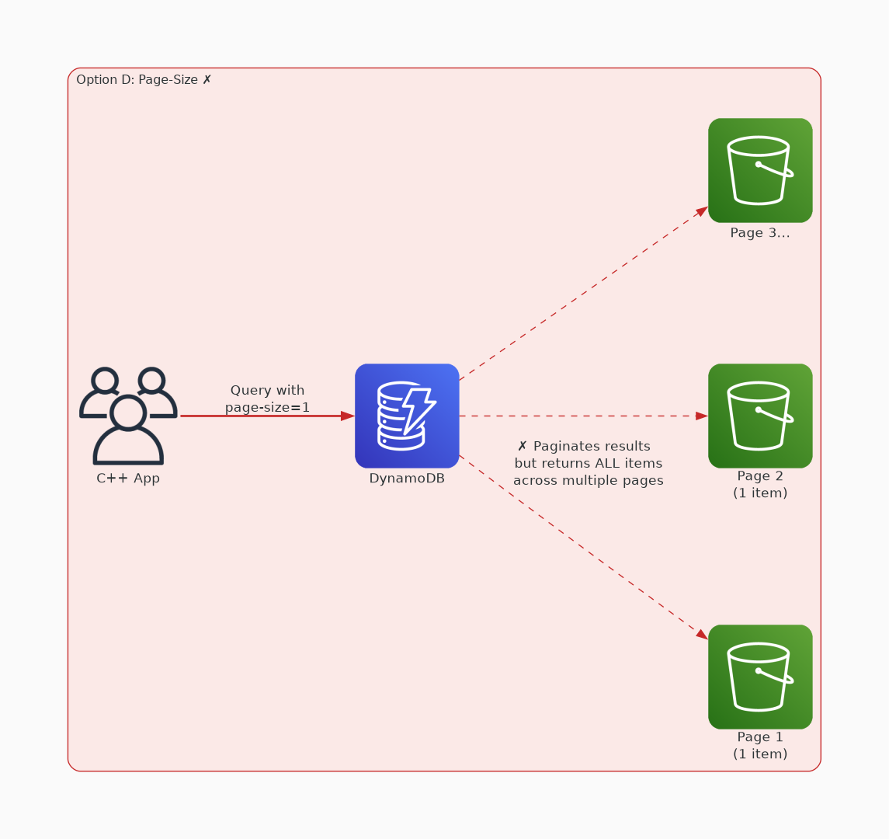
✗ INCORRECT
Option D: The page-size parameter will determine the number of items returned in each page of a query. This me
Why this is incorrect:
• The page-size parameter will determine the number of items returned in each page of a query.
• This method is only relevant for queries that involve the key.

