Slide 1
Session 3 - Question 4
⏱ TIME
A company developed a warehouse fulfillment application by using AWS Step Functions. The Step Functions activity workers run on tablets that warehouse employees use. Some long-running activities fail because of problems with individual tablets. These problems include loss of battery power. The application must re-assign interrupted activities to another worker as soon as possible. If an activity fails three times, the state machine should fail. Which Step Functions configuration will meet the...
A
You set the Retry field at the individual state level, not at the overall state machine level. States.Timeout is an erro
B
States.TaskFailed is an error name. This error name is not a field that you can set.
C
The TimeoutSeconds attribute defines the maximum task duration before the task is considered failed. A value of 30 would
D
The HeartbeatSeconds attribute defines the maximum interval that the task will wait for a heartbeat signal. If an activi

Slide 2
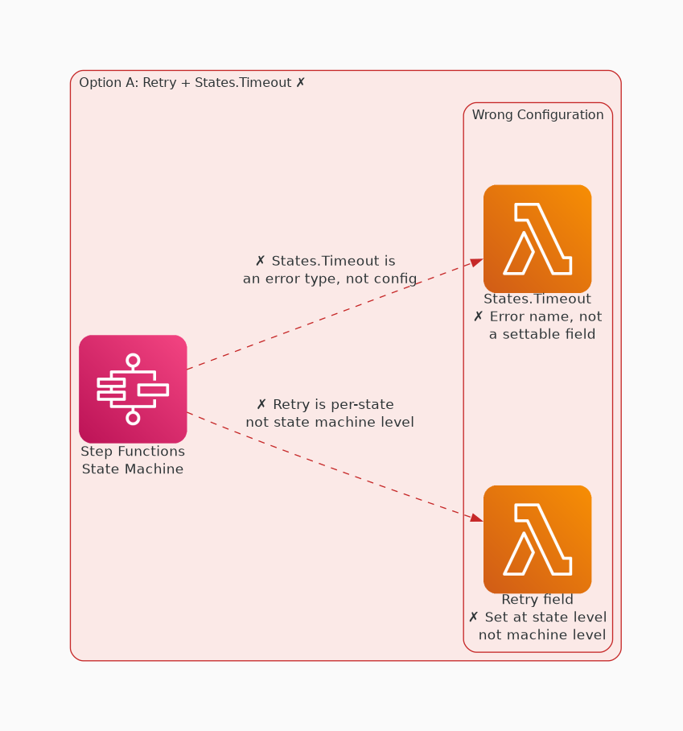
✗ INCORRECT
Option A: You set the Retry field at the individual state level, not at the overall state machine level. State
Why this is incorrect:
• You set the Retry field at the individual state level, not at the overall state machine level.
• States.Timeout is an error name and not a field that you can set.

Slide 3
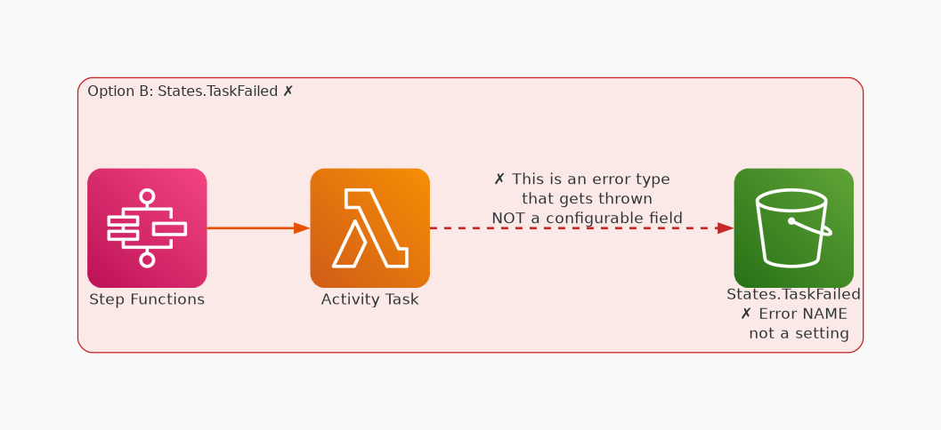
✗ INCORRECT
Option B: States.TaskFailed is an error name. This error name is not a field that you can set.
Why this is incorrect:
• States.TaskFailed is an error name.
• This error name is not a field that you can set.

Slide 4
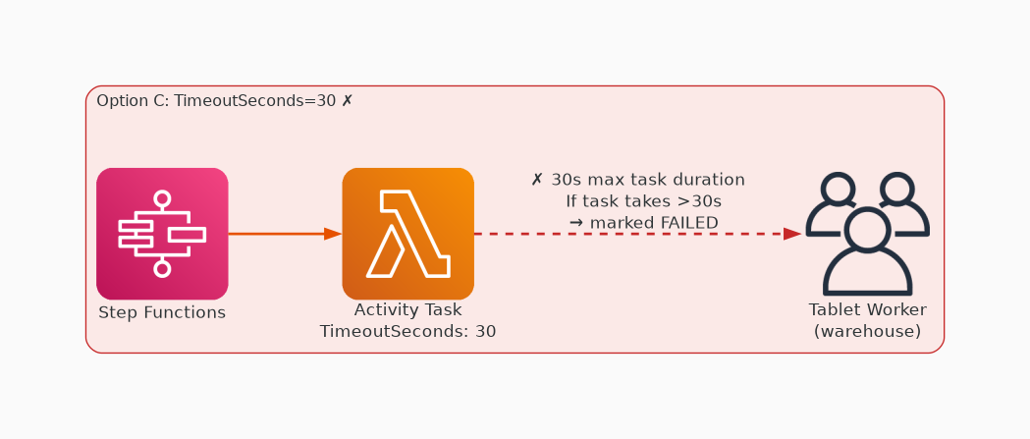
✗ INCORRECT
Option C: The TimeoutSeconds attribute defines the maximum task duration before the task is considered failed.
Why this is incorrect:
• The TimeoutSeconds attribute defines the maximum task duration before the task is considered failed.
• A value of 30 would cause any task that runs longer than 30 seconds to fail, even if there were no problems with the tablet.

Slide 5
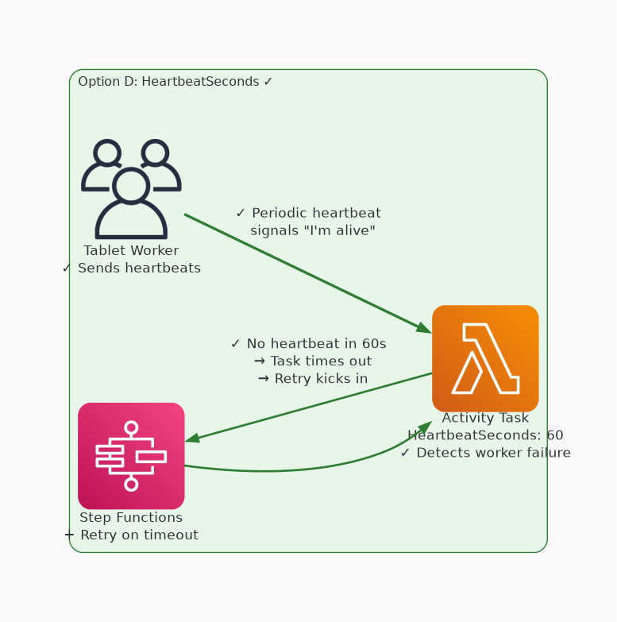
✓ CORRECT
Option D: The HeartbeatSeconds attribute defines the maximum interval that the task will wait for a heartbeat
Why this is correct:
• The HeartbeatSeconds attribute defines the maximum interval that the task will wait for a heartbeat signal.
• If an activity worker fails to send heartbeats within this interval, the state is failed.
• A retry policy on the state allows another activity worker to attempt to complete the state.

