Slide 1
Session 3 - Question 5
⏱ TIME
Picking the right database option
A
Aurora is a relational database (not a key-value database). Aurora is not likely to achieve microsecond latency consiste
B
DynamoDB is a NoSQL database that supports key-value records. DAX delivers response times in microseconds.
C
Aurora is a relational database (not a key-value database). Aurora is not likely to achieve microsecond latency consiste
D
Neptune is a graph database that is optimized for working with highly connected data. Neptune is not optimized for simpl

Slide 2
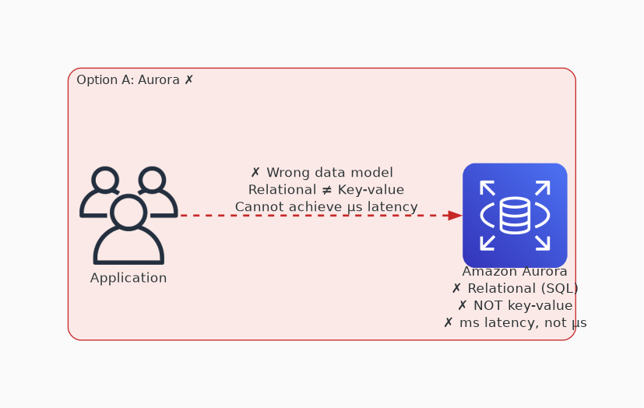
✗ INCORRECT
Option A: Aurora is a relational database (not a key-value database). Aurora is not likely to achieve microsec
Why this is incorrect:
• Aurora is a relational database (not a key-value database).
• Aurora is not likely to achieve microsecond latency consistently.

Slide 3
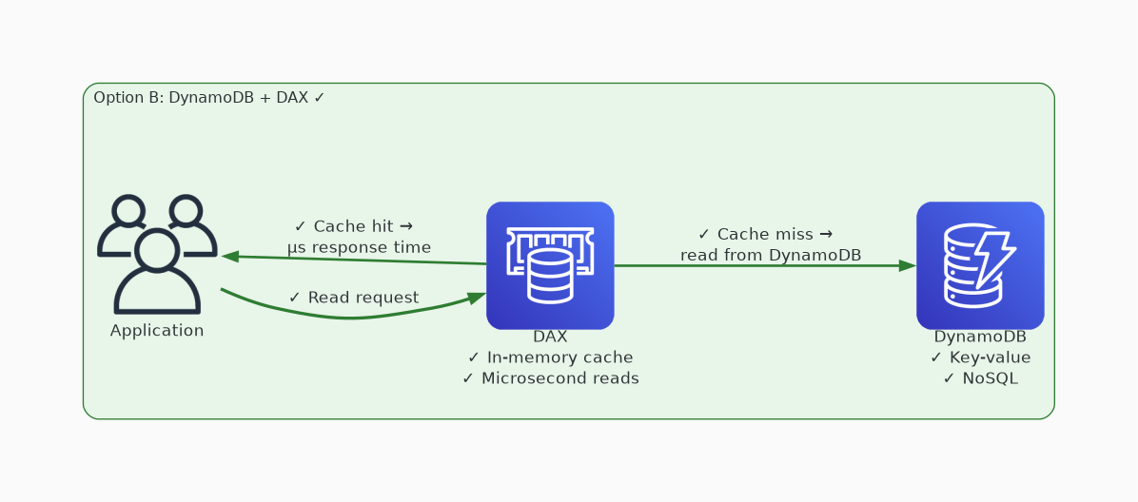
✓ CORRECT
Option B: DynamoDB is a NoSQL database that supports key-value records. DAX delivers response times in microse
Why this is correct:
• DynamoDB is a NoSQL database that supports key-value records.
• DAX delivers response times in microseconds.

Slide 4
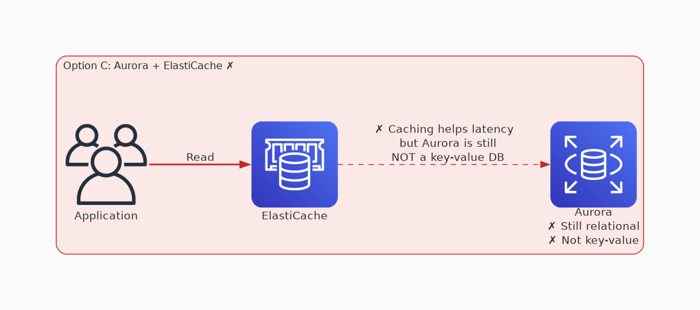
✗ INCORRECT
Option C: Aurora is a relational database (not a key-value database). Aurora is not likely to achieve microsec
Why this is incorrect:
• Aurora is a relational database (not a key-value database).
• Aurora is not likely to achieve microsecond latency consistently, even with ElastiCache.

Slide 5
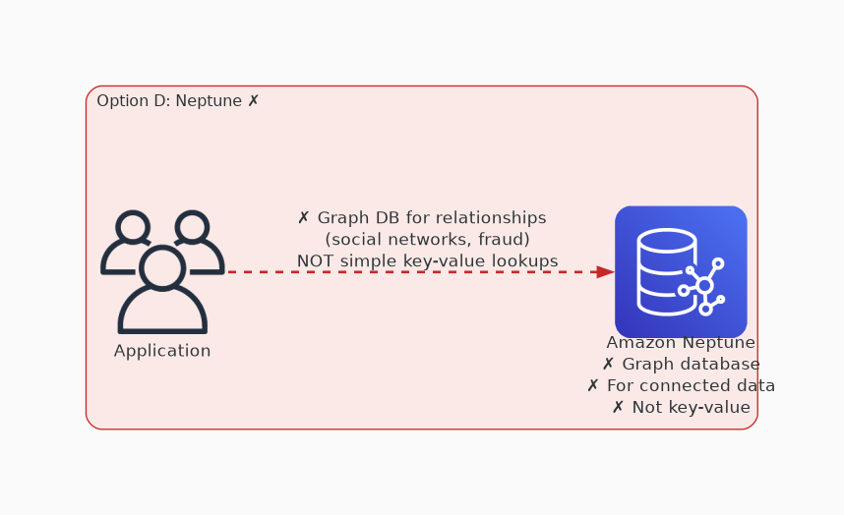
✗ INCORRECT
Option D: Neptune is a graph database that is optimized for working with highly connected data. Neptune is not
Why this is incorrect:
• Neptune is a graph database that is optimized for working with highly connected data.
• Neptune is not optimized for simple key-value data.

