Slide 1
Session 4 - Question 1
⏱ TIME
A company notices performance degradation in one of its production web applications. The application is running on AWS services and uses a microservices architecture. The company suspects that one of these microservices is causing the performance issue. Which AWS solution should the company use to identify the service that is contributing to higher application latency?
A
X-Ray creates a map of services used by your application with trace data. You can use the trace data to drill into speci
B
CloudTrail event history is used to record API calls for governance, compliance operation, and risk auditing purposes. C
C
EventBridge (CloudWatch Events) delivers a near-real-time stream of system events that describe changes in Amazon Web Se
D
Trusted Advisor provides real-time guidance to help provision AWS resources to follow AWS best practices. It can report

Slide 2
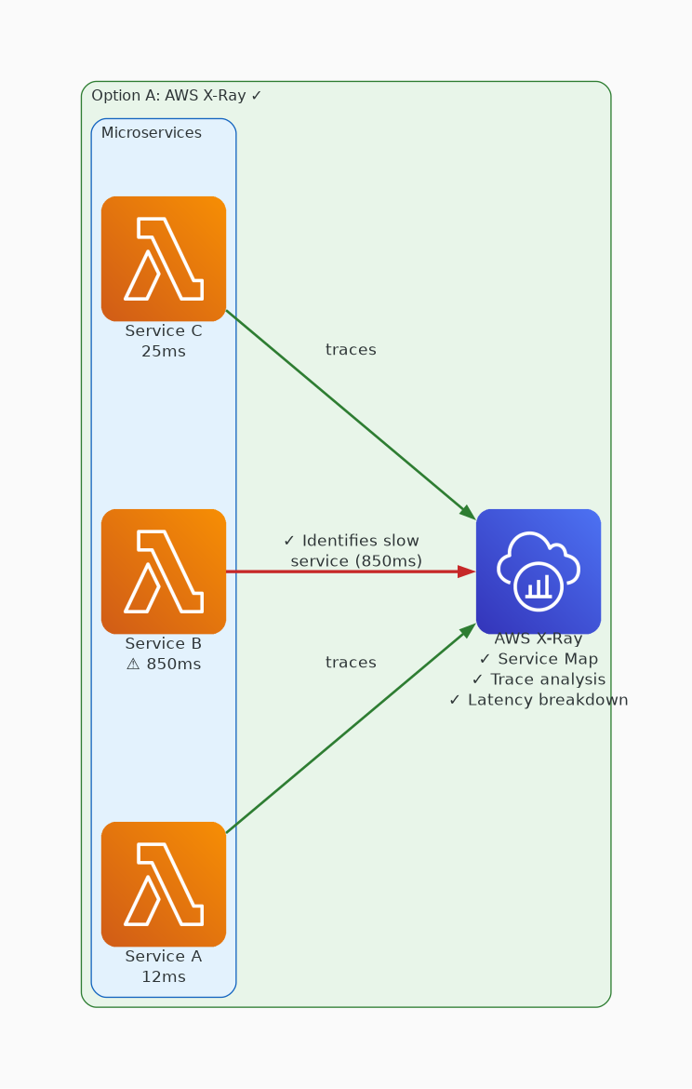
✓ CORRECT
Option A: X-Ray creates a map of services used by your application with trace data. You can use the trace data
Why this is correct:
• X-Ray creates a map of services used by your application with trace data.
• You can use the trace data to drill into specific services or issues.
• This data provides a view of connections between services in your application and aggregated data for each service, including average latency and failure rates.

Slide 3
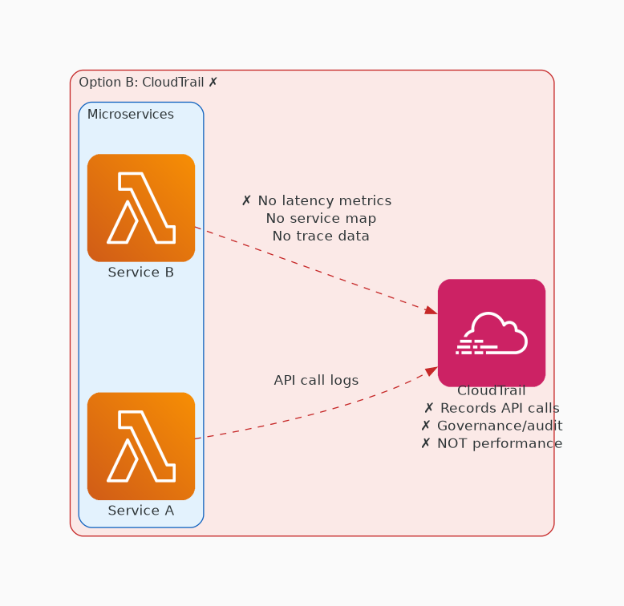
✗ INCORRECT
Option B: CloudTrail event history is used to record API calls for governance, compliance operation, and risk
Why this is incorrect:
• CloudTrail event history is used to record API calls for governance, compliance operation, and risk auditing purposes.
• CloudTrail is not a service that is used for identifying application performance issues.

Slide 4
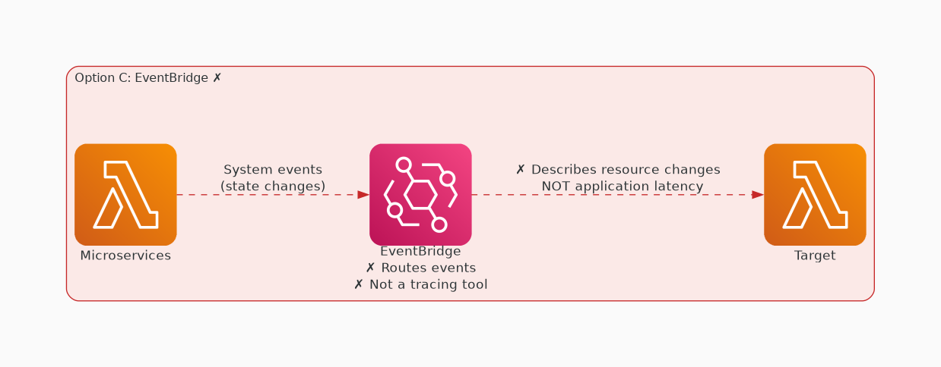
✗ INCORRECT
Option C: EventBridge (CloudWatch Events) delivers a near-real-time stream of system events that describe chan
Why this is incorrect:
• EventBridge (CloudWatch Events) delivers a near-real-time stream of system events that describe changes in Amazon Web Services resources.
• It is not used for identifying application performance issues.

Slide 5
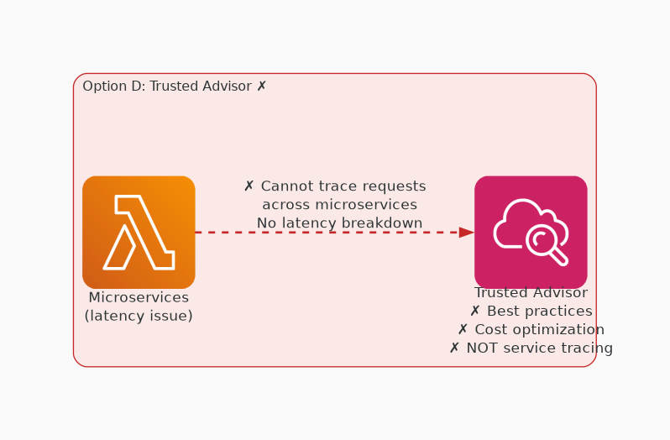
✗ INCORRECT
Option D: Trusted Advisor provides real-time guidance to help provision AWS resources to follow AWS best pract
Why this is incorrect:
• Trusted Advisor provides real-time guidance to help provision AWS resources to follow AWS best practices.
• It can report overall system utilization, but it is not used for identifying application performance issues.

