Slide 1
Session 4 - Question 2
⏱ TIME
A developer migrates a web application from an on-premises data center to the AWS Cloud. Authenticated customers use the application from many different clients simultaneously, including laptops, smartphones, and tablets. The application runs on Amazon EC2 instances behind an Application Load Balancer. The instances run in an Amazon EC2 Auto Scaling group. Upon initial testing, users report that they have to reenter information when they use the web application on their laptops and then switc...
A
The sticky session feature of the Application Load Balancer does not solve the problem across devices. Sticky sessions r
B
ElastiCache for Redis is a fast in-memory data store that provides sub-millisecond latency to power internet-scale appli
C
A local file could store session state information persistently over time, but this does not solve the problem presented
D
Systems Manager State Manager is not for use of session state information management. Systems Manager State Manager is u

Slide 2
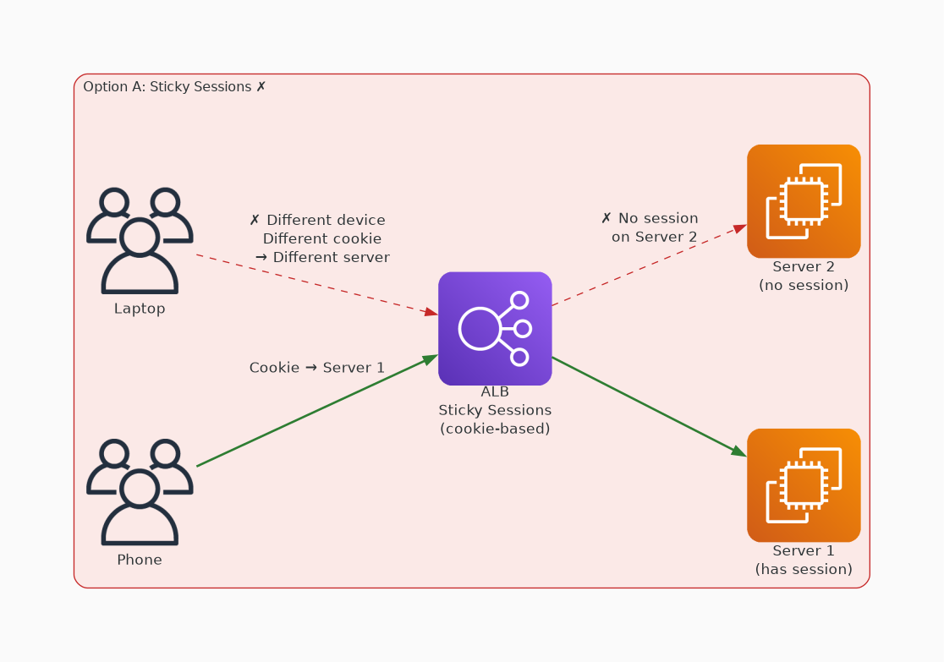
✗ INCORRECT
Option A: The sticky session feature of the Application Load Balancer does not solve the problem across device
Why this is incorrect:
• The sticky session feature of the Application Load Balancer does not solve the problem across devices.
• Sticky sessions rely on a cookie that is not going to be consistent across devices.

Slide 3
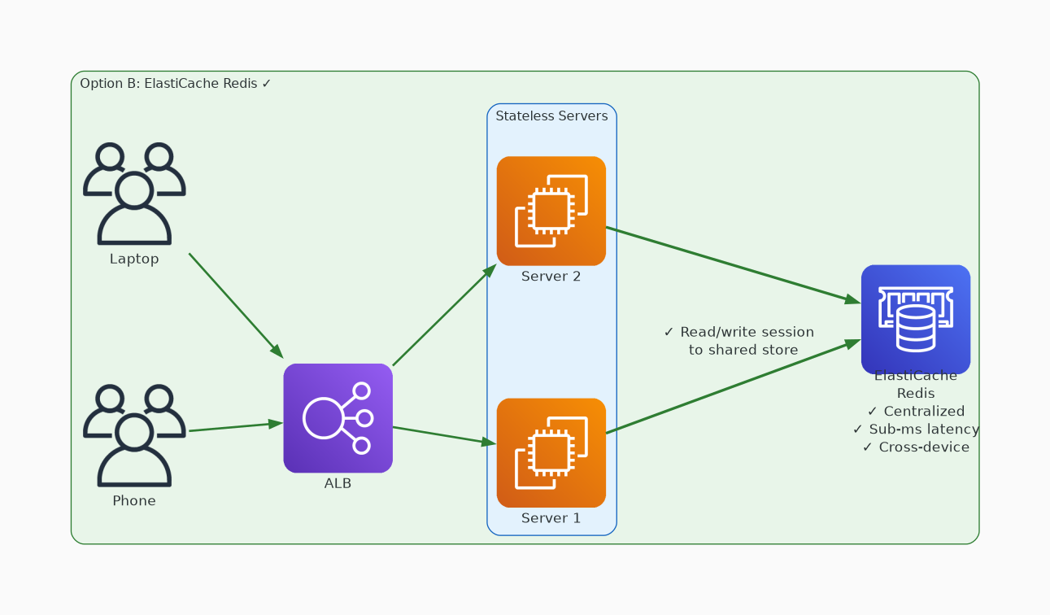
✓ CORRECT
Option B: ElastiCache for Redis is a fast in-memory data store that provides sub-millisecond latency to power
Why this is correct:
• ElastiCache for Redis is a fast in-memory data store that provides sub-millisecond latency to power internet-scale applications in real time.
• The data will not be stored on the instance itself.
• This choice is ideal for ensuring that the session state information persists across devices.

Slide 4
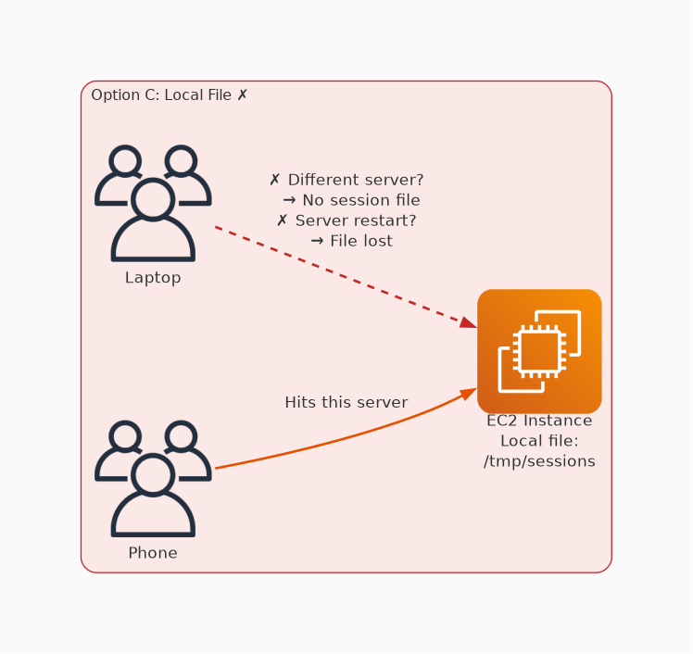
✗ INCORRECT
Option C: A local file could store session state information persistently over time, but this does not solve t
Why this is incorrect:
• A local file could store session state information persistently over time, but this does not solve the problem presented.
• If session state information is stored locally on the instance when a request is sent to another node behind the Application Load Balancer, the other node does not have access to the session state information.

Slide 5
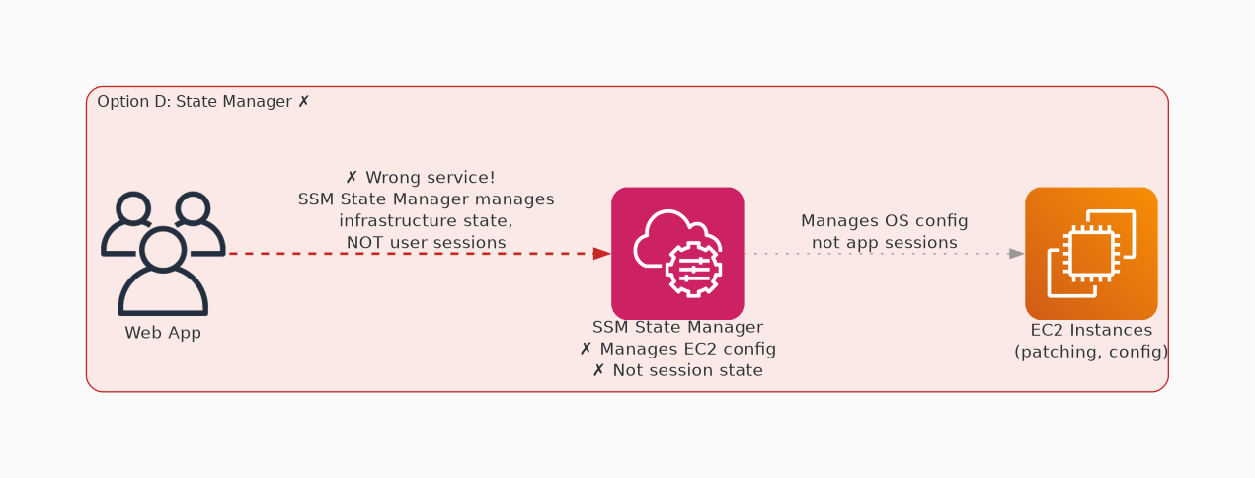
✗ INCORRECT
Option D: Systems Manager State Manager is not for use of session state information management. Systems Manage
Why this is incorrect:
• Systems Manager State Manager is not for use of session state information management.
• Systems Manager State Manager is used to manage the state of an instance itself, such as specific instance configurations or software installations.

