Slide 1
Session 4 - Question 3
⏱ TIME
A company is working on a project to enhance its serverless application development process. The company hosts applications on AWS Lambda. The development team regularly updates the Lambda code and wants to use stable code in production. Which combination of steps should the development team take to configure Lambda functions to meet both development and production requirements? (Select TWO.)
A
Using a Lambda layer, you can access additional code and content. It is not suitable for code updates.
B
Lambda function versions are designed to manage deployment of functions. They can be used for code changes, without affe
C
Using a Lambda layer, you can access additional code and content. It is not suitable for code updates. Additionally, a L
D
By creating separate aliases for Production and Development, systems can initiate the correct alias as needed. A Lambda
E
A Lambda function alias can only point to an unqualified function ARN. LAMBDA_TASK_ROOT is a variable used by Lambda to

Slide 2
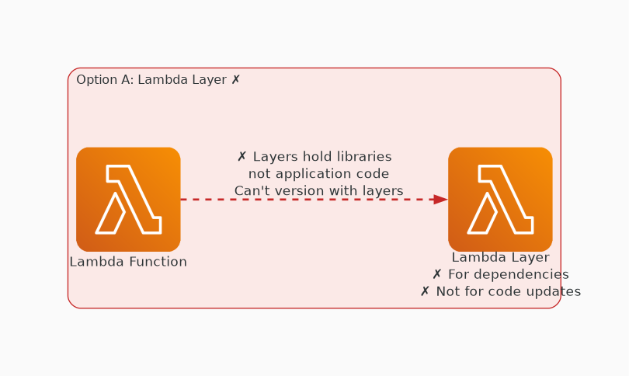
✗ INCORRECT
Option A: Using a Lambda layer, you can access additional code and content. It is not suitable for code update
Why this is incorrect:
• Using a Lambda layer, you can access additional code and content.
• It is not suitable for code updates.

Slide 3
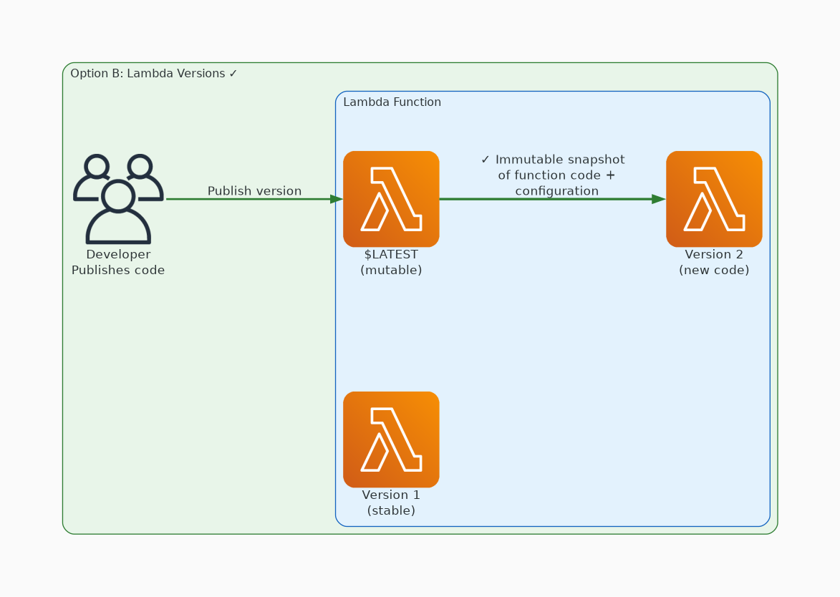
✓ CORRECT
Option B: Lambda function versions are designed to manage deployment of functions. They can be used for code c
Why this is correct:
• Lambda function versions are designed to manage deployment of functions.
• They can be used for code changes, without affecting the stable production version of the code.

Slide 4
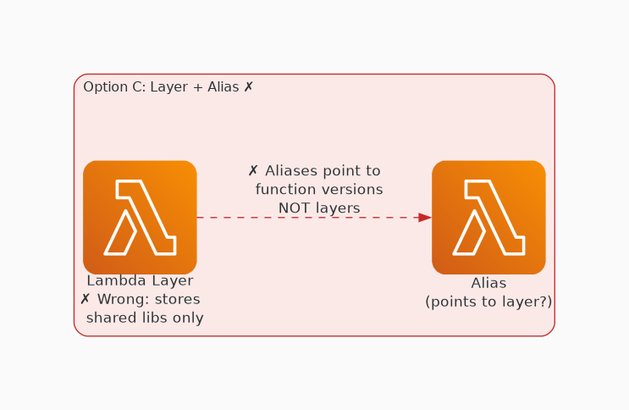
✗ INCORRECT
Option C: Using a Lambda layer, you can access additional code and content. It is not suitable for code update
Why this is incorrect:
• Using a Lambda layer, you can access additional code and content.
• It is not suitable for code updates.
• Additionally, a Lambda function alias points to a Lambda function version.

Slide 5
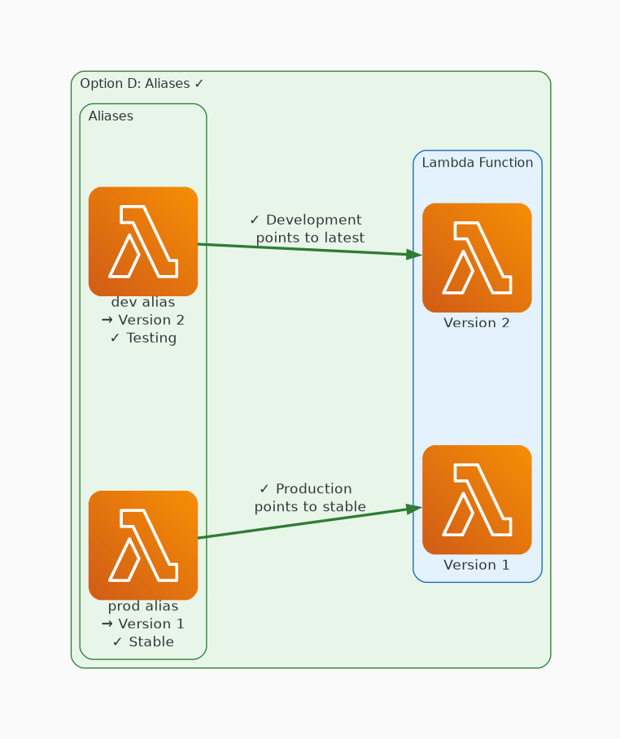
✓ CORRECT
Option D: By creating separate aliases for Production and Development, systems can initiate the correct alias
Why this is correct:
• By creating separate aliases for Production and Development, systems can initiate the correct alias as needed.
• A Lambda function alias can be used to point to a specific Lambda function version.
• Using the functionality to update an alias and its linked version, the development team can update the required version as needed.
• The $LATEST version is the newest published version.

Slide 6
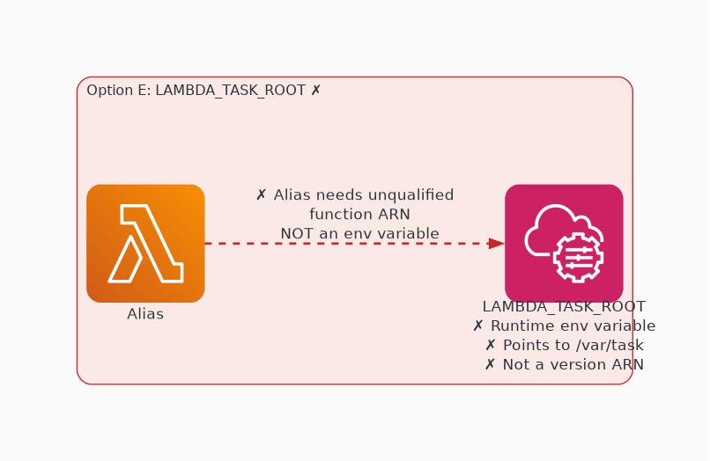
✗ INCORRECT
Option E: A Lambda function alias can only point to an unqualified function ARN. LAMBDA_TASK_ROOT is a variabl
Why this is incorrect:
• A Lambda function alias can only point to an unqualified function ARN.
• LAMBDA_TASK_ROOT is a variable used by Lambda to record the path to the code.
• However, it cannot be used in the way the response describes.

