Slide 1
Session 4 - Question 4
⏱ TIME
A developer has written several custom applications that read and write to the same Amazon DynamoDB table. Each time the data in the DynamoDB table is modified, this change should be sent to an external API. Which combination of steps should the developer perform to accomplish this task? (Select TWO.)
A
If you enable DynamoDB Streams on a table, you can associate the stream Amazon Resource Name (ARN) with an Lambda functi
B
EventBridge (CloudWatch Events) is used to connect applications with a variety of data. It would not be able to detect u
C
A trigger cannot be enabled on a DynamoDB table. To create a trigger, a DynamoDB stream should be enabled on the specifi
D
A DynamoDB stream cannot be used to create an Amazon SNS topic.
E
You can enable DynamoDB Streams on a table to create an event that invokes an AWS Lambda function.

Slide 2
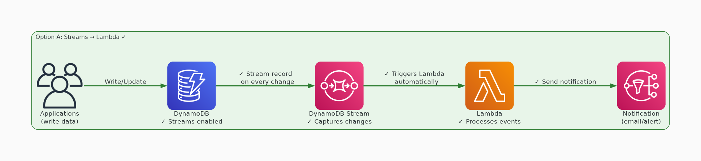
✓ CORRECT
Option A: If you enable DynamoDB Streams on a table, you can associate the stream Amazon Resource Name (ARN) w
Why this is correct:
• If you enable DynamoDB Streams on a table, you can associate the stream Amazon Resource Name (ARN) with an Lambda function that you write.
• Immediately after an item in the table is modified, a new record appears in the table's stream.
• Lambda polls the stream and invokes your Lambda function synchronously when it detects new stream records.

Slide 3
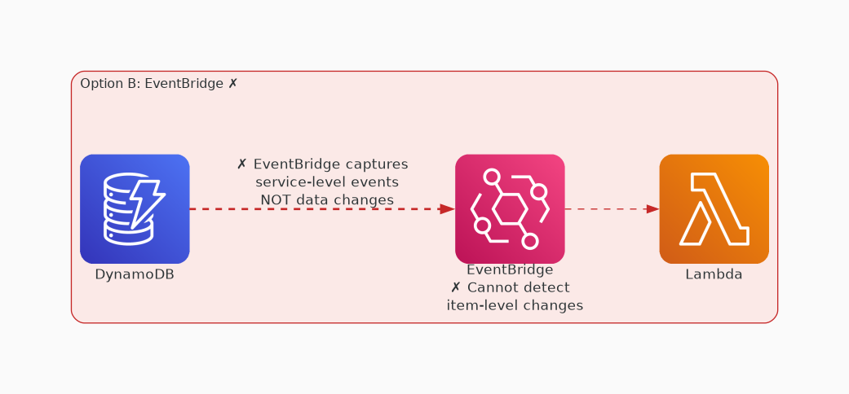
✗ INCORRECT
Option B: EventBridge (CloudWatch Events) is used to connect applications with a variety of data. It would not
Why this is incorrect:
• EventBridge (CloudWatch Events) is used to connect applications with a variety of data.
• It would not be able to detect updates to a DynamoDB table.

Slide 4
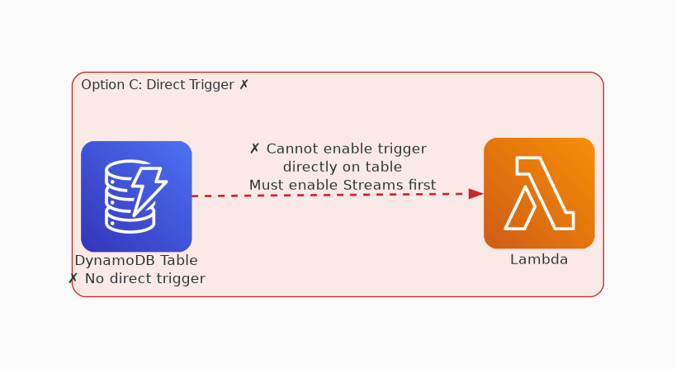
✗ INCORRECT
Option C: A trigger cannot be enabled on a DynamoDB table. To create a trigger, a DynamoDB stream should be en
Why this is incorrect:
• A trigger cannot be enabled on a DynamoDB table.
• To create a trigger, a DynamoDB stream should be enabled on the specific DynamoDB table.

Slide 5
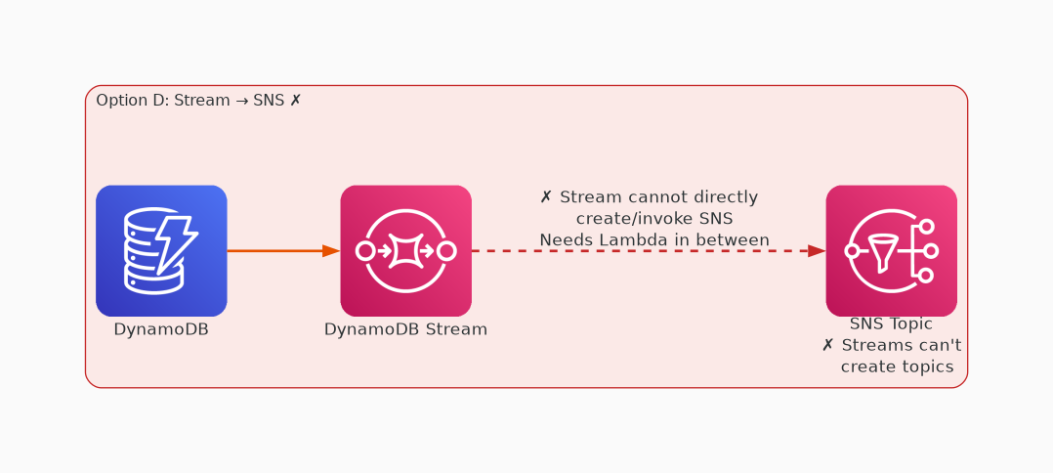
✗ INCORRECT
Option D: A DynamoDB stream cannot be used to create an Amazon SNS topic.
Why this is incorrect:
• A DynamoDB stream cannot be used to create an Amazon SNS topic.

Slide 6
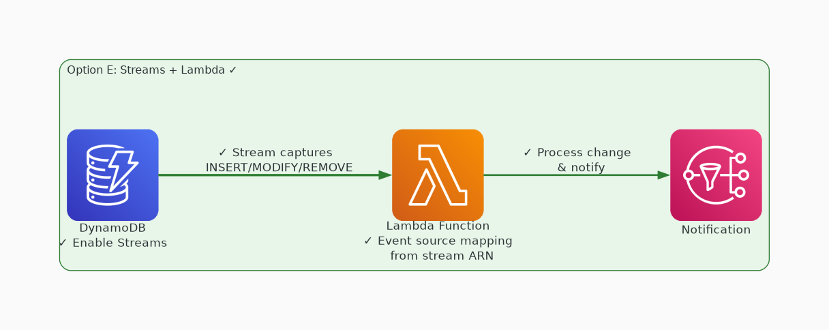
✓ CORRECT
Option E: You can enable DynamoDB Streams on a table to create an event that invokes an AWS Lambda function.
Why this is correct:
• You can enable DynamoDB Streams on a table to create an event that invokes an AWS Lambda function.

