Slide 1
Session 4 - Question 5
⏱ TIME
Each time a developer publishes a new version of an AWS Lambda function, all the dependent event source mappings need to be updated with the reference to the new version’s Amazon Resource Name (ARN). These updates are time consuming and error-prone. Which combination of actions should the developer take to avoid performing these updates when publishing a new Lambda version? (Select TWO.)
A
A Lambda event source mapping can either point to the version ARN, or an alias ARN, but not to the layer ARN.
B
A Lambda alias is a pointer to a specific Lambda function version.
C
This solution does not address your problem. Every alias has its own unique ARN. Therefore, you would still need to upda
D
A Lambda alias cannot point to another Lambda alias, only to a Lambda function version.
E
Instead of using ARNs for the Lambda function in event source mappings, you can use an alias ARN. You do not need to upd

Slide 2
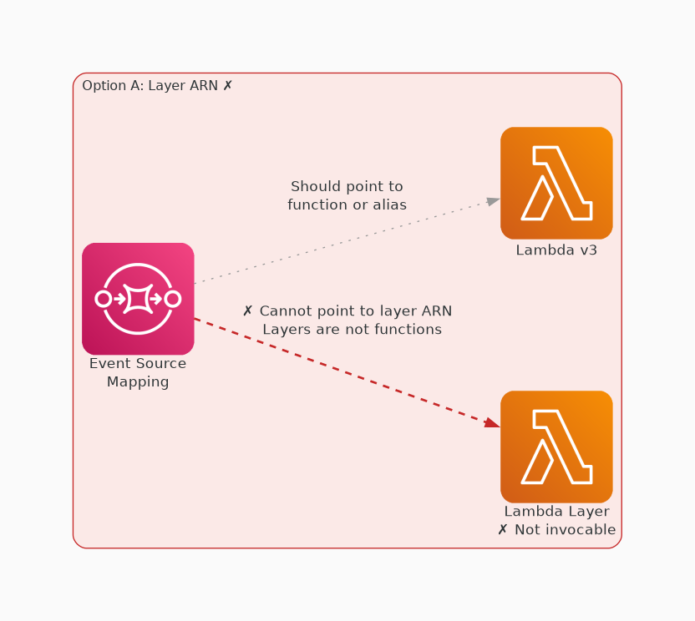
✗ INCORRECT
Option A: A Lambda event source mapping can either point to the version ARN, or an alias ARN, but not to the l
Why this is incorrect:
• A Lambda event source mapping can either point to the version ARN, or an alias ARN, but not to the layer ARN.

Slide 3
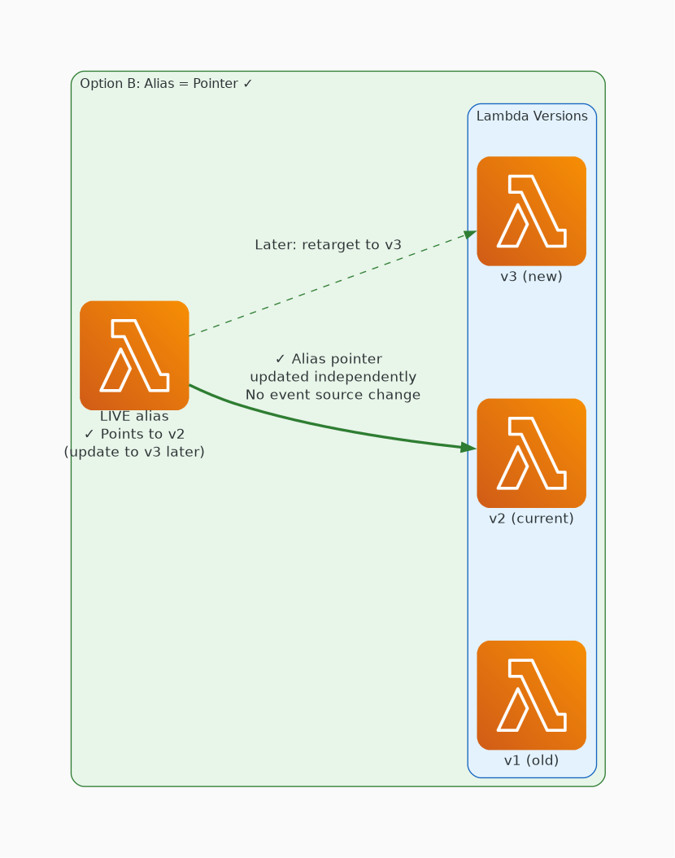
✓ CORRECT
Option B: A Lambda alias is a pointer to a specific Lambda function version.
Why this is correct:
• A Lambda alias is a pointer to a specific Lambda function version.

Slide 4
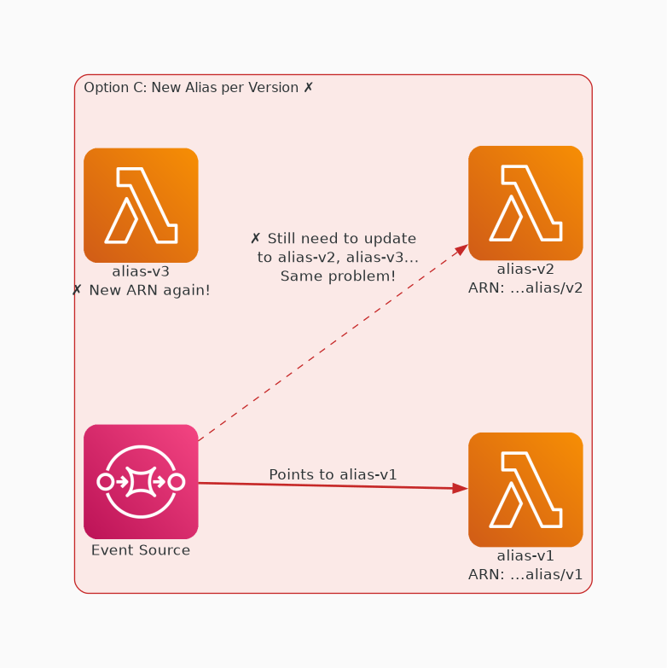
✗ INCORRECT
Option C: This solution does not address your problem. Every alias has its own unique ARN. Therefore, you woul
Why this is incorrect:
• This solution does not address your problem.
• Every alias has its own unique ARN.
• Therefore, you would still need to update the event source mapping with the new ARN when a new version is published.

Slide 5
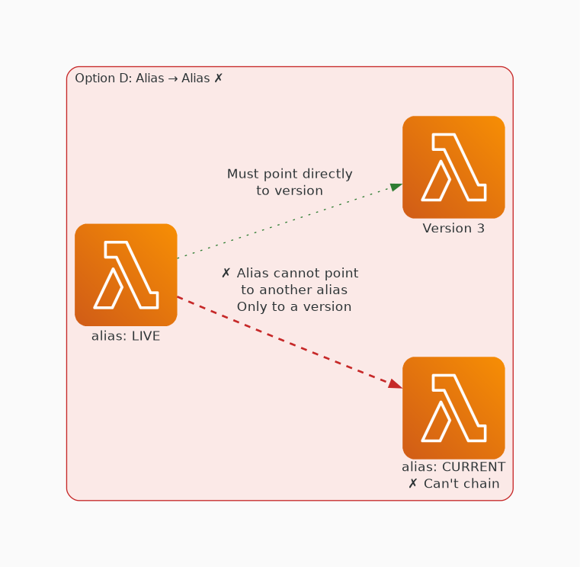
✗ INCORRECT
Option D: A Lambda alias cannot point to another Lambda alias, only to a Lambda function version.
Why this is incorrect:
• A Lambda alias cannot point to another Lambda alias, only to a Lambda function version.

Slide 6
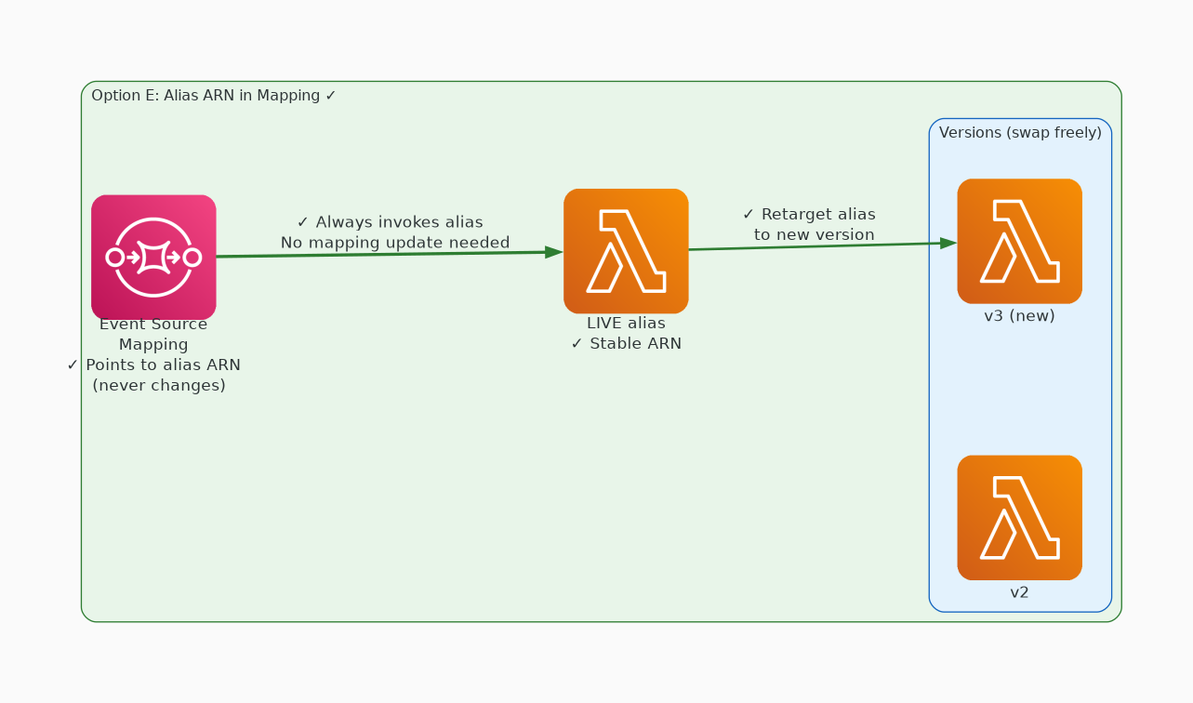
✓ CORRECT
Option E: Instead of using ARNs for the Lambda function in event source mappings, you can use an alias ARN. Yo
Why this is correct:
• Instead of using ARNs for the Lambda function in event source mappings, you can use an alias ARN.
• You do not need to update your event source mappings when you promote a new version or roll back to a previous version.

