Slide 1
Session 5 - Question 1
⏱ TIME
A company has an inventory system that receives sporadic inventory updates from a fulfillment system in the form of large JSON files. While many files can be sent in a short time period, days can pass when no files are sent. The company wants to process these files as soon as they arrive. Which solution will meet these requirements?
A
Lambda functions can connect to Amazon EFS file systems. However, Amazon EFS file system changes cannot invoke Lambda fu
B
Lambda functions can run on a schedule and connect to Amazon EFS file systems. However, a scheduled/polling process woul
C
Lambda functions can be invoked from S3 events and can read from S3 buckets. An event-based invocation would allow for t
D
Lambda functions can run on a schedule and read from S3 buckets. However, a scheduled/polling process would not process

Slide 2
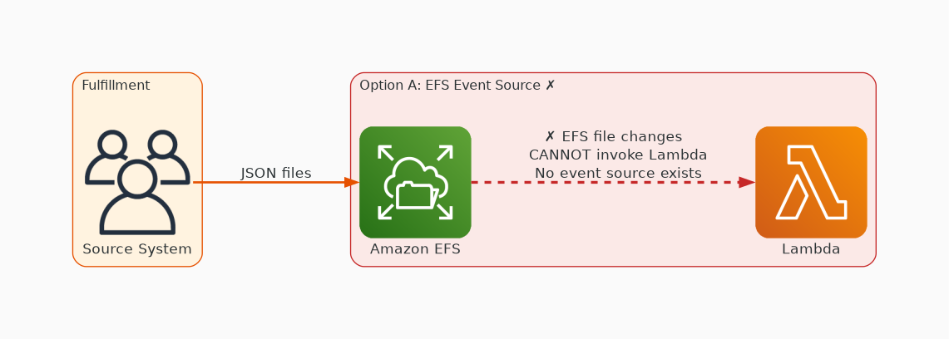
✗ INCORRECT
Option A: Lambda functions can connect to Amazon EFS file systems. However, Amazon EFS file system changes can
Why this is incorrect:
• Lambda functions can connect to Amazon EFS file systems.
• However, Amazon EFS file system changes cannot invoke Lambda functions.

Slide 3
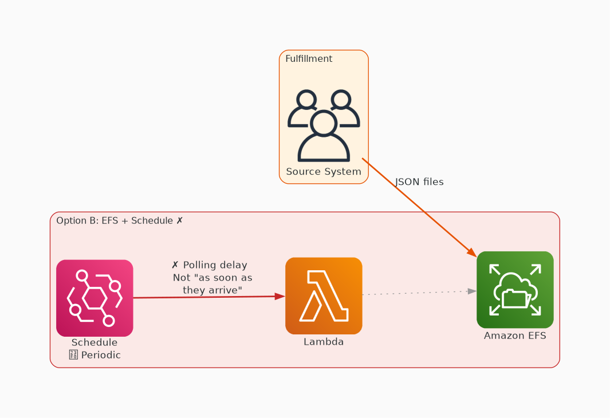
✗ INCORRECT
Option B: Lambda functions can run on a schedule and connect to Amazon EFS file systems. However, a scheduled/
Why this is incorrect:
• Lambda functions can run on a schedule and connect to Amazon EFS file systems.
• However, a scheduled/polling process would not process the files as soon as they arrive.

Slide 4
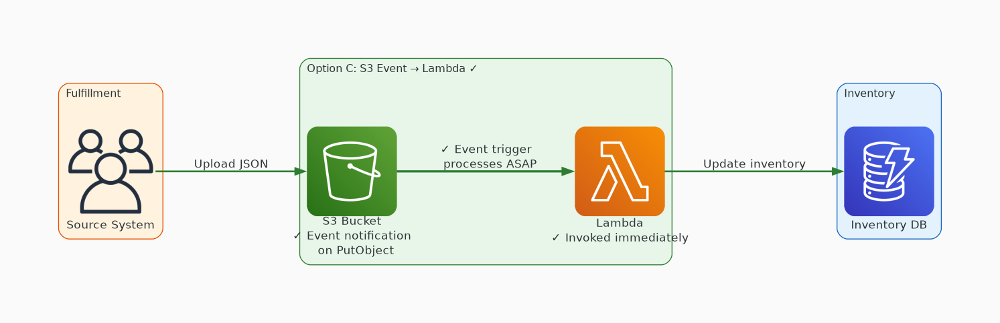
✓ CORRECT
Option C: Lambda functions can be invoked from S3 events and can read from S3 buckets. An event-based invocati
Why this is correct:
• Lambda functions can be invoked from S3 events and can read from S3 buckets.
• An event-based invocation would allow for the S3 objects to be processed as soon as they arrive.

Slide 5
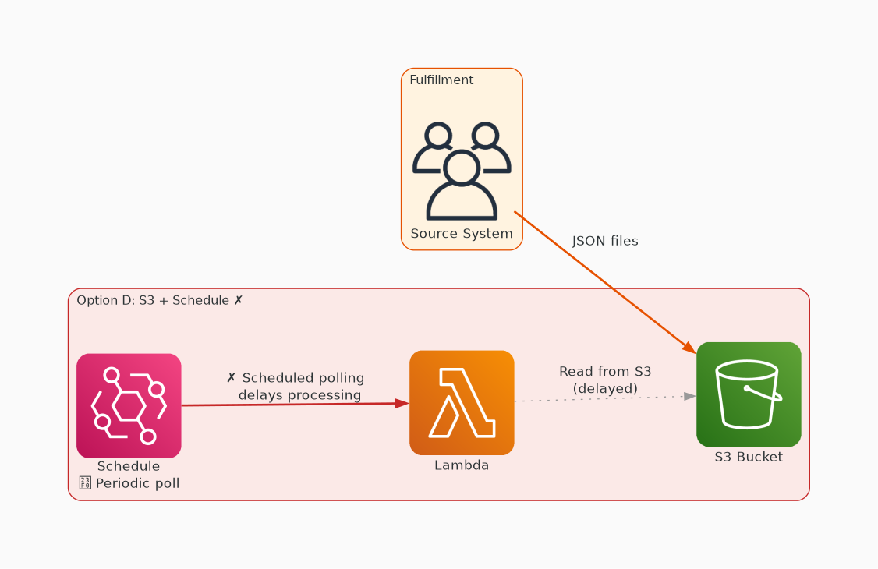
✗ INCORRECT
Option D: Lambda functions can run on a schedule and read from S3 buckets. However, a scheduled/polling proces
Why this is incorrect:
• Lambda functions can run on a schedule and read from S3 buckets.
• However, a scheduled/polling process would not process the S3 objects as soon as they arrive.

