Slide 1
Session 5 - Question 2
⏱ TIME
A developer needs to query a relational database from an AWS Lambda function. The Lambda function will be called frequently. The developer needs to avoid the latency introduced by the initial JDBC connection to the database in subsequent invocations of the Lambda function. How can the developer ensure the database connection is reused by Lambda?
A
Database connection details can be stored as an environment variable. However, the developer still needs to initialize t
B
The Lambda environment can reuse the same database connection for subsequent invocations when defining the database conn
C
Database connection details can be stored in Systems Manager Parameter Store. However, initializing the connection withi
D
Initializing the connection within the handler method will result in it re-initializing each subsequent Lambda function

Slide 2
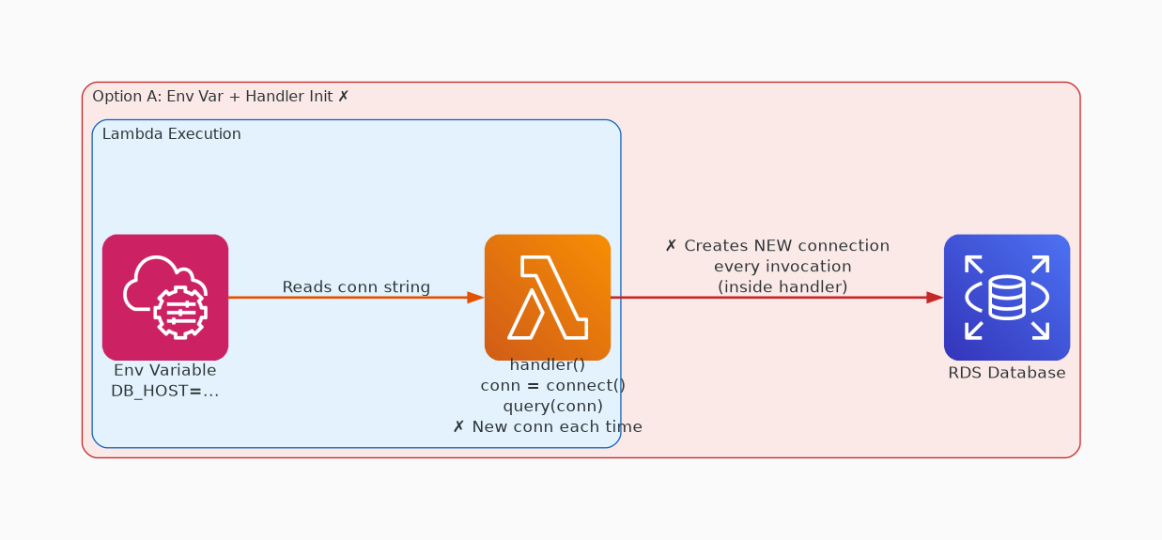
✗ INCORRECT
Option A: Database connection details can be stored as an environment variable. However, the developer still n
Why this is incorrect:
• Database connection details can be stored as an environment variable.
• However, the developer still needs to initialize the connection within the code for the connection to be used in queries.

Slide 3
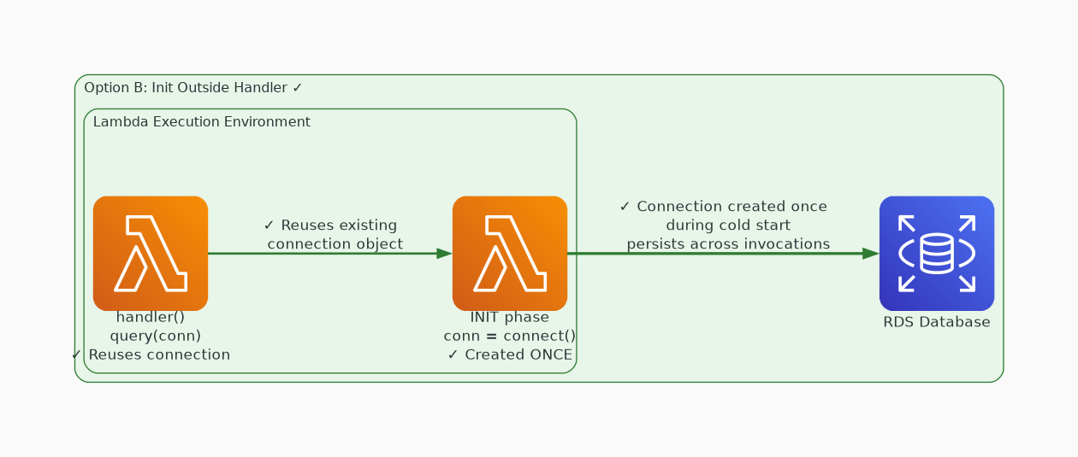
✓ CORRECT
Option B: The Lambda environment can reuse the same database connection for subsequent invocations when defini
Why this is correct:
• The Lambda environment can reuse the same database connection for subsequent invocations when defining the database connection details in the code but outside the handler method.

Slide 4
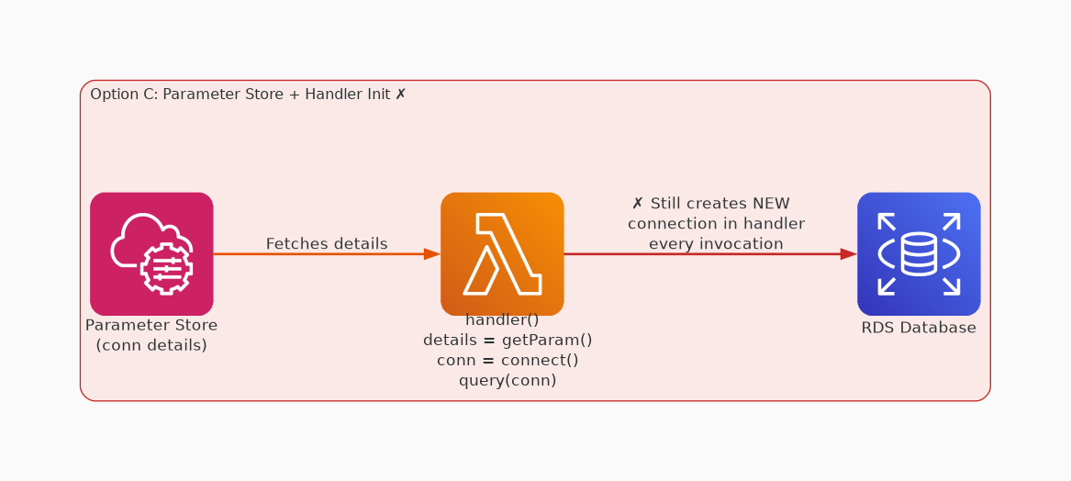
✗ INCORRECT
Option C: Database connection details can be stored in Systems Manager Parameter Store. However, initializing
Why this is incorrect:
• Database connection details can be stored in Systems Manager Parameter Store.
• However, initializing the connection within the handler method will result in it re-initializing each subsequent Lambda function invocation.

Slide 5
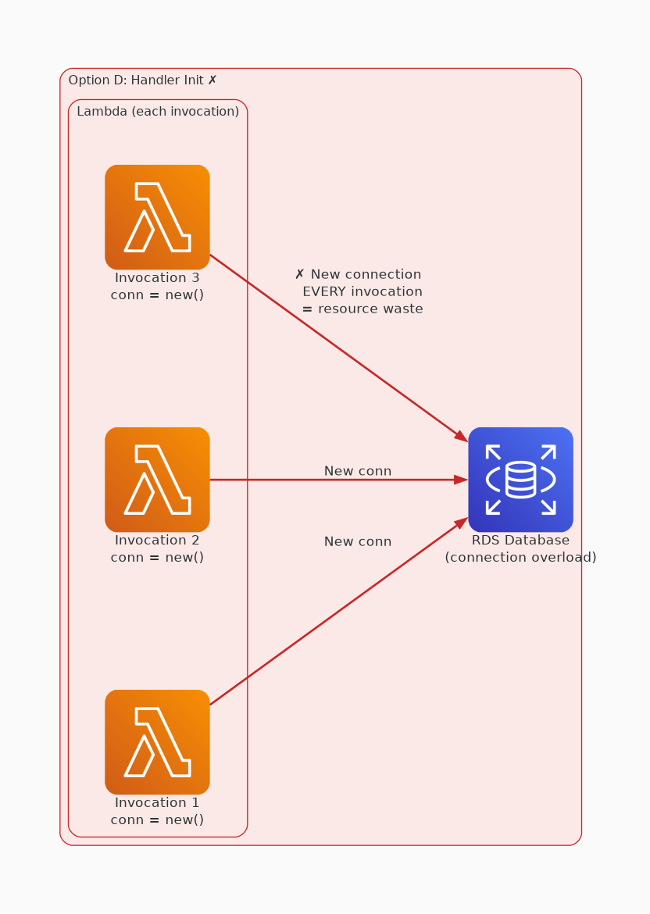
✗ INCORRECT
Option D: Initializing the connection within the handler method will result in it re-initializing each subsequ
Why this is incorrect:
• Initializing the connection within the handler method will result in it re-initializing each subsequent Lambda function invocation.

