Slide 1
Session 5 - Question 3
⏱ TIME
A developer builds an application that uses the AWS SDK for Python (Boto3) to query an Amazon DynamoDB table. When the application is tested on an Amazon EC2 instance, the application returns this error message: "An error occurred (AccessDenied) when calling the operation” The EC2 instance is associated with an existing IAM role named myRole. Which set of actions would resolve this error?
A
An EC2 instance, or any AWS principal, service, or resource, can only assume one role at a time.
B
"AccessDenied" indicates an authorization error related to permissions. Multiple policies can be attached to a single IA
C
"AccessDenied" indicates an authorization error related to permissions, not an authentication problem caused by credenti
D
"AccessDenied" indicates an authorization error related to permissions, not an authentication problem caused by credenti

Slide 2
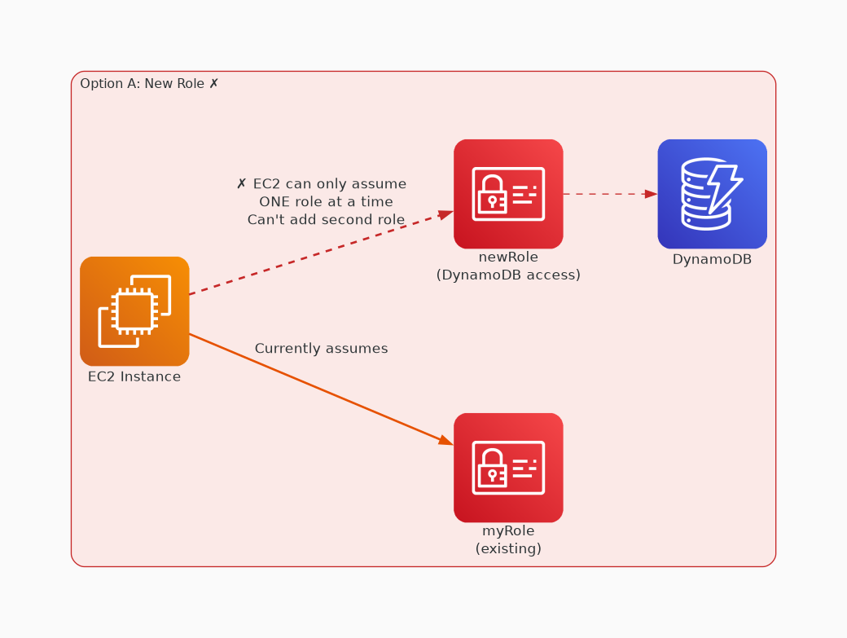
✗ INCORRECT
Option A: An EC2 instance, or any AWS principal, service, or resource, can only assume one role at a time.
Why this is incorrect:
• An EC2 instance, or any AWS principal, service, or resource, can only assume one role at a time.

Slide 3
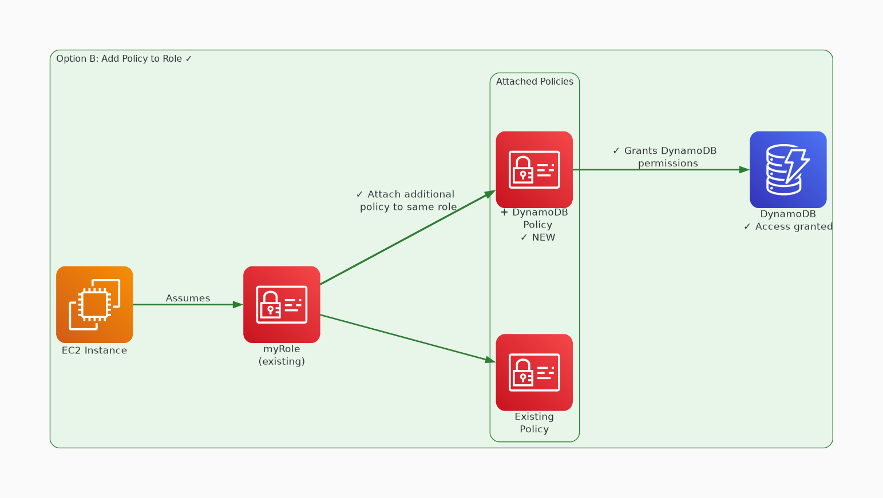
✓ CORRECT
Option B: "AccessDenied" indicates an authorization error related to permissions. Multiple policies can be att
Why this is correct:
• "AccessDenied" indicates an authorization error related to permissions.
• Multiple policies can be attached to a single IAM role.

Slide 4
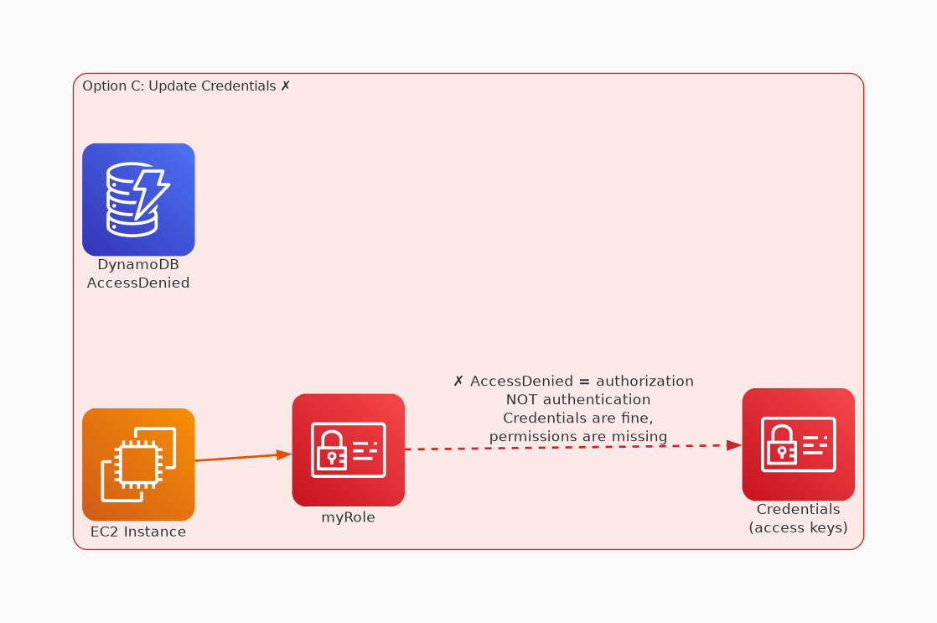
✗ INCORRECT
Option C: "AccessDenied" indicates an authorization error related to permissions, not an authentication proble
Why this is incorrect:
• "AccessDenied" indicates an authorization error related to permissions, not an authentication problem caused by credentials.
• The API call is already authenticated.
• Accessing or modifying the location of AWS credentials will have no effect.
• The EC2 instance profile has already performed the assume-role call because the role is already associated with the EC2 instance.

Slide 5
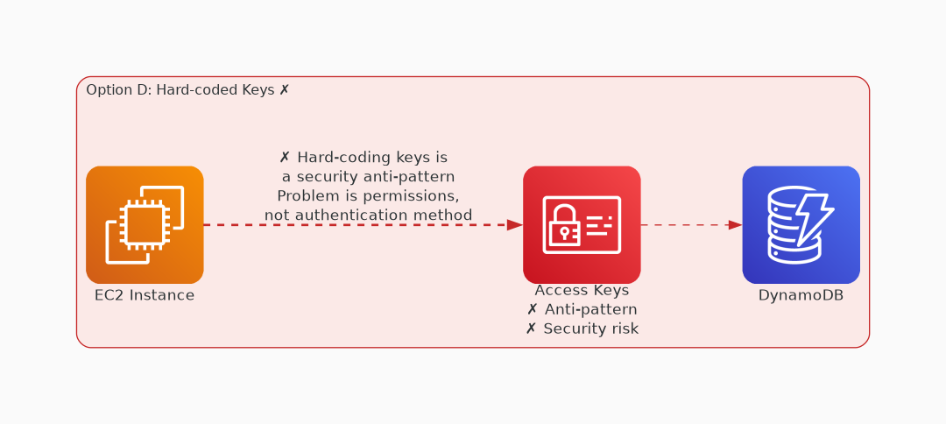
✗ INCORRECT
Option D: "AccessDenied" indicates an authorization error related to permissions, not an authentication proble
Why this is incorrect:
• "AccessDenied" indicates an authorization error related to permissions, not an authentication problem caused by credentials.
• The API call is already authenticated.
• Accessing or modifying the location of AWS credentials will have no effect.

