Slide 1
Session 5 - Question 4
⏱ TIME
An ecommerce company deploys more than 20 services behind Amazon API Gateway. The interaction between services is complex. Each service can potentially call several others, making performance issues and errors difficult to identify. Some individual API calls have experienced slow response times. The development team needs to quickly identify the underlying causes of the slowdowns. Which approach would MOST quickly identify the underlying cause of performance issues?
A
It is time consuming to examine and compare metric values of various services. The number of CPU or network calls a serv
B
Not all services send logs to CloudWatch Logs. It is time consuming to examine a large numbers of different log files. L
C
Unlike metrics or logs, X-Ray can help users quickly identify services by their relative response times. X-Ray can ident
D
CloudTrail records API calls. CloudTrail is not an application log aggregator, such as CloudWatch Logs. Any API calls th

Slide 2
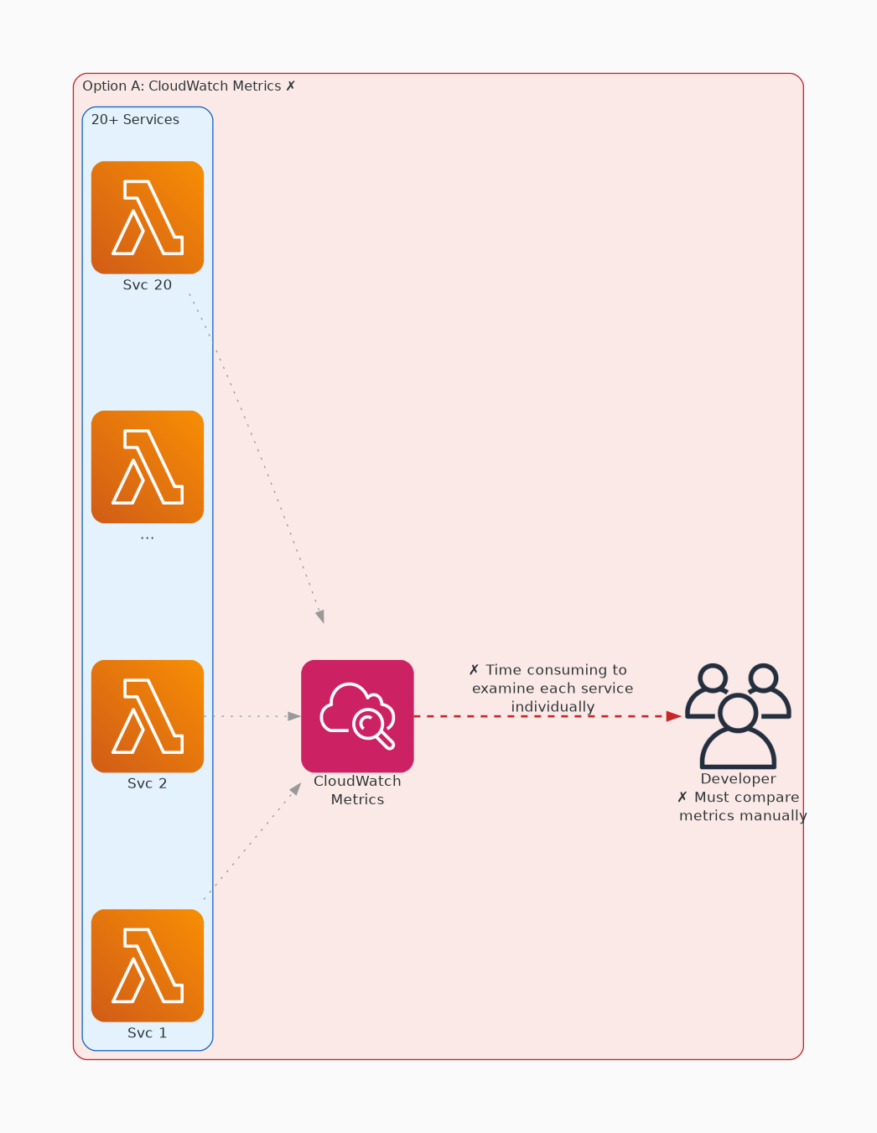
✗ INCORRECT
Option A: It is time consuming to examine and compare metric values of various services. The number of CPU or
Why this is incorrect:
• It is time consuming to examine and compare metric values of various services.
• The number of CPU or network calls a service makes indicates relative work load.
• The number of these CPU or network calls does not indicate poor performance.
• X-Ray is mainly used to study a service's interaction time with other services.
• It has limited utility to diagnose an individual service's performance.

Slide 3
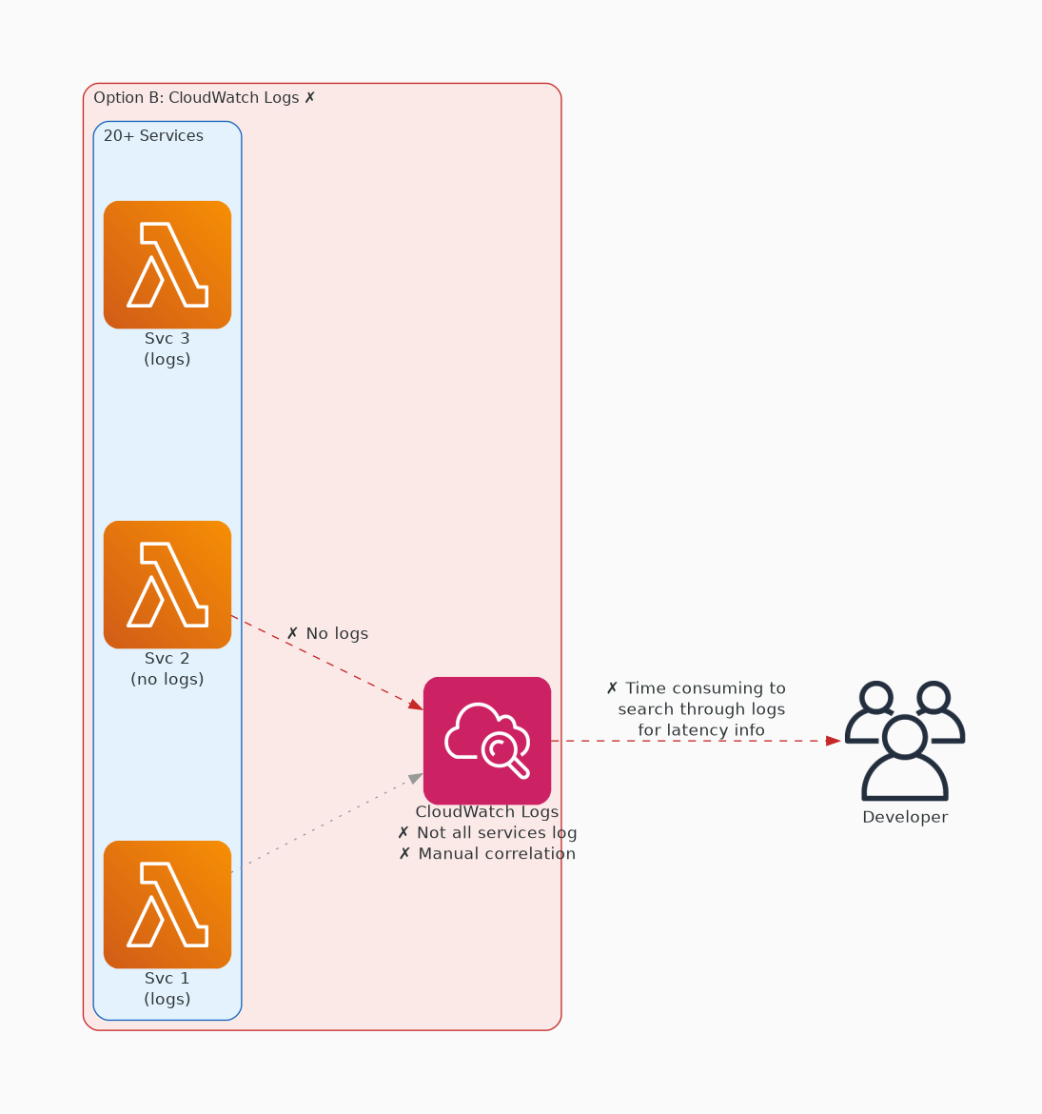
✗ INCORRECT
Option B: Not all services send logs to CloudWatch Logs. It is time consuming to examine a large numbers of di
Why this is incorrect:
• Not all services send logs to CloudWatch Logs.
• It is time consuming to examine a large numbers of different log files.
• Log output is application-specific and may not provide any insight into performance issues.
• CloudTrail records API calls, not application-level activity.

Slide 4
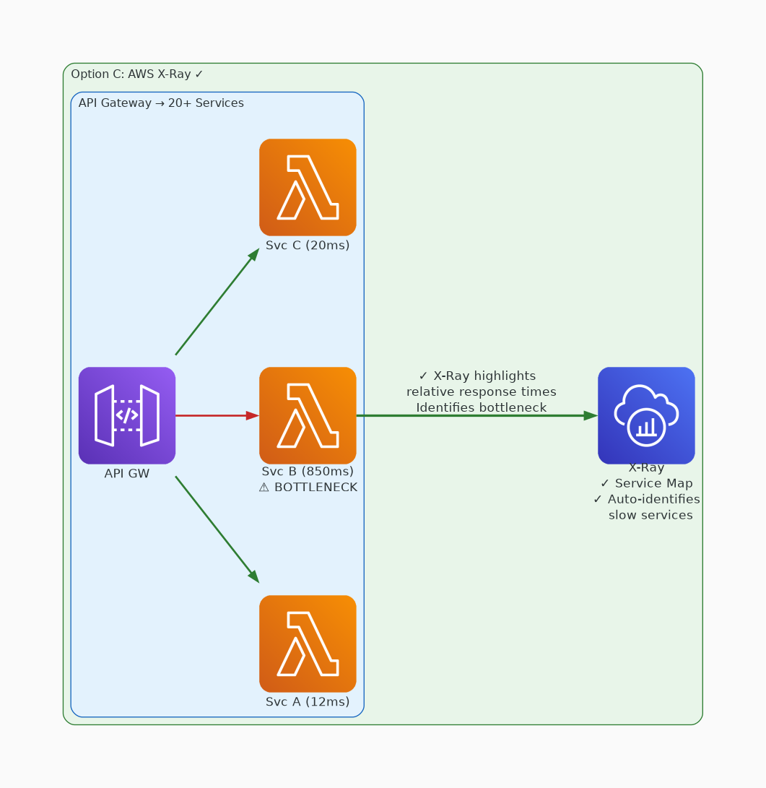
✓ CORRECT
Option C: Unlike metrics or logs, X-Ray can help users quickly identify services by their relative response ti
Why this is correct:
• Unlike metrics or logs, X-Ray can help users quickly identify services by their relative response times.
• X-Ray can identify a poorly performing service from within a web of interacting services.
• Once identified, CloudWatch provides the context, including the logs and metrics necessary to study specific issues.

Slide 5
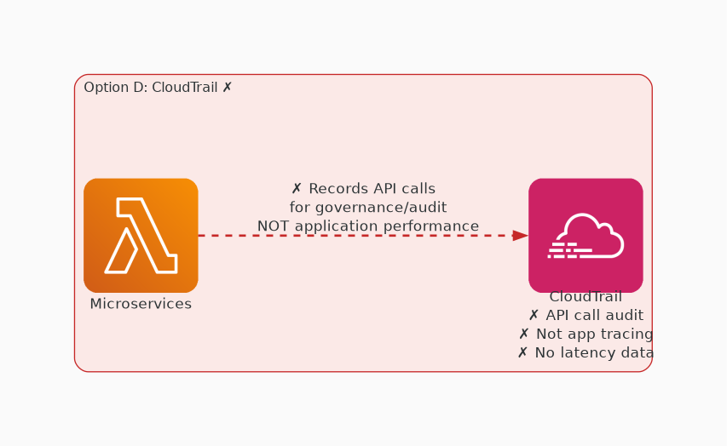
✗ INCORRECT
Option D: CloudTrail records API calls. CloudTrail is not an application log aggregator, such as CloudWatch Lo
Why this is incorrect:
• CloudTrail records API calls.
• CloudTrail is not an application log aggregator, such as CloudWatch Logs.
• Any API calls that individual services make would be not be likely to affect application performance.
• Also, X-Ray is mainly used to study a service's interaction time with other services.
• It has limited utility to diagnose an individual service's performance.

