Slide 1
Session 5 - Question 5
⏱ TIME
A developer wants to deploy an AWS Serverless Application Model (AWS SAM) application with the AWS SAM CLI. The developer is using the AWS CLI in an AWS Cloud9 environment for deployment and has run the sam build command to prepare the application for deployment. The next day, the developer connects to the same AWS Cloud9 environment and attempts to deploy the application. The sam deploy command returns the following error: Invalid (or missing) template file (path must be workspace-relative, ...
A
The template.yaml file is required, and it needs to be located in either the aws-sam subfolder or in the root of the cur
B
The template.yaml file is required, and it needs to be located either in the aws-sam subfolder or in the root of the cur
C
The developer needs to change the working directory to the root of the application that was created by sam build. By def
D
Because the sam build command completed successfully, the focus of problem resolution should be the location of the temp

Slide 2
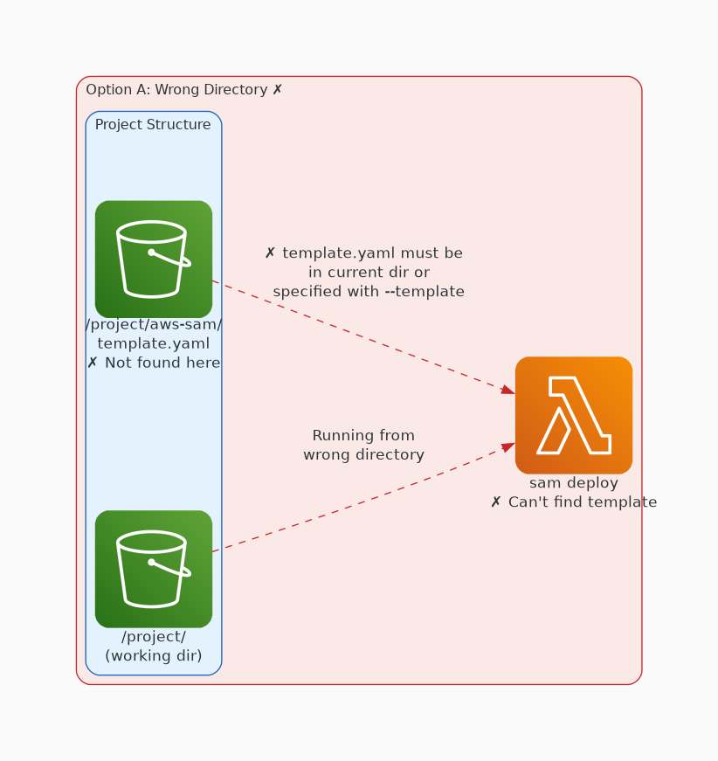
✗ INCORRECT
Option A: The template.yaml file is required, and it needs to be located in either the aws-sam subfolder or in
Why this is incorrect:
• The template.yaml file is required, and it needs to be located in either the aws-sam subfolder or in the root of the current working directory for the sam deploy command to succeed.

Slide 3
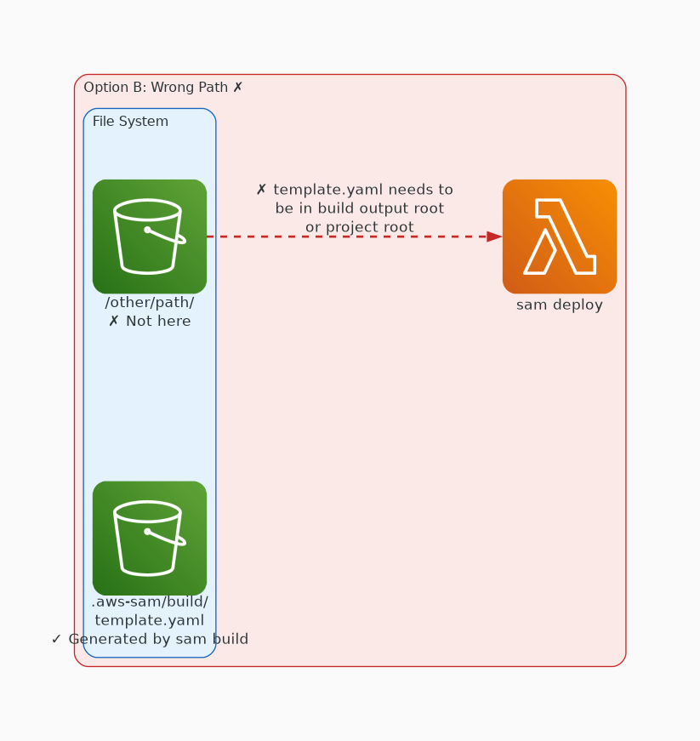
✗ INCORRECT
Option B: The template.yaml file is required, and it needs to be located either in the aws-sam subfolder or in
Why this is incorrect:
• The template.yaml file is required, and it needs to be located either in the aws-sam subfolder or in the root of the current working directory for the sam deploy command to succeed.

Slide 4
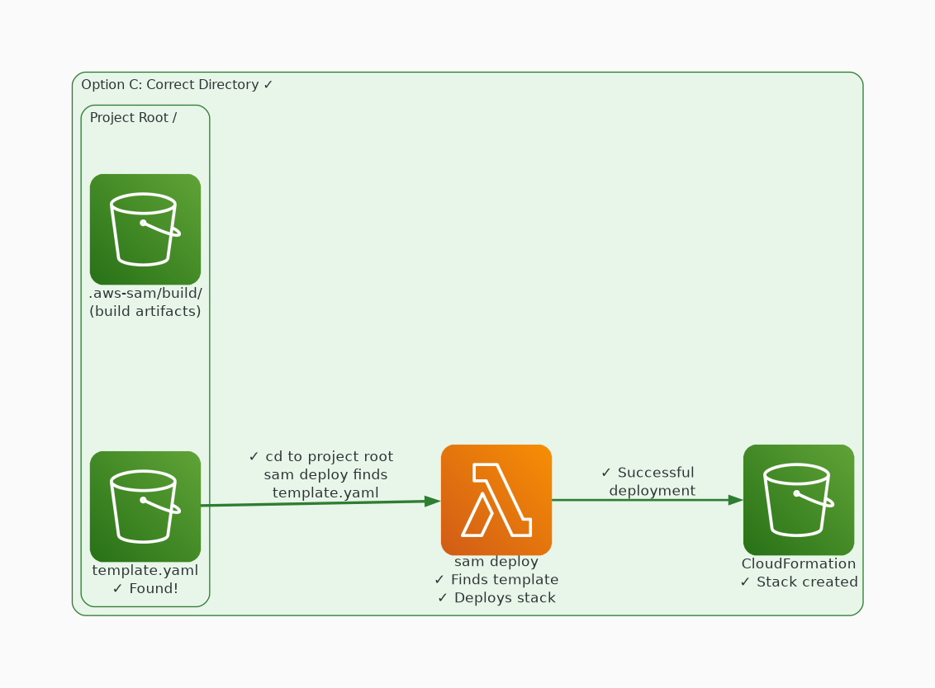
✓ CORRECT
Option C: The developer needs to change the working directory to the root of the application that was created
Why this is correct:
• The developer needs to change the working directory to the root of the application that was created by sam build.
• By default, sam deploy assumes that the current working directory is the project's root directory and tries to locate the template.
• yaml file either in the .
• aws-sam subfolder or in the root of the current working directory.

Slide 5
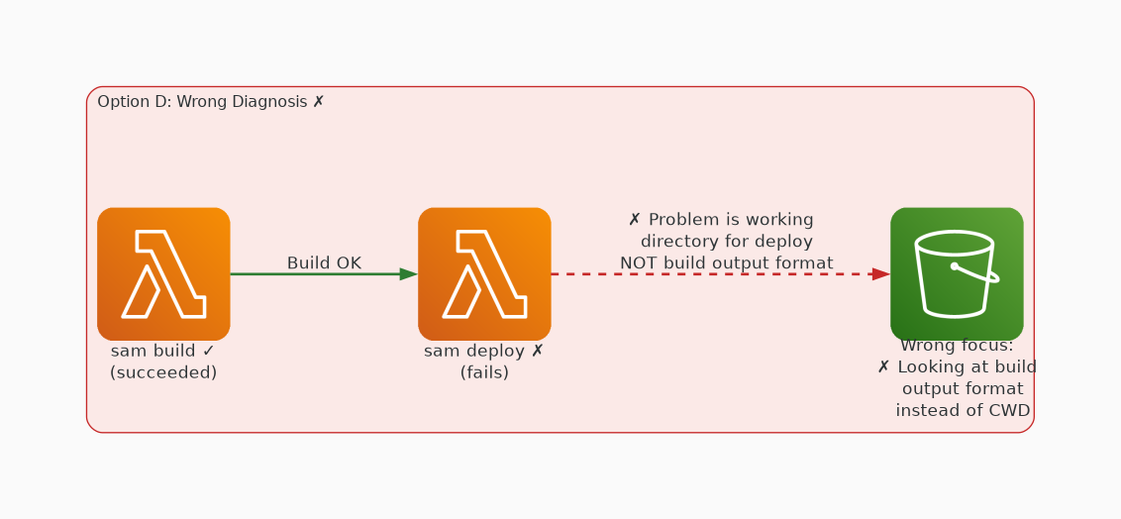
✗ INCORRECT
Option D: Because the sam build command completed successfully, the focus of problem resolution should be the
Why this is incorrect:
• Because the sam build command completed successfully, the focus of problem resolution should be the location of the template.
• yaml file.

