Slide 1
Javascript Libraries faker.js Ali Osman YILDIRIM
20.02.2021

Slide 2
Agenda
faker.js
faker.js nedir ve neden ihtiyaç duyulmustur?
faker.js nasil kullanilir?
Demo faker.js
Questions

Slide 3
GitHup:https://github.com/marak/Faker.js/
npm i faker
https://cdnjs.cloudflare.com/ajax/libs/Faker/3.1.0/faker.min.js
faker.js

Slide 4
faker.name.firstName();
faker.name.lastName();
faker.name.findName();
faker.internet.email();
faker.phone.phoneNumber();
faker.image.avatar();
faker.helpers.createCard();
faker.js

Slide 5
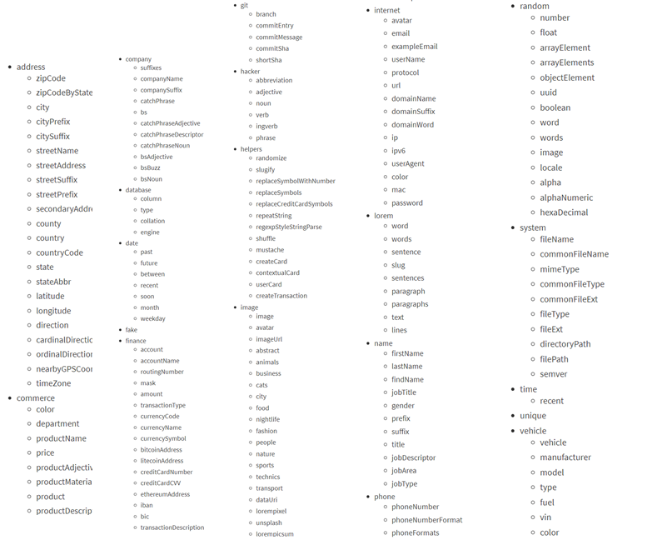
faker.js

Slide 6
az ar cz de de_AT de_CH en en_AU en_AU_ocker en_BORK
faker.locale = "de_CH";
faker.locale = “fr_CH";
faker.locale = “tr";
faker.js
Lokasyon
fr_CH
ge
id_ID
it
ja
ko
nb_NO
ne
nl
nl_BE
pl
en_CA en_GB en_IE en_IND en_US en_ZA
es
es_MX
fa
fi
fr
fr_CA
pt_BR
pt_PT
ro
ru
sk
sv
tr
uk
vi
zh_CN
zh_TW

Slide 7
Demo

Slide 8
Questions?

Slide 9
Kaynakça
https://github.com/marak/Faker.js/
https://js.plainenglish.io/faker-js-npm-module-for-generating-fake-data-5dae437ec3a
https://redstapler.co/generate-random-name-faker-js/

