Slide 1
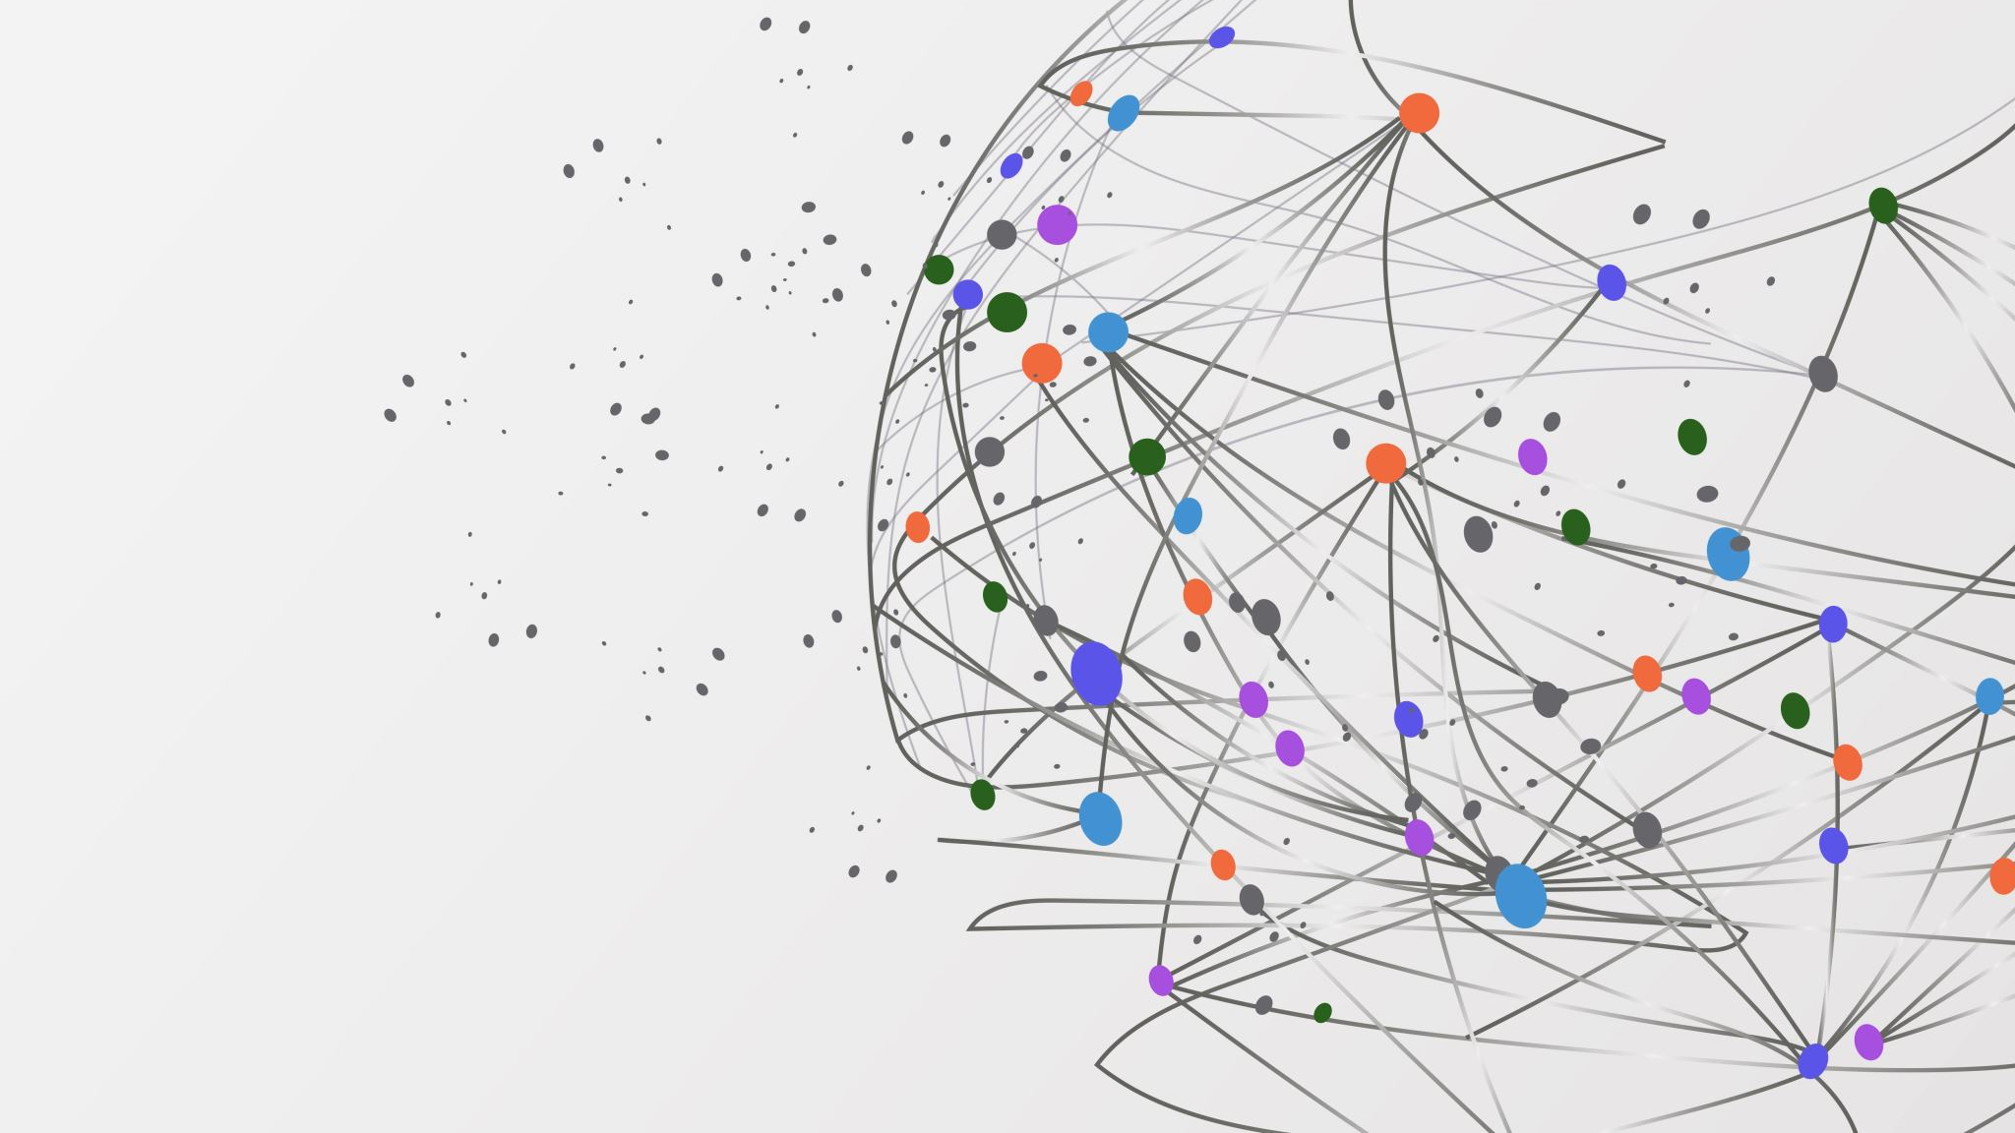
Employee Churn Classification Project
A collaboration of G2&G6

Slide 2
Contents
What is the project about?
What will we do?
How will we do?
Which model will we choice?
How will we present it to the public?

Slide 3
What is the project about?
Employee Churn: Definition, Importance for Markets and its Use in Data Science
- cost and productivity
- predictive analytics
- employee retention strategies
- talent management
- organizational health and culture
* The data: An imbalanced binary classification

Slide 4
What will we do?
A detailed exploratory data analysis process
- Main statistical insights
- Visualizations
Are these insights statistically significant?
- T-tests
- Mann-Whitney tests
- Shapiro tests
- Chi-square tests
3) Machine learning and deep learning algorithms
4) Model deployment
- Detailed theoretical and practical explanation for each step for a sustainable project

Slide 5
HOW will we do?
1) EDA and Statistical Analysis
2) Build models and check their scores by various algorithms:
K-Means Clustering (Unsupervised)
Logistic Regression
KNN
SVM
Random Forest
Catboost
XGBoost
LightGBM
DEEP Learning ANN
Hyperparameter tuning: Gridsearch, Optuna, Automl from Flaml
3) Compare the models and choice the one with best scores
4) Deploy the model via streamlit

Slide 6
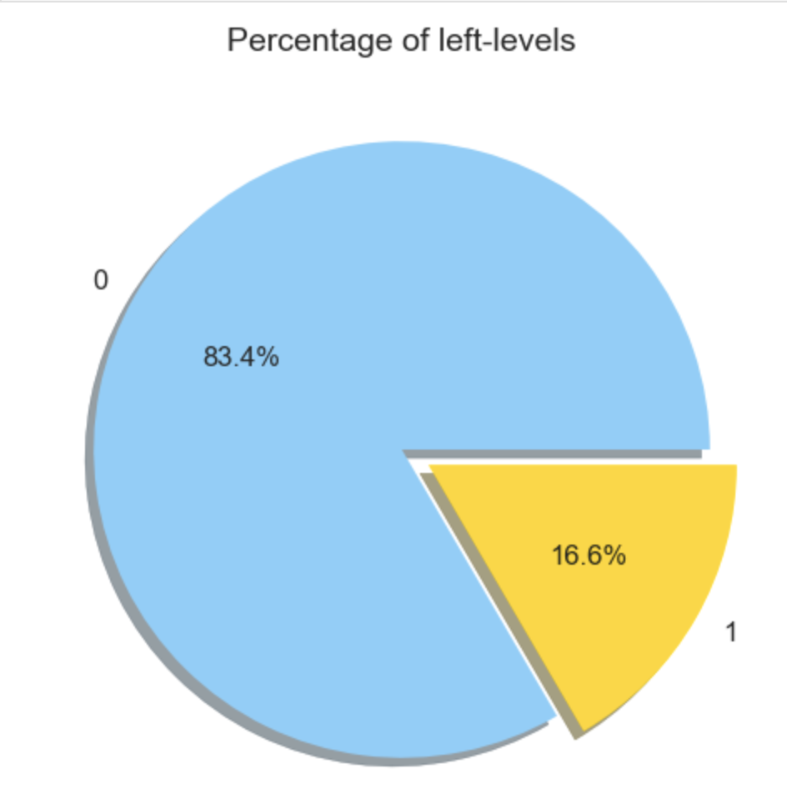
Which model will we choice?
Metrics to be compared for an imbalanced data:
Recall
Precision
F1 Score
Matthew
Time

Slide 7
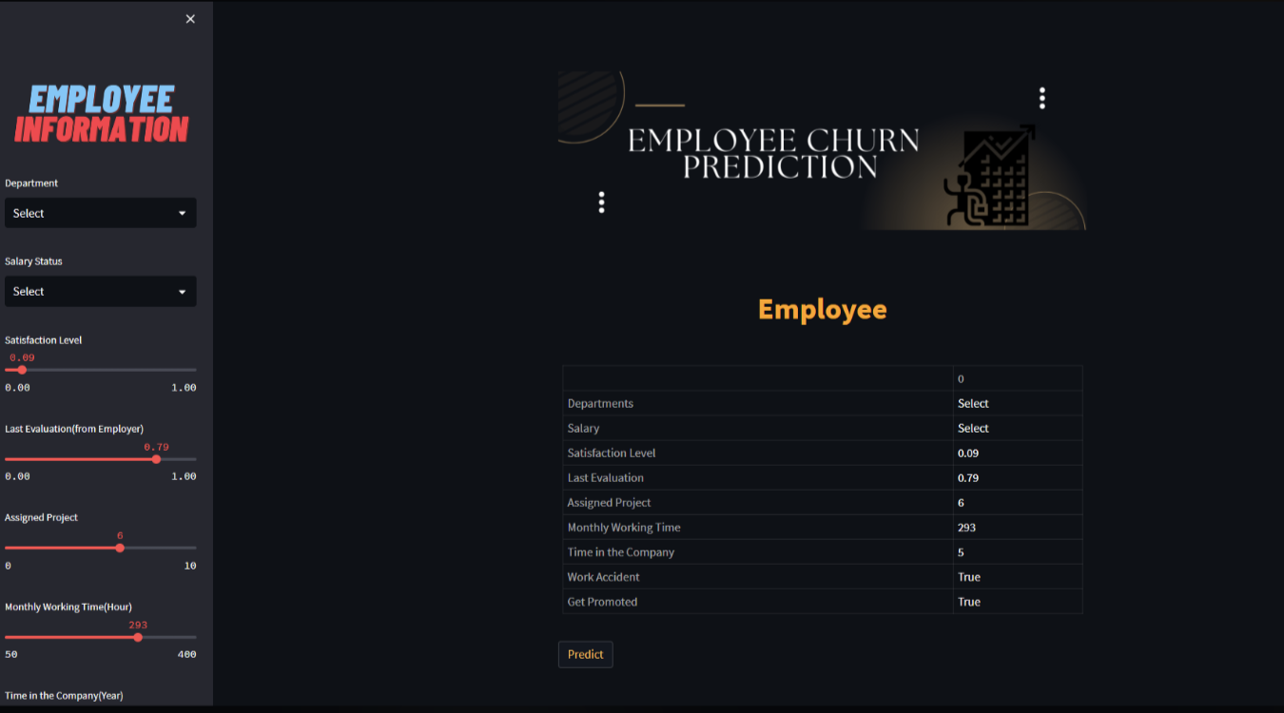
How will we present it to the public?
Via Streamlit
Enable user to predict if an employee is churned or not
Use Chat-GPT (open-ai API) as a chatbot
Use Chat-GPT to generate an analysis
on a specific employee and download the report if needed

Slide 8

READY TO GO!

