Slide 1

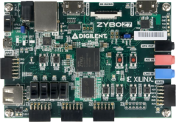
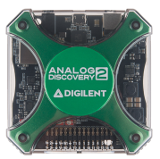
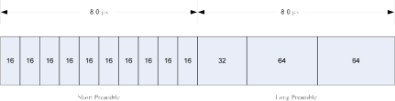

PREAMBLE SYNCHRONIZATION
Yıldız BİLGİN
Nazlıcan GÜNEŞ

Slide 2
OUTLINE
detection,
classification,
decision statistics,
simulation model and results,
summary of work done.

Slide 3
preamble structures
Three commercial wireless networking 802.11standards:
IEEE 802.11a,
IEEE b, and
IEEE 802.16.

Slide 4
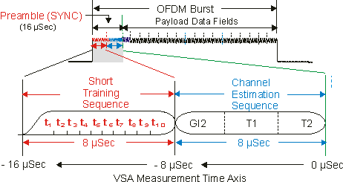
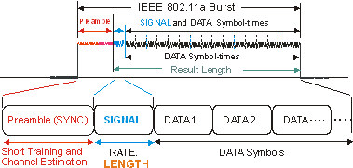
PREAMBLE
a signal used in network communications to synchronize transmission timing between two or more systems.
"someone is about to transmit data".

Slide 5

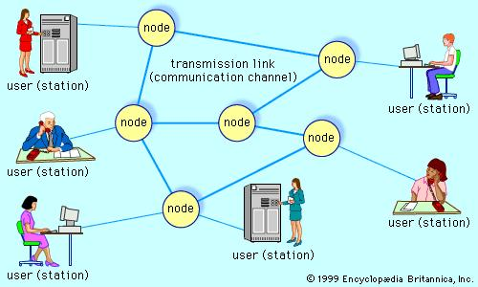
Usage Areas
military wireless
communications
Commercial
markets

Slide 6
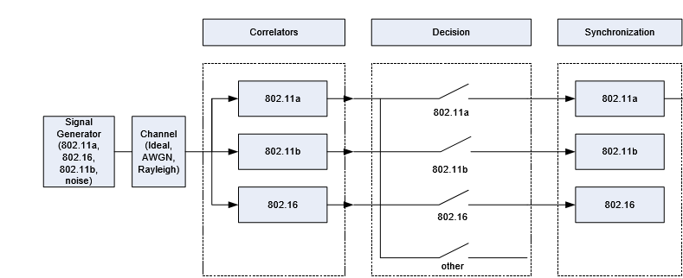
Block Diagram
Figure 1. Single Receiver Block Diagram for Multiple Wireless Networking Waveform Detection and Synchronization.

Slide 7
How to use preamble structure?
CROSS
CORRELATION
ALIGNED
PERFECTLY
ALIGNED NOT
PERFECTLY
maintains a copy of each preamble
compares every received signal with the stored preambles

Slide 8

CORRELATION
Correlation or “Co-Relation” is a measure of
similarity/ relationship between two signals
r_{xy}[l]=$\sum_{m=−∞}^{∞}{x\left[m\right]y[m−l]}$

Slide 9
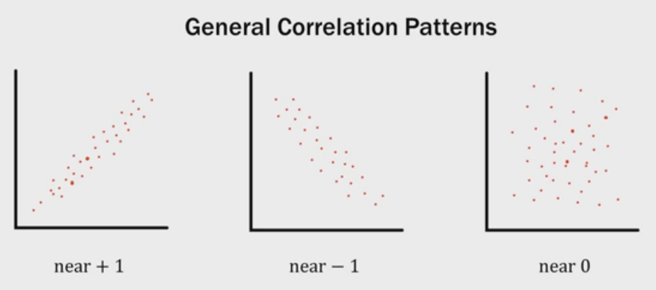
Why We Use Correlation
compare one reference signal with one or more signals to determine;
the similarity between the pair,
additional information based on the similarity.
and

Slide 10
Preamble Detection
requirements;
fast detection and classification,
synchronizing quickly to avoid suffering a lower data rate.
Detection of IEEE 802.11a and IEEE 802.16 signals is performed by searching for the preamble in a received signal by correlating the received signal against one symbol of the short or first preamble, respectively.

Slide 11
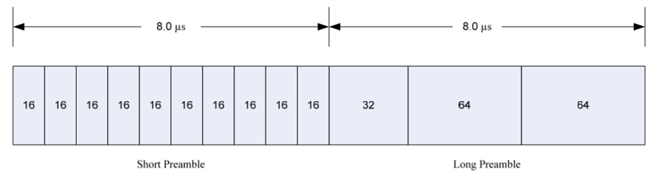
Preamble structure
IEEE 802.11a Preambles
Consist of two parts:
Short preamble
Long preamble
Figure 2. IEEE 802.11a Short and Long Preambles

Slide 12
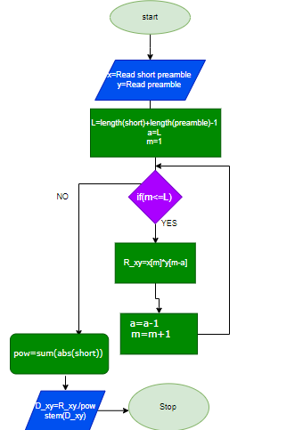
Figure 3. Flow chart of Preamble and one short preamble symbol correlation code

Slide 13
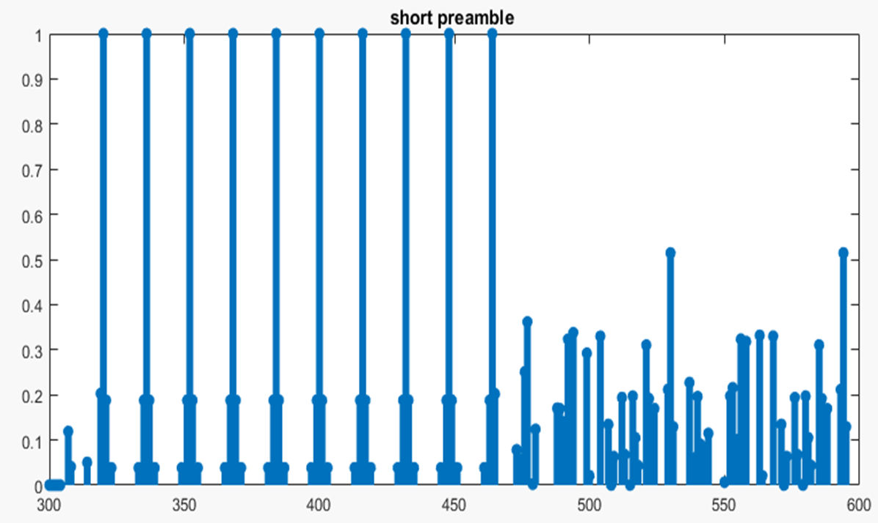
Figure 4. Preamble and one short preamble symbol correlation

Slide 14
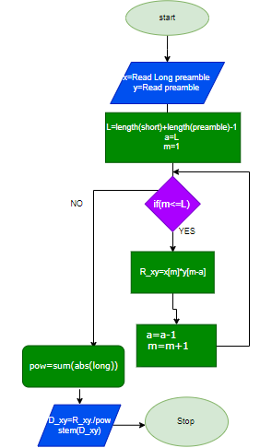
Figure 5. Flow chart of Preamble and one long preamble symbol correlation code

Slide 15
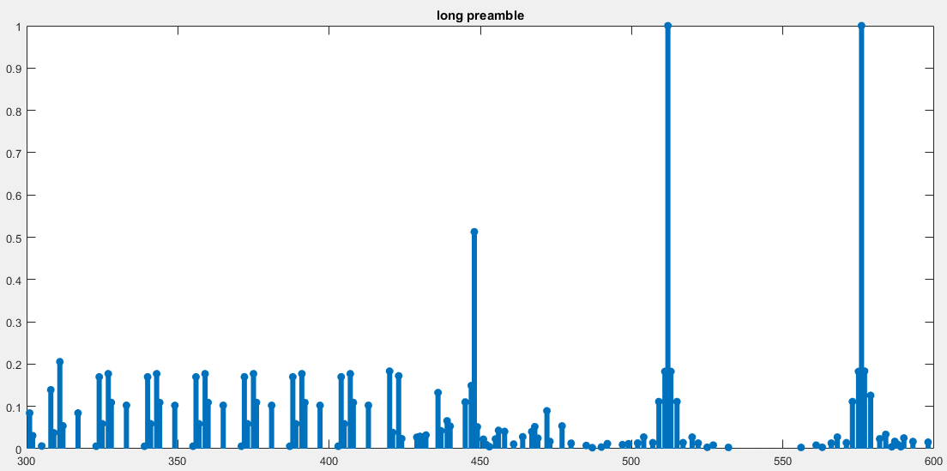
Figure 6. Preamble and one long preamble symbol correlation

Slide 16
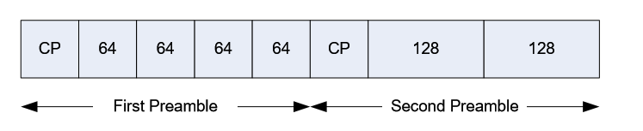
IEEE 802.16 Preambles
Consists of two parts
First Preamble
Second Preamble
Figure 7. IEEE 802.16 Downlink Preamble Structure

Slide 17
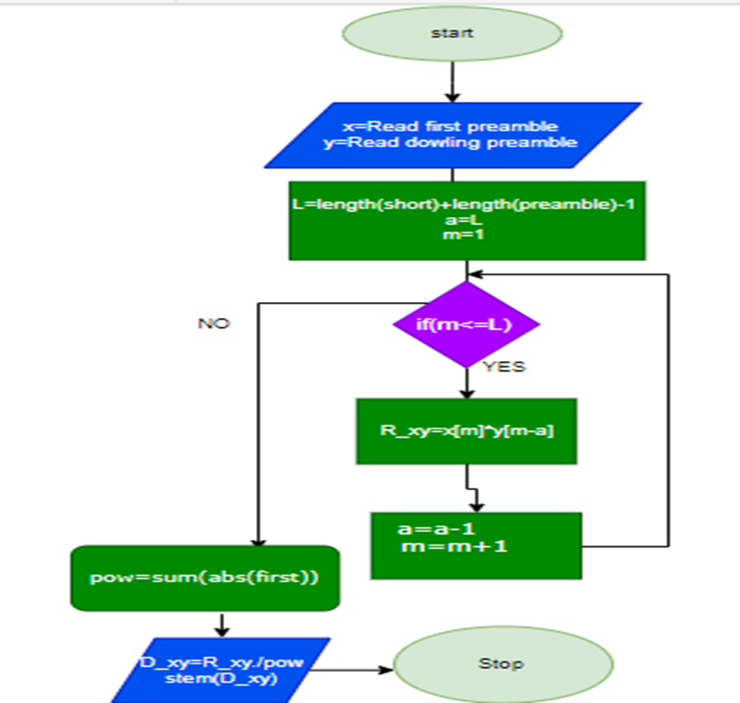
Figure 8. Flow chart of downling Preamble and one first preamble symbol correlation code

Slide 18
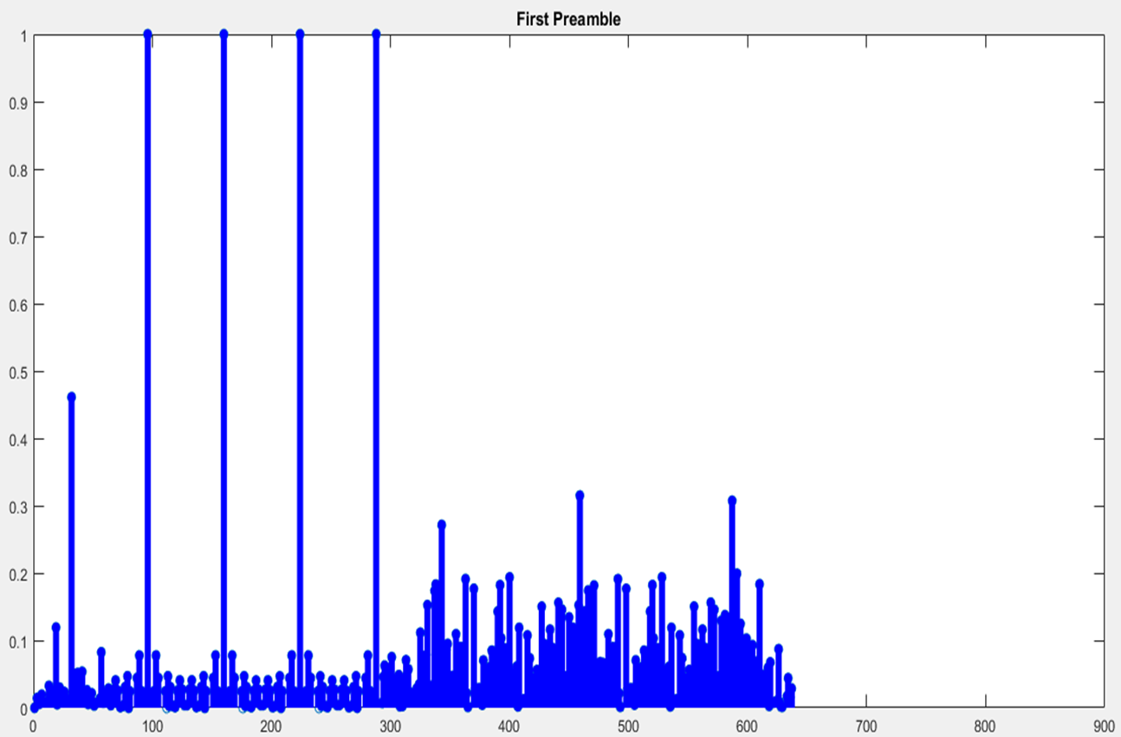
Figure 9. Correlation between downlink preamble and one symbol of first preamble

Slide 19
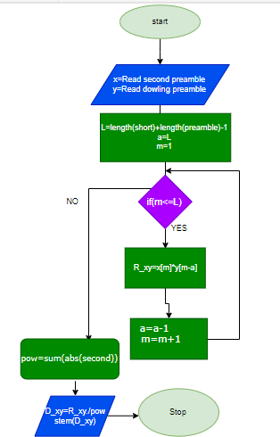
Figure 10. Flow chart of downling Preamble and one second preamble symbol correlation code

Slide 20
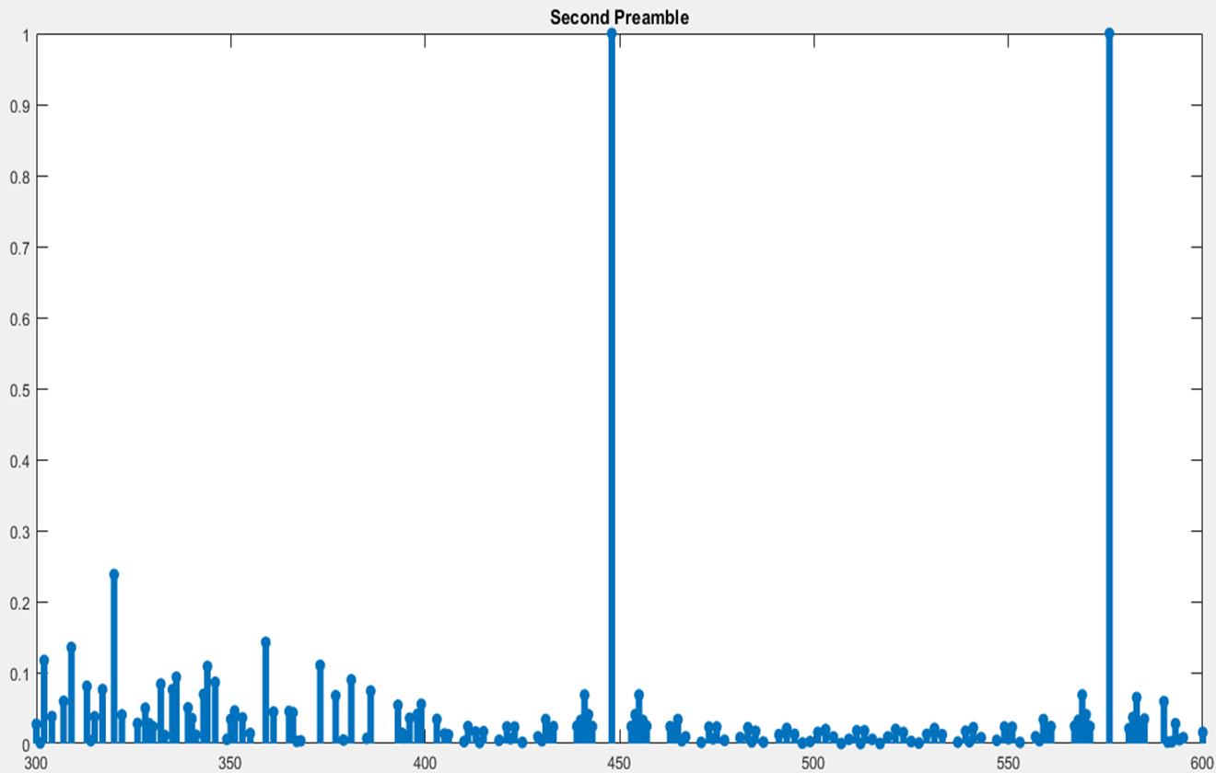
Figure 11. Correlation between downlink preamble and one symbol of second preamble

Slide 21
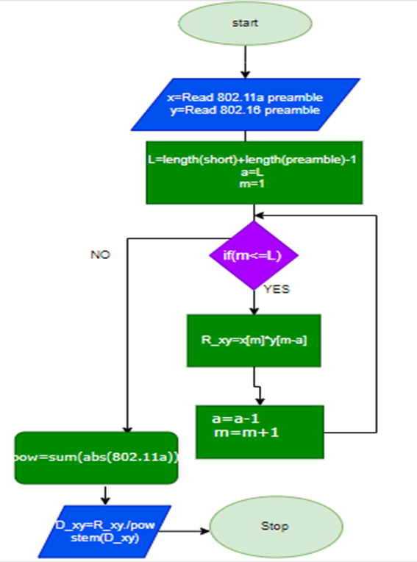
Figure 12. Flow chart of IEE 802.11a Preamble and IEE 802.16 preamble symbol correlation code

Slide 22
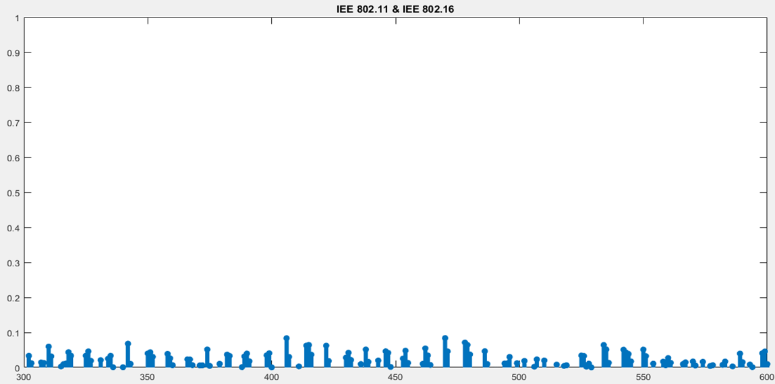
Figure 13. Correlation between IEEE 802.11a and IEEE 802.16 Preambles

Slide 23
Decision Statistics
To compare the decision statistics from two correlation methods used for signal detection:
1. Autocorrelation Method
2. Cross-correlation Method
For each method, the mean and the variance of the decision statistic is determined when the signal is present and when only noise is present.

Slide 24
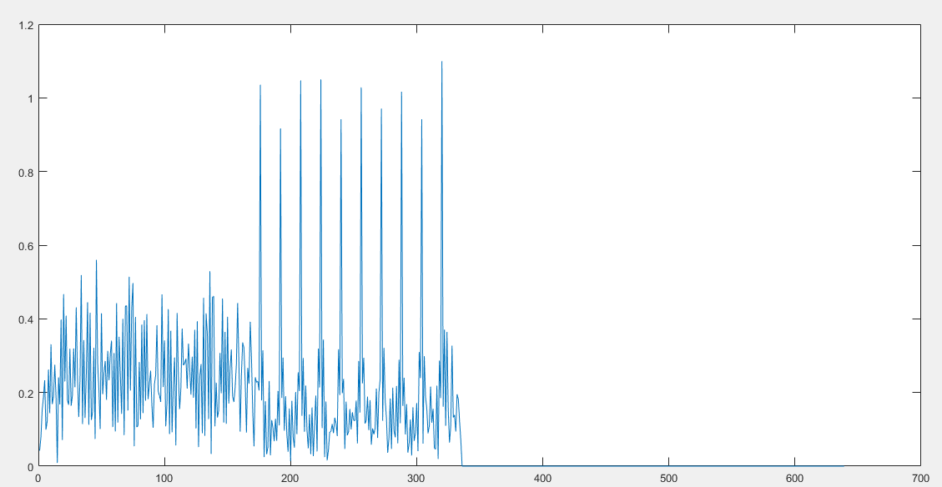
Figure 14. Cross-correlation with IEEE 802.11a Short Preamble at 0 dB SNR.

Slide 25
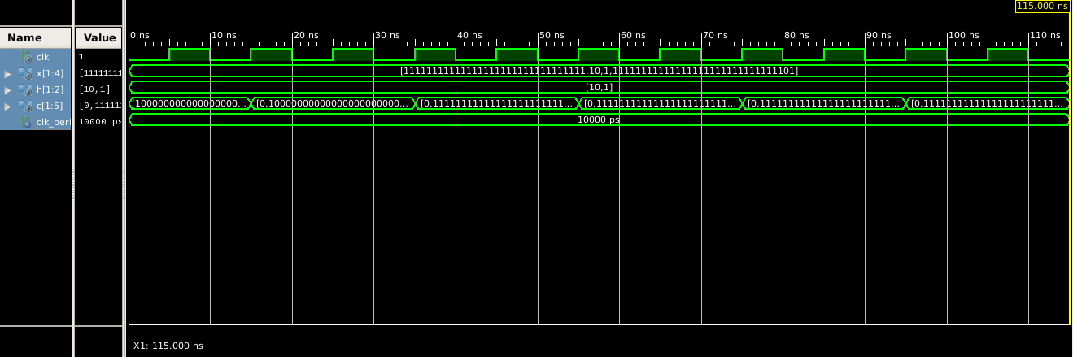
Simulations
Figure 15. Correlation of two integer vectors

Slide 26
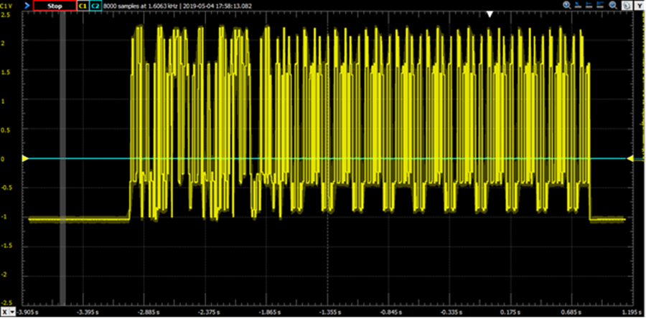
Results
Figure 16. Cross-Correlation with IEEE 802.11a Short Preamble at 0 dB SNR

Slide 27
DEMO

Slide 28

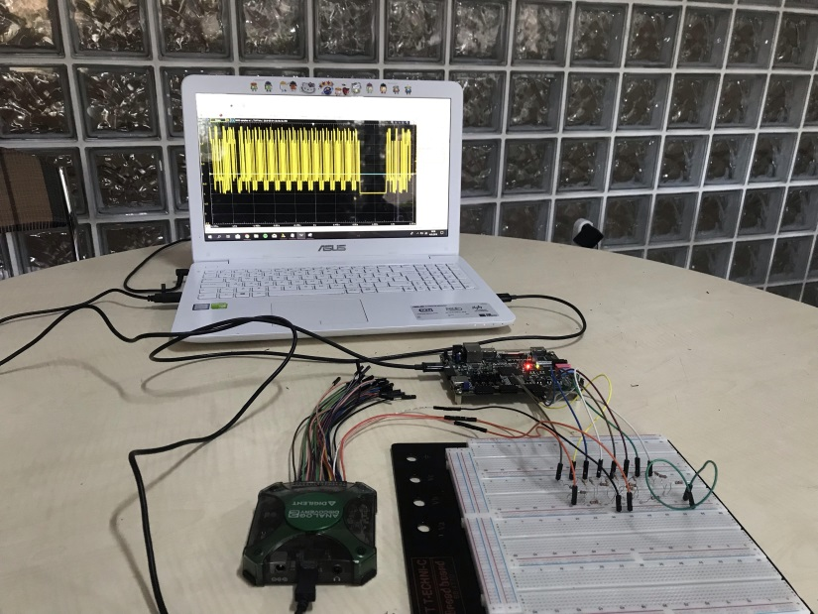
Conclusion
The objective of this project:
to investigate if a single, digital, baseband receiver could detect, classify, and synchronize to IEEE 802.11a, IEEE 802.16
IEEE 802.11b signals with MATLAB and Vivado with VHDL codes. The packet information available when an IEEE 802.11a signal was detected, and it was also investigated.

Slide 29
References
1) Thesis of Signal detection and frame synchronization of m)ultiple wireless networking waveforms By Howland, Keith C.
2)Thesis of IEEE Standard for Information Technology— Telecommunications and information exchange between systems— Local and metropolitan area networks— Specific requirements by Stuart J. Kerry, Al Petrick, Harry R. Worstell,
3) Thesis of UPLINK AND DOWNLINK SYNCHRONIZATION OF 802.16 Presented to the Faculty of San Diego State University by Qing Wang Summer 2011
4)http://host.uniroma3.it/laboratori/sp4te/teaching/sp4bme/documents/LectureCorrelation.pdf
5) A Tutorial Introduction to VHDL Programming by Orhan GAZİ

