Slide 1
Movie Genre Classification from Subtitles
Enes Akdogan, Omer Akgul, Ali Burak Erdogan, Mesut Gurlek, Mustafa Yildiz

Slide 2
How can we learn movie genre from a subtitle content?

Slide 3
OVERVIEW
DATASET
METHODS
HEARING IMPAIRED DESCRIPTIONS
DPM AND WPM
FULL TEXT OF SUBTITLES
MODEL COMBINATION
OVERALL RESULTS & EXPERIENCE
CONCLUSION

Slide 4
Dataset
9000+ Subtitles
6000+ hearing impaired
Opensubtitles API
8 genres from IMDB
Action, Comedy, Crime, Horror, Musical, Romance, War, Western
Before;
1000+ Subtitles

Slide 5
Data Separation
Cross-Validation
Training Data:
%20 Validation Set
%80 Training Set
Tune Parameters with several iteration
In each iteration shuffle training data and divide again
%80 Training Set
%20 Test Set

Slide 6
Hearing Impaired Descriptions

Slide 7
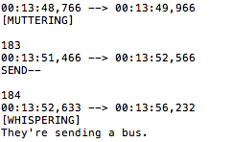
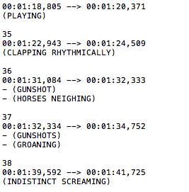
Motivation and Methodology
Distinguishing hearing impaired descriptions
Preprocessing to separate descriptions
NLTK: stopwords, stemming
TF-IDF vectorizer
Multinomial Naive Bayes
🐎

Slide 8
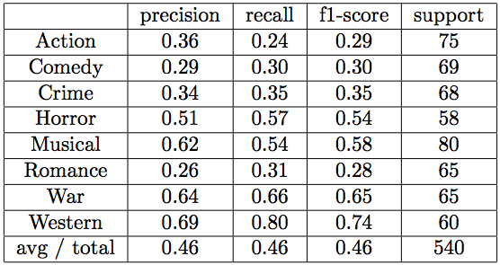
Results and Experience
Distinguishing Feature for specific genres
Analysing f1 scores not average accuracy score
Horror, Musical, War, Western gives promising scores
Leads to model combination

Slide 9
Dialog per Minute & Word Per Minute

Slide 10
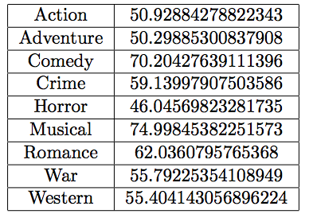
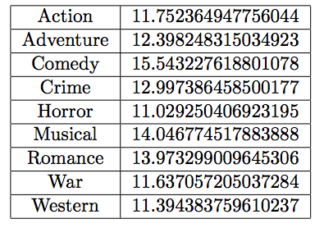
Motivation and Methodology
Movie dialog frequencies can have a pattern
Knn with Dialog per Minute, Word per Minute
Table: Word per minute
Table: Dialog per minute

Slide 11
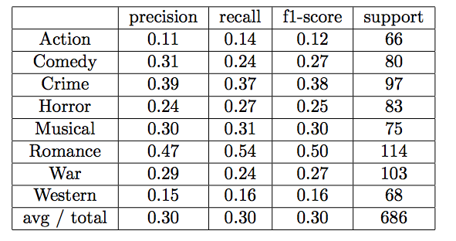
Results and Experience
Crime, Comedy, Romance scores are promising
Can be supporting model for some categories
Table: Score for dpm, wpm

Slide 12
Whole Subtitle Text

Slide 13
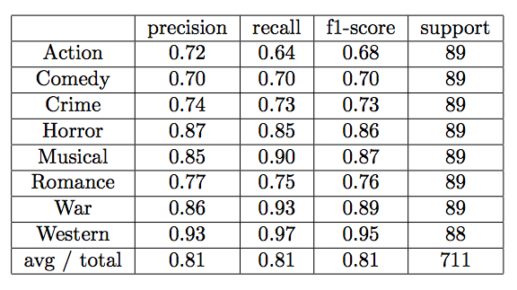
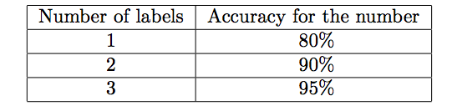
Methodology & Results
Multiclass SVM model
Single label & Multi label
Word2vec
Table: Only full text classification with single-label statistics
Table: Multi Label Results

Slide 14
Model Combination

Slide 15
Motivation and Methodology
3 different model and each have strength and weakness in different genres
Promising f1 scores for some categories in each model
Decided to use f1 scores to combine models

Slide 16
Combination Logic

Slide 17
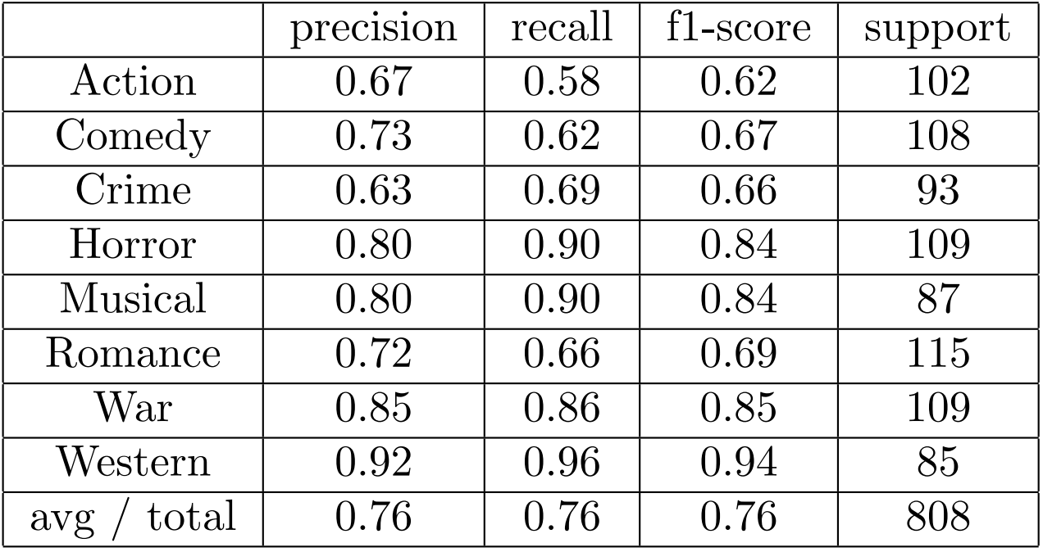
Results
Table: Overall accuracy of the combined models

Slide 18
Overall Results and Experience
Since we have tried different features, models and model combination we could not get perfects results.
Pure Full Text classification with SVM gave the best results for our project.
Data Collection, Preprocess and training are time consuming processes
Learning with small dataset results might be deceitful
Larger Dataset, better and reliables results

Slide 19
Multi label classification makes difficult to combine models
Intuitive features might give trivial results

Slide 20
Conclusion
8 categories
The best model was whole text svm model (~79%)
Combination of models system was adequate (~75%)
Tension modeling was not very successful.
Hearing impaired data and the whole text was useful

Slide 21
Thanks...

