Slide 1

Computer Architecture ----A Quantitative Approach
陈文智
浙江大学计算机学院
chenwz@zju.edu.cn

Slide 2
Why Multiprocessors?
Application requirements
Uniprocessor speed improving fast
But there are things that need even more speed
Microprocessors as the fastest CPUs
Collecting several much easier than redesigning one
Complexity of current microprocessors
Do we have enough ideas to sustain 1.5X/year?
Can we deliver such complexity on schedule?
Slow (but steady) improvement in parallel software
(scientific apps, databases, OS)

Slide 3
Opportunities for Applications
Scientific computing
Nearly unlimited demand (Grand challenge)
App Perf(GFLOPS) Memory (GB)
72 hour weather 3 1
Pharmaceutical design 100 10
Global Change, Genome 1000 1000
Successes in some real industries:
Petroleum reservoir modeling
Automotive: crash simulation, drag analysis, engine
Aeronautics: airflow analysis, engine, structural mechanics
Pharmaceuticals: molecular modeling
Entertainment: full length movies (“Toy Story”)
Commercial application
Transaction processing, file servers, electronic CAD simulation, search engine
Examples: IBM RS6000, Tandem (Compaq) Himalaya

Slide 4
Parallel Processing
Multiple processors working cooperatively on problems: not the same as multiprogramming
Goals/Motivation
Performance: limits of uniprocessors
ILP (branch prediction, RAW dependencies, memory)
Cost Efficiency: build big systems with commodity parts
(uniprocessors)
Scalability: just add more processors to get more performance
Fault tolerance: One processor fails you still can continue processing

Slide 5
Parallel Computers
Definition: “A parallel computer is a collection of processing elements that cooperate and communicate to solve large problems fast.”
Almasi and Gottlieb, Highly Parallel Computing ,1989
Questions about parallel computers:
How large a collection?
How powerful are processing elements?
How do they cooperate and communicate?
How are data transmitted?
What type of interconnection?
What are HW and SW primitives for programmer?
Does it translate into performance?

Slide 6
Popular Flynn Taxonomy
Flynn’s Taxonomy of Parallel Machines
How many Instruction streams?
How many Data streams?
SISD (Single Instruction Single Data) ----Uniprocessors
MISD (Multiple Instruction Single Data) ---- Not used much
SIMD (Single Instruction Multiple Data)
Each “processor” works on its own data, but execute the same instr.
Examples: connection machine 2：65535 1bit processors;
Illiac IV： 64 64bit processors;
Ad: Simple programming model; Low overhead; Flexibility;
MIMD (Multiple Instruction Multiple Data)
Each processor executes its own instr. and operates on its own data
Examples: Sun Enterprise 5000, Cray T3D, SGI Origin
Ad: Flexible; Use off-the-shelf microprocessors;
Not superscalar, each node is superscalar, lessons will apply to multi-core

Slide 7
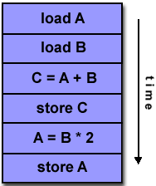
Program execute on SISD

Slide 8
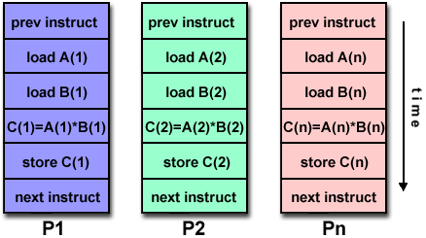
Program execute on SIMD

Slide 9
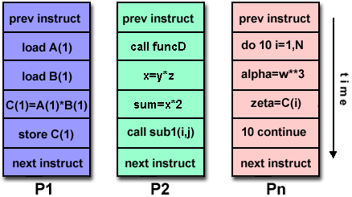
Program execute on MIMD

Slide 10
Catalogue the Parallel (MIMD) processors
Center on organization of main memory
Shared vs. Distributed
Appearance of memory to hardware
Q1: Memory access latency uniform?
Shared: yes, doesn’t matter where data goes
Distributed: no, makes a big difference
Appearance of memory to software
Q2: Can processors communicate directly via memory?
Shared (shared memory): yes, communicate via load/store
Distributed (message passing): no, communicate via messages
Dimensions are orthogonal
e.g. DSM: (physically) distributed, (logically) shared memory

Slide 11
Dimensions are orthogonal
(SMP)/UMA
(DSM)/ NUMA

Slide 12
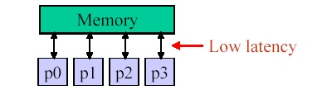
UMA vs. NUMA: Why it matters
Ideal model:
Perfect (single-cycle) memory latency
Perfect (infinite) memory bandwidth
Real systems:
Latencies are long and grow with system size
Bandwidth is limited
Add memory banks, interconnect to hook up (latency goes up)

Slide 13
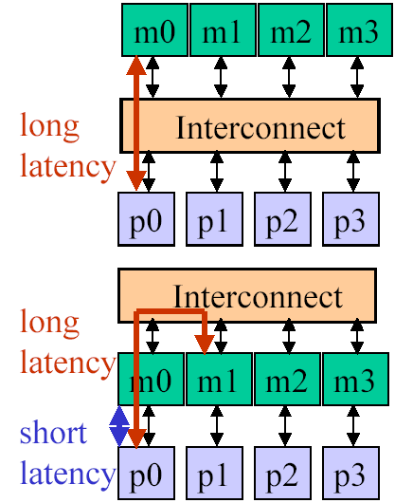
UMA vs. NUMA
UMA: uniform memory access
From p0 same latency to m0-m3
Data placement doesn’t matter
Latency worse as system scales
Interconnect contention restricts bandwidth
Small multiprocessors only
NUMA: non-uniform memory access
From p0 faster to m0 than m1-m3
Low latency to local memory helps performance
Data placement important (software!)
Less contention => more scalable
Large multiprocessor systems

Slide 14
Major MIMD Styles
Centralized shared memory ("Uniform Memory Access" time or "Shared Memory Processor")
Decentralized memory (memory module with CPU)
get more memory bandwidth, lower memory latency
Drawback: Longer communication latency
Drawback: Software model more complex

Slide 15
Centralized shared-memory multiprocessor
< 100 processor nodes in 2006, normal few dozen

Slide 16
Structure of distributed-memory multiprocessor

Slide 17
Comparison in graph
Uniprocessor
Pipelined
Superscalar
VLIW
SMP(Symmetric)
or CSM(Centralized)
Distributed
P
M
P
M
M
P
M
P
M
N
E
T
P
M
M

Slide 18
Distributed-memory multiprocessor (1)
Distributed shared memory (DSM or scalable shared memory)
logical uniform address space but physical distributed memory, so any one of the processors can access any one of the memories.
Shared memory means sharing the address space, which is different from centralized shared memory.

Slide 19
Distributed-memory multiprocessor (2)
multiple computers
Address space consists of multiple private (separate) address spaces. A processor can NOT access the remote memory node directly.
Every node (processor-memory pair) is a independent computer.
NOW (Network of Workstation) is consisted of multiple node (PC or workstation) connected by LAN
PC cluster

Slide 20
Parallel Architecture
Parallel Architecture extends traditional computer architecture with a communication architecture
abstractions (HW/SW interface)
organizational structure to realize abstraction efficiently

Slide 21
Parallel Framework
Programming Model:
Multiprogramming: lots of jobs, no communication
Shared address space: communicate via memory
Message passing: send and receive messages
Data Parallel: several agents operate on several data sets simultaneously and then exchange information globally and simultaneously (shared or message passing)
Communication Abstraction:
Shared address space: e.g., load, store, atomic swap
Message passing: e.g., send, receive library calls

Slide 22
Shared Address Model-1
Each processor can name every physical location in the machine
Each process can name all data that shares with other processes
Data transfer via load and store
Data size: byte, word, ... or cache blocks
Uses virtual memory to map virtual space to local or remote physical space
Memory hierarchy model applies: now communication moves data to local processor cache (as load moves data from memory to cache)
Latency, Bandwidth, scalability when communicate?
For distributed memory architecture, a layer (software or hardware) is generally added to allow transparent address mapping

Slide 23
Shared Address Model-2
Significant research has been conducted to make the translation transparent and scalable for many node
Handling data consistency and protection is typically a challenge
For multi-computer systems, address mapping has to be performed by software modules, typically added as part of the operating system
Latency depends on the underlined hardware architecture (bus bandwidth, memory access time and support for address translation)
Scalability is limited given that the communication model is so tightly coupled with process address space*

Slide 24
Message Passing Model-1
Whole computers (CPU, memory, I/O devices) communicate as explicit I/O operations
Essentially NUMA but integrated at I/O devices vs. memory system
Send specifies local buffer + receiving process on remote computer
Receive specifies sending process on remote computer + local buffer to place data
Usually send includes process tag and receive has rule on tag: match 1, match any
Synch: when send completes, when buffer free, when request accepted, receive wait for send
Send + receive => memory-memory copy, where each supplies local address, AND does pairwise synchronization!

Slide 25
Message Passing Model-2
History of message passing:
Network topology important because could only send to immediate neighbor
Typically synchronous, blocking send & receive
Later DMA with non-blocking sends, DMA for receive into buffer until processor does receive, and then data is transferred to local memory
Later SW libraries to allow arbitrary communication
Example:
IBM SP-2, RS6000 workstations in racks
Network Interface Card has Intel 960
8X8 Crossbar switch as communication building block
40 MB/sec per link

Slide 26
Shared Memory vs. Message Passing
Shared Memory (multiprocessors)
One shared address space
Processors use conventional load/stores to access shared data
Communication can be complex/dynamic
Simpler programming model (compatible with uniprocessors)
Hardware controlled caching is useful to reduce latency contention
Has drawbacks
Synchronization (discussed later)
More complex hardware needed

Slide 27
Shared Memory vs. Message Passing
MIMD (appearance of memory to software)
Message Passing (multicomputers)
Each processor has its own address space
Processors send and receive messages to and from each
other
Communication patterns explicit and precise
Explicit messaging forces programmer to optimize this
Used for scientific codes (explicit communication)
Message passing systems: PVM, MPI, OpenMP
Simple Hardware
Difficult programming Model

Slide 28
Communication Models
Shared Memory
Processors communicate with shared address space
Easy on small-scale machines
Advantages:
Model of choice for uniprocessors, small-scale MPs
Ease of programming
Lower latency
Easier to use hardware controlled caching
Message passing
Processors have private memories, communicate via messages
Advantages:
Less hardware, easier to design
Focuses attention on costly non-local operations
Can support either SW model on either HW base

Slide 29
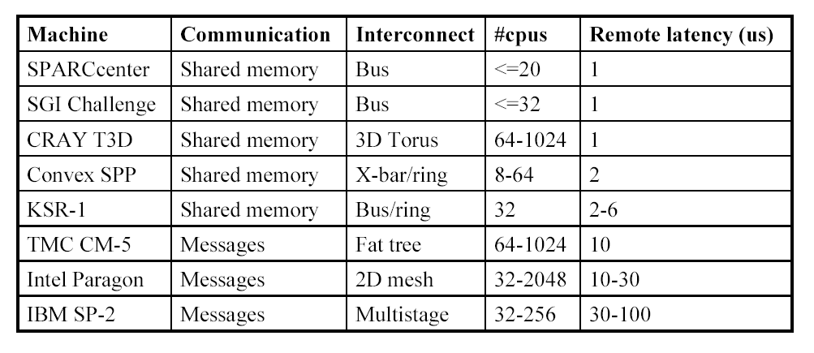
Parallel Systems (80s and 90s)

Slide 30
Multiprocessor Trends
Shared Memory
Easier, more dynamic programming model
Can do more to optimize the hardware
Small-to-medium size UMA systems (2-8 processors)
Processor + memory + switch on single board (4x Pentium)
Single-chip multiprocessors (POWER4)
Commodity parts soon – glueless MP systems
Larger NUMAs built from smaller UMAs
Use commodity small UMAs with commodity interconnects (ethernet, myrinet)
NUMA clusters

Slide 31
Fundamental Issues_1
Naming: how to solve large problem fast
what data is shared
how it is addressed
what operations can access data
how processes refer to each other
Choice of naming affects code produced by a compiler; via load where just remember address or keep track of processor number and local virtual address for message passing
Choice of naming affects replication of data; via load in cache memory hierarchy or via SW replication and consistency

Slide 32
Fundamental Issues_2
Global physical address space: any processor can generate, address and access it in a single operation
Global virtual address space: if the address space of each process can be configured to contain all shared data of the parallel program
memory can be anywhere: virtual address translation handles it
Segmented shared address space: locations are named <process number, address>
uniformly for all processes of the parallel program

Slide 33
Fundamental Issues_3
Synchronization:
To cooperate, processes must coordinate
Message passing is implicit coordination with transmission or arrival of data
Shared address => additional operations to explicitly coordinate: e.g., write a flag, awaken a thread, interrupt a processor

Slide 34
Fundamental Issues_4: Latency and Bandwidth
Bandwidth
Need high bandwidth in communication
Match limits in network, memory, and processor
Challenge is link speed of network interface vs. bisection bandwidth of network
Latency
Affects performance, since processor may have to wait
Affects ease of programming, since requires more thought to overlap communication and computation
Overhead to communicate is a problem in many machines
Latency Hiding
How can a mechanism help hide latency?
Increases programming system burden
Examples: overlap message send with computation, prefetch data, switch to other tasks

Slide 35
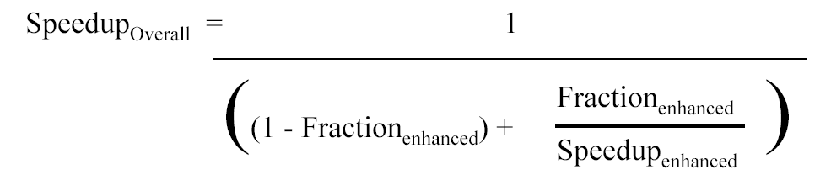
Challenge: limited program parallelism
Example: Achieve speedup of 80 x using 100 processors
80 = 1/[Fracparallel/100+1-Fracparallel]
Frac parallel = 0.9975
==> only 0.25% of the work can be serial!
Can parallized part be imporved to 100 times considering the overheads ?

Slide 36
Challenge : long communication latency
Given： (P203)
32-processor machine, with each processor cycle time=0.5ns (2GHz );
remote reference time= 200ns;
all references except those involving communication hit in local memory;
base CPI=0.5 (all reference hit in the cache);
Processors are stalled on a remote request.
0.2% of the instructions involve a remote reference.
Answer:
CPI = Base CPI + Remote request rate * Remote request cost =0.5 + 0.2% * Remote request cost
The remote request cost is:
CPI=0.5 + 0.8 = 1.3
The multiprocessor with all local references is 1.3/0.5 = 2.6 times faster.
Remote access cost
400ns
=400cycles
=
Cycle time
1ns

Slide 37
What can we do?
Limited program parallelism
New algorithm
Long communication latency
HW: caching shared data to lower the remote access frequency
Problem: cache coherence, cache consistence
SW:
restructuring the data to make more accesses local
Synchronization
latency hiding techniques

Slide 38

THANK YOU
THANK YOU

