Slide 1

Computer Architecture ----A Quantitative Approach
陈文智
浙江大学计算机学院
chenwz@zju.edu.cn

Slide 2
Chapter 3
ILP: Concepts and Challenge
Basic compiler Techniques for exposing ILP
Overcoming Data Hazards with Dynamic Scheduling
Reducing Branch Costs with Dynamic Hardware Prediction
HP instruction Delivery & Multiple Issue
Hardware-based Speculation
Thread-level Parallelism

Slide 3
Recall from Pipelining Review
Pipeline CPI = Ideal pipeline CPI + Structural Stalls + Data Hazard Stalls + Control Stalls
Ideal pipeline CPI: measure of the maximum performance attainable by the implementation
Structural hazards: HW cannot support this combination of instructions
Data hazards: Instruction depends on result of prior instruction still in the pipeline
Control hazards: Caused by delay between the fetching of instructions and decisions about changes in control flow (branches and jumps)

Slide 4
Ideas to Reduce Stalls
ChC
Ch3
ChG

Slide 5
What is Instruction-Level Parallelism ?
Instruction-level parallelism
The potential overlap among instructions
Basic Block ILP is quite small
Basic Block: a straight-line code sequence with no branches in except to the entry and no branches out except at the exit
average dynamic branch frequency 15% to 25% => 4 to 7 instructions execute between a pair of branches
Plus instructions in BB likely to depend on each other

Slide 6
Instruction-Level Parallelism (ILP)
To obtain substantial performance enhancements, we must exploit ILP across multiple basic blocks
Simplest: loop-level parallelism to exploit parallelism among iterations of a loop
Vector is one way
If not vector, then either dynamic via branch prediction or static via loop unrolling by compiler

Slide 7
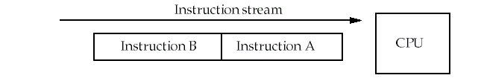
Recall: Types of data hazards
Consider two instructions, A and B. A occurs before B.
RAW (Read after write) true dependence
Instruction A writes Rx，instruction B reads Rx
WAW (Write after write) output dependence
Instruction A writes Rx，instruction B writes Rx
WAR (Write after read) anti-denpendence
Instruction A reads Rx，instruction B writes Rx
Hazards are named according to the ordering that MUST be preserved by the pipeline

Slide 8
True Data Dependence and Hazards
True Data Dependence:
Instr_{J} is data dependent on Instr_{I} Instr_{J} tries to read operand before Instr_{I} writes it
I: add r1,r2,r3
J: sub r4,r1,r3
or Instr_{J} is data dependent on Instr_{K} which is dependent on Instr_{I}
Caused by a “True Dependence” (compiler term)
If true dependence caused a hazard in the pipeline, called a Read After Write (RAW) hazard

Slide 9
True Data Dependence and Hazards
Dependences are a property of programs
Presence of dependence indicates potential for a hazard, but actual hazard and length of any stall is a property of the pipeline
Importance of the data dependencies
indicates the possibility of a hazard
determines order in which results must be calculated
sets an upper bound on how much parallelism can possibly be exploited

Slide 10
Name Dependence 1:Anti-dependence
Name dependence: when 2 instructions use same register or memory location, called a name, but no flow of data between the instructions associated with that name;
Instr_{J} writes operand before Instr_{I} reads it
I: sub r4,r1,r3
J: add r1,r2,r3
K: mul r6,r1,r7
called an “anti-dependence” by compiler writers. This results from reuse of the name “r1”
If anti-dependence caused a hazard in the pipeline, called a Write After Read (WAR) hazard

Slide 11
Name Dependence 2: Output dependence
Instr_{J} writes operand before Instr_{I} writes it.
Called an “output dependence” by compiler writers This also results from the reuse of name “r1”
If anti-dependence caused a hazard in the pipeline, called a Write After Write (WAW) hazard
I: sub r1,r4,r3
J: add r1,r2,r3
K: mul r6,r1,r7

Slide 12
ILP and Data Hazards
HW/SW must preserve program order: order instructions would execute in if executed sequentially 1 at a time as determined by original source program
HW/SW goal: exploit parallelism by preserving program order only where it affects the outcome of the program
Instructions involved in a name dependence can execute simultaneously if name used in instructions is changed so instructions do not conflict
Register renaming resolves name dependence for regs
Either by compiler or by HW

Slide 13
Control Dependencies
Every instruction is control dependent on some set of branches, and, in general, these control dependencies must be preserved to preserve program order
if p1 {
S1;
};
if p2 {
S2;
}
S1 is control dependent on p1, and S2 is control dependent on p2 but not on p1.

Slide 14
Control Dependence Ignored
Control dependence need not be preserved
willing to execute instructions that should not have been executed, thereby violating the control dependences, if can do so without affecting correctness of the program
Instead, 2 properties critical to program correctness are exception behavior and data flow

Slide 15
Exception Behavior
Preserving exception behavior
=> any changes in instruction execution order must not change how exceptions are raised in program
(=> no new exceptions)
Example: DADDU R2,R3,R4 BEQZ R2,L1 LW R1,0(R2) L1: ……
Problem with moving LW before BEQZ?

Slide 16
Data Flow
Data flow: actual flow of data values among instructions that produce results and those that consume them
branches make flow dynamic, determine which instruction is supplier of data
Example:
DADDU R1,R2,R3 BEQZ R4,L DSUBU R1,R5,R6 L: … OR R7,R1,R8
OR depends on DADDU or DSUBU? Must preserve data flow on execution

Slide 17
A short summary
ILP
The potential overlap among instructions
Reduce stalls from
Structural hazards
Data hazards
Control hazards
To keep the program correctness, we should
Preserving Data flow
Preserving exception behavior

Slide 18
Lecture for ILP: Software approaches
Basic Compiler Technique for Exposing ILP
Loop unrolling
Static Branch Prediction
Static multiple Issue: VLIW
Advanced Compilor Support for Exposing and Exploiting ILP
Software pipelining
Global Code scheduling
Hardware Support for Exposing More Parallelism at compile time
Conditional or Predicated instructions
Compiler speculation with hardware support

Slide 19
FP Loop: Where are the Hazards?
Loop: LD F0,0(R1) ;F0=vector element
ADDD F4,F0,F2 ;add scalar from F2
SD 0(R1),F4 ;store result
SUBI R1,R1,8 ;decrement pointer 8B (DW)
BNEZ R1,Loop ;branch R1!=zero
NOP ;delayed branch slot
Instruction Instruction Execution Latency
producing result using result in cycles in cycles
FP ALU op Another FP ALU op 4 3
FP ALU op Store double 3 2
Load double FP ALU op 1 1
Load double Store double 1 0
Integer op Integer op 1 0
Where are the stalls?

Slide 20
Specification for the latency
ALU F1, -,- : IF ID FD FD FD FD WB
ALU -, F1,-: IF ID s s s FD FD FD FD WB
ALU: IF ID FD FD FD FD WB
SW: IF ID s s EX DM
LW F1, - : IF ID EX DM WB
SW: F1, 8(R1): IF ID EX DM WB
MEM/WB.LDMR --→DM input port

Slide 21
Reducing stalls from scheduling in BB and delayed branch
Loop: LD F0, 0(R1)
ADDD F4, F0, F2
SD 0(R1), F4
SUBI R1, R1, #8
BNEZ R1, Loop
F D X M W
F D s A₁ A₂ A₃ A₄ W
F s D s s X M W
F s s D X M W
F s D X M W
10 CC F F
Loop: LD F0, 0(R1)
SUBI R1, R1,#8
ADDD F4, F0, F2
BNEZ R1, Loop
SD +8(R1), F4
F D X M W
F D X M W
F D A₁A₂A₃A₄W
F D X M W
F D s X M W
6 CC F s D X M W

Slide 22
Unroll Loop Four Times (straightforward way)
Rewrite loop to minimize stalls?
1 Loop: LD F0,0(R1)
2 ADDD F4,F0,F2
3 SD 0(R1),F4 ;drop SUBI & BNEZ
4 LD F6,-8(R1)
5 ADDD F8,F6,F2
6 SD -8(R1),F8 ;drop SUBI & BNEZ
7 LD F10,-16(R1)
8 ADDD F12,F10,F2
9 SD -16(R1),F12
10 LD F14,-24(R1)
11 ADDD F16,F14,F2
12 SUBI R1,R1,#32 ;alter to 4*8
13 SD +8(R1),F16
14 BNEZ R1,LOOP
NOP
14 + 3 x (1+2) +1 +1 +1= 26 clock cycles, or 6.5 per iteration
Assumes R1 is multiple of 4
1 cycle stall
2 cycle stall
1 cycle stall
1 cycle stall waiting for F16
1 cycle control stall

Slide 23
Unrolled Loop That Minimizes Stalls
1 Loop: LD F0,0(R1)
2 LD F6,-8(R1)
3 LD F10,-16(R1)
4 LD F14,-24(R1)
5 ADDD F4,F0,F2
6 ADDD F8,F6,F2
7 ADDD F12,F10,F2
8 ADDD F16,F14,F2
9 SD 0(R1),F4
10 SD -8(R1),F8
11 SUBI R1,R1,#32
12 SD +16(R1),F12
13 BNEZ R1,LOOP
14 SD 8(R1),F16 ; 8-32 = -24
14 clock cycles, or 3.5 per iteration
What assumptions made when moved code?
OK to move store past SUBI even though changes register
OK to move loads before stores: get right data?
When is it safe for compiler to do such changes?

Slide 24
Ideas to Reduce Stalls
ChC
Ch3
ChG

Slide 25
Why Dynamic Scheduling ?
Example1 :
DIVD F0,F2,F4 ADDD F10,F0,F8 SUBD F12,F8,F14
Example2: Structure Hazard
DIVD F2,F2,F4
ADDD F10,F0,F8 ; FP ADDer unpipelined
ADDD F12, F0,F4
MULD F16, F14, F4
Problem: instruction (SUBD, MULD) stalled due to irrelevant forward instructions.

Slide 26
HW Schemes: Dynamic scheduling
Key idea: Allow instructions behind stall to proceed
Enables out-of-order execution and allows out-of-order completion
Will distinguish when an instruction begins execution and when it completes execution; between 2 times, the instruction is in execution
In a dynamically scheduled pipeline, all instructions pass through issue stage in order (in-order issue)

Slide 27
Adv. Of Dynamic Scheduling
Handles cases when dependences unknown at compile time
(e.g., because they may involve a memory reference)
It simplifies the compiler
Allows code that compiled for one pipeline to run efficiently on a different pipeline
Hardware speculation, a technique with significant performance advantages, that builds on dynamic scheduling

Slide 28
Dynamic Scheduling Step 1
Simple pipeline had 1 stage to check both structural and data hazards: Instruction Decode (ID), also called Instruction Issue
Split the ID pipe stage of simple 5-stage pipeline into 2 stages:
Issue—Decode instructions, check for structural hazards
Read operands—Wait until no data hazards, then read operands

Slide 29
Dynamic Scheduling with a Scoreboard
Scoreboarding
Named after CDC6600 scoreboard
Allowing instructions to execute out of order when there are sufficient resources and no data dependences.
In-order issue
Out-of order completion
Executing an instruction as early as possible

Slide 30
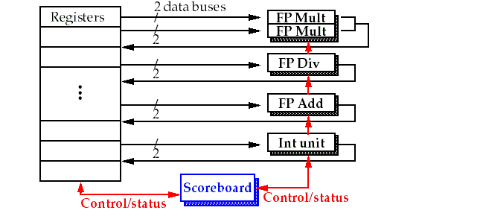
Basic structure of a pipelined processor with a scoreboard

Slide 31
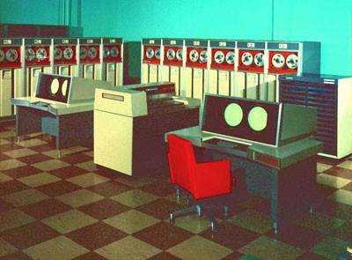
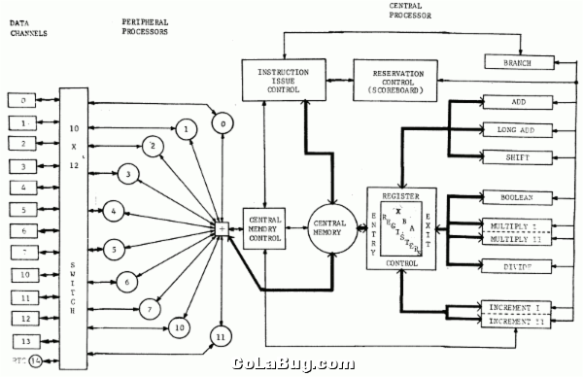
CDC6600 –First Supercomputer(top1 1964-1969)

Slide 32
The pipeline stages with scoreboard
The Five stages: IF, ID, EX, MEM, WB
IF: the same for all instructions
ID: split into two stages: issue and read operands
EX: no change
MEM: omitted for only concentrating on the FP operations
WB: no change
So, the stages are: IF, IS, RO, EX,WB.
Another way to lookat missing MEM ?

Slide 33
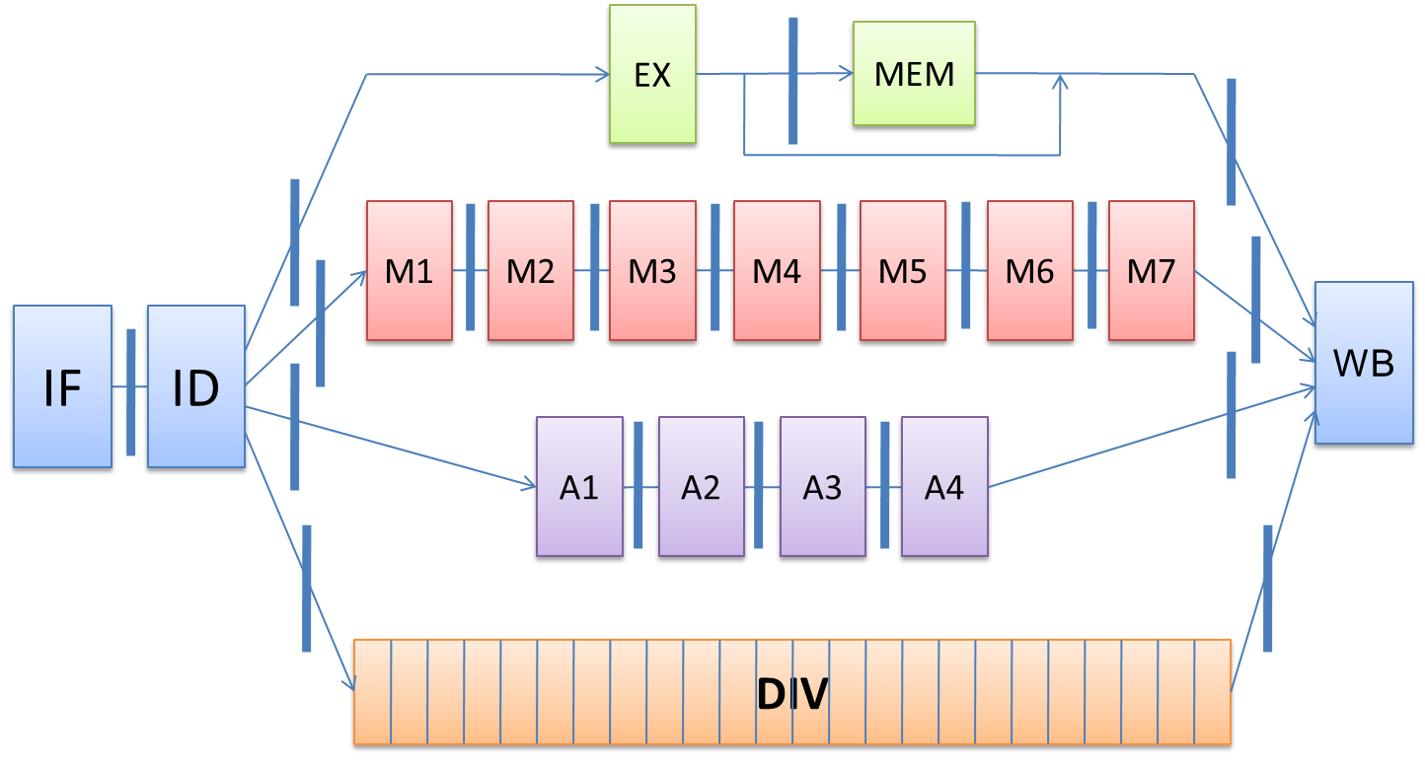
Pipeline supports multiple outstanding FP operations

Slide 34
Scoreboard Pipeline stage description
Issue: a instruction is issued when
The functional unit is available and
No other active instruction has the same destination register.
Avoid structural hazard and WAW hazard
Read Operands (RO)
The read operation is delayed until both the operands are available.
This means that no previously issued but ncompleted instruction has the operand as its destination.
This resolves RAW hazards dynamically
Execution (EX)
Notify the scoreboard when completed so the functional unit can be reused.
Write result (WB)
The scoreboard checks for WAR hazards and stalls the completing instruction if necessary.

Slide 35
The scoreboard algorithm
Scoreboard-takes full responsibility for instruction issue and execution
Create the dependence records
Decide when to fetch the operand
Decide when to enter execution
Decide when the result can be written into the register file
Three data structure
Instruction status:
which of the four steps the instruction is in
Functional unit status: busy, op, Fi, Fj, Fk, Qj, Qk, Rj, Rk
Register result status:
which functional unit will write that register

Slide 36
Example: Instruction status
LD F6, 34(R2)
LD F2, 45(R3)
MULTD F0, F2, F4
SUBD F8, F6, F2
DIVD F10, F0, F6
ADDD F6, F8, F2
MULTD : 10CC
DIVD : 40CC
ADDD/SUBD : 2CC

Slide 37
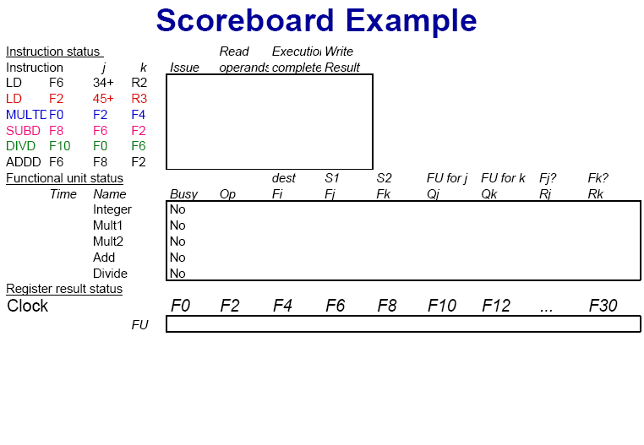

Slide 38
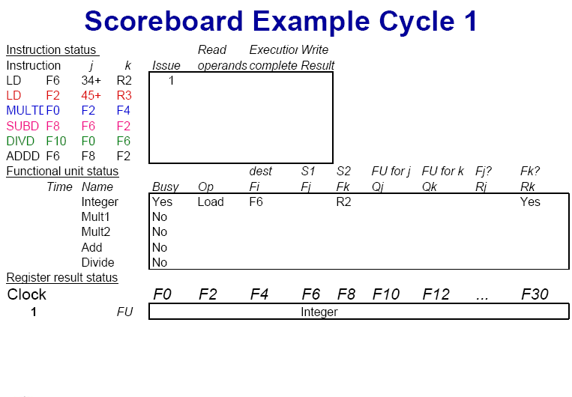
IMM34
Yes

Slide 39
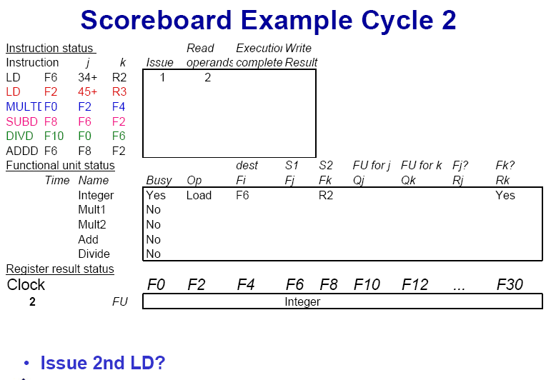
IMM34
Yes

Slide 40

IMM34
Yes

Slide 41
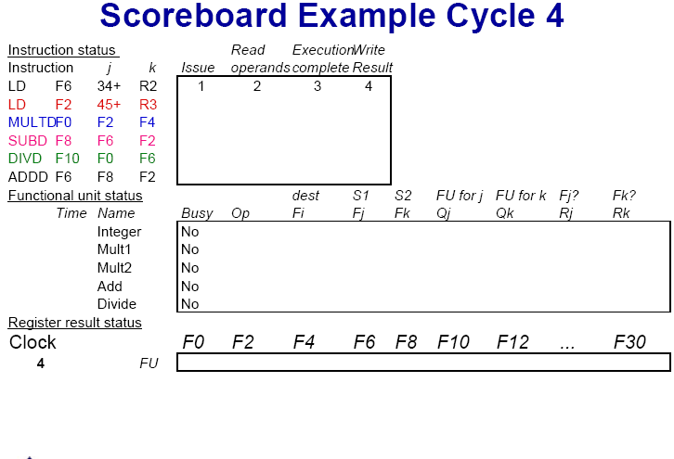

Slide 42
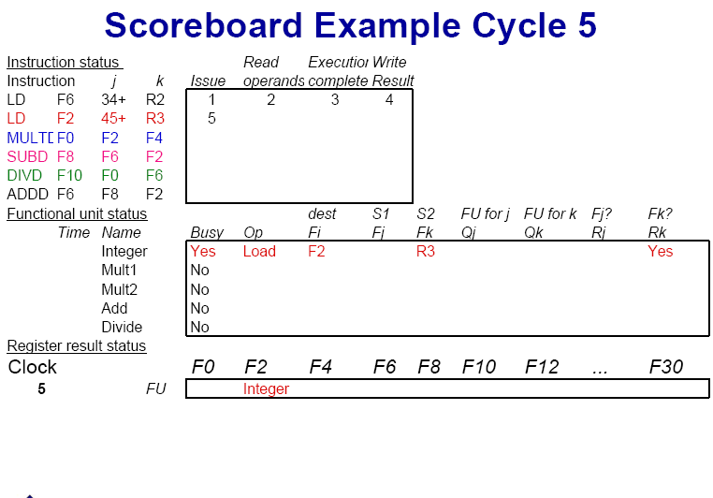

Slide 43
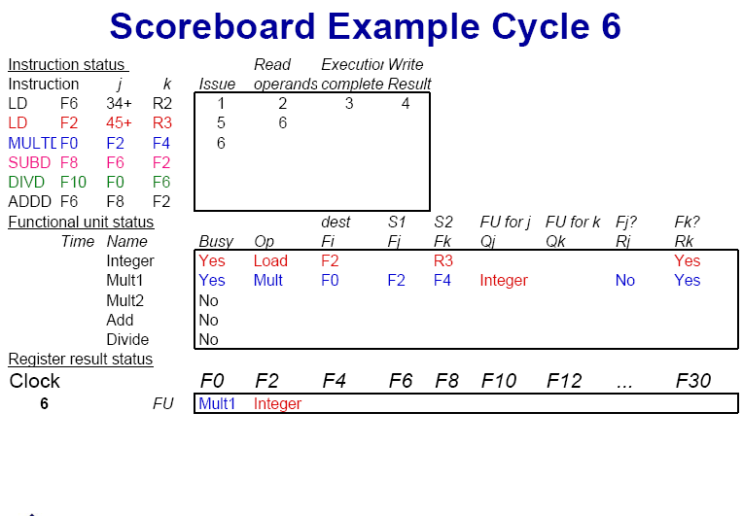

Slide 44
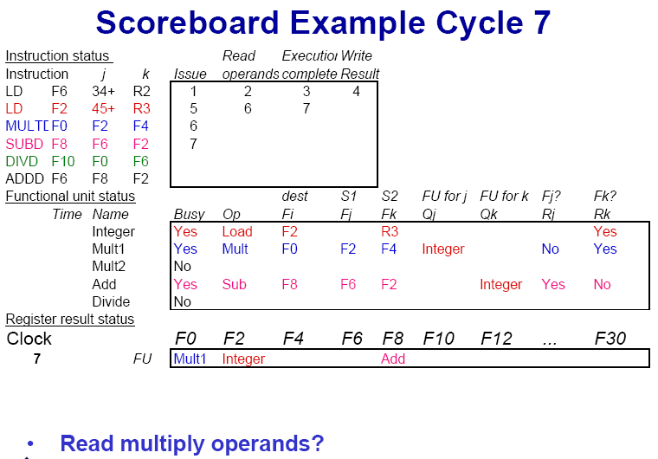

Slide 45
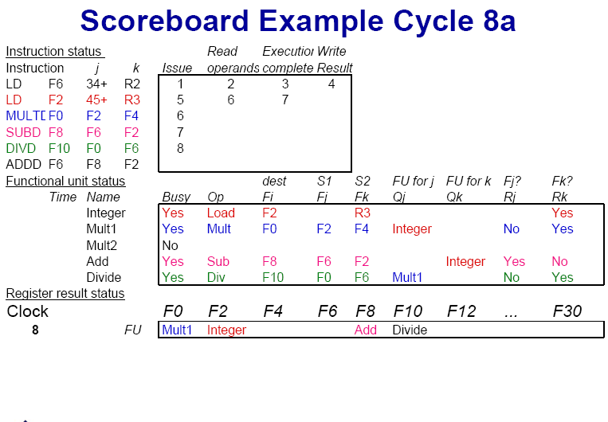

Slide 46
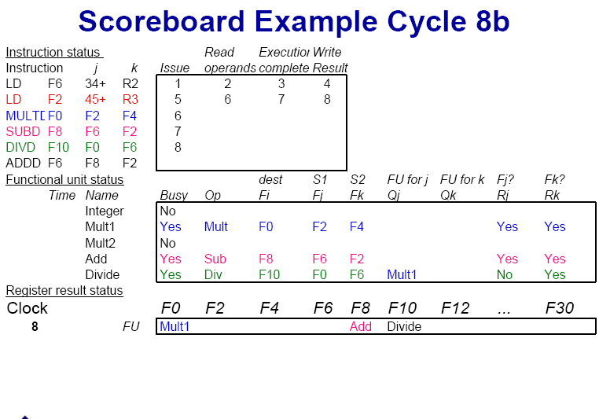

Slide 47
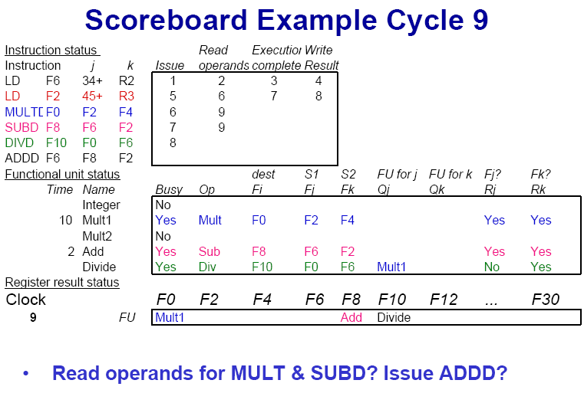

Slide 48
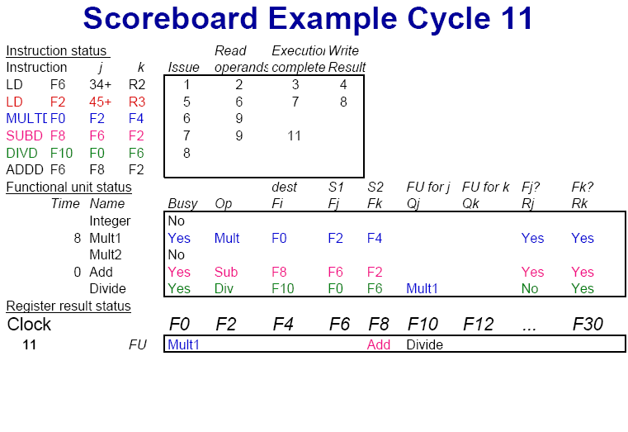

Slide 49
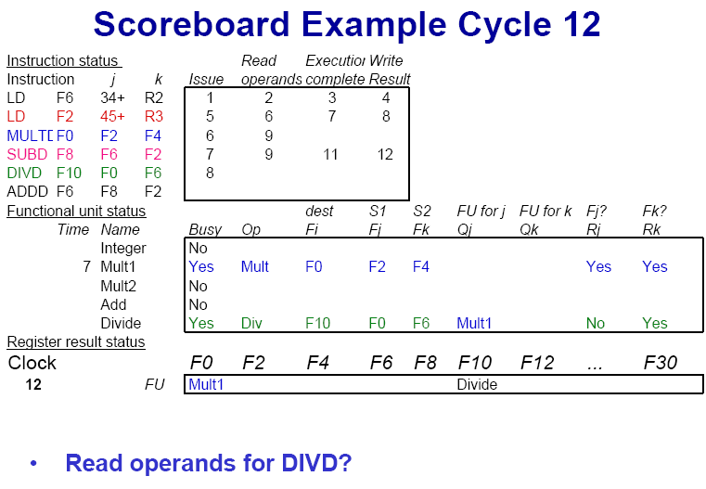

Slide 50
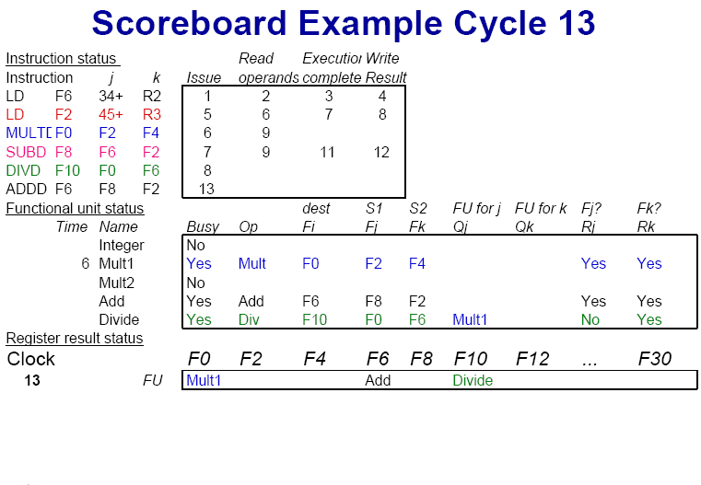

Slide 51


Slide 52
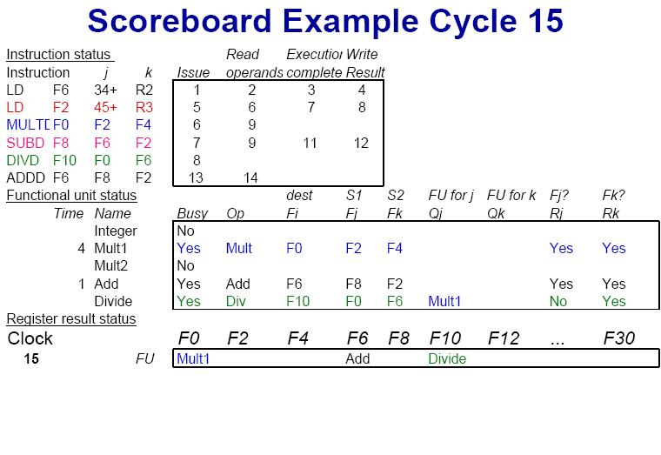

Slide 53
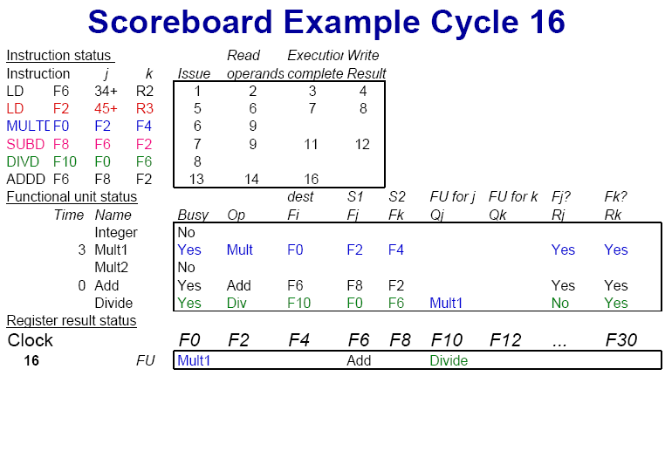

Slide 54
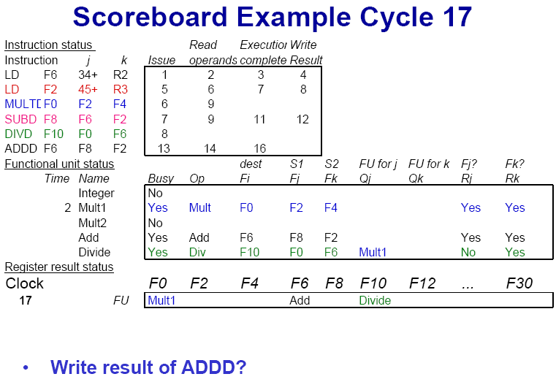

Slide 55
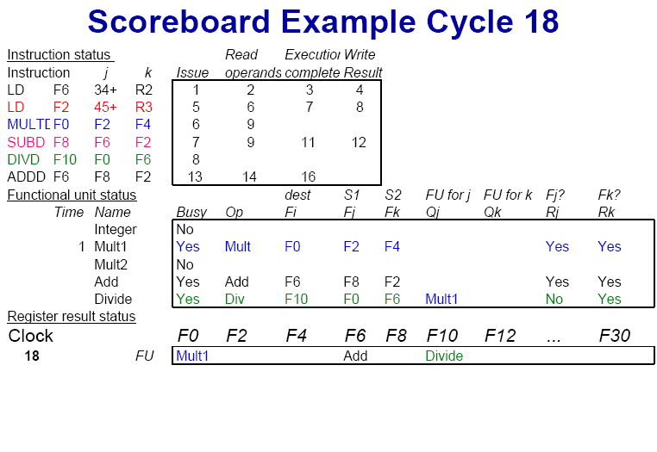

Slide 56


Slide 57
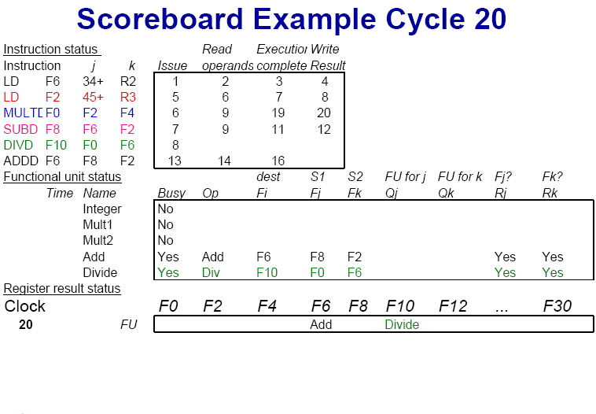

Slide 58
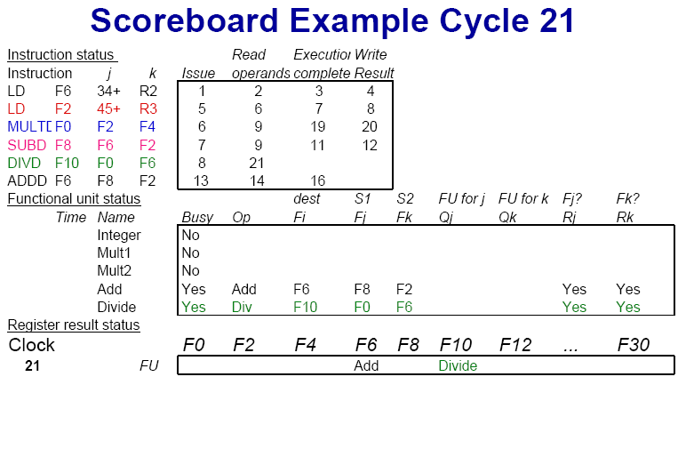

Slide 59
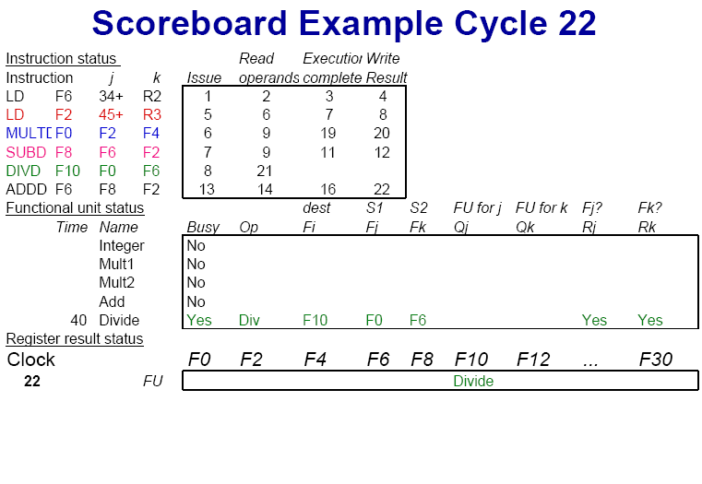

Slide 60
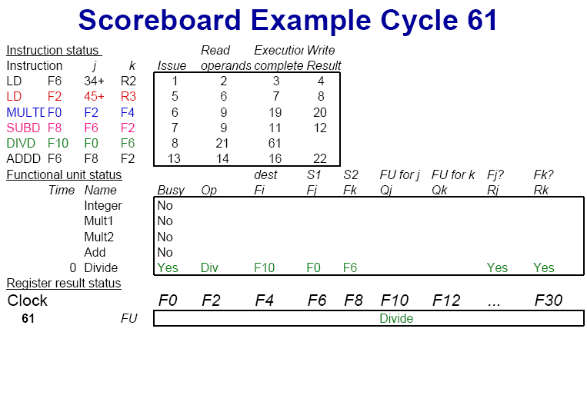

Slide 61
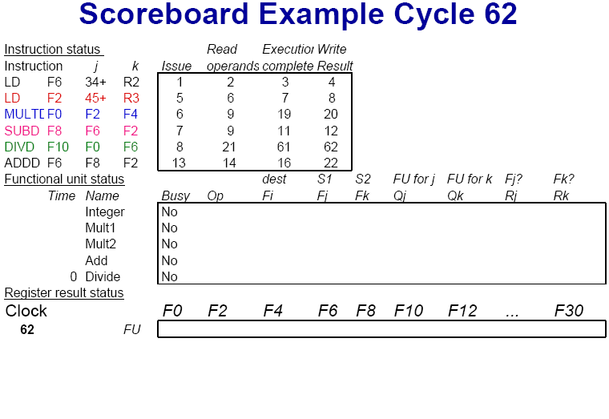

Slide 62
Limitations of Scoreboard-1
ILP
If we can't find independent instructions to execute, scoreboard (or any dynamic scheduling scheme for that matter) helps very little.
Size of the "issued" queue
This determines how far ahead the CPU can look for instructions to execute in parallel.
It's called the window.
For now, we assume that a window can not span a branch.
In other words, the window includes instructions only within basic blocks.

Slide 63
Limitations of Scoreboard-2
Number, types, and speed of the functional units
This determines how often a structural hazard results in stall.
The presence of anti-dependences and output dependences
WAR and WAW hazards limit the scoreboard more than RAW hazards, lead to WAR and WAW stalls.
RAW hazards are problems for any technique.
But WAR and WAW hazards can be solved in ways other than scoreboards.

Slide 64
Scoreboard vs. Tomasulo
特点
Multiple multiplier, etc. Funcs
Issue in order, Complete OOO
IF→ Issue, Ro
4 stages pipeline
Scoreboare centralized control
缺点
Stall when WAW, WAR
Fewer Func, unpipelined
Issue in order, Complete OOO
FP op. queue, Reservation station, LD/ST buffer, CDB
Reg. Rename→No WAW, WAR
Reduce structural hazard
RAW detection decentralized—reservation
CDB→ forwarding path

Slide 65
Dynamic Scheduling with Tomasulo’s Algorithm
For IBM 360/91 (before caches!)
Goal: High Performance without special compilers
Small number of floating point registers (4 in 360) prevented interesting compiler scheduling of operations
This led Tomasulo to try to figure out how to get more effective registers — renaming in hardware!
Why Study 1966 Computer?
The descendants of this have flourished!
Alpha 21264, HP 8000, MIPS 10000, Pentium III, PowerPC 604, …

Slide 66
Tomasulo Algorithm
Control & buffers distributed with Function Units (FU)
FU buffers called “reservation stations”; have pending operands
Registers in instructions replaced by values or pointers to reservation stations(RS); called register renaming ;
avoids WAR, WAW hazards
More reservation stations than registers, so can do optimizations compilers can’t
Results to FU from RS, not through registers, over Common Data Bus that broadcasts results to all FUs
Load and Stores treated as FUs with RSs as well
Integer instructions can go past branches, allowing FP ops beyond basic block in FP queue

Slide 67
Tomasulo Organization
From Intruction unit
From Mem
FP Op
Queue
FP Registers
Load Buffers
Load1
Load2
Load3
Load4
Load5
Load6
Store
Buffers
Add1
Add2
Add3
Mult1
Mult2
Reservation
Stations
To Mem
FP adders
FP multipliers
Common Data Bus (CDB)

Slide 68
Reservation Station Components
Reservation station:
Op: Operation to perform in the unit
Vj, Vk: Value of Source operands
Store buffers has V field, result to be stored
Qj, Qk: Reservation stations producing source registers (value to be written)
Note: Qj,Qk=0 => ready
Store buffers only have Qi for RS producing result
A: hold info. for memory address calculation
Busy: Indicates reservation station or FU is busy
Register result status—Indicates which functional unit will write each register, if one exists. Blank when no pending instructions that will write that register.

Slide 69
Three Stages of Tomasulo Algorithm
Issue—get instruction from FP Op Queue
If reservation station free (no structural hazard), control issues instr & sends operands (renames registers).
Execute—operate on operands (EX)
When both operands ready then execute; if not ready, watch Common Data Bus for result
Write result—finish execution (WB)
Write on Common Data Bus to all awaiting units; mark reservation station available

Slide 70
Data path
Normal data bus: data + destination (“go to” bus)
Common data bus: data + source (“come from” bus)
64 bits of data + 4 bits of Functional Unit source address
Write if matches expected Functional Unit (produces result)
Does the broadcast
Example speed: 3 clocks for Fl .pt. +,-; 10 for * ; 40 clks for /

Slide 71
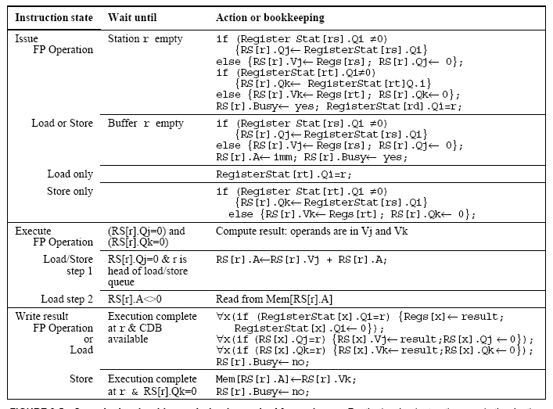

Slide 72
Tomasulo Example
Instruction stream
3 Load/Buffers
FU count
down
3 FP Adder R.S.
2 FP Mult R.S.
Clock cycle counter

Slide 73
Tomasulo Example Cycle 1

Slide 74
Tomasulo Example Cycle 2
Note: Can have multiple loads outstanding

Slide 75
Tomasulo Example Cycle 3
Note: registers names are removed (“renamed”) in Reservation Stations; MULT issued
Load1 completing; what is waiting for Load1?

Slide 76
Tomasulo Example Cycle 4
Load2 completing; what is waiting for Load2?

Slide 77
Tomasulo Example Cycle 5
Timer starts down for Add1, Mult1

Slide 78
Tomasulo Example Cycle 6
Issue ADDD here despite name dependency on F6?

Slide 79
Tomasulo Example Cycle 7

Slide 80
Tomasulo Example Cycle 8
Add1 (SUBD) completing; what is waiting for it?

Slide 81
Tomasulo Example Cycle 9

Slide 82
Tomasulo Example Cycle 10

Slide 83
Tomasulo Example Cycle 11

Slide 84
Tomasulo Example Cycle 12
Add2 (ADDD) completing; what is waiting for it?

Slide 85
Tomasulo Example Cycle 13
All simple operation are end here.

Slide 86
Tomasulo Example Cycle 14

Slide 87
Tomasulo Example Cycle 15
Mult1 (MULTD) completing; what is waiting for it?

Slide 88
Tomasulo Example Cycle 16
Just waiting for Mult2 (DIVD) to complete

Slide 89
Tomasulo Example Cycle 17

Slide 90
Tomasulo Example Cycle 55

Slide 91
Tomasulo Example Cycle 56
Mult2 (DIVD) is completing; what is waiting for it?

Slide 92
Tomasulo Example Cycle 57
Once again: In-order issue, out-of-order execution and out-of-order completion.

Slide 93
Tomasulo’s scheme offers 3 major advantages
The distribution of the hazard detection logic
distributed reservation stations and the CDB
If multiple instructions waiting on single result, & each instruction has other operand, then instructions can be released simultaneously by broadcast on CDB
If a centralized register file were used, the units would have to read their results from the registers when register buses are available.
The elimination of stalls for WAW and WAR hazards

Slide 94
Tomasulo Drawbacks
Complexity
delays of 360/91, MIPS 10000, Alpha 21264, IBM PPC 620 in CA:AQA 2/e, but not in silicon!
Many associative stores (CDB) at high speed
Performance limited by Common Data Bus
Each CDB must go to multiple functional units → high capacitance, high wiring density
Number of functional units that can complete per cycle limited to one!
Multiple CDBs → more FU logic for parallel assoc stores
Non-precise interrupts!
We will address this later

Slide 95
Why can Tomasulo overlap iterations of loops?
Register renaming
Multiple iterations use different physical destinations for registers (dynamic loop unrolling).
Reservation stations
Permit instruction issue to advance past integer control flow operations
Also buffer old values of registers - totally avoiding the WAR stall that we saw in the scoreboard.
Other perspective: Tomasulo building data flow dependency graph on the fly.

Slide 96
Tomasulo overlap iterations of loops
Register renaming
Multiple iterations use different physical destinations for registers (dynamic loop unrolling).
Reservation stations
Permit instruction issue to advance past integer control flow operations
Also buffer old values of registers - totally avoiding the WAR stall that we saw in the scoreboard.
Other perspective: Tomasulo building data flow dependency graph on the fly.

Slide 97
Loop Example

Slide 98
Tomasulo Loop Example
Loop: LD F0 0 R1
MULTD F4 F0 F2
SD F4 0 R1
SUBI R1 R1 #8
BNEZ R1 Loop
Assume Multiply takes 4 clocks
Assume first load takes 8 clocks (cache miss), second load takes 1 clock (hit)
To be clear, will show clocks for SUBI, BNEZ
Reality: integer instructions ahead

Slide 99
Loop Example Cycle 1

Slide 100
Loop Example Cycle 2

Slide 101
Loop Example Cycle 3
Implicit renaming sets up “DataFlow” graph

Slide 102
Loop Example Cycle 4
Dispatching SUBI Instruction

Slide 103
Loop Example Cycle 5
And, BNEZ instruction

Slide 104
Loop Example Cycle 6
Notice that F0 never sees Load from location 80

Slide 105
Loop Example Cycle 7
Register file completely detached from computation
First and Second iteration completely overlapped

Slide 106
Loop Example Cycle 8

Slide 107
Loop Example Cycle 9
Load1 completing: who is waiting?
Note: Dispatching SUBI

Slide 108
Loop Example Cycle 10
Load2 completing: who is waiting?
Note: Dispatching BNEZ

Slide 109
Loop Example Cycle 11
Next load in sequence

Slide 110
Loop Example Cycle 12
Why not issue third multiply?

Slide 111
Loop Example Cycle 13

Slide 112
Loop Example Cycle 14
Mult1 completing. Who is waiting?

Slide 113
Loop Example Cycle 15
Mult2 completing. Who is waiting?

Slide 114
Loop Example Cycle 16

Slide 115
Loop Example Cycle 17

Slide 116
Loop Example Cycle 18

Slide 117
Loop Example Cycle 19

Slide 118
Loop Example Cycle 20

Slide 119
Summary of Tomasulo Algorithm
Reservations stations: implicit register renaming to larger set of registers + buffering source operands
Prevents registers as bottleneck
Avoids WAR, WAW hazards of Scoreboard
Allows loop unrolling in HW
Not limited to basic blocks
(integer units gets ahead, beyond branches)
Lasting Contributions
Dynamic scheduling
Register renaming
Load/store disambiguation
360/91 descendants are Pentium III; PowerPC 604; MIPS R10000; HP-PA 8000; Alpha 21264

Slide 120
What about Precise Interrupts?
Tomasulo had: In-order issue, out-of-order execution, and out-of-order completion
Need to “fix” the out-of-order completion aspect so that we can find precise breakpoint in instruction stream.
Speculation，Reorder buffer ! (later)

Slide 121
Scoreboard vs. Tomasulo
特点
Multiple multiplier, etc. Funcs
Issue in order, Complete OOO
IF→ Issue, Ro
4 stages pipeline
Scoreboare centralized control
缺点
Stall when WAW, WAR
Fewer Func, unpipelined
Issue in order, Complete OOO
FP op. queue, Reservation station, LD/ST buffer, CDB
Reg. Rename→No WAW, WAR
Reduce structural hazard
RAW detection decentralized—reservation
CDB→ forwarding path
Can Scoreboard avoid WAW, WAR with Reg. Rename?

Slide 122
Scoreboard Pipeline stage description
Issue: a instruction is issued when
The functional unit is available and
No other active instruction has the same destination register.
Avoid structural hazard and WAW hazard
Read Operands (RD)
The read operation is delayed until both the operands are available.
This means that no previously issued but not completed instruction has the operand as its destination.
This resolves RAW hazards dynamically
Execution (EX)
Notify the scoreboard when completed so the functional unit can be reused.
Write result (WB)
The scoreboard checks for WAR hazards and stalls the completing instruction if necessary.

Slide 123
The scoreboard algorithm
Scoreboard-takes full responsibility for instruction issue and execution
Create the dependence records
Decide when to fetch the operand
Decide when to enter execution
Decide when the result can be written into the register file
Three data structure
Instruction status:
which of the four steps the instruction is in
Functional unit status: busy, op, Fi, Fj, Fk, Qj, Qk, Rj, Rk
Register result status:
which functional unit will write that register

Slide 124
Explicit Register Renaming
Make use of a physical register file that is larger than number of registers specified by ISA
Key insight: Allocate a new physical destination register for every instruction that writes
Very similar to a compiler transformation called Static Single Assignment (SSA) form — but in hardware!
Removes all chance of WAR or WAW hazards
Like Tomasulo, good for allowing full out-of-order completion
Like hardware-based dynamic compilation?
Mechanism? Keep a translation table:
ISA register → physical register mapping
When register written, replace entry with new register from freelist.
Physical register becomes free when not used by any active instructions

Slide 125
Advantages of Explicit Renaming
Decouples renaming from scheduling:
Pipeline can be exactly like “standard” MIPS pipeline (perhaps with multiple operations issued per cycle)
Or, pipeline could be Tomasulo-like or a scoreboard, etc.
Standard forwarding or bypassing could be used
Allows data to be fetched from single register file
No need to bypass values from reservation station or reorder buffer
This can be important for balancing pipeline

Slide 126
Adv. Explicit Renaming (cont.)
Many processors use a variant of this technique:
R10000, Alpha 21264, HP PA8000
Another way to get precise interrupt points:
All that needs to be “undone” for precise break point is to undo the table mappings
Provides an interesting mix between reorder buffer and future file
Results are written immediately back to register file
Registers names are “freed” in program order (by ROB)

Slide 127
Explicit Renaming Support Includes:
Rapid access to a table of translations
A physical register file that has more registers than specified by the ISA
Ability to figure out which physical registers are free.
No free registers → stall on issue
Thus, register renaming doesn’t require reservation stations. However:
Many modern architectures use explicit register renaming + Tomasulo-like reservation stations to control execution.
Two Questions:
How do we manage the “free list”?
How does Explicit Register Renaming mix with Precise Interrupts?

Slide 128
Explicit register renaming: (R1000 Style)
P0
P2
P4
F6
F8
P10
P12
P14
P16
P18
P20
P22
P24
p26
P28
P30
Current Map Table
Done?
Newest
…
P32
P34
P36
P38
P60
P62
Freelist
Oldest
Physical register file larger than ISA register file
On issue, each instruction that modifies a register is allocated new physical register from freelist

Slide 129
Explicit register renaming: (R1000 Style)
P32
P2
P4
F6
F8
P10
P12
P14
P16
P18
P20
P22
P24
p26
P28
P30
Current Map Table
Done?
Newest
…
P34
P36
P38
P40
P60
P62
Freelist
F0
P0
LD P32,10(R2)
N
Oldest
Note that physical register P0 is “dead” (or not “live”) past the point of this load.
When we go to commit the load, we free up

Slide 130
Explicit register renaming: (R1000 Style)
P32
P2
P4
F6
F8
P34
P12
P14
P16
P18
P20
P22
P24
p26
P28
P30
Current Map Table
Done?
Newest
…
P36
P38
P40
P42
P60
P62
Freelist
F10
P10
ADDD P34,P4,P32
N
F0
P0
LD P32,10(R2)
N
Oldest

Slide 131
Explicit register renaming: (R1000 Style)
P32
P36
P4
F6
F8
P34
P12
P14
P16
P18
P20
P22
P24
p26
P28
P30
Current Map Table
Done?
--
Newest
…
P38
P40
P44
P48
P60
P62
--
BNE P36,<…>
N
F2
P2
DIVD P36,P34,P6
N
Freelist
F10
P10
ADDD P34,P4,P32
N
F0
P0
LD P32,10(R2)
N
Oldest
P32
P36
P4
F6
F8
P34
P12
P14
P16
P18
P20
P22
P24
p26
P28
P30
…
P38
P40
P44
P48
P60
P62
Checkpoint at BNE instruction

Slide 132
Explicit register renaming: (R1000 Style)
P40
P36
P38
F6
F8
P34
P12
P14
P16
P18
P20
P22
P24
p26
P28
P30
Current Map Table
Done?
--
ST 0(R3),P40
Y
Newest
F0
P32
ADDD P40,P38,P6
Y
F4
P4
LD P38,0(R3)
Y
…
P42
P44
P48
P50
P0
P10
--
BNE P36,<…>
N
F2
P2
DIVD P36,P34,P6
N
Freelist
F10
P10
ADDD P34,P4,P32
y
F0
P0
LD P32,10(R2)
y
Oldest
P32
P36
P4
F6
F8
P34
P12
P14
P16
P18
P20
P22
P24
p26
P28
P30
…
P38
P40
P44
P48
P60
P62
Checkpoint at BNE instruction

Slide 133
Explicit register renaming: (R1000 Style)
P32
P36
P4
F6
F8
P34
P12
P14
P16
P18
P20
P22
P24
p26
P28
P30
Current Map Table
Done?
Newest
…
P38
P40
P44
P48
P60
P62
F2
P2
DIVD P36,P34,P6
N
Freelist
F10
P10
ADDD P34,P4,P32
y
F0
P0
LD P32,10(R2)
y
Oldest
Speculation error fixed by restoring map table and freelist
P32
P36
P4
F6
F8
P34
P12
P14
P16
P18
P20
P22
P24
p26
P28
P30
…
P38
P40
P44
P48
P60
P62
Checkpoint at BNE instruction

Slide 134
Can we use explicit register renaming with scoreboard?
FP Mult
FP Mult
Registers
FP Divide
Functional Units
FP Add
Integer
SCOREBOARD
Memory
Rename
Table

Slide 135
Four Stages of Scoreboard Control With Explicit Renaming
Issue—decode instructions & check for structural hazards & allocate new physical register for result
Instructions issued in program order (for hazard checking)
Don’t issue if no free physical registers
Don’t issue if structural hazard
Read operands—wait until no hazards, read operands
All real dependencies (RAW hazards) resolved in this stage, since we wait for instructions to write back data.
Execution—operate on operands
The functional unit begins execution upon receiving operands. When the result is ready, it notifies the scoreboard
Write result—finish execution
Note: No checks for WAR or WAW hazards!

Slide 136
Scoreboard With Explicit Renaming
Initialized Rename Table

Slide 137
Renamed Scoreboard 1
Each instruction allocates free register
Similar to single-assignment compiler transformation

Slide 138
Renamed Scoreboard 2

Slide 139
Renamed Scoreboard 3

Slide 140
Renamed Scoreboard 3
Next step Int1 will write result, where need
the value?

Slide 141
Renamed Scoreboard 5
Next step Int2 will write result, where need
the value?

Slide 142
Renamed Scoreboard 6
Why ADDD not issue ? Structure hazard ! Adder is occupied by with SUBD.

Slide 143
Renamed Scoreboard 7

Slide 144
Renamed Scoreboard 8
Next step Adder will complete execution

Slide 145
Renamed Scoreboard 9
Next step Adder will write result, where need the value?

Slide 146
Renamed Scoreboard 10
Adder is cleared, so ADDD can be issued next cycle.

Slide 147
Renamed Scoreboard11
Notice that P32 not listed in Rename Table
Still live. Must not be reallocated by accident
WAR dependence
WAR Hazard gone!

Slide 148
Renamed Scoreboard 12

Slide 149
Renamed Scoreboard 13

Slide 150
Renamed Scoreboard 14

Slide 151
Renamed Scoreboard 15

Slide 152
Renamed Scoreboard 16

Slide 153
Renamed Scoreboard 17

Slide 154
Renamed Scoreboard 18

Slide 155
Renamed Scoreboard 19

Slide 156
Summary #2
Explicit Renaming: more physical registers than needed by ISA.
Separates renaming from scheduling
Opens up lots of options for resolving RAW hazards
Rename table: tracks current association between architectural registers and physical registers
Potentially complicated rename table management

Slide 157

THANK YOU
THANK YOU

