Slide 1

Computer Architecture ----A Quantitative Approach
陈文智
浙江大学计算机学院
chenwz@zju.edu.cn

Slide 2
课程简介
《计算机体系结构》是计算机专业的一门重要专业课，从计算机系统角度介绍计算机设计原理和设计方法。课程内容包括：
1）计算机体系结构基本概念、计算机设计生命周期、量化设计原理和计算机性能评价方法；
2）存储体系改进性能的方法，包括cache的提高性能的方法、存储器的性能提升、虚拟存储器和虚拟机；
3）开发指令级并行性提高性能：转移预测、动态调度、猜测执行、多发射处理器等；
4）利用数据级并行性提高性能：向量处理器、SIMD以及GPU；
5）利用线程级并行性提高性能：多处理器结构、Cache一致性以及同步。

Slide 3
课程简介
在学习理论同时，要求掌握硬件设计工具和环境，在Vivado环境下，用Verilog语言进行硬件设计实现，并在FPGA板上验证正确性。实验包括：实现支持RISC V 32i指令的带forwarding和Predict-not-taken的流水线CPU、支持精确中断、实现2路组关联Cache并与应用于指令流水线；进一步扩展流水线以支持多周期的复杂操作；最终实现动态调度的流水线CPU。

Slide 4
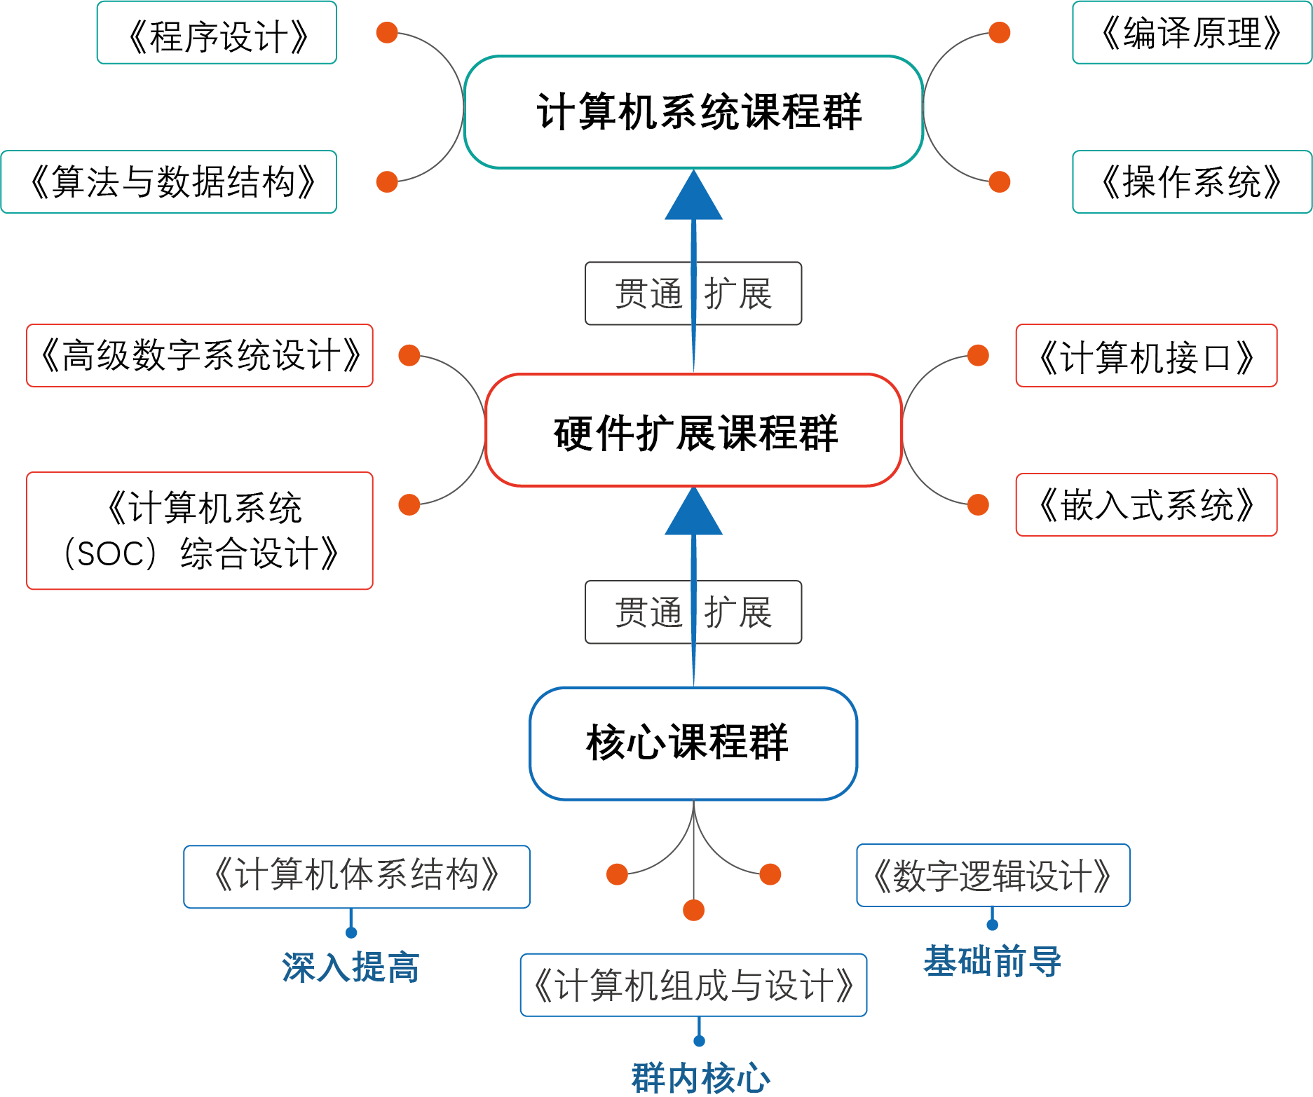
改革中的课程体系
Notes:
逻辑与计算机设计基础，4.0， 3.0-2.0， 二秋冬
计算机组成，4.5，3.5-2.0，二春夏
计算机体系结构，3.5， 2.5-2.0， 三春夏
汇编与接口， 3.0，3.0-0.0，三秋冬
接口实验， 1.5， 0-3.0，三秋冬
编译原理，2.0， 2.0-0， 三春
编译系统设计， 2.0， 1.0-2.0，三夏
操作系统原理，3.0，3.0-0，三秋冬
操作系统实验， 2.0，1-2.0，三冬
Soc／计算机系统设计，3.0， 1.0-4.0， 三夏

Slide 5
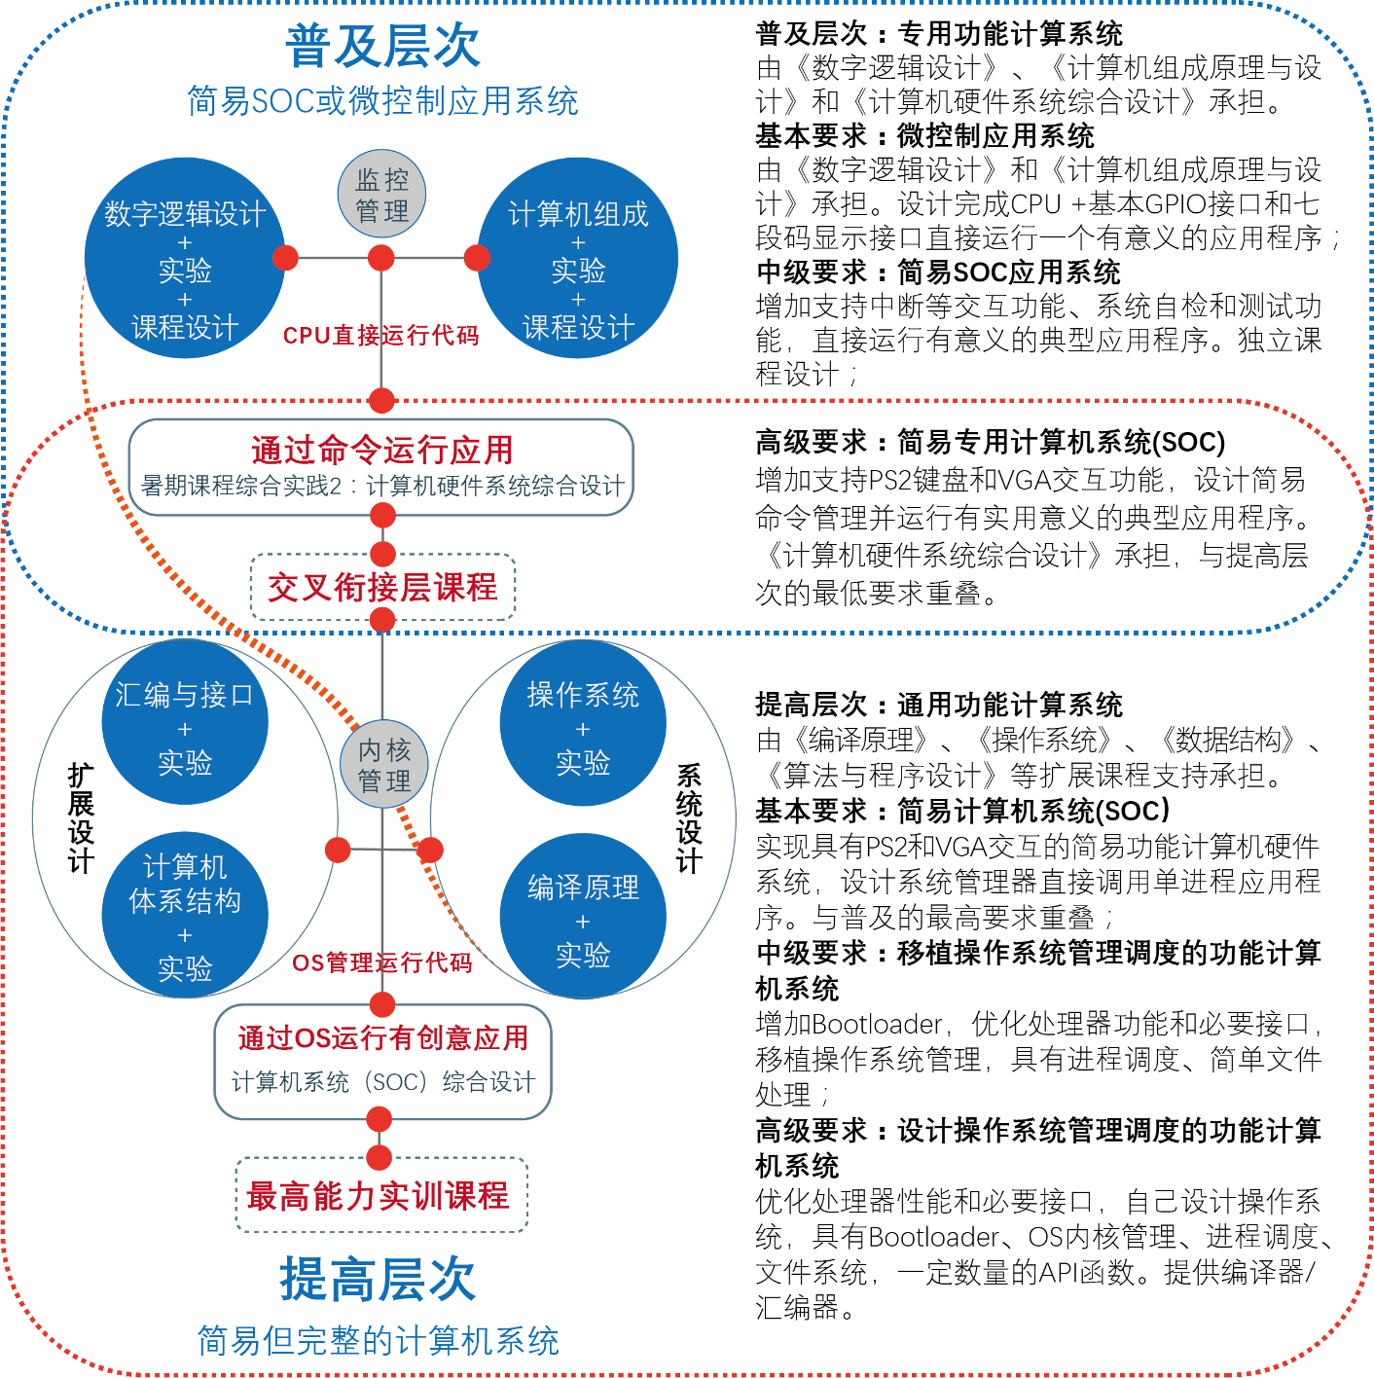
计算机系统能力培养总体思路

Slide 6





改革中的实验体系
自主研发统一的实验平台，建立实验成果库，构建系列化、递进式的实验体系
渐近的计算机硬件系统
Simple but Rich
CACHE
MMU
动态流水
ISA扩展
中断处理
数字逻辑→计算机组成(CPU) →体系结构(流水CPU) →简易计算机系统
高级数字系统设计→计算机接口 →SOC设计→计算机系统设计→多核系统设计
→嵌入式系统设计
操作系统 + 编译系统 + 应用软件

Slide 7
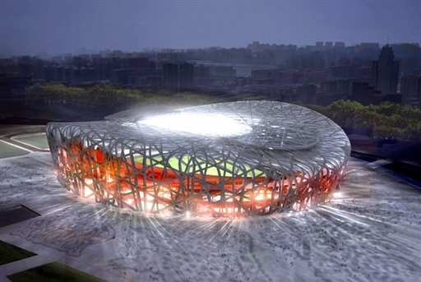
What is Computer Architecture

Slide 8
What is Computer Architecture
Application
Operating
System
Compiler
Firmware
Instruction Set
Architecture
Instr. Set Proc.
I/O system
Datapath & Control
Digital Design
Circuit Design
Layout

Slide 9
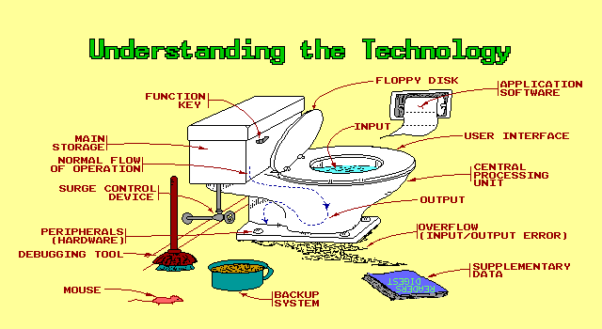
What is Computer Architecture

Slide 10
What is Computer Architecture
Difference with Instruction Set
Difference with Computer Organization
Difference with Computer Implementation
Categories of Computer science

Slide 11
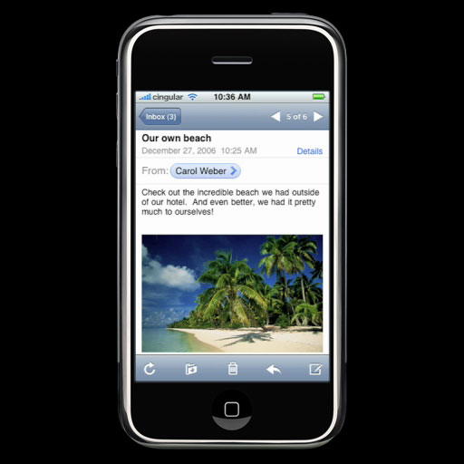
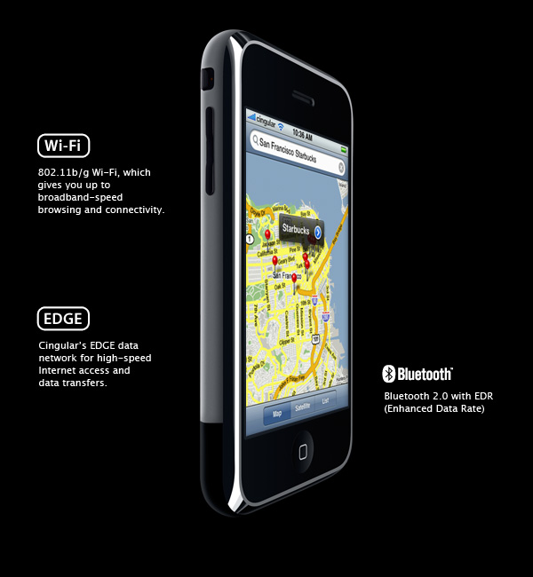
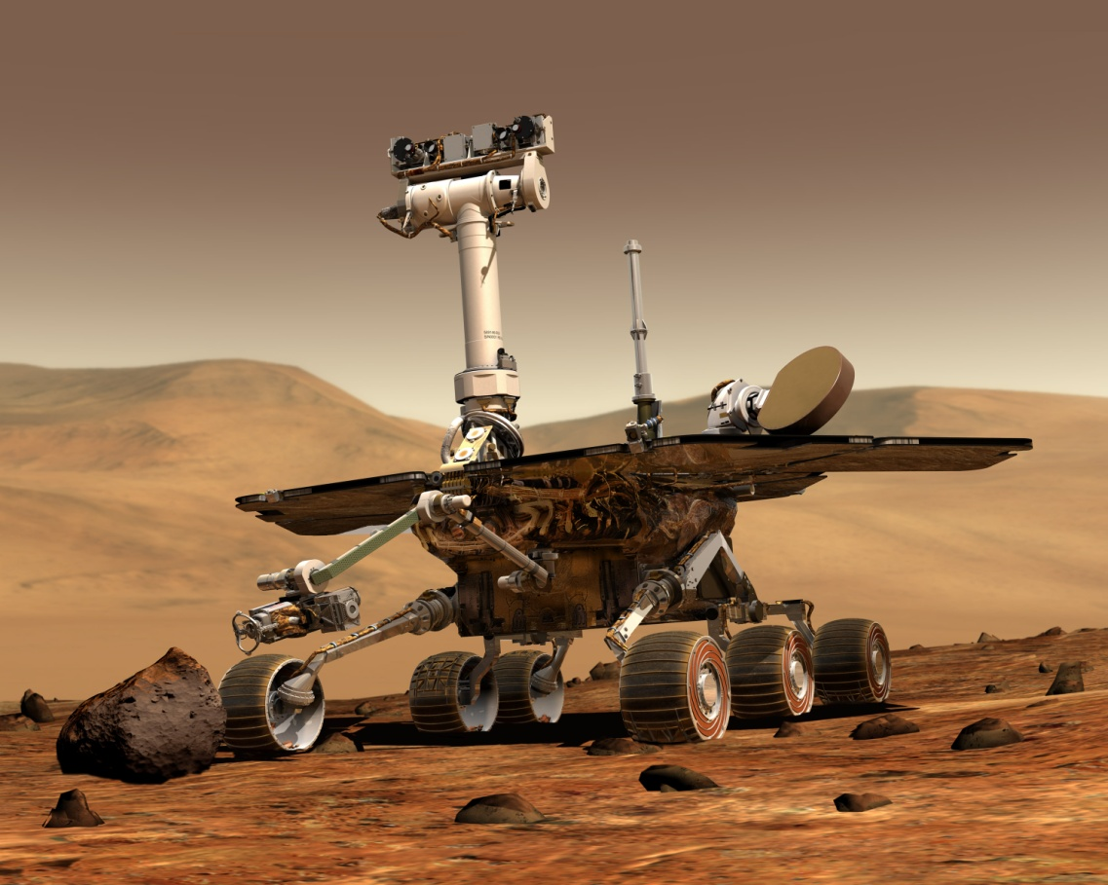
Recent research fields
Develop the performance of single processor
More transistors, less feature size/onechip;
High frequency 2.0-3.5GHz;
Low voltage 0.9-1.2V
Embedded Computer System
Reconfigurable computer Architecture
Power-aware computer Architecture

Slide 12
on-chip multilevel cache & pre-fetch buffer
Context switch by hardware
Massive on-chip DRAM
Depth pipeline 8-12→ 20
Advanced Super-scalar：16-32 instr./clock cycle
Super-speculative Processor：fine-grain heavy speculation
Trace Processor
Vector Intelligent RAM Processor, V-IRAM
on-chip multiprocessor
Instruction-level Distributed Processing ( ILDP)
Clustered Dependence-based Architecture

Slide 13
Multi-processor architecture based on micro-processor
Availability maintainability scalability
HA
RAID
Reconfigurable

Slide 14
New apparatus to make processor
Light computer
Molecule computer
DNA computer

Slide 15
Top500, HPC
Rank | Site | Computer
1 | DOE/NNSA/LANL United States | Roadrunner - BladeCenter QS22/LS21 Cluster, PowerXCell 8i 3.2 Ghz / Opteron DC 1.8 GHz , Voltaire Infiniband IBM
2 | Oak Ridge National Laboratory United States | Jaguar - Cray XT5 QC 2.3 GHz Cray Inc.
3 | NASA/Ames Research Center/NAS United States | Pleiades - SGI Altix ICE 8200EX, Xeon QC 3.0/2.66 GHz SGI
4 | DOE/NNSA/LLNL United States | BlueGene/L - eServer Blue Gene Solution IBM
5 | Argonne National Laboratory United States | Blue Gene/P Solution IBM
6 | Texas Advanced Computing Center/Univ. of Texas United States | Ranger - SunBlade x6420, Opteron QC 2.3 Ghz, Infiniband Sun Microsystems
7 | NERSC/LBNL United States | Franklin - Cray XT4 QuadCore 2.3 GHz Cray Inc.
8 | Oak Ridge National Laboratory United States | Jaguar - Cray XT4 QuadCore 2.1 GHz Cray Inc.
9 | NNSA/Sandia National Laboratories United States | Red Storm - Sandia/ Cray Red Storm, XT3/4, 2.4/2.2 GHz dual/quad core Cray Inc.
10 | Shanghai Supercomputer Center China | Dawning 5000A - Dawning 5000A, QC Opteron 1.9 Ghz, Infiniband, Windows HPC 2008 Dawning

Slide 16
TOP 10, 11/2009
1 | Jaguar - Cray XT5-HE Opteron Six Core 2.6 GHz
2 | Roadrunner - BladeCenter QS22/LS21 Cluster, PowerXCell 8i 3.2 Ghz / Opteron DC 1.8 GHz, Voltaire Infiniband
3 | Kraken XT5 - Cray XT5-HE Opteron Six Core 2.6 GHz
4 | JUGENE - Blue Gene/P Solution
5 | Tianhe-1 - NUDT TH-1 Cluster, Xeon E5540/E5450, ATI Radeon HD 4870, Infiniband
6 | Pleiades - SGI Altix ICE 8200EX, Xeon QC 3.0 GHz/Nehalem EP 2.93 Ghz
7 | BlueGene/L - eServer Blue Gene Solution
8 | Blue Gene/P Solution
9 | Ranger - SunBlade x6420, Opteron QC 2.3 Ghz, Infiniband
10 | Red Sky - Sun Blade x6275, Xeon X55xx 2.93 Ghz, Infiniband

Slide 17
TOP 10, 11/2010
1 | Tianhe-1A - NUDT TH MPP, X5670 2.93Ghz 6C, NVIDIA GPU, FT-1000 8C
2 | Jaguar - Cray XT5-HE Opteron 6-core 2.6 GHz
3 | Nebulae - Dawning TC3600 Blade, Intel X5650, NVidia Tesla C2050 GPU
4 | TSUBAME 2.0 - HP ProLiant SL390s G7 Xeon 6C X5670, Nvidia GPU, Linux/Windows
5 | Hopper - Cray XE6 12-core 2.1 GHz
6 | Tera-100 - Bull bullx super-node S6010/S6030
7 | Roadrunner - BladeCenter QS22/LS21 Cluster, PowerXCell 8i 3.2 Ghz / Opteron DC 1.8 GHz, Voltaire Infiniband
8 | Kraken XT5 - Cray XT5-HE Opteron 6-core 2.6 GHz
9 | JUGENE - Blue Gene/P Solution
10 | Cielo - Cray XE6 8-core 2.4 GHz

Slide 18
TOP 10, 11/2011
1 | K computer, SPARC64 VIIIfx 2.0GHz, Tofu interconnect
2 | NUDT YH MPP, Xeon X5670 6C 2.93 GHz, NVIDIA 2050
3 | Cray XT5-HE Opteron 6-core 2.6 GHz
4 | Dawning TC3600 Blade, Intel X5650, NVidia Tesla C2050 GPU
5 | HP ProLiant SL390s G7 Xeon 6C X5670, Nvidia GPU, Linux/Windows
6 | Cray XE6, Opteron 6136 8C 2.40GHz, Custom
7 | SGI Altix ICE 8200EX/8400EX, Xeon HT QC 3.0/Xeon 5570/5670 2.93 Ghz, Infiniband
8 | Cray XE6, Opteron 6172 12C 2.10GHz, Custom
9 | Bull bullx super-node S6010/S6030
10 | BladeCenter QS22/LS21 Cluster, PowerXCell 8i 3.2 Ghz / Opteron DC 1.8 GHz, Voltaire Infiniband

Slide 19
TOP 10, 11/2017
Rank | System | Cores | Rmax (TFlop/s) | Rpeak (TFlop/s) | Power (kW)
1 | Sunway TaihuLight - Sunway MPP, Sunway SW26010 260C 1.45GHz, Sunway , NRCPC | 10,649,600 | 93,014.6 | 125,435.9 | 15,371
2 | Tianhe-2A - TH-IVB-FEP Cluster, Intel Xeon E5-2692 12C 2.200GHz, TH Express-2, Intel Xeon Phi 31S1P , NUDT | 3,120,000 | 33,862.7 | 54,902.4 | 17,808
3 | Piz Daint - Cray XC50, Xeon E5-2690v3 12C 2.6GHz, Aries interconnect , NVIDIA Tesla P100 , Cray Inc. | 361,760 | 19,590.0 | 25,326.3 | 2,272
4 | Gyoukou - ZettaScaler-2.2 HPC system, Xeon D-1571 16C 1.3GHz, Infiniband EDR, PEZY-SC2 700Mhz , ExaScaler | 19,860,000 | 19,135.8 | 28,192.0 | 1,350
5 | Titan - Cray XK7, Opteron 6274 16C 2.200GHz, Cray Gemini interconnect, NVIDIA K20x , Cray Inc. | 560,640 | 17,590.0 | 27,112.5 | 8,209
6 | Sequoia - BlueGene/Q, Power BQC 16C 1.60 GHz, Custom , IBM | 1,572,864 | 17,173.2 | 20,132.7 | 7,890
7 | Trinity - Cray XC40, Intel Xeon Phi 7250 68C 1.4GHz, Aries interconnect , Cray Inc. | 979,968 | 14,137.3 | 43,902.6 | 3,844
8 | Cori - Cray XC40, Intel Xeon Phi 7250 68C 1.4GHz, Aries interconnect , Cray Inc. | 622,336 | 14,014.7 | 27,880.7 | 3,939
9 | Oakforest-PACS - PRIMERGY CX1640 M1, Intel Xeon Phi 7250 68C 1.4GHz, Intel Omni-Path , Fujitsu | 556,104 | 13,554.6 | 24,913.5 | 2,719
10 | K computer, SPARC64 VIIIfx 2.0GHz, Tofu interconnect , Fujitsu | 705,024 | 10,510.0 | 11,280.4 | 12,660

Slide 20
TOP 10, 06/2019
Rank | System | Cores | Rmax (TFlop/s) | Rpeak (TFlop/s) | Power (kW)
1 | Summit - IBM Power System AC922, IBM POWER9 22C 3.07GHz, NVIDIA Volta GV100, Dual-rail Mellanox EDR Infiniband , IBM | 2,414,592 | 148,600.00 | 200,794.90 | 10,096
2 | Sierra - IBM Power System S922LC, IBM POWER9 22C 3.1GHz, NVIDIA Volta GV100, Dual-rail Mellanox EDR Infiniband , IBM / NVIDIA / Mellanox | 1,572,480 | 94,640.00 | 125,712.00 | 7,438
3 | Sunway TaihuLight - Sunway MPP, Sunway SW26010 260C 1.45GHz, Sunway , NRCPC | 10,649,600 | 93,014.60 | 125,435.90 | 15,371
4 | Tianhe-2A - TH-IVB-FEP Cluster, Intel Xeon E5-2692v2 12C 2.2GHz, TH Express-2, Matrix-2000 , NUDT | 4,981,760 | 61,444.50 | 100,678.70 | 18,482
5 | Frontera - Dell C6420, Xeon Platinum 8280 28C 2.7GHz, Mellanox InfiniBand HDR , Dell EMC | 448,448 | 23,516.40 | 38,745.90
6 | Piz Daint - Cray XC50, Xeon E5-2690v3 12C 2.6GHz, Aries interconnect , NVIDIA Tesla P100 , Cray Inc. | 387,872 | 21,230.00 | 27,154.30 | 2,384
7 | Trinity - Cray XC40, Xeon E5-2698v3 16C 2.3GHz, Intel Xeon Phi 7250 68C 1.4GHz, Aries interconnect , Cray Inc. | 979,072 | 20,158.70 | 41,461.20 | 7,578
8 | AI Bridging Cloud Infrastructure (ABCI) - PRIMERGY CX2570 M4, Xeon Gold 6148 20C 2.4GHz, NVIDIA Tesla V100 SXM2, Infiniband EDR , Fujitsu | 391,680 | 19,880.00 | 32,576.60 | 1,649
9 | SuperMUC-NG - ThinkSystem SD650, Xeon Platinum 8174 24C 3.1GHz, Intel Omni-Path , Lenovo | 305,856 | 19,476.60 | 26,873.90
10 | Lassen - IBM Power System S922LC, IBM POWER9 22C 3.1GHz, Dual-rail Mellanox EDR Infiniband, NVIDIA Tesla V100 , IBM / NVIDIA / Mellanox | 288,288 | 18,200.00 | 23,047.20

Slide 21
TOP, 06/2021
Rank | System | Cores | Rmax (TFlop/s) | Rpeak (TFlop/s) | Power (kW)
1 | Supercomputer Fugaku - Supercomputer Fugaku, A64FX 48C 2.2GHz, Tofu interconnect D, Fujitsu | 7,630,848 | 442,010.0 | 537,212.0 | 29,899
2 | Summit - IBM Power System AC922, IBM POWER9 22C 3.07GHz, NVIDIA Volta GV100, Dual-rail Mellanox EDR Infiniband, IBM | 2,414,592 | 148,600.0 | 200,794.9 | 10,096
3 | Sierra - IBM Power System AC922, IBM POWER9 22C 3.1GHz, NVIDIA Volta GV100, Dual-rail Mellanox EDR Infiniband, IBM / NVIDIA / Mellanox | 1,572,480 | 94,640.0 | 125,712.0 | 7,438
4 | Sunway TaihuLight - Sunway MPP, Sunway SW26010 260C 1.45GHz, Sunway, NRCPC | 10,649,600 | 93,014.6 | 125,435.9 | 15,371
5 | Perlmutter - HPE Cray EX235n, AMD EPYC 7763 64C 2.45GHz, NVIDIA A100 SXM4 40 GB, Slingshot-10, HPE | 706,304 | 64,590.0 | 89,794.5 | 2,528
6 | Selene - NVIDIA DGX A100, AMD EPYC 7742 64C 2.25GHz, NVIDIA A100, Mellanox HDR Infiniband, Nvidia | 555,520 | 63,460.0 | 79,215.0 | 2,646
7 | Tianhe-2A - TH-IVB-FEP Cluster, Intel Xeon E5-2692v2 12C 2.2GHz, TH Express-2, Matrix-2000, NUDT | 4,981,760 | 61,444.5 | 100,678.7 | 18,482
8 | JUWELS Booster Module - Bull Sequana XH2000 , AMD EPYC 7402 24C 2.8GHz, NVIDIA A100, Mellanox HDR InfiniBand/ParTec ParaStation ClusterSuite, Atos | 449,280 | 44,120.0 | 70,980.0 | 1,764
9 | HPC5 - PowerEdge C4140, Xeon Gold 6252 24C 2.1GHz, NVIDIA Tesla V100, Mellanox HDR Infiniband, Dell EMC | 669,760 | 35,450.0 | 51,720.8 | 2,252
10 | Frontera - Dell C6420, Xeon Platinum 8280 28C 2.7GHz, Mellanox InfiniBand HDR, Dell EMC | 448,448 | 23,516.4 | 38,745.9 | NA

Slide 22
Fastest computer in China
2018:
Tianhe-2A 61 petaflop/s
2016:
Sunway TaihuLight 93.01 petaflop/s
2013:
TianHe-2 33.86 petaflop/s
2011:
TianHe-1A 2.57 petaflop/s
2009
TianHe-1
2008 ShuGuang5000A
180.6 TeraFlops
122.88TB RAM, 30720 computing Cell
2004 ShuGuang4000A
11 TeraFLOPS
rank 10 in top 500 in June, 2004
2003 ShenTeng6800
5.324 TeraFLOPS
2002 ShenTeng1800
2.04 TeraFLOPS
2000 YinHe IV
1024 CPU 1 TeraFLOPS
……?

Slide 23
Why ?
Where there is a will, there is a way.

Slide 24
Top conference in CA
ISCA: The International Symposium on Computer Architecture
MICRO: Intl Symp on Microarchitecture
OSDI、SOAP、HPCA、ASPLOS……

Slide 25
Eckert-Mauchly Award
2011 Sohi, Gurindar S 2010 Dally, William J 2009 Emer, Joel 2008 Patterson, David 2007 Valero, Mateo 2006 Pomerene, James H 2005 Colwell, Robert P. 2004 Brooks, Frederick P. 2003 Fisher, Joseph A. (Josh) 2002 Rau, B. Ramakrishna (Bob) 2001 Hennessy, John 2000 Davidson, Edward 1999 Smith, James E. 1998 Watanabe, T. 1997 Tomasulo, Robert 1996 Patt, Yale 1995 Crawford, John | 1994 Thornton, James E. 1993 Kuck, David J 1992 Flynn, Michael J. 1991 Smith, Burton J. 1990 Batcher, Kenneth E. 1989 Cray, Seymour 1988 Siewiorek, Daniel P. 1987 Amdahl, Gene M. 1986 Cragon, Harvey G 1985 Cocke, John 1984 Dennis, Jack B. 1983 Kilburn, Tom 1982 Bell, C. Gordon 1981 Clark, Wesley A. 1980 Wilkes, Maurice V. 1979 Barton, Robert S.

Slide 26
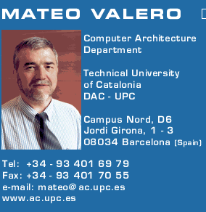
Big Men in Architecture(1)
2007 Mateo Valero
http://personals.ac.upc.edu/mateo/
For important contributions to instruction level parallelism and superscalar processor design.

Slide 27
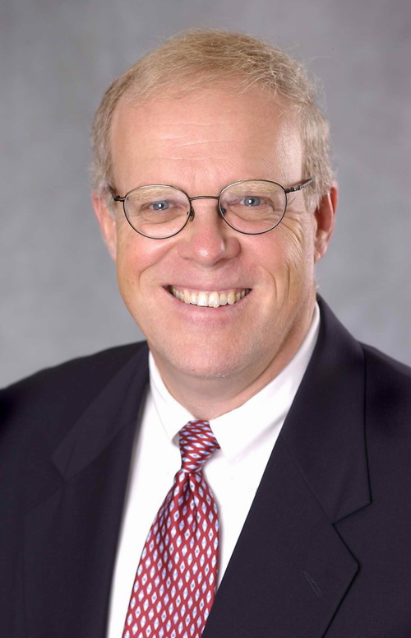
Big Men in Architecture(2)
2001 Hennessy, John
For being the founder and chief architect of the MIPS Computer Systems and contributing to the development of the landmark MIPS R2000 microprocessor.

Slide 28
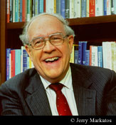
Big Men in Architecture(3)
1999 ACM Turing Award
landmark contributions to computer architecture, operating systems, and software engineering."
2004 Eckert-Mauchly Award
"For the definition of computer architecture and contributions to the concept of computer families and to the principles of instruction set design; for seminal contributions in instruction sequencing, including interrupt systems and execute instructions; and for contributions to the IBM 360 instruction set architecture."
Frederick P. Brooks
http://www.cs.unc.edu/~brooks/

Slide 29
Big Men in Architecture(4)
1997 Robert Tomasulo For the ingenious Tomasulo's algorithm, which enabled out-of-order execution processors to be implemented.

Slide 30
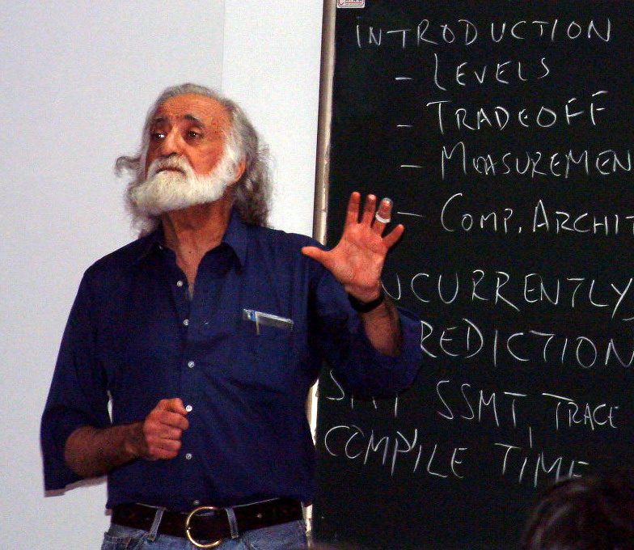
Big Men in Architecture(5)
1996 Yale Patt
For important contributions to instruction level parallelism and superscalar processor design.

Slide 31
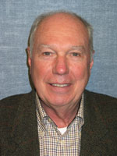
Big Men in Architecture(6)
1992 Michael J. Flynn
http://www.cpe.calpoly.edu/IAB/flynn.html
For his important and seminal contributions to processor organization and classification, computer arithmetic and performance evaluation.

Slide 32
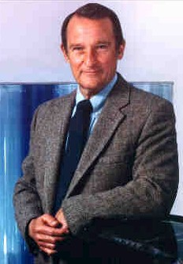
Big Men in Architecture(7)
1989 Cray, Seymour
For a career of achievements that have advanced supercomputing design.

Slide 33
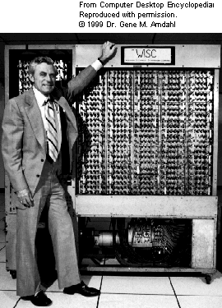
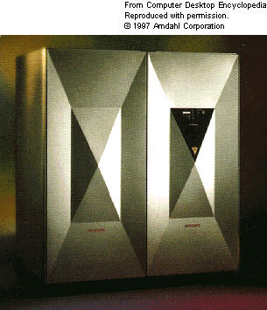
Big Men in Architecture(8)
1987 Amdahl, Gene M. For outstanding innovations in computer architecture, including pipelining, instruction look-ahead, and cache memory.
In 1975, Dr. Amdahl stands beside the Wisconsin Integrally Synchronized Computer (WISC), which he designed in 1950. It was built in 1952. (Image courtesy of Dr. Gene M. Amdahl.)

Slide 34
How ?
Possibility:
standing on the shoulder of giants.
Concepts, Ideas and Principles
Quantitative approaches
Hit the problem and right way to solve problem
As a man sows, so he shall reap.

Slide 35
Grading
Final Grade = Performance * 60% + Final exam * 40%
Performance = Homework (16%) + Pop Quiz (12%) + Labs (32%) + Bonus (<=10%)
Performance <= 60%
Labs = Lab1 (3weeks, 6%) + Lab2 (2weeks, 4%) + Lab3 (1weeks, 3%) + Lab4 (2weeks, 4%) + Lab5 (3weeks, 7%) + Lab6 (5weeks, 8%)

Slide 36
Important Note about Grading
Don’t ask me for a higher score after the final examination no matter what reason you have !

Slide 37
Assignments and reading
Group work in assignments is permitted
Group discussion is strongly encouraged
Members in one group are no more than 2
Homework need to be submitted in time.
the more Late the more discount

Slide 38
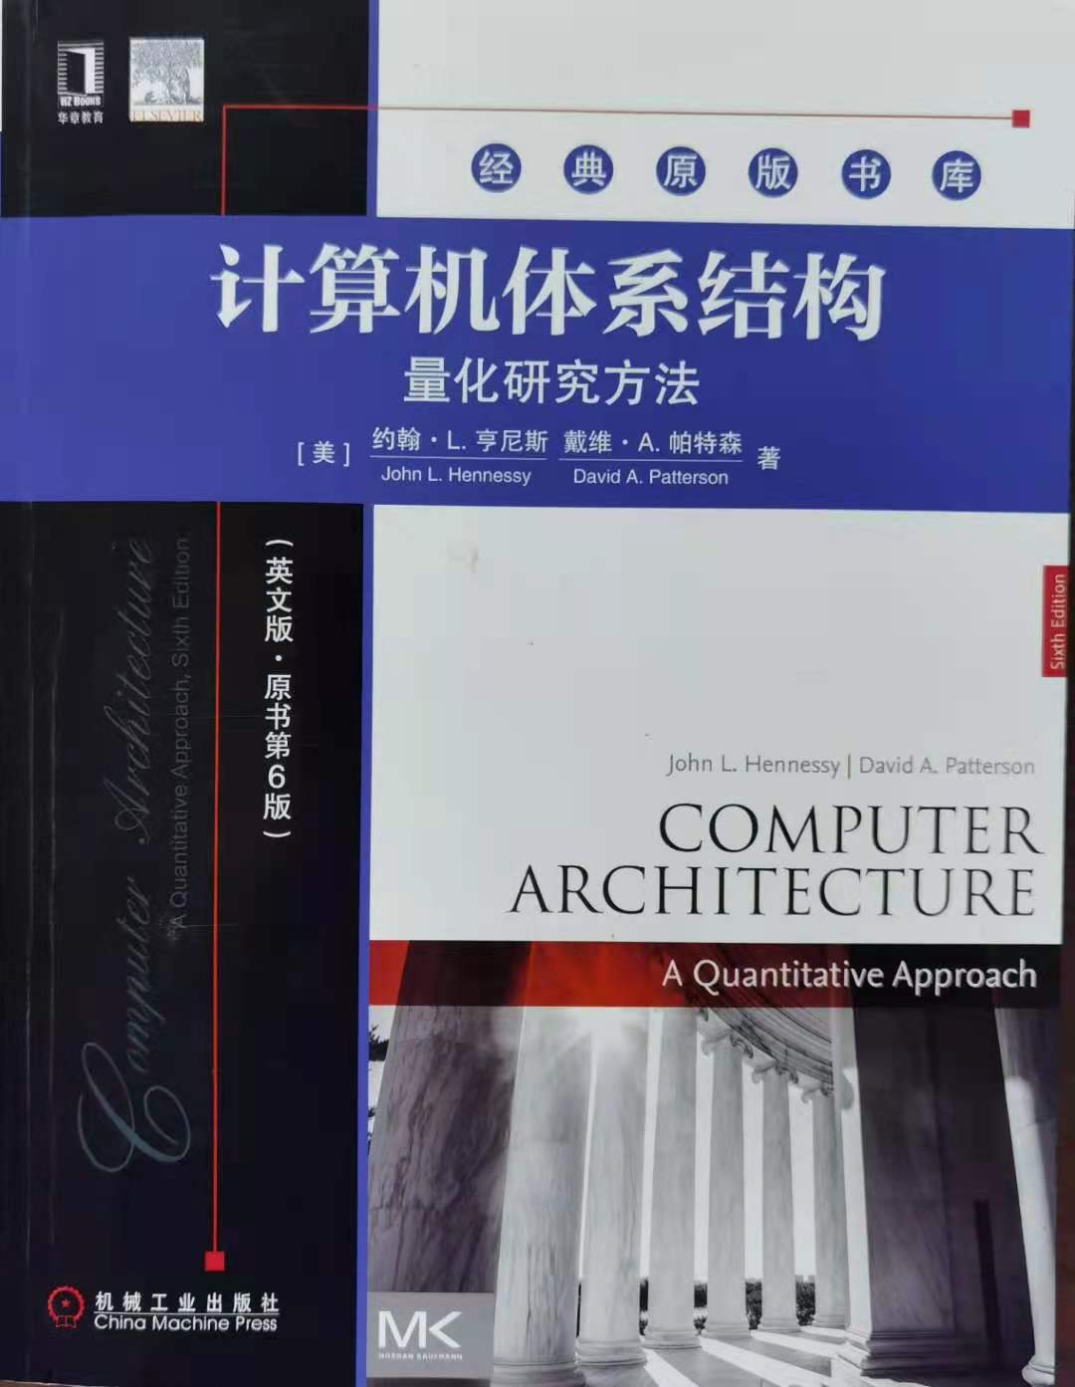
Text Book
Computer Architecture - A quantitative approach
(6th edition)
John L. Hennessy (Stanford University)
David A. Patterson (University of California, Berkeley)
China Machine Press

Slide 39
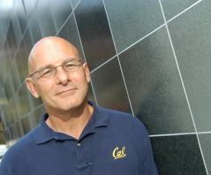
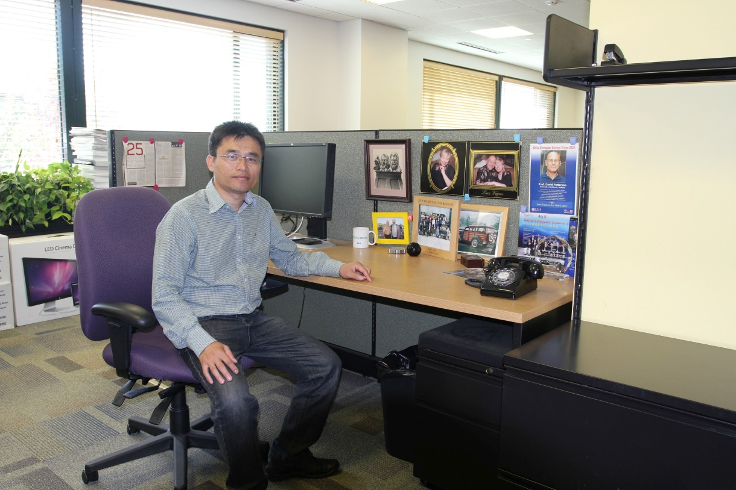
David A. Patterson （UC Berkeley）
He led the design and implementation of RISC I (the foundation of the SPARC architecture )
Leader of RAID
involved in the Network of Workstations (NOW) project
Research Accelerator for Multiple Processors (RAMP)

Slide 40

Reference-1
Computer Architecture - A quantitative approach
(3rd edition , Chinese Version)
Translated by Zheng-WeiMin, Tang-ZhiZhong,etc
Publishing House of Electronics Industry
郑纬民 汤志忠 汪东升等 , 电子工业出版社

Slide 41
Reference-2
Computer Architecture - A quantitative approach
(4rd edition , Chinese Version)
Translated by Bai-Yuebi etc
Publishing House of Electronics Industry
白跃彬等 ,
电子工业出版社

Slide 42
What’s new on this Edition ?
Most significant edition:
1~3 edition focus on ILP(Inst-Level Parallelism)
=>Focus on TLP(Thread-level parallelism) and DLP(Data-level parallelism).
Chapter adjustment:
Changing technology
=>More emphasize on Dependability and topics of Power
Book size limitation:
More contents move to Appendix and CD

Slide 43
Contents
Ch1 Fundamentals of computer design
Ch2 ILP and its exploitation
Ch3 Limits of ILP
Ch4 Multiprocessor and TLP
Ch5 Memory Hierarchy Design
Ch6 Storage Systems
AppA Pipelining: Basic and Intermediate Concepts
AppB Instruction Set Principles and Examples
AppC Review of Memory Hierarchy
AppD Embedded systems
AppE Interconnection Networks
AppF Vector Processors

Slide 44
Topics covered in this class
Ch1 Fundamentals of computer design
AppB Instruction Set Principles and Examples
AppA Pipelining: Basic and Intermediate Concepts
AppC Review of Memory Hierarchy
Ch5 Memory Hierarchy Design
Ch6 Storage Systems
Ch4 Basic concepts of Multiprocessor
AppF Vector Processors

Slide 45
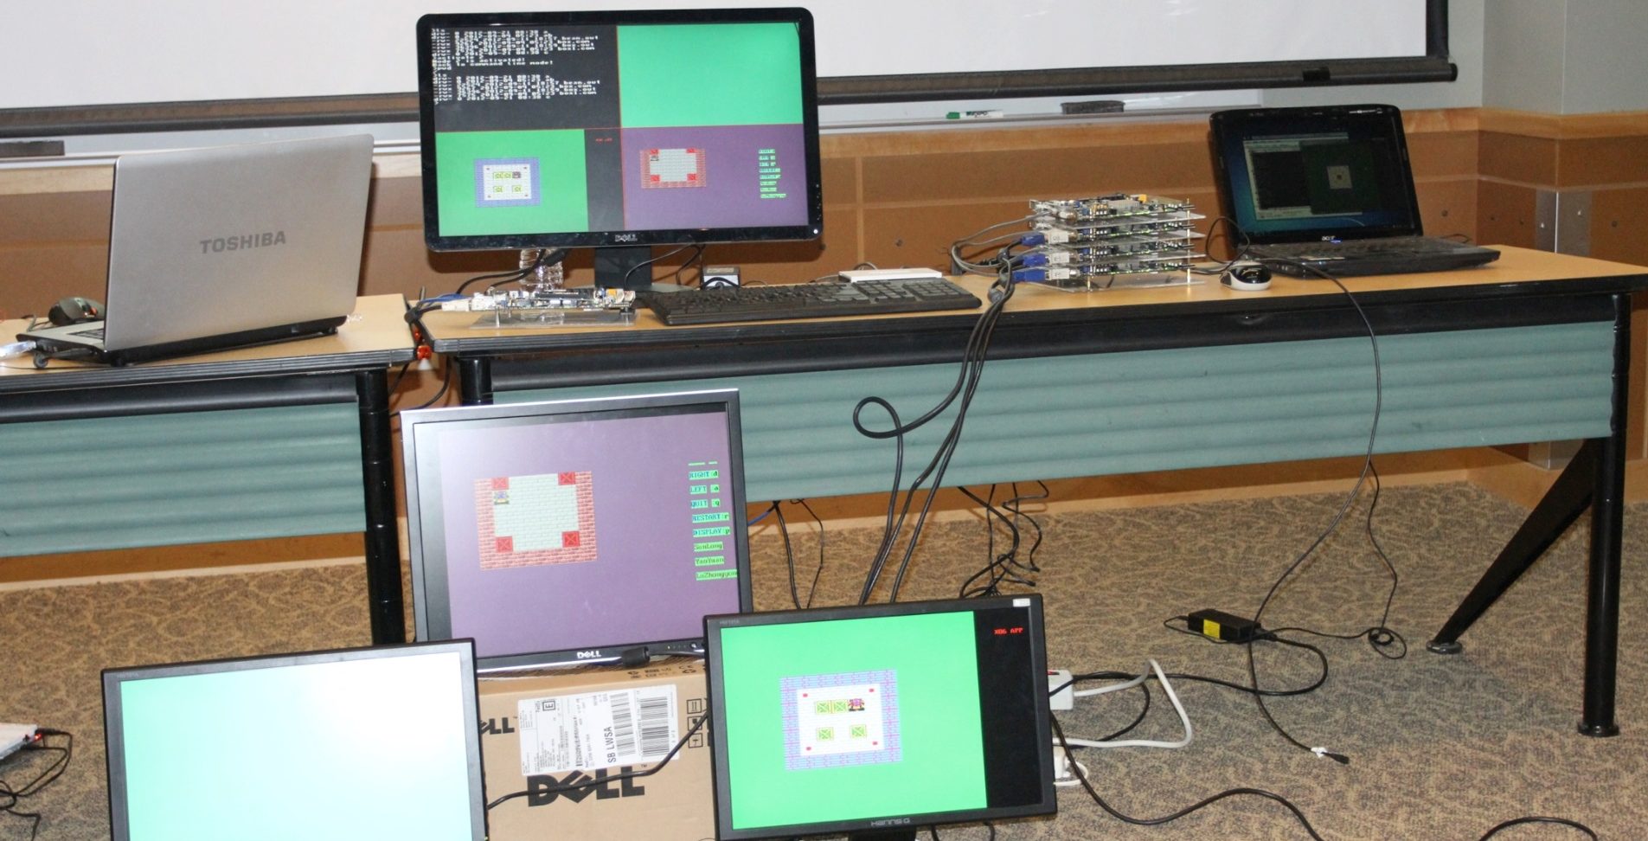
What can you learn from this course ?

Slide 46
Outlook
Open-source Architecture
RISC-V
Security Risks
Spectre and Meltdown
Intel ME
Security Improvements
Domain Specific Architectures

Slide 47

Open Source Architecture
RISC-V
A completely open ISA based on RISC principles
Freely available to academia and industry
Simple and extendable modular design
A small base integer ISA (RV32I, etc.)
Optional standard extensions
Free implementations & commercial implementations
Free: Rocket, PULPino, Hummingbird “蜂鸟”
Commercial: SiFive
Notes:
https://riscv.org/risc-v-cores/

Slide 48
Security Risks
Spectre & Meltdown
Complicated techniques are widely used on modern processors to improve performance
However, these widely-used techniques may cause security risks
Out-of-order execution
Meltdown
Branch predication & speculative execution
Spectre
Intel Management Engine
Notes:
https://meltdownattack.com/
https://en.wikipedia.org/wiki/Intel_Management_Engine
Intel Management Engine
A ”secret” microprocessor built in all Intel processors since 2008
Runs proprietary firmware while computer is running, asleep or even turned off

Slide 49
Security Improvements
Pointer Authentication
The actual address space of a 64-bit architecture is less than 64-bits.
We can place a “signature” of pointer in unused bits, to prove it comes from a valid operation, rather than a software flaw.
New instructions to sign/authenticate pointers.
Enclave (Intel SGX)
Keeping trusted environment on a untrusted platform is challenging.
Untrusted OS/Malware/Cloud
Root of trust on the CPU
If you trust CPU’s vendor, you can probably trust its enclave

Slide 50
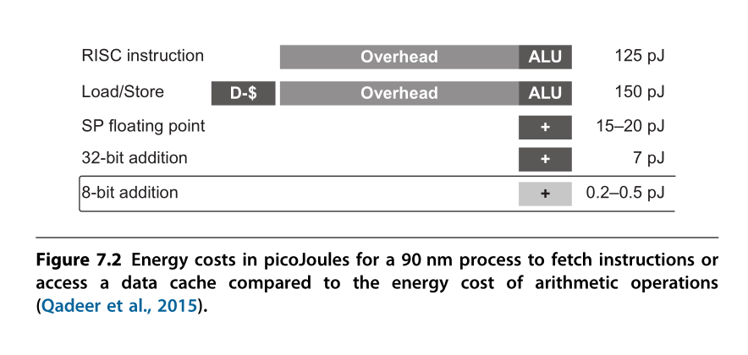
Domain Specific Architectures
General processors are not efficient when solving specific problems
Performance & Energy
To achieve a higher level of efficiency, we need a drastic change in computer architecture from general-purpose cores to domain-specific architectures (DSAs).

Slide 51
Domain Specific Architectures
Google TPU
Data Center ASIC
Google Pixel vCore
Mobile Device ASIC
寒武纪 NPU
Mobile/Data center IP

Slide 52
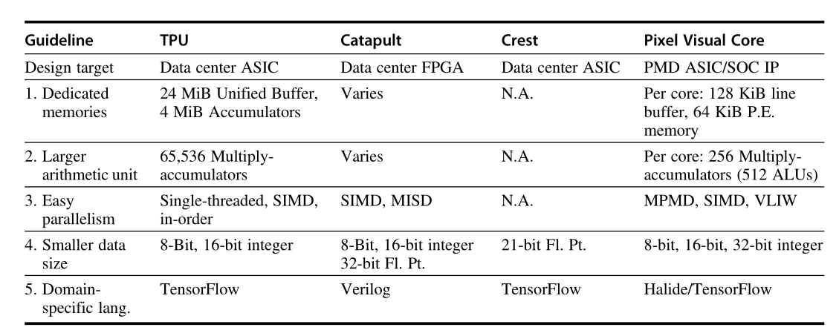

Slide 53
Course materials & Readings
WWW Computer Architecture Website:
http://www.cs.wisc.edu/arch/www/
http://www.ece.cmu.edu/~ece347/
RISCV ISA Manual
https://github.com/riscv/riscv-isa-manual

Slide 54

学在浙大
https://courses.zju.edu.cn

Slide 55
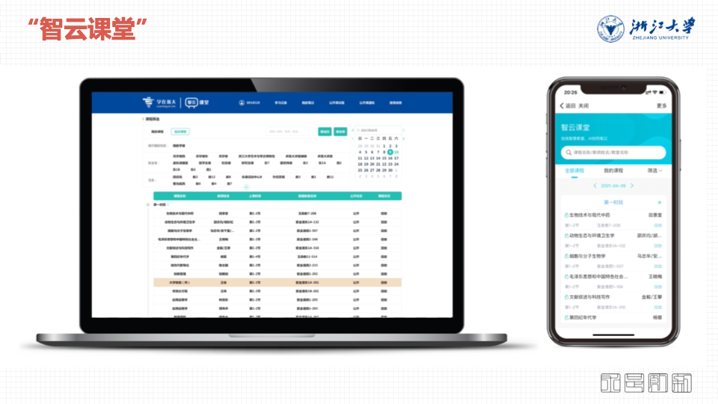
智云课堂
https://classroom.zju.edu.cn

Slide 56

THANK YOU
THANK YOU

