Slide 1

Computer Architecture ----A Quantitative Approach
陈文智
浙江大学计算机学院
chenwz@zju.edu.cn

Slide 2
What is Pipelining ?
Pipelining:
“A technique designed into some computers to increase speed by starting the execution of one instruction before completing the previous one.”
----Modern English-Chinese Dictionary
implementation technique whereby different instructions are overlapped in execution at the same time.
implementation technique to make fast CPUs

Slide 3
Why Pipelining: Its Natural
Laundry
Ann, Brian, Cathy, Dave each have one load of clothes to wash, dry, and fold
Washer takes 30 minutes
Dryer takes 40 minutes
“Folder” takes 20 minutes
A
B
C
D

Slide 4
Sequential Laundry
6 PM
7
8
9
10
11
Midnight
Time
30
40
20
30
40
20
30
40
20
30
40
20
T
a
s
k
O
r
d
e
r
A
B
C
D
Sequential laundry takes 6 hours for 4 loads
If they learned pipelining, how long would laundry take?

Slide 5
Pipelined Laundry----Start work ASAP
6 PM
7
8
9
10
11
Midnight
Time
30
40
40
40
40
20
T
a
s
k
O
r
d
e
r
A
B
C
D
Pipelined laundry takes 3.5 hours for 4 loads

Slide 6
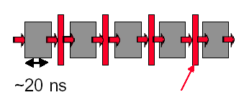
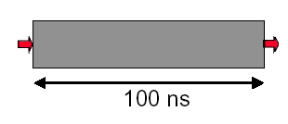
Why pipelining : overlapped
Latches, called pipeline registers’ break up computation into 5 stages
Deal 5 tasks at the same time.
Only deal one task each time.
This task takes
“ such a long time”

Slide 7
Why pipelining: more faster
Can “launch” a new computation every 100ns in this structure
Can finish 10⁷ computations per second
Can launch a new computation every 20ns in pipelined structure
Can finish 5×10⁷ computations per second

Slide 8
Why pipelining : conclusion
The key implementation technique used to Make fast CPU: decrease CPUtime.
Improving of Throughput ( rather than individual execution time)
Improving of efficiency for resources (functional unit)

Slide 9
What is a pipeline ?
A pipeline is like an auto assemble line
A pipeline has many stages
Each stage carries out a different part of instruction or operation
The stages, which cooperates at a synchronized clock, are connected to form a pipe
An instruction or operation enters through one end and progresses through the stages and exit through the other end
Pipelining is an implementation technique that exploits parallelism among the instructions in a sequential instruction stream

Slide 10
Ideal Performance for Pipelining
If the stages are perfectly balanced, The time per instruction on the pipelined processor equal to:
Time per instruction on unpipelined machine
Number of pipe stages
So, Ideal speedup equal to
Number of pipe stages.

Slide 11
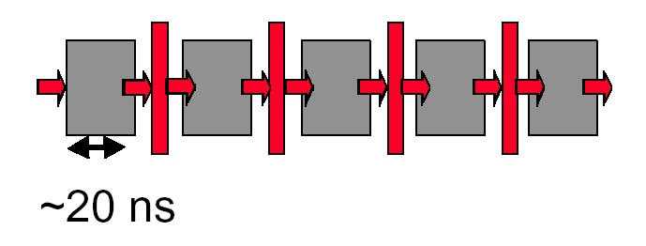
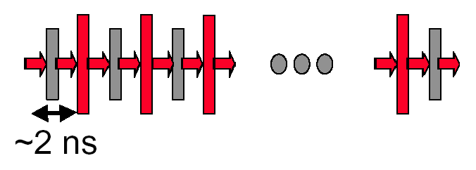
Why not just make a 50-stage pipeline ?
Some computations just won’t divide into any finer (shorter in time) logical implementation.
5 stages OK
50 stages NO. Sorry!

Slide 12
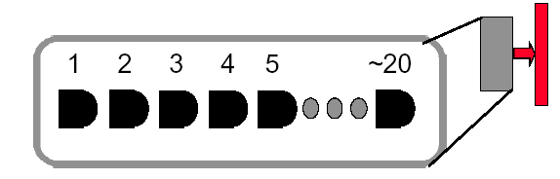
Why not just make a 50-stage pipeline ?
Those latches are NOT free, they take up area, and there is a real delay to go THRU the latch itself.
Machine cycle > latch latency + clock skew
In modern, deep pipeline (10-20 stages), this is a real effect
Typically see logic “depths” in one pipe stage of 10-20 “gates”.
At these speeds, and with this few levels of logic, latch delay is important

Slide 13
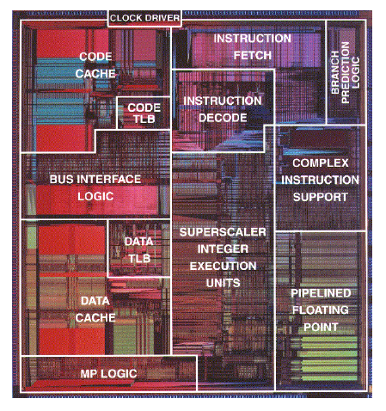
How Many Pipeline Stages?
E.g., Intel
Pentium III, Pentium 4: 20+ stages
More than 20 instructions in flight
High clock frequency (>1GHz)
High IPC
Too many stages:
Lots of complications
Should take care of possible dependencies among in-flight instructions
Control logic is huge

Slide 14
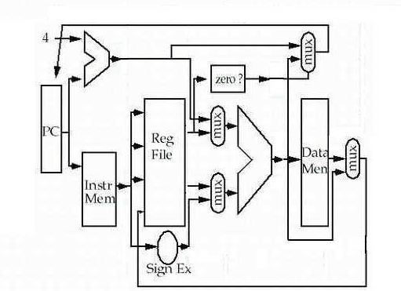
Single-cycle implementation
seldom used !

Slide 15
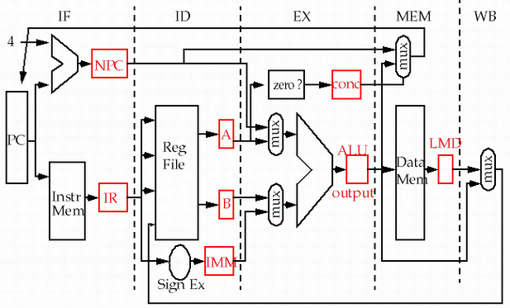
Multi-cycle implementation

Slide 16
Optimized Multi-cycle implementation
Temporary storage locations

Slide 17
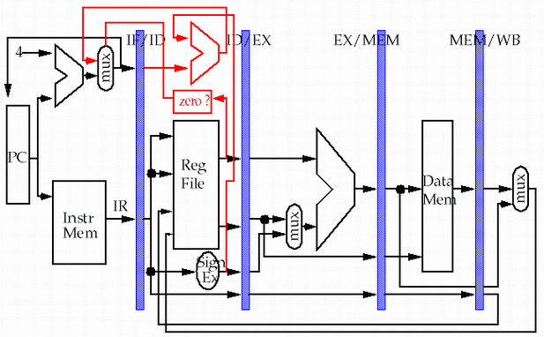
5-stage Version of MIPS Datapath
store
pipeline
registers or
latches
load

Slide 18
Single-cycle implementation vs. pipelining
Single Cycle Implementation: CPI=1, long clock cycle
Cycle 1
Cycle 2
Clk
Load
Store
Waste
Pipeline Implementation: CPI=1, clock cycle ≈ long clock cycle/5
Cycle 1
Cycle 2
Cycle 3
Cycle 4
Cycle 5
Cycle 6
Cycle 7
Cycle 8
Cycle 9
Cycle 10
Clk
Load
IF
ID
EX
MEM
WB
Store
IF
ID
EX
MEM
WB
R-type
IF
ID
EX
MEM
WB

Slide 19
Multi-cycle implementation vs. pipelining
Multip-Cycle Implementation: CPI=5,
Cycle 1
Cycle 2
Cycle 3
Cycle 4
Cycle 5
Cycle 6
Cycle 7
Cycle 8
Cycle 9
Cycle 10
Clk
Load
Store
R-type
IF
ID
EX
MEM
WB
IF
ID
EX
MEM
WB
Pipeline Implementation: CPI=1,
Cycle 1
Cycle 2
Cycle 3
Cycle 4
Cycle 5
Cycle 6
Cycle 7
Cycle 8
Cycle 9
Cycle 10
Clk
Load
IF
ID
EX
MEM
WB
Store
IF
ID
EX
MEM
WB
R-type
IF
ID
EX
MEM
WB

Slide 20
How simple as this ! Really ?
store
pipeline
registers or
latches
load
Why need to add this line?

Slide 21
Pipeline hazard: the major hurdle
A hazard is a condition that prevents an instruction in the pipe from executing its next scheduled pipe stage
Taxonomy of hazard
Structural hazards
These are conflicts over hardware resources.
Data hazards
Instruction depends on result of prior computation which is not ready (computed or stored) yet
Control hazards
branch condition and the branch PC are not available in time to fetch an instruction on the next clock

Slide 22
Hazards can always be resolved by Stall
The simplest way to "fix" hazards is to stall the pipeline.
Stall means suspending the pipeline for some instructions by one or more clock cycles.
The stall delays all instructions issued after the instruction that was stalled, while other instructions in the pipeline go on proceeding.
A pipeline stall is also called a pipeline bubble or simply bubble.
No new instructions are fetched during a stall .

Slide 23

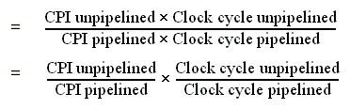
Performance of pipeline with stalls
Pipeline stalls decrease performance from the ideal
Recall the speedup formula:

Slide 24

Case of multi-cycle implementation
The ideal CPI on a pipelined processor is almost always 1. (may less than or greater that )
So
Ignore the overhead of pipelining clock cycle.
Pipe stages are ideal balanced.

Slide 25


Case of multi-cycle implementation
So: Clock cycle unpipelined = Clock cycle pipelining
CPl unpipelined = pipeline depth

Slide 26
Case of single-cycle implementation
CPI unpipelined = 1
Clock cycle unpipelined
pipeline depth
• Clock cycle pipelined =

Slide 27
Structural hazard: Pipe Stage Contention
Structural hazards
Occurs when two or more instructions want to use the same hardware resource in the same cycle
Causes bubble (stall) in pipelined machines
Overcome by replicating hardware resources
Multiple accesses to the register file
Multiple accesses to memory
some functional unit is not fully pipelined.
Not pipelined functional units

Slide 28
Problems that pipelining introduces
Focus: different operations with the same data path resource on the same clock cycle is not possible. (structure hazard)
There is conflict about the memory !
Time (clock cycles)
I
n
s
t
r.
O
r
d
e
r
Ld/St
Mem
Reg
ALU
Mem
Reg
Instr 1
Mem
Reg
ALU
Mem
Reg
Instr 2
Mem
Reg
ALU
Mem
Reg
Instr 3
Mem
Reg
ALU
Mem
Reg

Slide 29
Insert Stall
Time (clock cycles)
I
n
s
t
r.
O
r
d
e
r
Ld/St
Mem
Reg
ALU
Mem
Reg
Instr 1
Mem
Reg
ALU
Mem
Reg
Instr 2
Mem
Reg
ALU
Mem
Reg
Stall
Bubble
Bubble
Bubble
Bubble
Bubble
Instr 3
Mem
Reg
ALU
Mem
Reg

Slide 30
Separate instruction and data memories
Let’s split instruction and data cache
the memory system must deliver 5 times the bandwidth over the unpipelined version.
Time (clock cycles)
I
n
s
t
r.
O
r
d
e
r
Ld/St
IM
Reg
ALU
DM
Reg
Instr 1
IM
Reg
ALU
DM
Reg
Instr 2
IM
Reg
ALU
DM
Reg
Instr 3
IM
Reg
ALU
DM
Reg

Slide 31
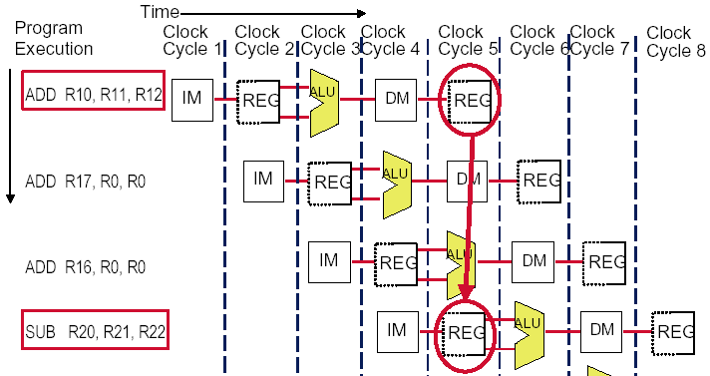
Multi access to the register file
Simply insert a stall , speedup will be decreased.
We have resolved it with “ double bump”

Slide 32
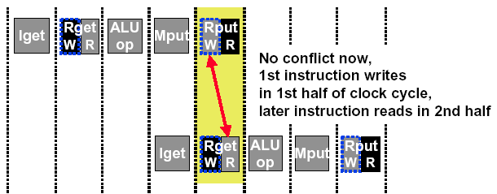
Sometimes we can redesign the resource
allow WRITE-then-READ in one clock cycle (double pump)
Two reads and one write required per clock.
Need to provide two read port and one write port.
What happens when a read and a write occur to the same register ? ( Data hazard )

Slide 33
Not fully pipelined function unit : may cause structural hazard

Slide 34
Machine without structural hazards will always have a lower CPI
Example (pA-14)
Data reference constitute 40% of the mix
Ideal CPI ignoring the structural hazard is 1
The processor with the structural hazard has a clock rate that is 1.05 times higher than that of a processor without structural hazard.
Answer
Average instruction time = CPI×Clock cycle time
=(1+0.4 ×1) ×CC_{ideal}/1.05
= 1.3 × CC_{ideal}
Clearly, the processor without the structural hazard is faster.

Slide 35
Why allow machine with structural hazard ?
To reduce cost.
i.e. adding split caches, requires twice the memory bandwidth.
also fully pipelined floating point units costs lots of gates.
It is not worth the cost if the hazard does not occur very often.
To reduce latency of the unit.
Making functional units pipelined adds delay
(pipeline overhead -> registers.)
An unpipelined version may require fewer clocks per operation.
Reducing latency has other performance benefits, as we will see.

Slide 36
Example: impact of structural hazard to performance
Example
Many machines have unpipelined float-point multiplier.
The function unit time of FP multiplier is 6 clock cycles
FP multiply has a frequency of 14% in a SPECfp benchmark
Will the structural hzard have a large performance impact on the SPECfp benchmark?

Slide 37
Answer to the example
In the best case: FP multiplies are distributed uniformly.
There is one multiply in every 7 clock. 1/14%
Then there will be no structural hazard, then there is no performance penalty at all.
In the worst case: the multiplies are all clustered with no intervening instructions.
Then every multiply instruction have to stall 5 clock cycles to wait for the multiplier be released.
The CPI will increase 70% to 1.7, if the ideal CPI is 1.
Experiment result:
This structural hazard increase execution time by less than 3%.

Slide 38
Data hazard
Data hazards occur when the pipeline changes the order of read/write accesses to operands comparing with that in sequential executing .
Let’s see an Example
DADD R1, R1, R3
DSUB R4, R1, R5
AND R6, R1, R7
OR R8, R1, R9
XOR R10, R1, R11

Slide 39
Coping with data hazards:example

Slide 40
Data hazard
Basic structure
An instruction in flight wants to use a data value that’s not “done” yet
“Done” means “it’s been computed” and “it’s located where I would normally expect to go look in the pipe hardware to find it”
Basic cause
You are used to assuming a purely sequential model of instruction execution
Instruction N finishes before instruction N+k, for k >= 1
There are dependencies now between “nearby” instructions (“near” in sequential order of fetch from memory)
Consequence
Data hazards -- instructions want data values that are not done yet, or in the right place yet

Slide 41
Somecases “Double Bump” can do !

Slide 42
Proposed solution
Proposed solution
Don’t let them overlap like this…?
Mechanics
Don’t let the instruction flow through the pipe
In particular, don’t let it WRITE any bits anywhere in the pipe hardware that represents REAL CPU state (e.g., register file, memory)
Let the instruction wait until the hazard resolved.
Name for this operation: PIPELINE STALL
SLOW！

Slide 43
Forwarding: reduce data hazard stalls
If the result you need does not exist AT ALL yet,
you are out of luck, sorry.
But, what if the result exists, but is not stored back yet?
Instead of stalling until the result is stored back in its “natural” home…
grab the result “on the fly” from “inside” the pipe, and send it to the other instruction (another pipe stage) that wants to use it

Slide 44
Forwarding
Generic name: forwarding ( bypass, short-circuiting)
Instead of waiting to store the result, we forward it immediately (more or less) to the instruction that wants it
Mechanically, we add buses to the datapath to move these values around, and these buses always “point backwards” in the datapath, from later stages to earlier stages

Slide 45
Forwarding: reduce data hazard stalls
Data may be already computed - just not in the Register File
EX/MEM.ALUoutput → ALU input port
MEM/WB.ALUoutput → ALU input port

Slide 46
Hardware Change for Forwarding
NextPC
ID/EX
EX/MEM
MEM/WR
Registers
mux
ALU
Data
Memory
mux
mux
Immediate
EX/Mem.ALUoutput → ALU input
MEM/WB.ALUoutput → ALU input
MEM/WB.LMD → ALU input

Slide 47
Forwarding path to other input entry
store
load
MEM/WB.LMD → DM input

Slide 48
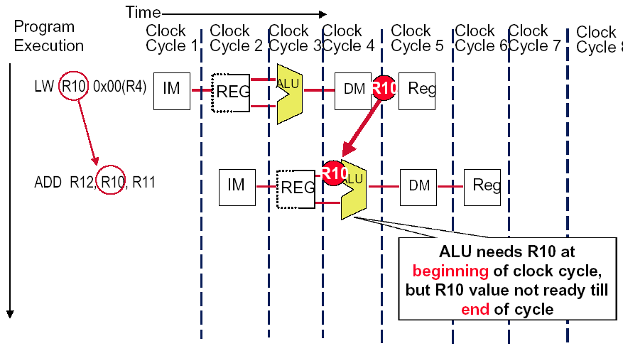
Forwarding Doesn’t Always Work

Slide 49
So we have to insert stall: Load stall
Time (clock cycles)
I
n
s
t
r.
O
r
d
e
r
lw r1, 0(r2)
Ifetch
Reg
ALU
DMem
Reg
Bubble
sub r4,r1,r6
Ifetch
Reg
ALU
DMem
Reg
Bubble
and r6,r1,r7
Ifetch
Reg
ALU
DMem
Reg
or r8,r1,r9
Bubble
Ifetch
Reg
ALU
DMem

Slide 50
How to implement Load Interlock
Detect when should use Load Interlock
situation | Example code sequence | Action
No dependence | LD R1, 45(R2) DADD R5,R6,R7 DSUB R8,R6,R7 OR R9,R6,R7 | No hazard possible because of no dependence
Dependence requiring stall | LD R1, 45(R2) DADD R5,R1,R7 DSUB R8,R6,R7 OR R9,R6,R7 | Comparators detect the use of R1 in the DADD and stall the DADD (and DSUB and OR ) before the DADD begins EX
Dependence overcome by forwarding | LD R1, 45(R2) DADD R5,R6,R7 DSUB R8,R1,R7 OR R9,R6,R7 | Comparators detect the use of R1 in DSUB and forward result of load to ALU in time for DSUB to begin EX
Dependence with accesses in order | LD R1, 45(R2) DADD R5,R6,R7 DSUB R8,R6,R7 OR R9,R1,R7 | No action required because read of R1 by OR occurs in the second half of the ID phase, while the write of the loaded data occurred in the first half.

Slide 51
The logic to detect for Load interlock
Opcode field of ID/EX | Opcode Field of IF/ID | Matching operand fields
Load | Reg-Reg ALU | ID/EX.IR[rt]==IF/ID.IR[rs]
Load | Reg-Reg ALU | ID/EX.IR[rt]==IF/ID.IR[rt]
Load | Load,store, ALU immediate, branch | ID/EX.IR[rt]==IF/ID.IR[rs]

Slide 52
Example of Forwarding and Load Delay
Why forwarding?
ADD R4, R5, R2
LW R15, 0(R4)
SW R15, 4(R2)
Why load delay?
ADD R4, R5, R2
LW R15, 0(R4)
SW R15, 4(R2)

Slide 53
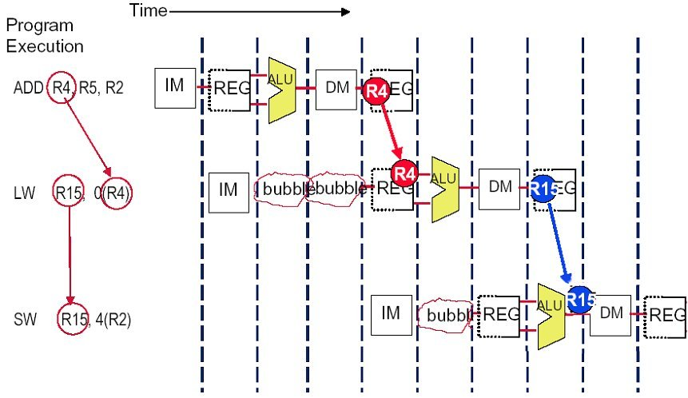
Solution (without forwarding)

Slide 54
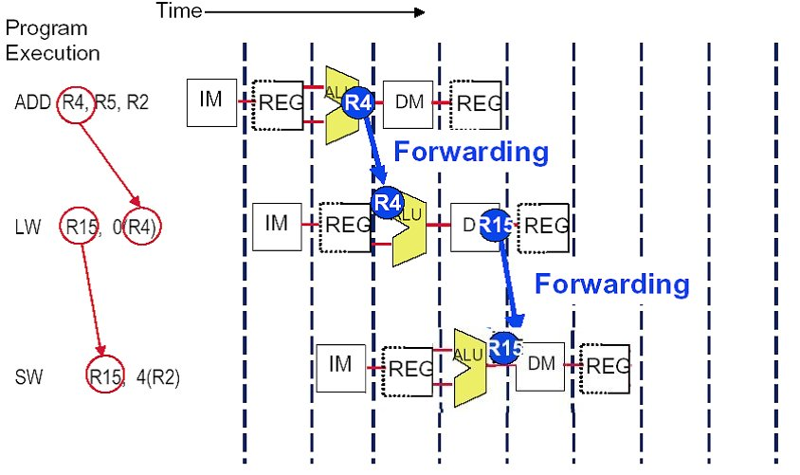
Solution (with forwarding)

Slide 55
The performance influence of load stall
Example
Assume 30% of the instructions are loads.
Half the time, instruction following a load instruction depends on the result of the load.
If hazard causes a single cycle delay, how much faster is the ideal pipeline ?
Answer
CPI = 1+30%×50% ×1=1.15
The performance decrease about 15% due to load stall.

Slide 56
Fraction of load that cause a stall

Slide 57
Instruction reordering by compiler to avoid load stall
Try producing fast code for
a = b + c;
d = e – f;
assuming a, b, c, d ,e, and f in memory.
Slow code:
LW Rb,b
LW Rc,c
ADD Ra,Rb,Rc
SW a,Ra
LW Re,e
LW Rf,f
SUB Rd,Re,Rf
SW d,Rd
Fast code:
LW Rb,b
LW Rc,c
LW Re,e
ADD Ra,Rb,Rc
LW Rf,f
SW a,Ra
SUB Rd,Re,Rf
SW d,Rd

Slide 58
The Control hazard
Cause
branch condition and the branch PC are not available in time to fetch an instruction on the next clock
The next PC takes time to compute
For conditional branches, the branch direction takes time to compute.
Control hazards can cause a greater performance loss for MIPS pipeline than do data hazards.

Slide 59
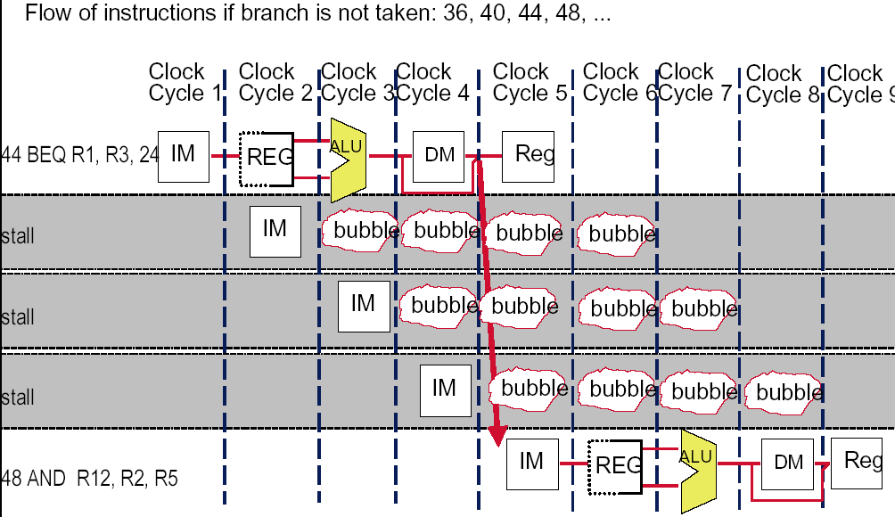
Recall: solve the hazard by inserting stalls
24
48 or 72

Slide 60
The pipeline status
Branch instruction | IF | ID | EX | MEM | WB
Branch Successor |  | IF | stall | stall | idle | idle
Branch successor+1 |  |  |  |  | IF | ID | EX
Branch successor+2 |  |  |  |  |  | IF | ID
Branch successor+3 |  |  |  |  |  |  | IF

Slide 61
Flushing the pipeline
Simplest hardware:
Holding or deleting any instruction after branch until the branch destination is know.
Penalty is fixed.
Can not be reduced by software.

Slide 62
Stalls greatly hurt the performance
Problem:
With a 30% branch frequency and an ideal CPI of 1, how much the performace is by inserting stalls ?
Answer:
CPI = 1+30%×３＝1.9
this simple solution achieves only about half of the ideal performance.

Slide 63
Move the Branch Computation Forward

Slide 64
Move the Branch Computation more Forward
store
load

Slide 65
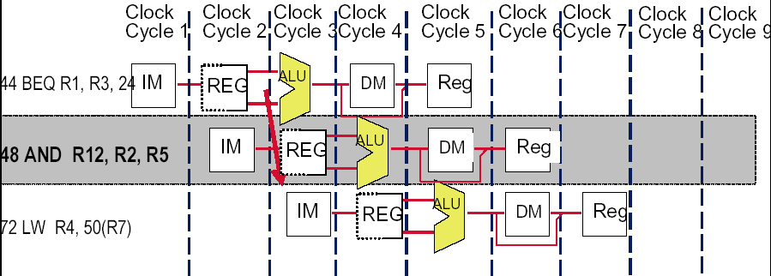
Why “waste” the fetched instruction ?
48 or 72
We have fetched the instruction 48, why we fetch the second time if the branch not taken at last ?

Slide 66
Delayed branch
Good news
Just 1 cycle to figure out what the right branch address is
So, not 2 or 3 cycles of potential NOP or stall
Strange news
OK, it’s always 1 cycle, and we always have to wait
And on MIPS, this instruction always executes, no matter whether the branch taken or not taken. (hardware scheme)

Slide 67
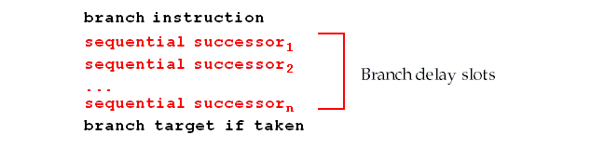
Branch delay slot
Hence the name: branch delay slot
The instruction cycle after the branch is used for address calculation , 1 cycle delay necessary
SO…we regard this as a free instruction cycle, and we just DO IT
Consequence
You (or your compiler) will need to adjust your code to put some useful work in that “slot”, since just putting in a NOP is wasteful (compiler scheme)

Slide 68
How to adjust the codes?

Slide 69
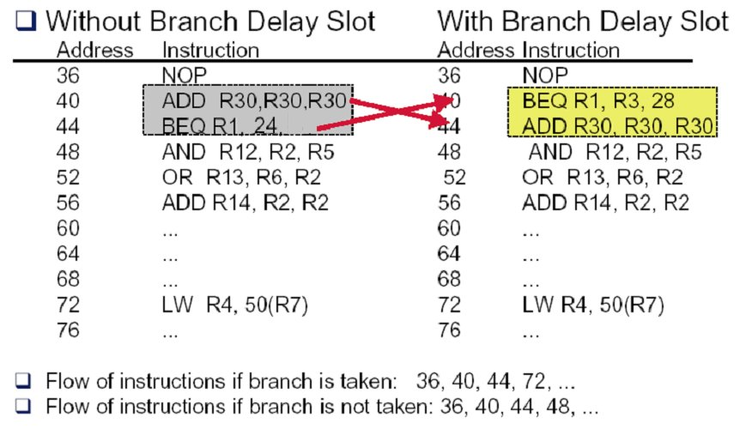
Example: rewrite the code (a)

Slide 70
Example: rewrite the code (b-1)
Loop: LW R2, 0(R1)
ADD R3, R2, R4
SW R3, 0(R1)
……
SUB R1, R1, #4
BNEZ R1, Loop
LW R2, 0(R1)
Loop: ADD R3, R2, R4
SW R3, 0(R1)
……
SUB R1,R1, #4
BNEZ R1, Loop
LW R2, 0(R1)

Slide 71
Example: rewrite the code (b-2)
Loop: LW R2, 0(R1)
ADD R3, R2, R4
SW R3, 0(R1)
DIV …..
……
SUB R1, R1, #4
BNEZ R1, Loop
Loop: LW R2, 0(R1)
ADD R3, R2, R4
DIV …...
…...
SUB R1, R1, #4
BNEZ R1, Loop
SW R3, +4(R1)

Slide 72
Extending the MIPS pipeline to handle MultiCycle Operations
Alternative resolutions to handle floating-point operations
Complete operation in 1 or 2 clock cycles,
Which means using a slow clock,
or/and using enormous amounts of logic in FP units.
Allow for a longer latency for operations
The EX cycle may be repeated as many times as needed to complete the operation
There may be multiple FP units

Slide 73
MIPS pipeline with FP units

Slide 74
Pipelining some of the FP units
Two terminologies
Latency---the number of intervening cycles between an instruction that produces a result and an instruction that uses the result.
Initiation interval---the number of cycles that must elapse between instructions issue to the same unit.
For full pipelined units, initiation interval is 1
For unpipelined units, initiation interval is always the latency plus 1.

Slide 75
Latencies and initiation intervals for functional units

Slide 76
Pipeline supports multiple outstanding FP operations

Slide 77
Specifications
Memory bandwidth: double words/one cycle
New pipeline latches are required:
M1/M2, M2/M3, M3/M4, M4/M5, M5/M6, M6/M7
A1/A2, A2/A3, A3/A4
New connection registers are required:
ID/EX, ID/M1, ID/A1, ID/DIV
EX/MEM, M7/MEM, A4/MEM, DIV/MEM
Because the divider unit is unpipelined, structural hazards can occur.
Because the instructions have varying running times, the number of register writes required in a cycle can be larger than 1
New data hazards: WAW is possible due to disorder WBs
Due to longer latency of operations, stalls for RAW hazards will be more frequent.
Problems with exceptions resulting from disorder completion

Slide 78
Issuing in order and completion out of order

Slide 79
Structural Hazards for the FP register write port

Slide 80
How to solve the write port conflict ?
Increase the number of write ports
Unattractive at all !
No worthy since steady state usage is close to 1.
Detect and insert stalls by serializing the writes
Track the use of the write port in the ID stage and to stall an instruction before it issues
Additional Hardware: a shift register+ write conflict logic
The shift register tracks when already-issued instructions will use the register file, and right shift 1 bit each clock.
The stalls might aggravate the data hazards
All interlock detection and stall insertion occurs in ID stage
To stall a conflicting instruction when it tries to enter the MEM or WB stage.
Easy to detect the conflict at this point
Complicates pipeline control since stalls can now occur in two places.

Slide 81
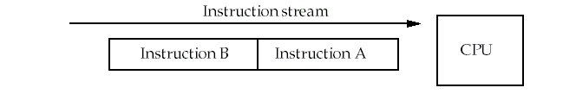
Types of data hazards
Consider two instructions, A and B. A occurs before B.
RAW( Read after write) true dependence
Instruction A writes Rx，instruction B reads Rx
WAW(Write after write) output dependence
Instruction A writes Rx，instruction B writes Rx
WAR( Write after read) anti-denpendence
Instruction A reads Rx，instruction B writes Rx
Hazards are named according to the ordering that MUST be preserved by the pipeline

Slide 82
RAW dependence
B tries to read a register before A has written it and gets the old value.
This is common, and forwarding helps to solve it.
Time
S(A)
D(A)
S(B)
D(B)
No hazard
S(A)
D(A)
If D(A)=S(B), hazard occur.
S(B)
D(B)

Slide 83
WAW dependence
B tries to write an operand before A has written it.
After instruction B has executed, the value of the register should be B's result, but A's result is stored instead.
This can only happen with pipelines that write values in more than one stage, or in variable-length pipelines (i.e. FP pipelines).
Time
S(A)
D(A)
S(B)
D(B)
No hazard
S(A)
D(A)
S(B)
D(B)
If D(A)=D(B), hazard occur.

Slide 84
WAR dependence
B tries to write a register before A has read it.
In this case, A uses the new (incorrect) value.
This type of hazard is rare because most pipelines read values early and write results late.
However, it might happen for a CPU that had complex addressing modes. i.e. autoincrement.
Time
S(A)
D(A)
S(B)
D(B)
No hazard
S(A)
D(A)
S(B)
D(B)
If S(A)=D(B), hazard occur.

Slide 85
Stalls arising from RAW hazards

Slide 86
The WAW hazards

Slide 87
Solving the WAW hazard
Stall an instruction that would "pass" another until after the earlier instruction reaches the MEM phase.
Cancel the WB phase of the earlier instruction
Both of these can be done in ID, i.e. when LD is about to issue.
Since pure WAW hazards are not common, either method works.
Pick the one that simplest to implement.
The simplest solution for the MIPS pipeline is to hold the instruction in ID if it writes the same register as an instruction already issued.

Slide 88
What other hazards are possible ?
Hazards among FP instructions.
Hazards between an FP instruction and an integer instruction.
Since two register files exist, only FP loads and stores and FP register moves to integer registers involve hazards.

Slide 89
Checks are required in ID
Check for structural hazards
The divide unit and Register write port.
Check for RAW hazards
The CPU simply stalls the instruction at ID stage until:
Its source registers are no longer listed as destinations in any of the execution pipeline registers (registers between stages of M and A) OR
Its source registers are no longer listed as the destination of a load in the EX/MEM register.
Check for WAW hazards
Check instructions in A1, ..., A4, Divide, or M1, ...,M7 for the same destination register (check pipeline registers.)
Stall instruction in ID if necessary.

Slide 90
Performance of MIPS FP pipeline

Slide 91
Performance of MIPS FP pipeline

Slide 92
The MIPS R4000 pipeline
IF－First half of instruction fetch. PC selection occurs. Cache access is initiated.
IS－Second half of instruction fetch.
－This allows the cache access to take two cycles.
RF－Decode and register fetch, hazard checking, I-cache hit detection.
EX－Execution: address calculation, ALU Ops, branch target calculation and condition evaluation.
DF/DS/TC
－ Data fetched from cache in the first two cycles.
－ The third cycle involves checking a tag check to determine if the cache access was a hit.
WB－Write back result for loads and R-R operations.

Slide 93
Possible stalls and delays
Load delay: two cycles
The delay might seem to be three cycles, since the tag isn't checked until the end of the TC cycle.
However, if TC indicates a miss, the data must be fetched from main memory and the pipeline is backed up to get the real value.

Slide 94
Load stalls

Slide 95
Example：load stalls

Slide 96
Branch delay: three cycles
Branch delay: three cycles (including one branch delay slot)
The branch is resolved during EX, giving a 3 cycle delay.
The first cycle may be a regular branch delay slot (instruction always executed) or a branch-likely slot (instruction cancelled if branch not taken).
MIPS uses a predict-not-taken method presumably because it requires the least hardware.

Slide 97
Branch Delays： 3 stalls

Slide 98
Pipeline status for branch latency

Slide 99
The FP 8-stage operational pipeline

Slide 100
Latency and initiation intervals

Slide 101
Structural hazards-1

Slide 102
Structural hazards-2

Slide 103
Structural hazards-3

Slide 104
Structural hazards-4

Slide 105
Performance loss measurements

Slide 106

THANK YOU
THANK YOU

