Slide 1
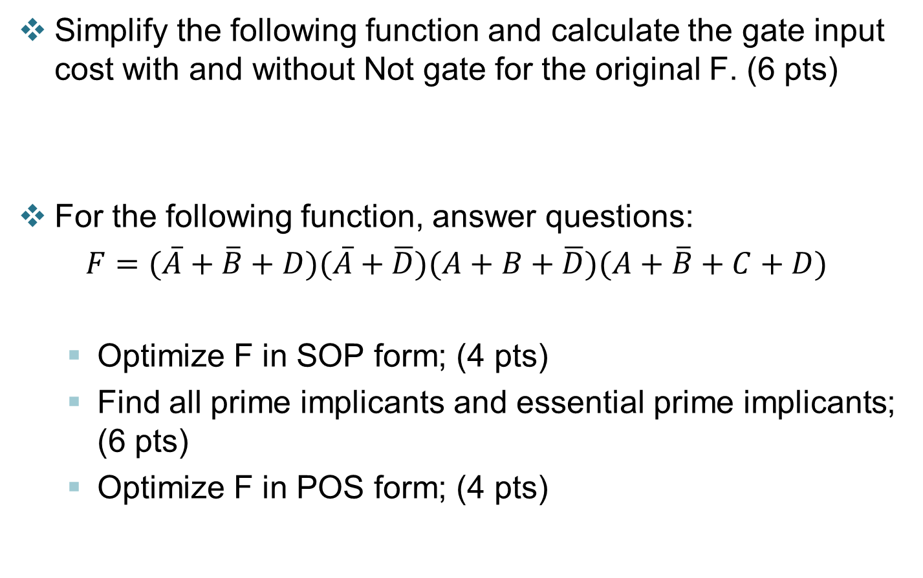
Quiz
Simplify the following function and calculate the gate input cost with and without Not gate for the original F. (6 pts)
For the following function, answer questions:
$F=(\overline{A}+\overline{B}+D)(\overline{A}+\overline{D})(A+B+\overline{D})(A+\overline{B}+C+D)$
Optimize F in SOP form; (4 pts)
Find all prime implicants and essential prime implicants; (6 pts)
Optimize F in POS form; (4 pts)

Slide 2


Answer
1. Simply the function (6 points)
(G=15)
$=X\overline{Z}+\overline{Y}W+\overline{X}ZW+YZW$ (GN=18) $=X\overline{Z}+\overline{Y}W+\overline{X}ZW+ZW$
$=X\overline{Z}+\overline{Y}W+ZW$
2.
1 |  |  | 1
 | 1 | 1 | 1
1 |  |  | 1
SOP. $F=\overline{B}\overline{D}+\overline{A}BD+\overline{A}BC$ or
$=\overline{B}\overline{D}+\overline{A}BD+\overline{A}C\overline{D}$
Primes: $\overline{B}\overline{D}$, $\overline{A}BD$, $\overline{A}BC, \overline{A}C\overline{D}$
essentials: $\overline{B}\overline{D}$, $\overline{A}BD$,
POS. $F=(\overline{A}+\overline{B})(B+\overline{D})(\overline{B}+C+D)$

