Slide 1
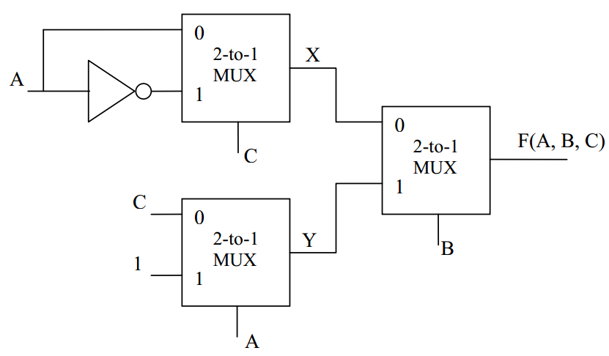
Quiz
Given the following logic circuits implemented with three 2-to-1 multiplexors and inputs A, B and C, please find the logic expressions of X, Y and F in its SOM form.
Design a circuit with a 8-to-1 multiplexer to generate a odd-parity bit for binary code (b3,b2,b1,b0). Write down the truth table, and the circuit.

