Slide 1
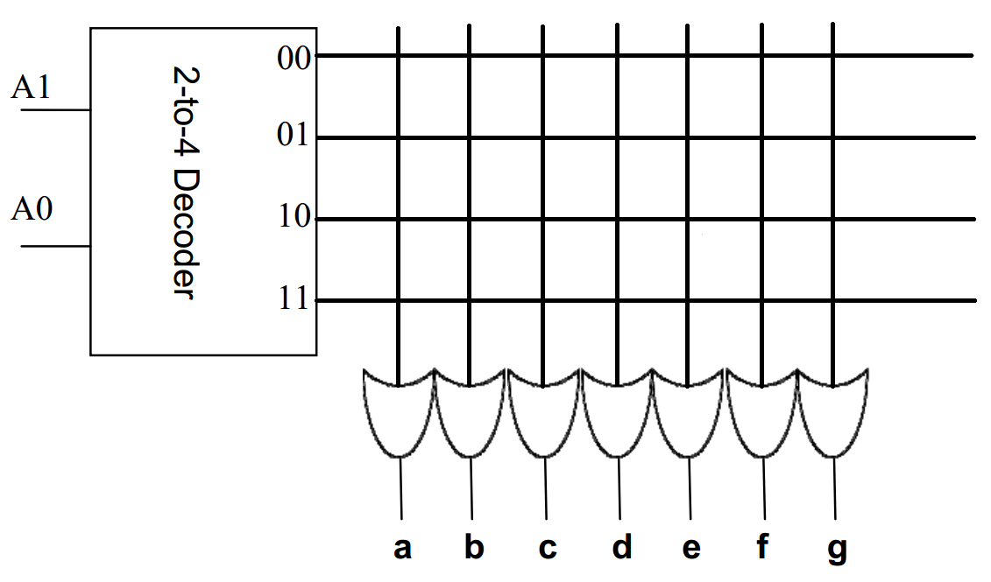
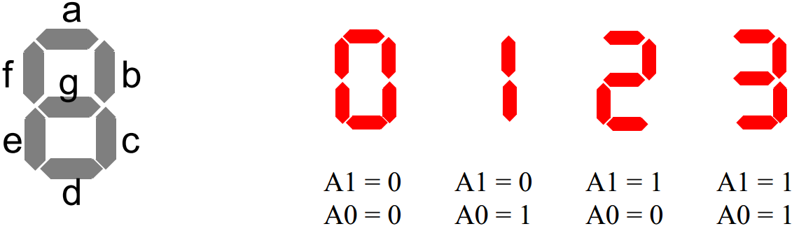
Quiz
Design a circuit with a 8-to-1 multiplexer to decide whether a 4-bits binary number can be divided by 4, output 1 if yes, otherwise output 0. Write down the truth table, logic function and the circuit.
Design a 7-segment display using a 22 x 7 ROM. There is 2 Inputs: A1 and A0 and 7 Outputs: a ~ g; if a ~ g = 1, LED light is on, and if a ~ g = 0, the light is off. You only need to display 0, 1, 2, 3 as follows. Draw the circuit design on the ROM plane.

