Slide 1
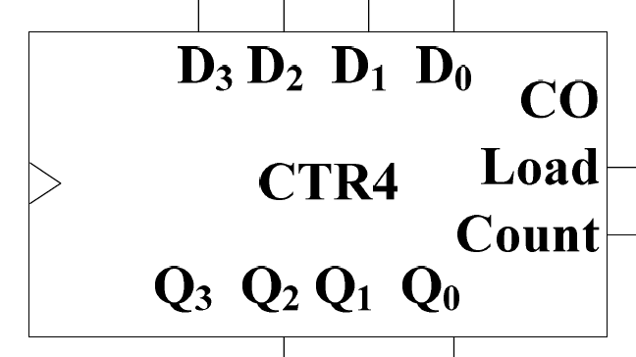
Quiz 4
Use two 4-bit synchronous binary counters and logic gates to implement a 2-bits date counter that counts from decimal “01” through decimal “28”.
Give two register transfer operations (R1 unchanged except for the following cases):
C1: R1←R1 + R2
(~C1)C2: R1←R1 - 1
Use two 4-bits registers, one 4-bit adder, and other necessary gates to implement the above operations.

