Slide 1
10月25日随堂练习解答

Slide 2
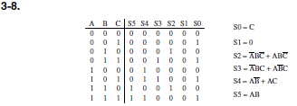
1

Slide 3

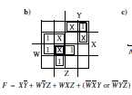
2.1
2.2

Slide 4

3

Slide 5
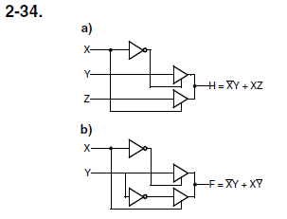
4
Notes:
类似多路选择器

Slide 6
11月日随堂练习解答

Slide 7

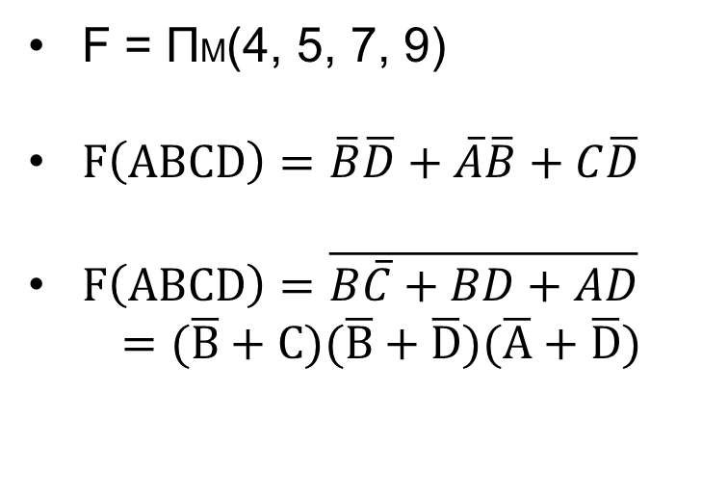
Answer2
1. Simply the function (6 points)
(18)
$=D+C+AB+B$
$=D+C+B$ (3)
2. F(A, B, C, D) = ∑m(0,1,2,3,6,8) + ∑d (10,11,12,13,14,15)
1 | 1 | 1 | 1
 |  |  | 1
x | x | x | x
1 |  | x | x
F = ΠM(4, 5, 7, 9)
$F\left(ABCD\right)=\overline{B}\overline{D}+\overline{A}\overline{B}+C\overline{D}$
$F\left(ABCD\right)=\overline{B\overline{C}+BD+AD}$
$=(\overline{B}+C)(\overline{B}+\overline{D})(\overline{A}+\overline{D})$

Slide 8
一、填空题
三态缓冲器的输出有____3_____个状态，若将几个三态缓冲器的输出端并联在一起，则最多允许_____1______个三态缓冲器输出使能。
数制转换：(17.5)₈ = (____15.625______)₁₀= (____F.A______)₁₆。
(-7.7)₁₀的8位机器数（3位小数，1位符号位）是_______10111.101________；反码是_______11000.010_________；补码是________11001.011_________。
一个10位地址码、8位输出的ROM，其存储容量为_________8192________位。

Slide 9
已知某函数
该函数的简形式的反函数
可以被用作可控门的逻辑门是____异或___________门。

Slide 10
二. 选择题
二值逻辑处理二进制的变量，其变量只取_______B______个离散值。
A. 1个 B. 2个 C. 3个 D. 4个

Slide 11
函数
的门输入成本G____C_____。
A. 9 B. 10 C. 11 D. 12
在四变量卡诺图中有_____D_______个小格是“1”。
A. 13 B. 12 C. 6 D. 5

Slide 12
下列卡诺图表示的函数中，质蕴涵项共有_____B______个。
A. 4 B. 5 C. 6 D. 7
 |  |  | Y
 | 1 |  | 1 | 1
 |  |  | 1 |  | X
W |  | 1 | 1
 | 1 | 1 | 1 | 1
 |  | Z

Slide 13
只读存储器 (ROM) 是由_____C____与门陈列和_________或门陈列组成的组合逻辑结构。
可编程，固定的
B. 可编程，可编程
C. 固定的，可编程
D. 固定的，固定的

Slide 14
（用公式化简，注明每步的主要公式）。

Slide 15
用卡诺图化简以下函数为最简与非-与非表达式：F = ∑m(0, 1, 5, 7, 8, 11, 13) + ∑d (3, 9, 12, 15)。（标出最大维块及对应的与项）
CD AB | 00 | 01 | 11 | 10
0 0 | 1 | 1 | x | 0
0 1 | 0 | 1 | 1 | 0
1 1 | x | 1 | x | 0
1 0 | 1 | x | 1 | 0

Slide 16
分析下列逻辑电路，其中A、B、C、D为输入，F为输出。请列出F的真值表，写出F的逻辑表达式，分析此电路最大可能的功能。

Slide 17
输入 |  |  |  | 输出
A | B | C | D | F
0 | 0 | 0 | 0 | 1
0 | 0 | 0 | 1 | 0
0 | 0 | 1 | 0 | 0
0 | 0 | 1 | 1 | 1
0 | 1 | 0 | 0 | 0
0 | 1 | 0 | 1 | 0
0 | 1 | 1 | 0 | 1
0 | 1 | 1 | 1 | 0
1 | 0 | 0 | 0 | 0
1 | 0 | 0 | 1 | 1
1 | 0 | 1 | 0 | 0
1 | 0 | 1 | 1 | 0
1 | 1 | 0 | 0 | 1
1 | 1 | 0 | 1 | 0
1 | 1 | 1 | 0 | 0
1 | 1 | 1 | 1 | 1
逻辑表达式：
功能：此电路是监测输入（A、B、C、D）是否能被3整除的电路，如果能则输出1。

Slide 18
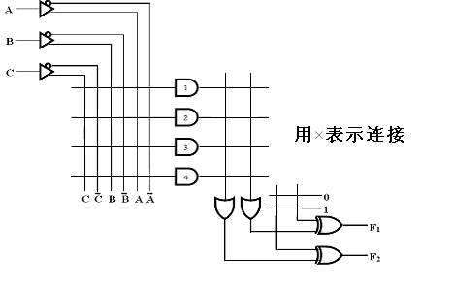
在下图的可编程逻辑阵列PLA上实现下列逻辑函数功能并作简要的设计说明（12分）：

Slide 21
随堂练习3解答:
12月日

Slide 22
时序电路的次态不仅与当前输入有关，而且还与_现态____有关。
通常情况下，主从触发器的建立时间要___大于_______边沿触发器。
电路输出方程只与电路现态相关的时序电路是_______穆尔________型电路。
如果对键盘上108个符号进行二进制编码，则至少要___7___位二进制数码
传输延迟（Propagation Delay）是指变化的信号从______输入___传输到_____输出______所需要的时间，电路的处理速度与电路门的最大传输延迟成反比例关系。
用2个或非门构成的基本S-R锁存器两个输入同时为0时，其功能 为输出Q____保持不变（构成互锁）____

Slide 23
基本R-S型触发器不具有_____B______功能。
保持 B. 翻转 C. 置1 D. 置0
存在“一次性采样”问题的触发器是____D____
A. S-R锁存器 B. D锁存器
C. 边沿触发的D触发器 D. S-R主从触发器
(p24)

Slide 24
A. 8.5ns B. 7.5ns
C. 6.5ns D. 5.5ns
设下图时序电路中门与触发器的参数如下：异或门的延时t_{pd}=3.0ns，与门的延时t_{pd}=1.5ns，触发器延时t_{pd}=3.0ns，建立时间t_{s}=1.0ns，保持时间t_{h}=0.25ns。外部输入需要在时钟脉冲上升沿的____D_______之前就需要确定下来(p56,p200,p32,)
A. 8.5ns B. 7.5ns
C. 6.5ns D. 5.5ns

Slide 25
根据下图写出电路的输出方程、次态方程，
列出状态表，画出状态图。
00
0/1
11
1/1
1/1
0/1
1/1
1/1
0/1
10
0/0
01
A(t)B(t) | A(t+1)B(t+1) |  | Z
 | X=0 | X=1 | X=0 | X=1
00 | 11 | 10 | 1 | 1
01 | 10 | 11 | 0 | 1
10 | 11 | 00 | 1 | 1
11 | 10 | 11 | 1 | 1

Slide 26
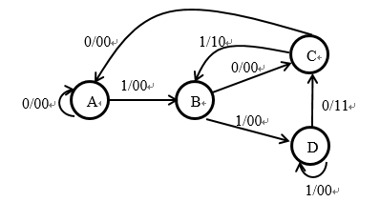
采用米利模型设计一个电路，来识别两个序列101和110。当识别到序列101时，电路输出10，当识别到序列110时，输出11。否则，电路输出00。请画出状态图、状态表、次态方程和输出方程，并画出电路图。(画出最简图）

Slide 27
A: 00, B: 01, C: 10, D: 11
Current State Q₁Q₀ | Next State D₁D₀ |  | Output Y₁Y₀
 | X=0 | X=1 | X=0 | X=1
A | A | B | 0 0 | 0 0
B | C | D | 0 0 | 0 0
C | A | B | 0 0 | 1 0
D | C | D | 1 1 | 0 0
用hidden table做简化(不能简化）
B AC
C X X
D X X X
A B C

Slide 28
Current State Q₁Q₀ | Next State D₁D₀ |  | Output Y₁Y₀
 | X=0 | X=1 | X=0 | X=1
0 0 | 0 0 | 0 1 | 0 0 | 0 0
0 1 | 1 0 | 1 1 | 0 0 | 0 0
1 0 | 0 0 | 0 1 | 0 0 | 1 0
1 1 | 1 0 | 1 1 | 1 1 | 0 0
A:00 B:01
C:10 D:11
P32
Rule1: AC BD
Rule2: none
Rule3: AB
Rule4: A

Slide 29
填空
Using a 4-bit synchronous binary counter to design a Module-8 counter, the activation of Load signal can be _____B_____.
A. Q2Q1Q0 B. Q2Q1Q0
C. Q2 Q1 Q0 D. Q2+Q1+Q0
1 Given two 8-bit registers R1 and R2, with R1 = (1011 0101)₂
and R2 = (0111 0110)₂. After two microoperations:
R1 ← sr R1 and b) R1 ← R1⊕R2,
R1= (_ 0010 1100_)₂.
2 74LS153 is a dual 4-to-1-line multiplexer, if the data input lines I₀ ~ I₃ = 1010, selection inputs S₁S₀ = 10, then the output of the multiplexer is Y=_______1_____, if the output Y is required to be square wave, then the selection inputs S₁S₀ could be_________2位计数器，或者00-01循环，或者00-01-10-11循环，或者square wave______.

Slide 30
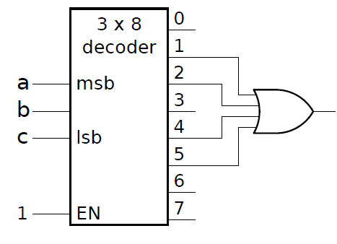
3 (2%) How many flip flops will be complemented in a 8-bit binary up counter to reach the next count after the count 10100011: ____3______.
4 What is the output function implemented by the following circuit： .
A’B’C+A’BC’+AB’C’+AB’C
= B’C+A’BC’+AB’

Slide 31
选择
1 Using a 4-bit synchronous binary counter to design a Module-8
counter, the activation of Load signal can be _____B_____.
A. Q2Q1Q0 （上划线） B. Q2Q1Q0
C. ~Q2 ~Q1 ~Q0 D. Q2+Q1+Q0
2 Q₃Q₂Q₁Q₀ are the outputs of a synchronous BCD counter，Q₃ is the most significant bit，then the output period of Q₃ and its width of the positive pulse (HIGH voltage value) are_____B_____.
10 clock periods, its width of the positive pulse is 1 clock period
10 clock periods, its width of the positive pulse is 2 clock period
16 clock periods, its width of the positive pulse is 2 clock periods
D. 16 clock periods, its width of the positive pulse is 10 clock periods

Slide 32
3 Using synchronous binary counter to design a Module-N counter, the activation of Load signal is to make the counter_____C_____ under the control of clock.
A. load the initial non-zero number at one time
B. initialize the starting states for all flip-flops at one time
C. load the initial number on the next clock transition before starting counting or when counting to N-1
D. none of the above
4 至少_____C_____个4位二进制计数器可以构成N=2010的计数器。
A. 12 B. 11 C. 3 D. 2

Slide 33
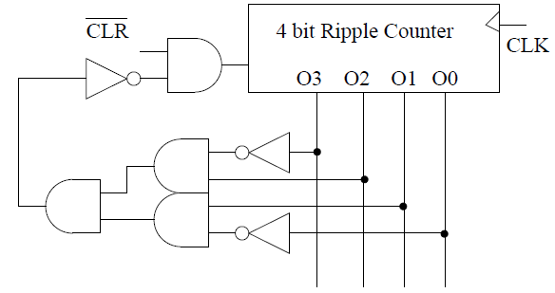
5 Given the Mod-N counter with synchronous reset signal shown below, N = B
A 6 B 7 C 8 D 9
CLR’=0 复位
CLR’=1 且组合电路输出0复位
那么必须反相器之前输出1

Slide 34
Circuit design
1 Magnitude comparators.
(1) Construct the Truth Table for a one-bit unsigned magnitude comparator. There are two inputs: A and B with three outputs: X, Y, Z, and X is Boolean value for logic A>B, Y for logic A<B and Z for logic A==B.
A | B | X (A>B) | Y (A<B) | Z (A==B)
0 | 0 | 0 | 0 | 1
0 | 1 | 0 | 1 | 0
1 | 0 | 1 | 0 | 0
1 | 1 | 0 | 0 | 1

Slide 35
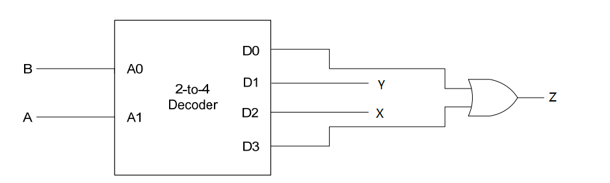
2) Use “one 2-to-4 decoder” and some “logic gates” (i.e., OR, AND, and such) to implement this one-bit comparator.

Slide 36
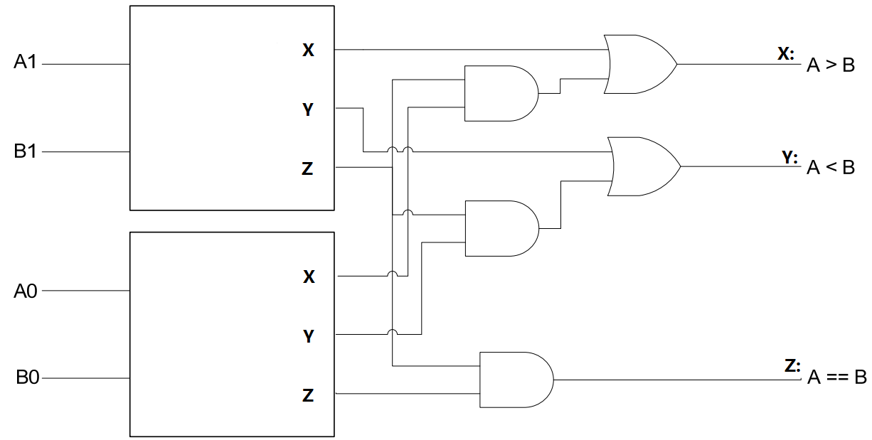
(3) Take the 1-bit comparator you design as a building block (i.e., draw it as a box with 2 inputs and 3 outputs), now use two of these and other logic gates to design a 2-bit unsigned magnitude comparator. The new comparator consists of 4 inputs: A[1:0] and B[1:0], and 3 outputs: A>B, A<B, and A==B. Please show your logic circuits schematic and label the inputs and outputs properly.
首位相同，次位比：x=x1+x0z0

Slide 37
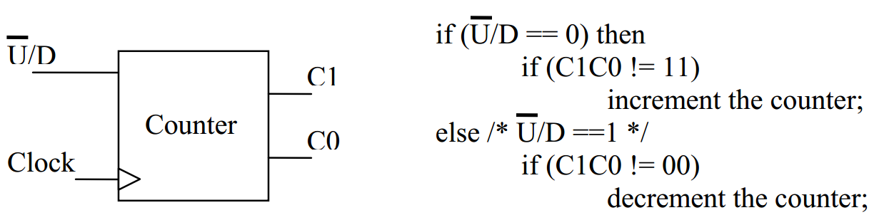
Sequential circuits design.
2 Design a 2-bit up/down saturating counter using D Flip-Flops and other basic gates: derive the state diagram, state table, and draw the circuits. The counter consists of 2 inputs (one for controlling direction, the other one is the clock) and 2 outputs that represent the current count value. The functionality of this counter is described in the pseudo code on the right.

Slide 38
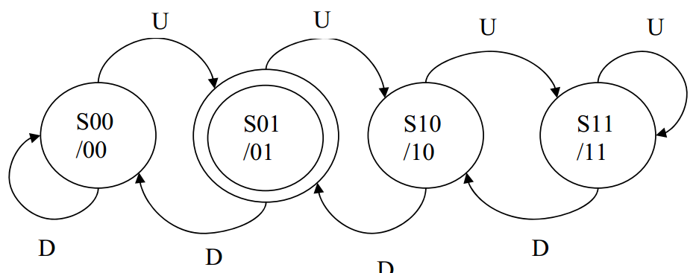
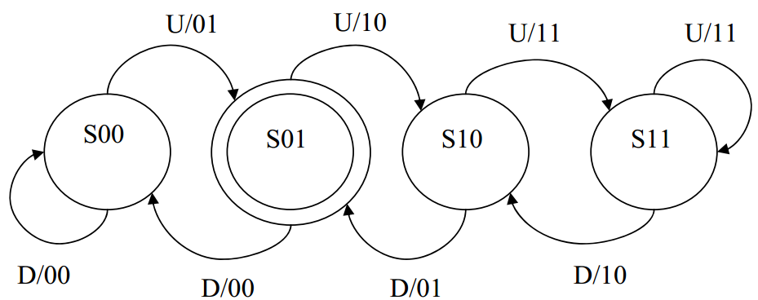
(1) Draw the State Diagram (Mealy or Moore)

Slide 39
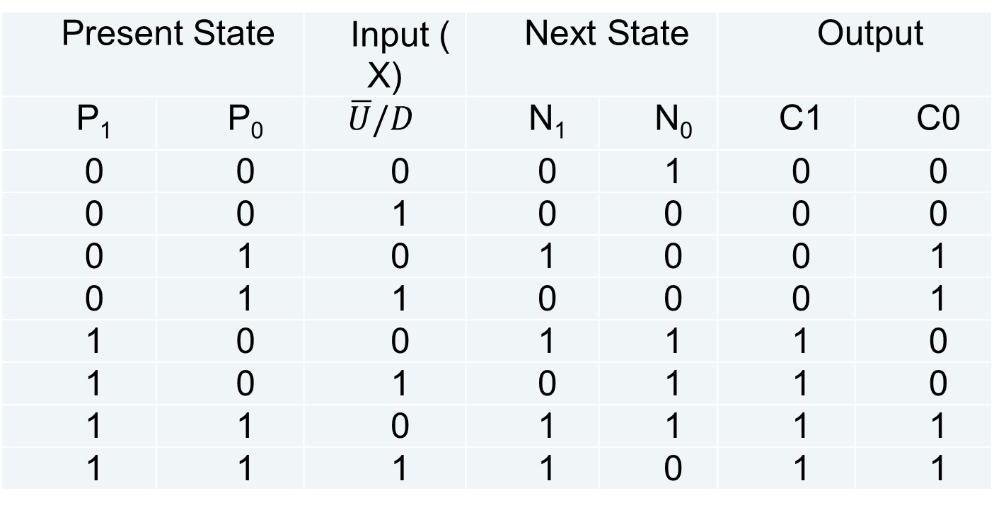
(2) Derive the State Table, write down next state equations and output equations, and simplify them.
Present State |  | Input (X) | Next State |  | Output
P₁ | P₀ | $$\overline{U}/D$$ | N­₁ | N₀ | C1 | C0
0 | 0 | 0 | 0 | 1 | 0 | 0
0 | 0 | 1 | 0 | 0 | 0 | 0
0 | 1 | 0 | 1 | 0 | 0 | 1
0 | 1 | 1 | 0 | 0 | 0 | 1
1 | 0 | 0 | 1 | 1 | 1 | 0
1 | 0 | 1 | 0 | 1 | 1 | 0
1 | 1 | 0 | 1 | 1 | 1 | 1
1 | 1 | 1 | 1 | 0 | 1 | 1

Slide 40
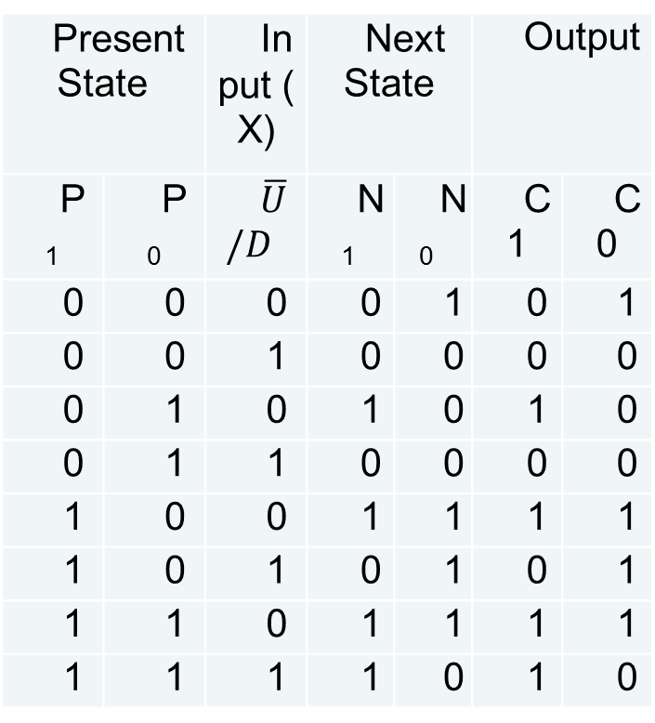
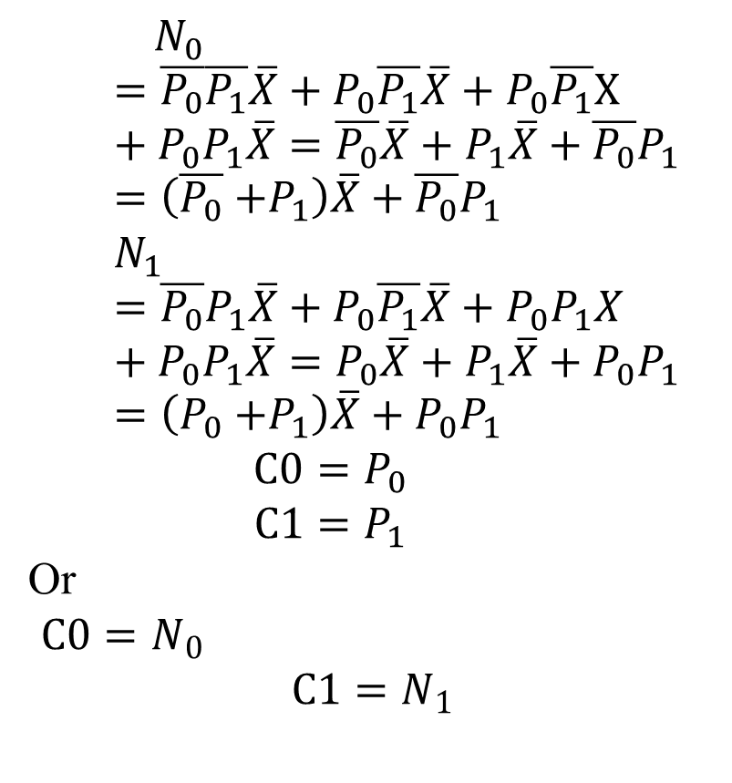
$$N_{0}=\overline{P_{0}}\overline{P_{1}}\overline{X}+P_{0}\overline{P_{1}}\overline{X}+P_{0}\overline{P_{1}}X+P_{0}P_{1}\overline{X}=\overline{P_{0}}\overline{X}+P_{1}\overline{X}+\overline{P_{0}}P_{1}=\left(\overline{P_{0}}{+P}_{1}\right)\overline{X}+\overline{P_{0}}P_{1}$$
$$N_{1}=\overline{P_{0}}P_{1}\overline{X}+P_{0}\overline{P_{1}}\overline{X}+P_{0}P_{1}X+P_{0}P_{1}\overline{X}=P_{0}\overline{X}+P_{1}\overline{X}+P_{0}P_{1}=\left(P_{0}{+P}_{1}\right)\overline{X}+P_{0}P_{1}$$
$$C0=P_{0}$$
$$C1=P_{1}$$
Or
$C0=N_{0}$
$$C1=N_{1}$$
Present State |  | Input (X) | Next State |  | Output
P₁ | P₀ | $$\overline{U}/D$$ | N­₁ | N₀ | C1 | C0
0 | 0 | 0 | 0 | 1 | 0 | 1
0 | 0 | 1 | 0 | 0 | 0 | 0
0 | 1 | 0 | 1 | 0 | 1 | 0
0 | 1 | 1 | 0 | 0 | 0 | 0
1 | 0 | 0 | 1 | 1 | 1 | 1
1 | 0 | 1 | 0 | 1 | 0 | 1
1 | 1 | 0 | 1 | 1 | 1 | 1
1 | 1 | 1 | 1 | 0 | 1 | 0

Slide 41
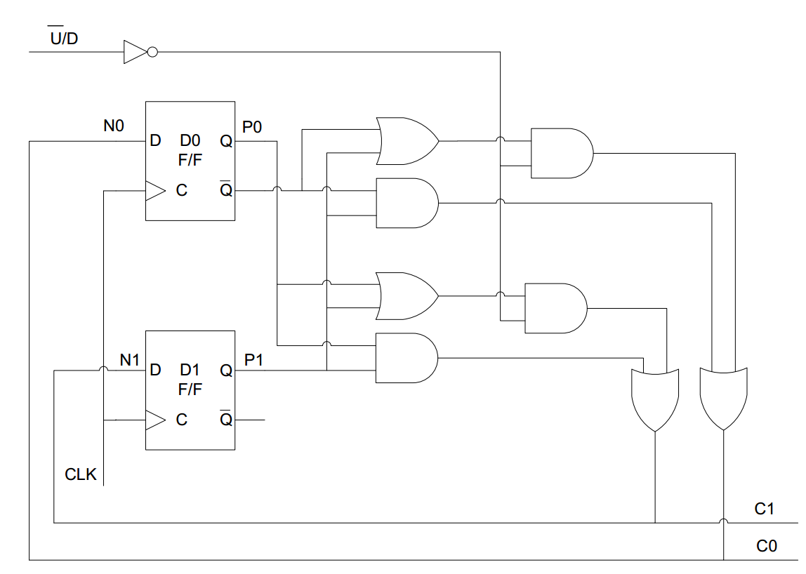
(3) Draw the sequential logic of this counter of your design. You do not need to draw the internals of the D Flip-Flop, simply draw each D Flip-Flop as a block.

Slide 42
填空和选择
1 SDRAM在进行地址加载时一般是先加载_____行_____地址，再加载____列_____地址。
2 计算机的各部分要用到两种类型的存储器：________ RAM ________和ROM。
3 A DRAM has 15 address lines and 32 data lines,
it’s maximum capacity is ______2³²_____Bytes.
To ensure the information is consistently stored in a DRAM chip,
DRAM is required to periodically______refresh______
4 How many 8K×4bit SRAM chips are needed to construct
a 32K×32bit memory? _____D_____.
A. 4 B. 8 C. 16 D. 32

Slide 43
一个位于十字路口的简单交通控制灯器，它使用一个模-8计数器输出A、B和C产生如下组合序列：000，001，011，010，111，110，101，100，在100之后，重复上述序列，即又从000开始，周而复始。计数器的时钟周期是5秒。
计数器输出驱动控制下列交通灯：RNS（Red – North/South）、YNS（Yellow – North/South）、GNS（Green – North/South）、REW（Red – East/West）、YEW（Yellow – East/West）以及GEW（Green - -East/West）
当输出端加载给灯的值为1时，被控制的灯亮，加载给灯的值为0时，被控制的灯灭。设定各方向，绿灯亮10秒，黄灯亮5秒，红灯亮25秒，如下图所示。

Slide 44
GNS=1
10秒
YNS=1
5秒
RNS=1
25秒
假设，对于计数输出为000时，交通灯刚刚发生改变，GNS=1，REW=1，同时，所有其他的灯的输出都是0。使用D触发器和逻辑门，产生这六种输出（1）画出模-8计数器的状态图，（2）写出模-8计数器的状态表；（3）写出电路的次态方程和输出方程；（4）说明所设计的电路是否能正常工作，能自恢复么？
REW=1
25秒
GEW=1
10秒
YEW=1
5秒

Slide 45
（1)状态图
（2）状态表
000
001
011
010
100
101
110
111
现态ABC | 次态ABC
000 | 001
001 | 011
011 | 010
010 | 111
111 | 110
110 | 101
101 | 100
100 | 000

Slide 46
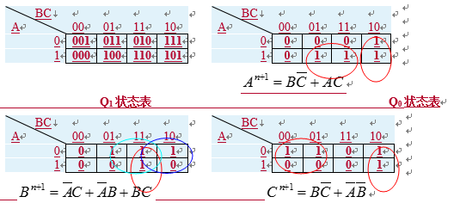


Slide 47
