Slide 1
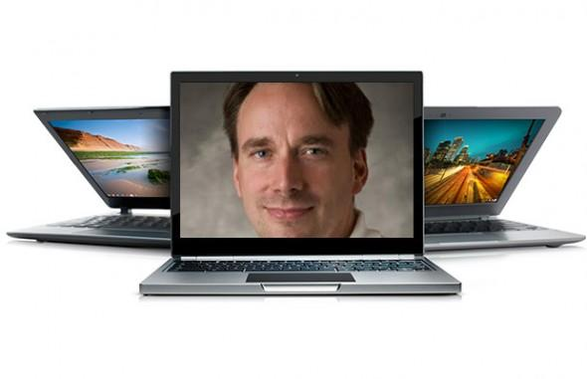


Linux Boot Camp
Jack Biggs
9 Sep 2014

Slide 2
Connecting
SSH
Windows users: PuTTY
Mac users: Terminal
andrewid@shark.ics.cs.cmu.edu
Files
Windows & Mac users: Filezilla
andrewid@unix.andrew.cmu.edu

Slide 3
Welcome!
$ ls
$ cd private
$ mkdir 15-213
$ cd 15-213
$ mv ~/Downloads/datalab-handout.tar .
$ tar xf datalab-handout.tar
$ cd datalab-handout

Slide 4
Some Nice Terminal Shortcuts
~/ is your home directory!
. is an alias for your present working directory!
Pressing tab will autocomplete file and folder names!
Control+C will stop execution of your current program!
Control+R will let you search your command history!
Control+L will clear your screen!
cmd argument1 … argumentn > file.txt will put the output of cmd into file.txt!
Use the up and down arrow keys to scroll through your command history!

Slide 5
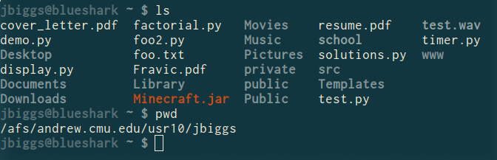
ls <dir>
Lists the files in the present working directory, or, if specified, dir.
pwd tells you your present working directory.

Slide 6
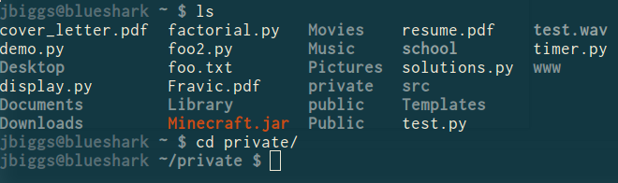
cd <directory>
Stands for change directory, or chdir
Try using chdir instead, it actually works!
Changes your present working directory.

Slide 7
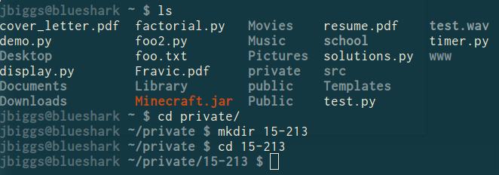
mkdir <dirname>
Makes a directory dirname in your present working directory.
Directories and folders are the same thing!

Slide 8
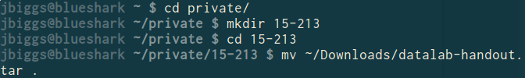
mv <src> <dest>
cp works in exactly the same way, but copies instead
for copying folders, use cp -r
dest can be into an existing folder (preserves name), or a file/folder of a different name
src can be either a file or a folder

Slide 9
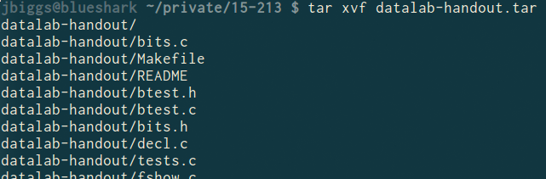
tar <options> <filename>
For full list of options, see man tar
tar stands for tape archive. Was used on tapes!
x - extract, v - verbose, f - file input
All of our handouts will be in tar format.

Slide 10
Also, rm <file1> <file2> … <filen>
To remove an (empty) directory, use rmdir
To remove a folder and its contents, use rm -rf
Please be careful, don’t delete your project.
There is no “Trash” here. It’s gone.

Slide 11
What’s in a file? (using cat)
cat <file1> <file2> … <filen> lets you display the contents of a file in the terminal window.
Use cat -n to add line numbers!
You can combine multiple files into one!
cat <file1> … <filen> > file.txt
Good for seeing what’s in small files.
Try cat -n bits.c. Too big, right?

Slide 12
What’s in a file? (using less)
less <file> will give you a scrollable interface for viewing large files without editing them.
To find something, use /
To view the next occurrence, press n
To view previous occurrence, press N
To quit, use q
Try it: Type “/isPower2”

Slide 13

What’s in a file? (using grep)
grep <pattern> <file> will output any lines of file that have pattern as a substring
grep -v will output lines without pattern as substring
grep -R will search recursively
Try it: grep ‘isPower2’ bits.c
grep -v ‘*’ bits.c
grep -R ‘unsigned’ .

Slide 14
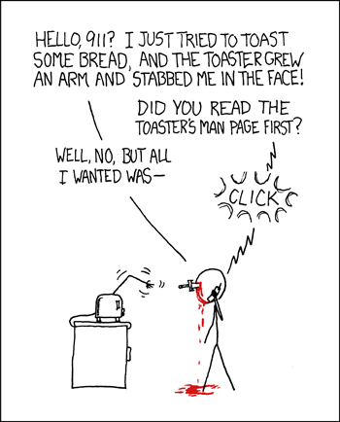
man <thing>
What is that command? What is this C standard library function? What does this library do? Check to see if it has a man page!
Pages viewed with less
Try it!
man grep
man tar
man printf
man strlen

Slide 15
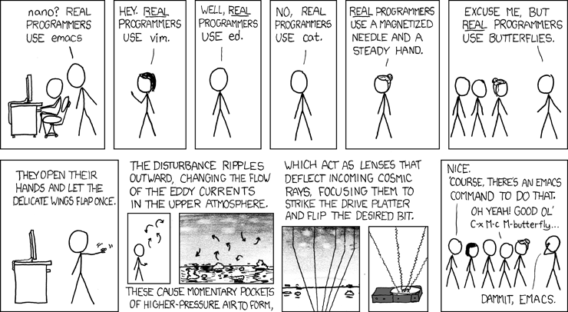
Editors (a touchy subject)

Slide 16
Editors (a touchy subject)
vim is nice, made for very powerful text editing
Try running vimtutor to get started learning
emacs is nice, made to be more versatile
Look online for help!
gedit has a GUI, but requires X Forwarding setup. Too platform-dependent to show here, sadly.
With enough dedication, the terminal will become your best friend and you will understand each other
So just edit on the terminal :)
Gist: Use an editor with auto-indent and line numbers

Slide 17
Editors (if you really really just want a GUI)
Simple answer: Go to a Linux cluster on-campus, open a terminal, and run:
ssh -Y andrewid@shark.ics.cs.cmu.edu
Now you can run gedit <filename> &
& forks your process into the background so you can use the prompt without waiting for gedit to finish

Slide 18
Editors (if you really, really just want a GUI)
Not-so-simple answer: Google “How to install X Forwarding on <platform>”
Mac: You need XQuartz
Windows: You need XMing and PuTTY
This allows you to execute GUI applications on the shark machines, but have the GUI appear on your computer.

Slide 19
Commands related to 15-213
gdb, the GNU Debugger, will be used for bomb lab.
objdump displays the symbols in an executable.
gcc is the GNU C Compiler.
make reads a configuration file to run a series of commands. Often used for compiling your programs.
We will provide other tools in the handouts as well

Slide 20
Virtualization
A nice environment for practicing Linux skills outside of the cluster is a virtual machine
We have created a Red Hat Linux virtual image
/afs/cs/project/ugradlabs/vm/RHEL6-20140905.img.zip
Copy to your computer (6GB), extract, and set up with VirtualBox: http://virtualbox.org
You have full administrative access!
Break it as much as you want! Experiment!!
Username is user, password is user

Slide 21
