Slide 1
Terminal Surviving Tutorial
Jiacai Cui
PASCAL Group @ Nanjing University

Slide 2
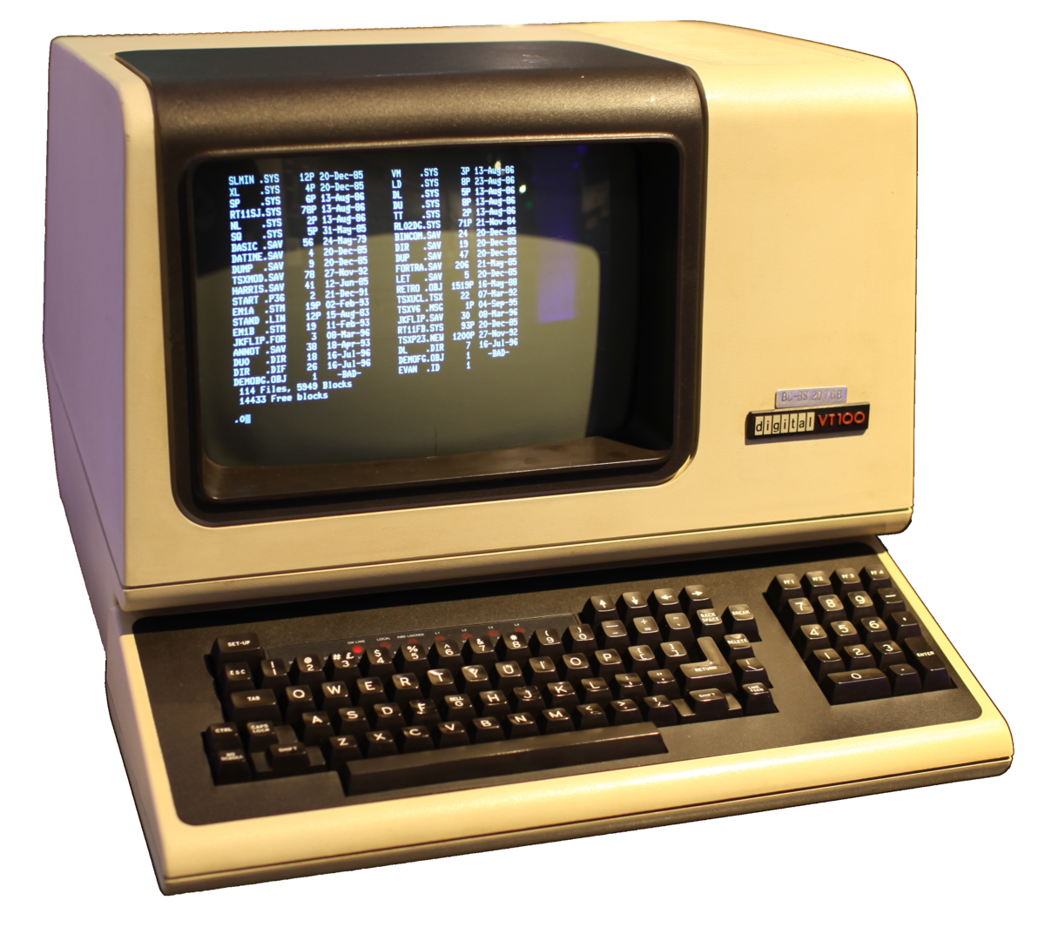
What is the Terminal ?
An interactive channel that allows talking with the computer.
Terminal is also known as console, shell, command line, etc.

Slide 3
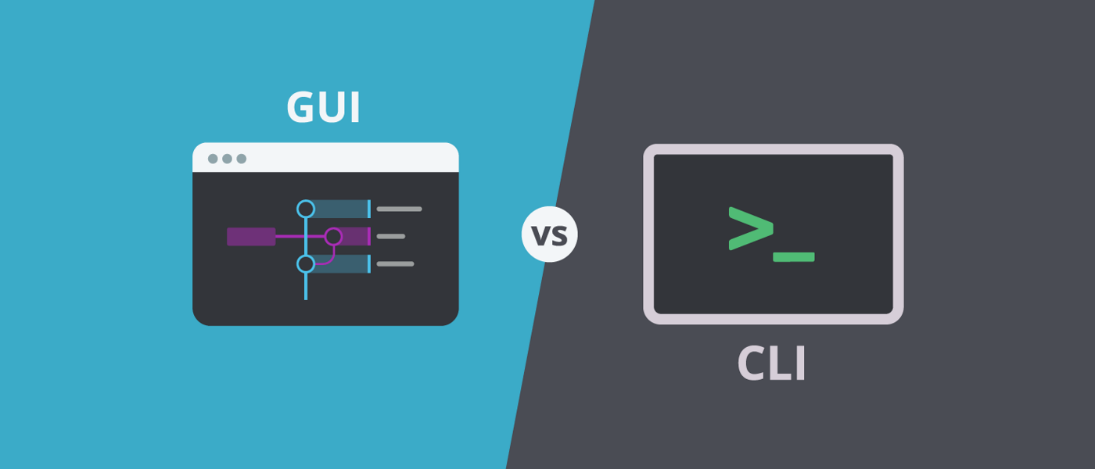
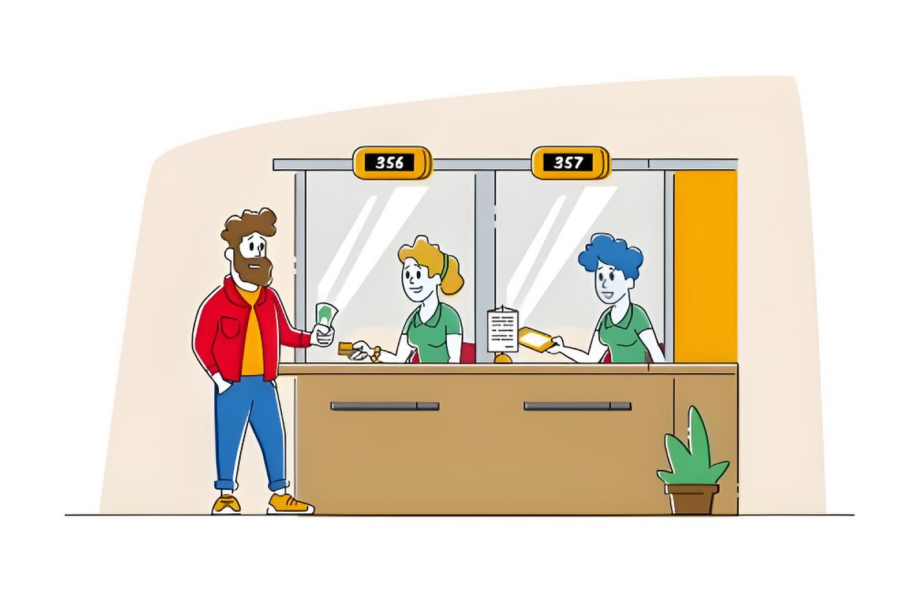

GUI vs. CLI
GUI
(Graphic User Interface)
CLI
(Command Line Interface)

Slide 4
Structure of CLI
Prompt
Instruction
PS C:\Users\Jacy\lab00-Code> python –i lab00.py
[Current Working Directory]
Command
[Argument]
[Shell Name]
PS = Power Shell
Input Indicator
[Option]

Slide 5
Structure of CLI
Prompt
Instruction
PS C:\Users\Jacy\lab00-Code> python –i lab00.py
[Current Working Directory]
Command
[Argument]
[Shell Name]
PS = Power Shell
Input Indicator
[Option]
CLI = Prompt + Instruction
Prompt = [Shell Name] + [Current Working Directory] + Input Indicator
Instruction = Command + [Option] + [Argument]
[xxx] means xxx is optional.

Slide 6
Navigating Around
List all items in the working directory:
> ls
Print working directory:
> pwd

Slide 7
Navigating Around
Change directory to a target (e.g. lab00-Code):
> cd lab00-Code
Change directory to the parent directory:
> cd ..

Slide 8
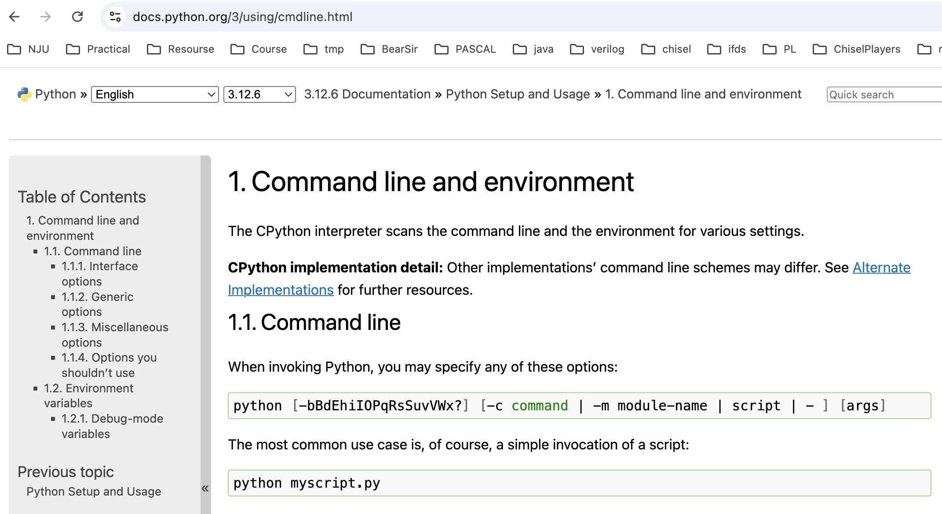
How to Read CLI Documentation?

Slide 9
Python CLI Usage
Open a fresh interactive python interpreter:
> python
Run a python file (e.g. lab00.py):
> python lab00.py

Slide 10
Python CLI Usage
Enter interactive mode after executing the file (e.g. lab00.py):
> python -i lab00.py
Run the doctest of a python file (e.g. lab00.py):
> python -m doctest lab00.py

Slide 11
Python OK CLI Usage
Test a given question (e.g. diff_square):
> python ok -q diff_square
Submit the assignment:
> python ok --submit

Slide 12
Python OK CLI Usage
Test all questions:
> python ok --all
Enter the interactive mode after failing a test:
> python ok –q diff_square -i
> python ok --all -i

Slide 13
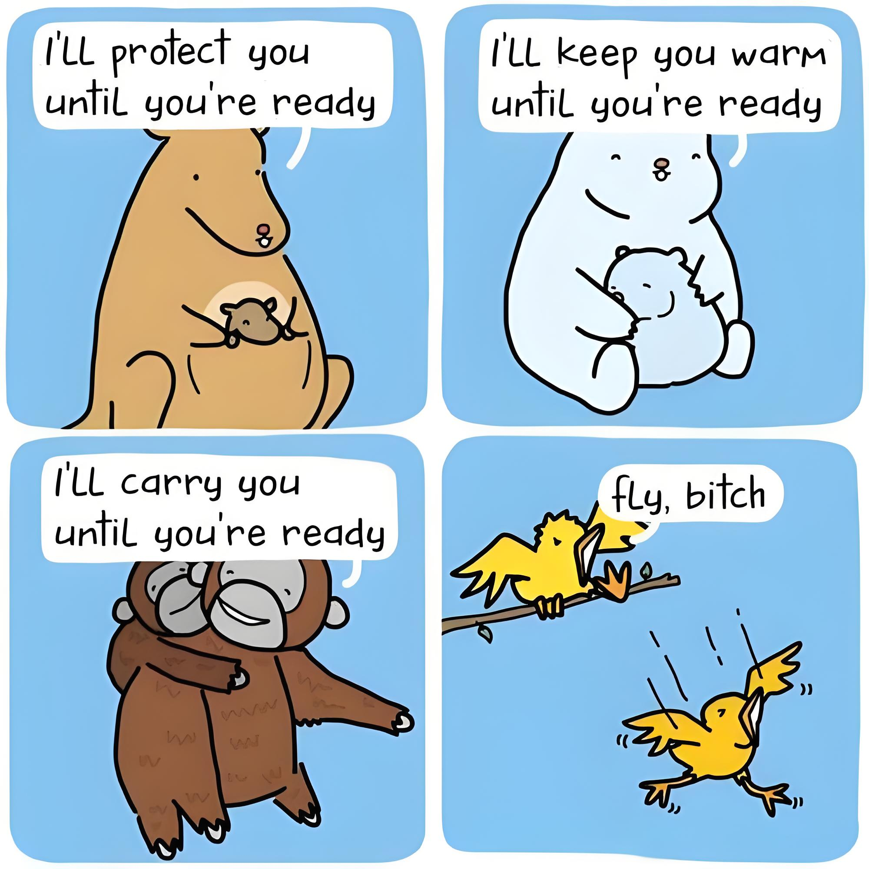
Ultimate CS Surviving Philosophy
STFW = Search The F* Web
RTFM = Read The F* Manual
Machine is always right.
Code untested is always wrong.

Slide 14
Have a nice day!
Jiacai Cui

