Slide 1
Higher-Order Functions
2024/ 10 / 09
Slides adapted from Berkeley CS61a

Slide 2
Higher-Order Functions
Functions are first-class, meaning they can be manipulated as values
A higher-order function is:
A function that takes a function as an argument
and/or
A function that returns a function as a return value

Slide 3
Designing Functions

Slide 4
Describing Functions
def square(x):
"""Return X * X"""
x is a number
square returns a non-negative real number
square returns the square of x
A function's domain is the set of all inputs it might possibly take as arguments.
A function's range is the set of output values it might possibly return.
A pure function's behavior is the relationship it creates between input and output.

Slide 5
A Guide to Designing Function
Give each function exactly one job, but make it apply to many related situations
>>> round(1.23)
1
>>> round(1.23, 1)
1.2
>>> round(1.23, 0)
1
>>> round(1.23, 5)
1.23
Don’t repeat yourself (DRY). Implement a process just once, but execute it many times.

Slide 6
Generalization

Slide 7

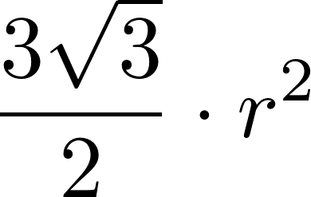
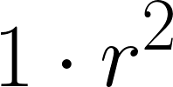
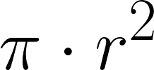
Generalizing Patterns with Arguments
Regular geometric shapes relate length and area.
Shape:
Area:
Finding common structure allows for shared implementation
Demo

Slide 8
Higher-Order Functions

Slide 9
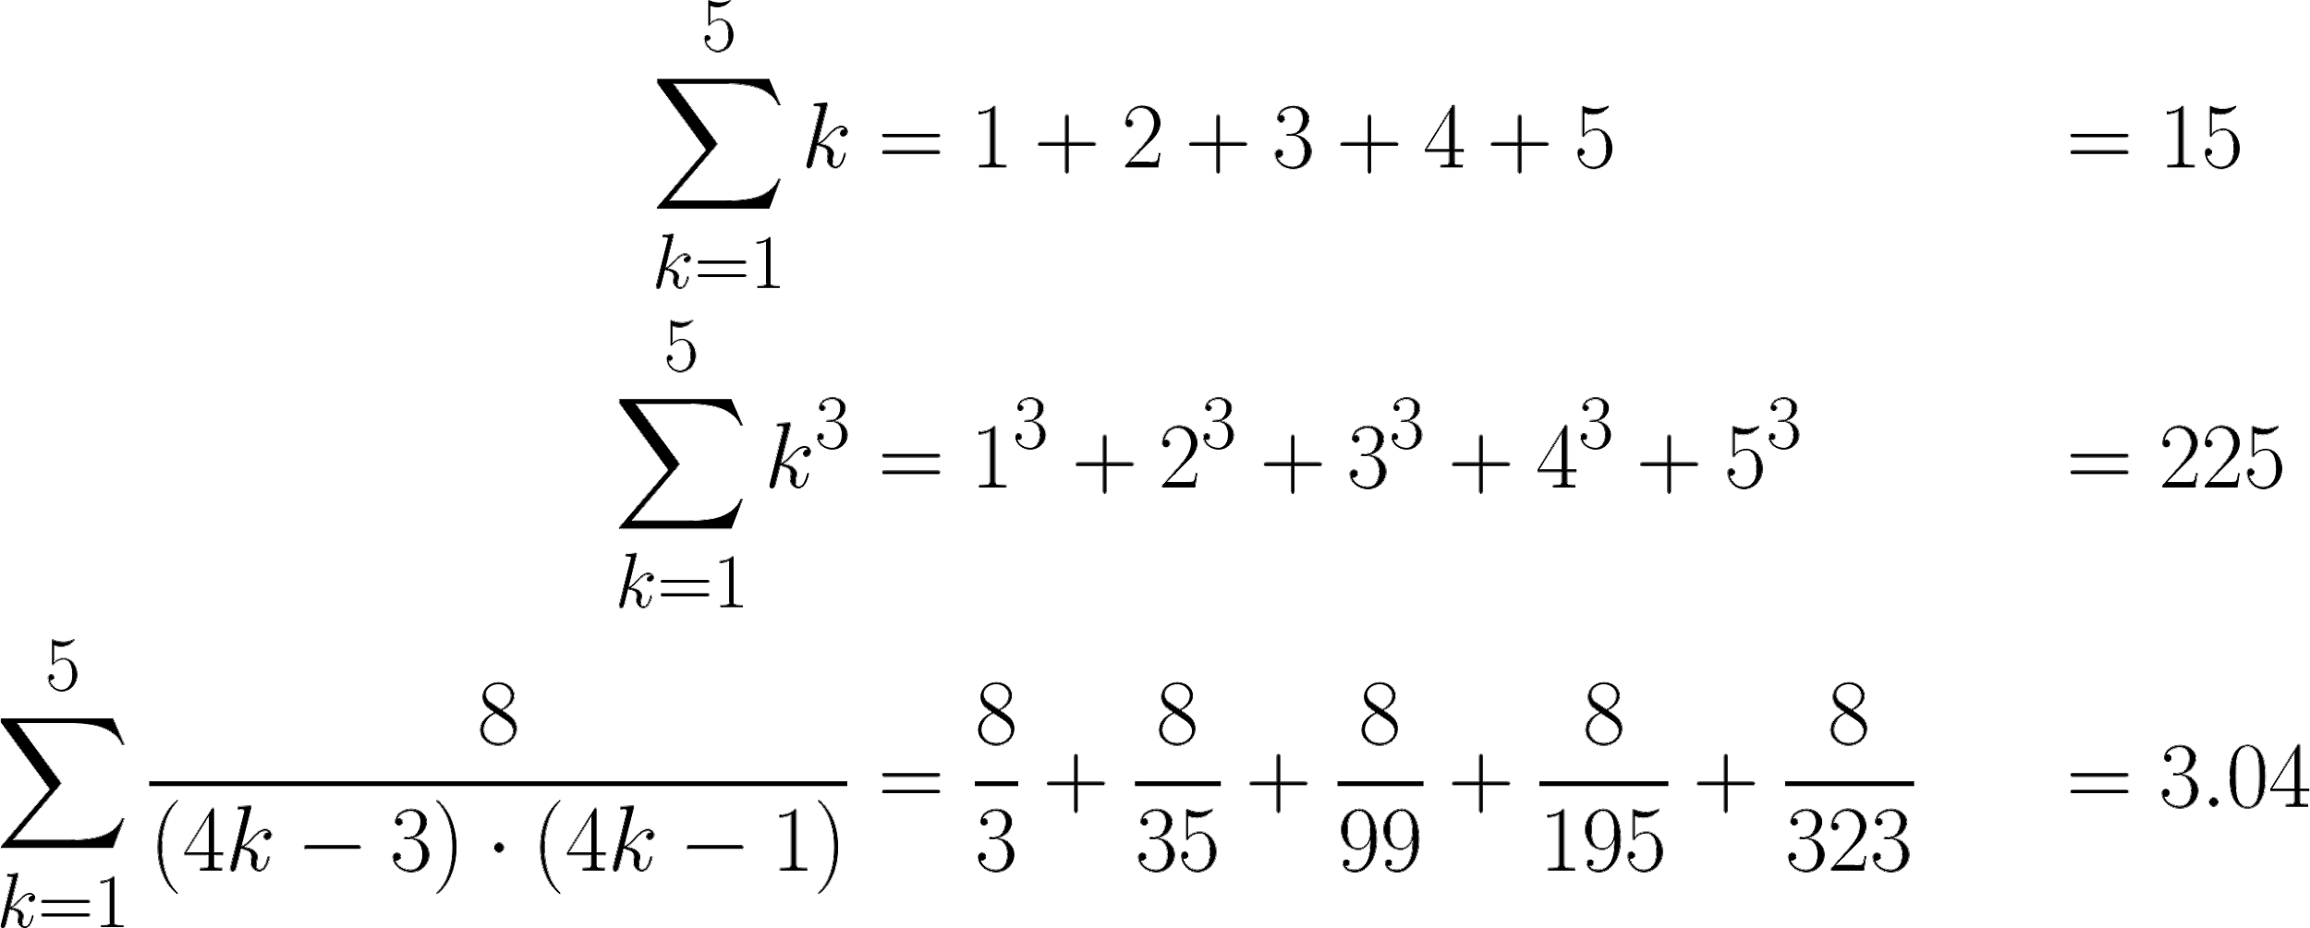
Generalizing Over Computational Processes
The common structure among functions may be a computational process, rather than a number.
Demo

Slide 10
Summation Example
Function of a single argument
(not called "term")
def cube(k):
return pow(k, 3)
def summation(n, term):
"""Sum the first n terms of a sequence.
>>> summation(5, cube)
225
"""
total, k = 0, 1
while k <= n:
total, k = total + term(k), k + 1
return total
A formal parameter that will be bound to a function
The cube function is passed as an argument value
0 + 1 + 8 + 27 + 64 + 125
The function bound to term gets called here

Slide 11
Functions as Return Values
Demo

Slide 12
Locally Defined Functions
Functions defined within other function bodies are bound to names in a local frame
A function that returns a function
def make_adder(n):
"""Return a function that takes one argument k and returns k + n.
>>> add_three = make_adder(3)
>>> add_three(4)
7
"""
def adder(k):
return k + n
return adder
The name add_three is bound to a function
A def statement within another def statement
Can refer to names in the enclosing function

Slide 13
Call Expressions as Operator Expressions
An expression that evaluates to a function
An expression that evaluates to its argument
3
make_adder(1) ( 2 )
2
func adder(k)
make_adder(1)
make_adder(1)
1
make_adder( n ):
def adder(k):
return k + n
return adder
func adder(k)

Slide 14
A More Complex Example
def make_adder(n):
"""Return a function that takes one argument k and returns k + n.
>>> add_three = make_adder(3)
>>> add_three(4)
"""
def adder(k):
return k + n
return adder
def square(x):
return x * x
def compose1(f, g):
def h(x):
return f(g(x))
return h
compose1(square, make_adder(2))(3)

Slide 15
Self Reference

Slide 16
Returning a Function Using Its Own Name
def print_sums(n):
print(n)
def next_sum(k):
return print_sums(n + k)
return next_sum
print_sums(1)(3)(5)

Slide 17
Summary
Higher-order function: any function that either accepts a function as an argument and/or returns a function
Why are these useful?
Generalize over different form of computation
Helps remove repetitive segments of code
One use case: summation
We generalized over the computation of each term
We saw nested functions can access variables in outer function (adder) as well as the outer function itself (print_sums)
Caution: avoid abusing higher-order functions, which affect readability
Abstraction is good, but avoid over-abstraction

