Slide 1
Lecture 6 - Recursion

Slide 2
Review: Abstraction

Slide 3
Describing Functions
def square(x):
"""Return X * X"""
x is a number
square returns a non-negative real number
square returns the square of x
A function's domain is the set of all inputs it might possibly take as arguments.
A function's range is the set of output values it might possibly return.
A pure function's behavior is the relationship it creates between input and output.

Slide 4
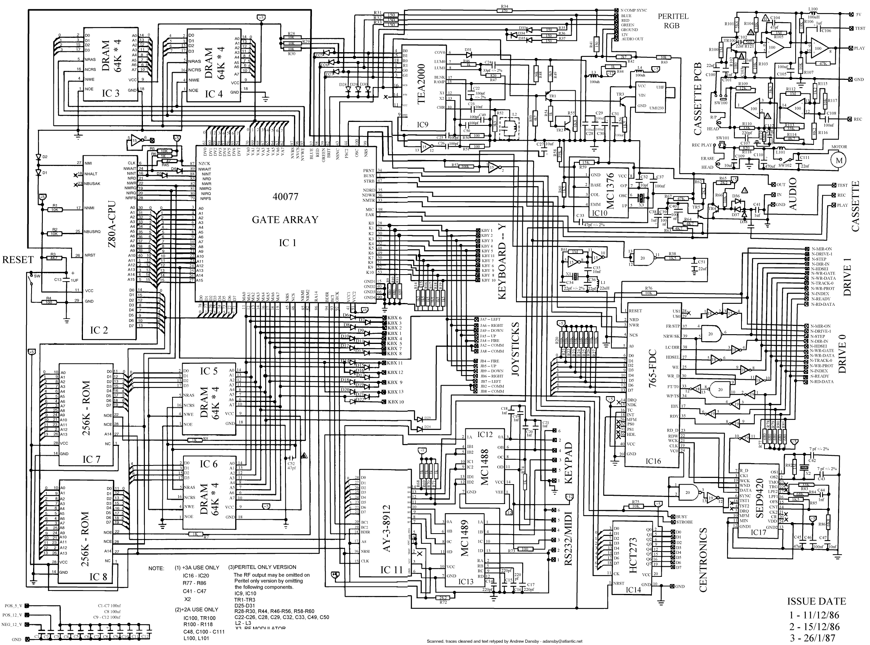

Functional Abstraction
Demo
Use (functional abstraction)
square(2) always returns 4
square(3) always returns 9
...
Without worrying about how Python evaluates the function
Mechanics
How does Python execute this program line-by-line (e.g. Python Tutor)
What happens when you evaluate a call expression, what goes on its body, etc.

Slide 5
Recursion

Slide 6
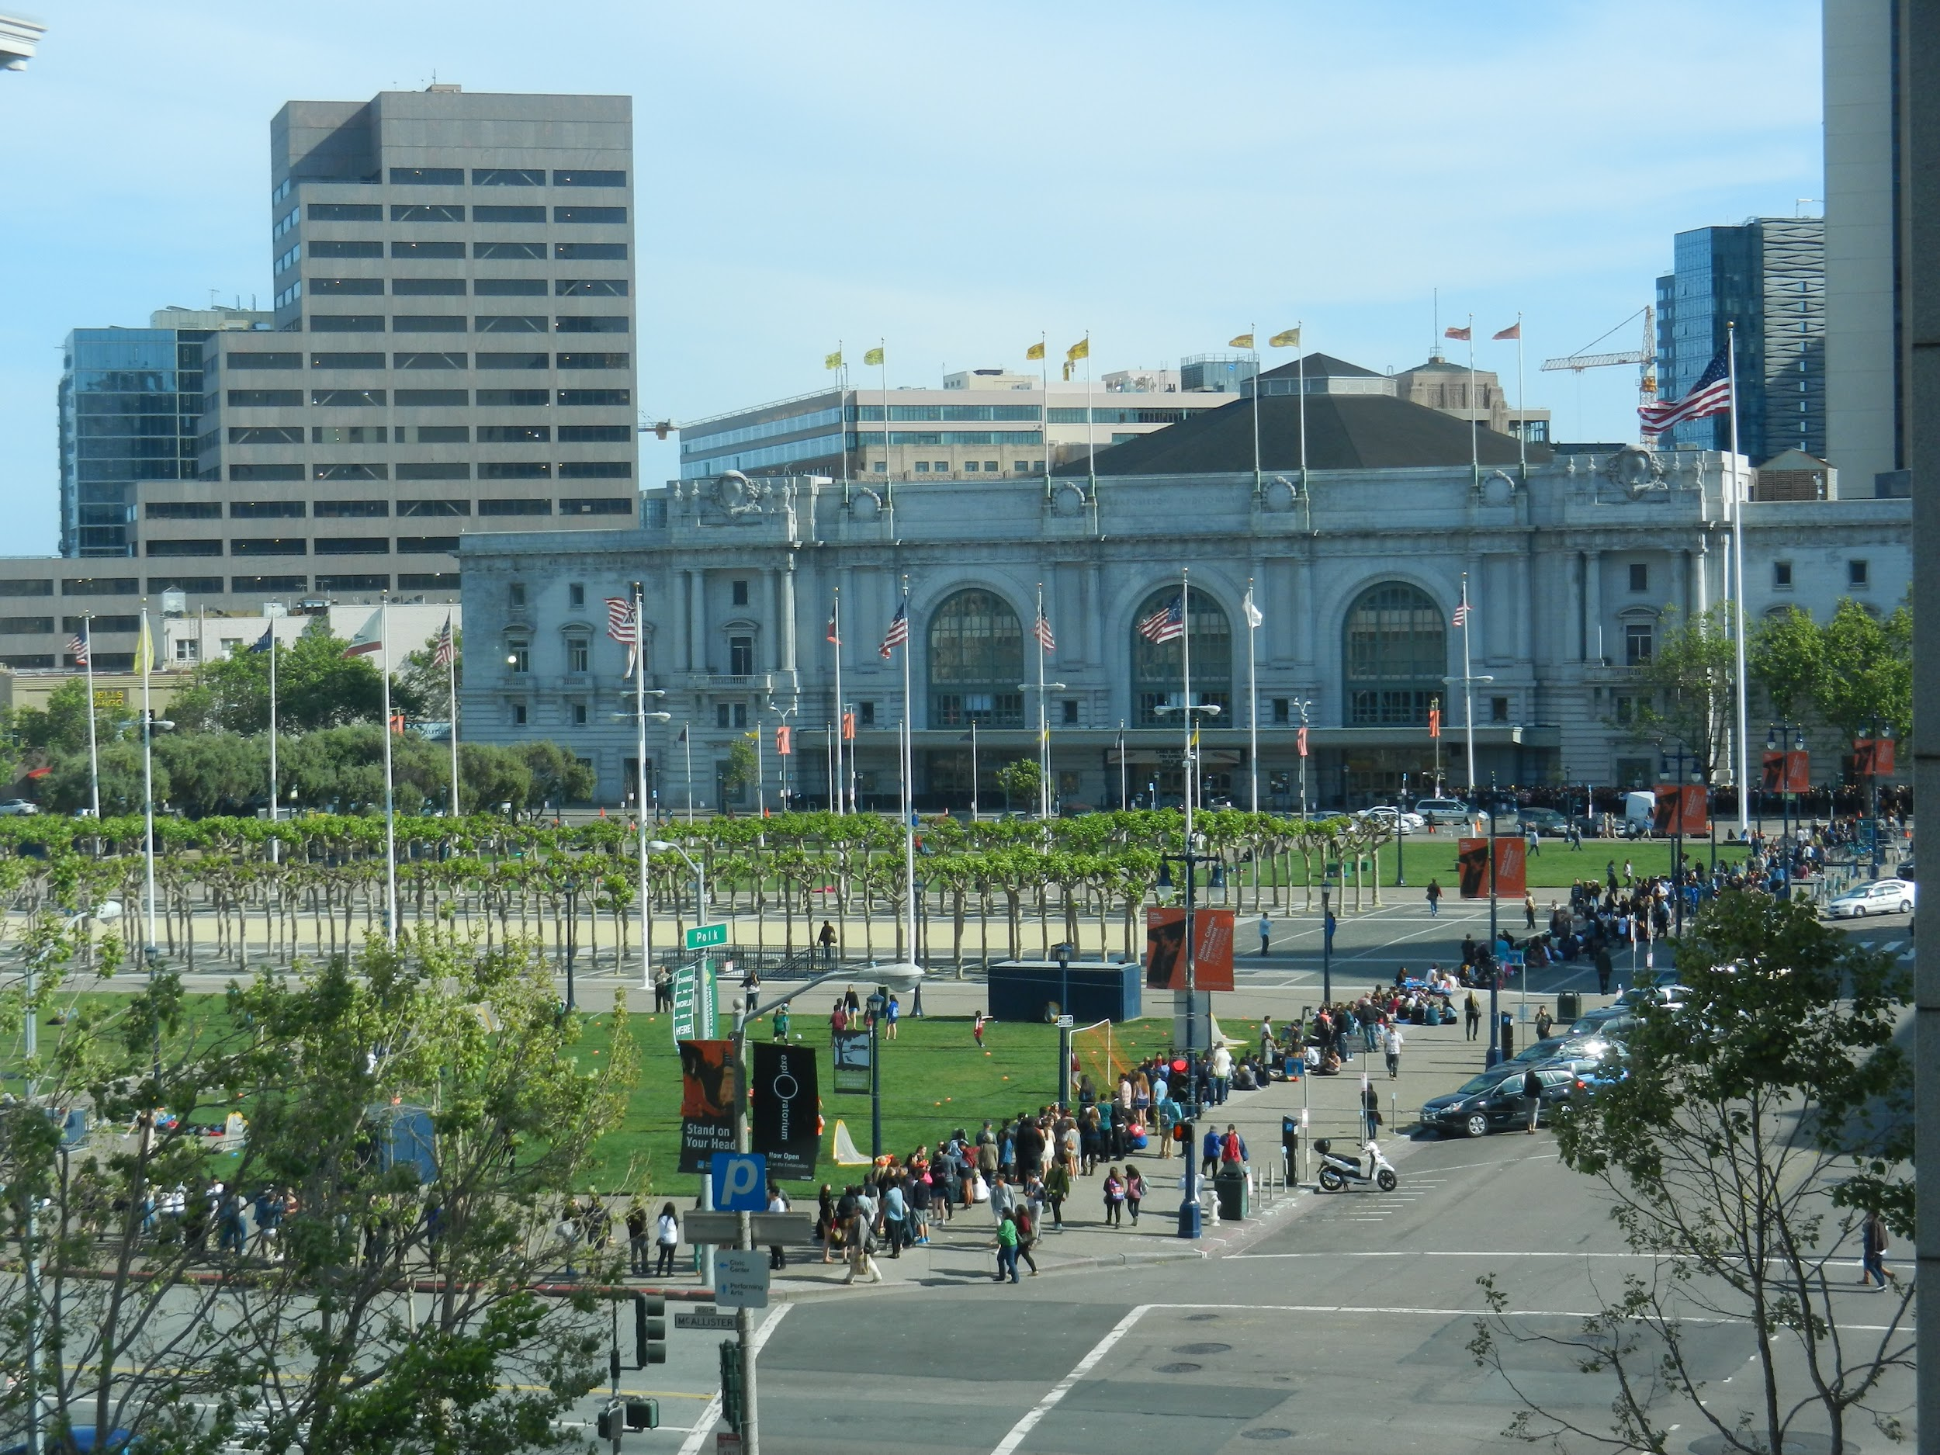
Suppose you're waiting in line for a concert.
You can't see the front of the line, but you want to know what your place in line is. Only the first 100 people get free t-shirts!
You can't step out of line because you'd lose your spot.
What should you do?

Slide 7
An iterative algorithm might say:
Ask my friend to go to the front of the line.
Count each person in line one-by-one.
Then, tell me the answer.

Slide 8
A recursive algorithm might say:
If you're at the front, you know you're first.
Otherwise, ask the person in front of you, "What number in line are you?"
The person in front of you figures it out by asking the person in front of them who asks the person in front of them etc…
Once they get an answer, they tell you and you add one to that answer.

Slide 9
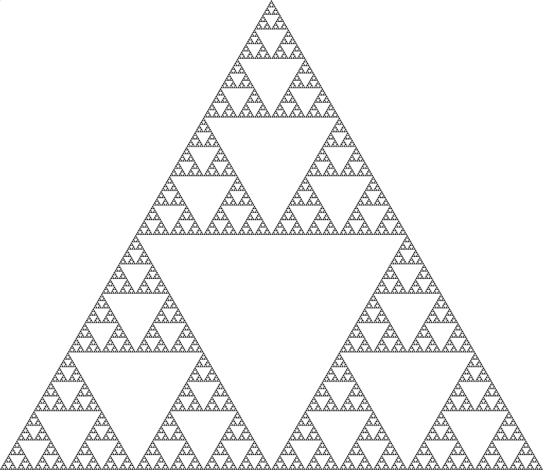
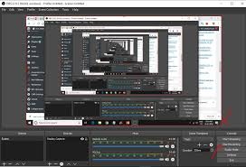
Recursion
Recursion is useful for solving problems with a naturally repeating structure - they are defined in terms of themselves
It requires you to find patterns of smaller problems, and to define the smallest problem possible

Slide 10
Recursion in Evaluation
f(g(h(2), True), h(x))
g(h(2), True)
h(x)
A call expression is composed of smaller (call) expressions!
Stop once you reach a number, boolean, name, etc.
h(2)

Slide 11
Recursive Functions

Slide 12
Recursive Functions
A function is called recursive if the body of that function calls itself, either directly or indirectly
This implies that executing the body of a recursive function may require applying that function multiple times
Recursion is inherently tied to functional abstraction

Slide 13
Structure of a Recursive Function
One or more base cases, usually the smallest input.
"If you're at the front, you know you're first."
One or more ways of reducing the problem, and then solving the smaller problem using recursion.
"Ask the person in front, 'What number in line are you?'"
One or more ways of using the solution to each smaller problem to solve our larger problem.
"When the person in front of you figures it out and tells you, add one to that answer."
Demo

Slide 14
Functional Abstraction & Recursion
Expression
fact(1)
fact(3)
fact(4)
fact(n - 1)
fact(n)
Value
1
6 (3 * 2 * 1)
24 (4 * 3 * 2 * 1)
n-1 * n-2 * ... * 1
n * n-1 * n-2 * .. * 1
n * fact(n - 1)

Slide 15

Verifying factorial
Is factorial correct?
Verify the base cases.
Are they correct?
Are they exhaustive?
Now, harness the power of functional abstraction!
Assume that factorial(n-1) is correct.
Verify that factorial(n) is correct.
def fact(n):
if n == 0:
return 1
else:
return n * fact(n-1)
Functional abstraction: don't worry that fact is recursive and just assume that factorial gets the right answer!

Slide 16
Break

Slide 17
Visualizing Recursion
Demo

Slide 18
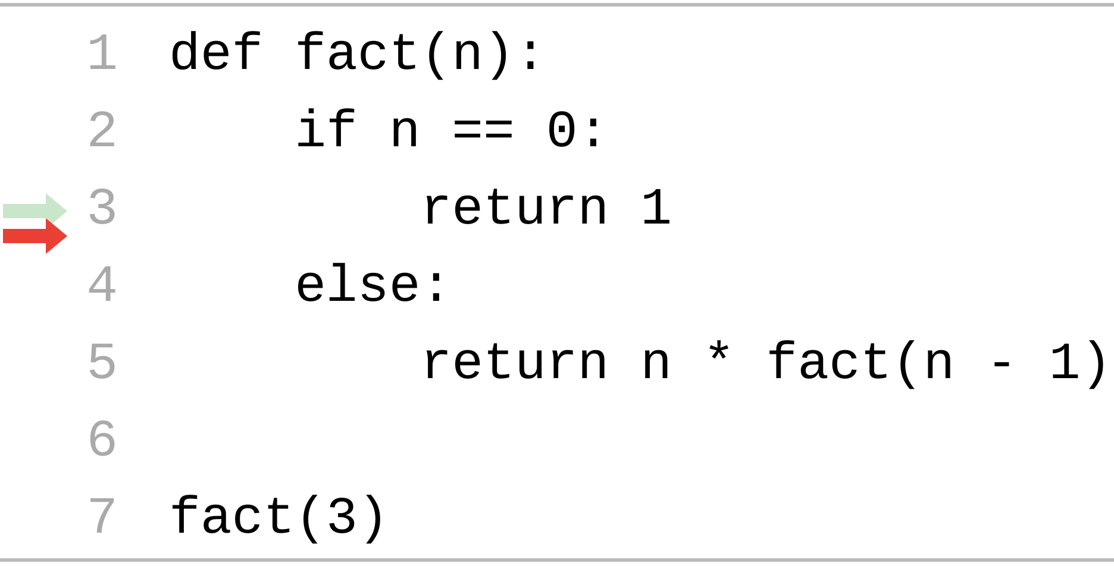
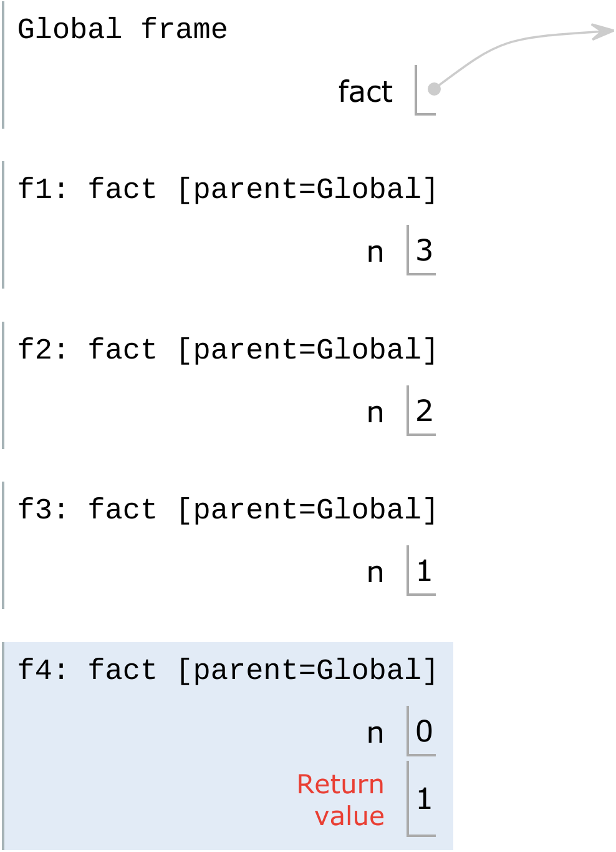
Recursion in Environment Diagrams
What is fact(3)?
What is fact(2)?
The same function fact is called multiple times, each time solving a simpler problem
All the frames share the same parent - only difference is the argument
What n evaluates to depends upon the current environment
What is fact(1)?
What is fact(0)?
fact(0) is 1

Slide 19
Recursive tree - another way to visualize recursion
6
fact(3)
1 def fact(n):
2 """Calculates n!"""
3 if n == 0:
4 return 1
5 else:
6 return n * fact(n-1)
2
3 *
fact(2)
1
2 *
fact(1)
1
1 *
fact(0)
1

Slide 20
How to Trust Functional Abstraction
Assume this all works!
Look at how we computed fact(3)
Which required computing fact(2)
Which required computing fact(1)
Which required computing fact(0)
Which we know is 1, thanks to the base case!
Verifying the correctness of recursive functions
Verify that the base cases work as expected
For each larger case, verify that it works by assuming the smaller recursive calls are correct

Slide 21
Identifying Patterns
def fact(n):
if n == 0 or n == 1:
return 1
elif n == 2:
return 2 * 1
elif n == 3:
return 3 * 2 * 1
elif n == 4:
return 4 * 3 * 2 * 1
elif n == 5:
return 5 * 4 * 3 * 2 * 1
elif n == 6:
return 6 * fact(5)
else:
return n * fact(n-1)
Is factorial correct?
List out all the cases.
Identify patterns between each case.
Simplify repeated code with recursive calls.

Slide 22
Examples

Slide 23
Count Up
Let’s implement a recursive function to print the numbers from 1 to `n`. Assume `n` is positive.
Demo
def count_up(n):
"""Prints the numbers from
1 to n.
>>> count_up(1)
1
>>> count_up(2)
1
2
>>> count_up(4)
1
2
3
4
"""
"*** YOUR CODE HERE ***"
One or more base cases
One or more recursive calls with simpler arguments.
Using the recursive call to solve our larger problem.

Slide 24
Count Up - Summary
Base case
What is the smallest number where we don’t have to do any work?
We know `n` is positive so the the smallest positive integer is 1 and if n = 1, print it out and do nothing else.
Recursive call with smaller arguments
Have access to the largest number, so try printing smaller numbers
Use recursive call to solve the problem
Once we’ve printed up to n - 1, what value is left?

Slide 25
Sum Digits
Let’s implement a recursive function to sum all the digits of `n`. Assume `n` is positive.
Demo
def sum_digits(n):
"""Calculates the sum of
the digits `n`.
>>> sum_digits(9)
9
>>> sum_digits(19)
10
>>> sum_digits(2019)
12
"""
"*** YOUR CODE HERE ***"
One or more base cases
One or more recursive calls with simpler arguments.
Using the recursive call to solve our larger problem.

Slide 26
Sum Digits Discussion
What’s our:
Input?
Number
Output?
Sum of all the digits
Base case?
A single digit
Smaller problem?
Sum of all digits but one
Larger problem?
Sum of all digits but one plus the digit that was left out

Slide 27
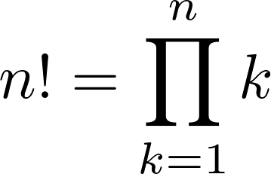
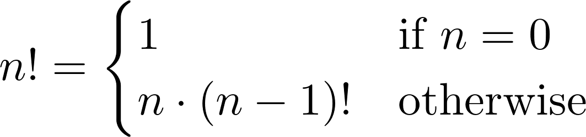
Iteration vs. Recursion
Iteration and recursion are somewhat related
Converting iteration to recursion is formulaic, but converting recursion to iteration can be more tricky
Iterative
Recursive
def fact_iter(n): total, k = 1, 1 while k <= n: total, k = total*k, k+1 return total
def fact(n): if n == 0: return 1 else: return n * fact(n-1)
Names: n, total, k, fact_iter
Names: n, fact

Slide 28
Summary
Recursive functions are functions that call themselves in their body one or more times
This allows us to break the problem down into smaller pieces
Using functional abstraction, we do not have to worry about how those smaller problems are solved
A recursive function has a base case to define its smallest problem, and one or more recursive calls
If we know the base case is correct, and that we get the correct solution assuming the recursive calls work, then we know the function is correct
Evaluating recursive calls follow the same rules we’ve talked about so far

