Slide 1

Comparative analysis of SARS and COVID-19 in Wuhan: Changes of vegetation using surface reflectance data in 2003 and 2020
Team member: Muxi Liu, Chunjiang Liu, Yilian Liu, Lirui Jiao

Slide 2
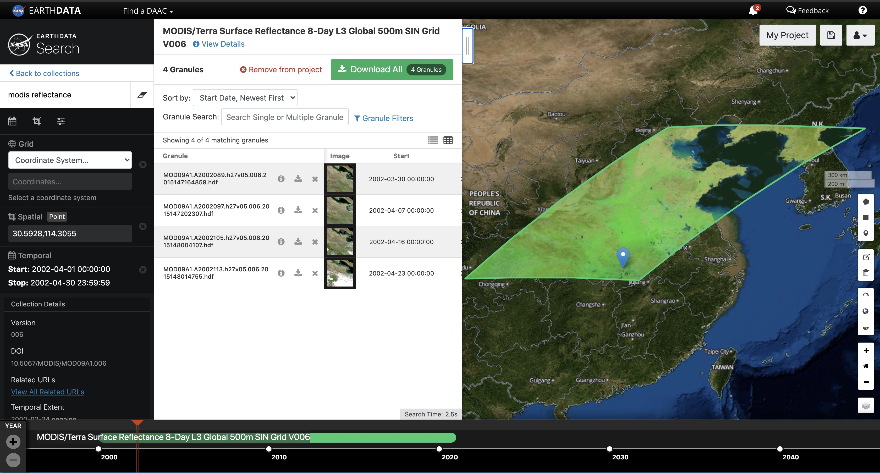
When a pandemic strikes, social systems result in major but unknown changes to the environment. In 2003, an outbreak of SARS caused a massive disturbance in China. Recently, the world has been battling the catastrophe of COVID-19. We’re interested in the environmental changes with and without the intervention of human. In this study, we will focus on Wuhan, China, and compare the vegetation coverage change during the breakout of SARS in 2002-2003 and the COVID-19 in 2019-2020.
Introduction & Background

Slide 3
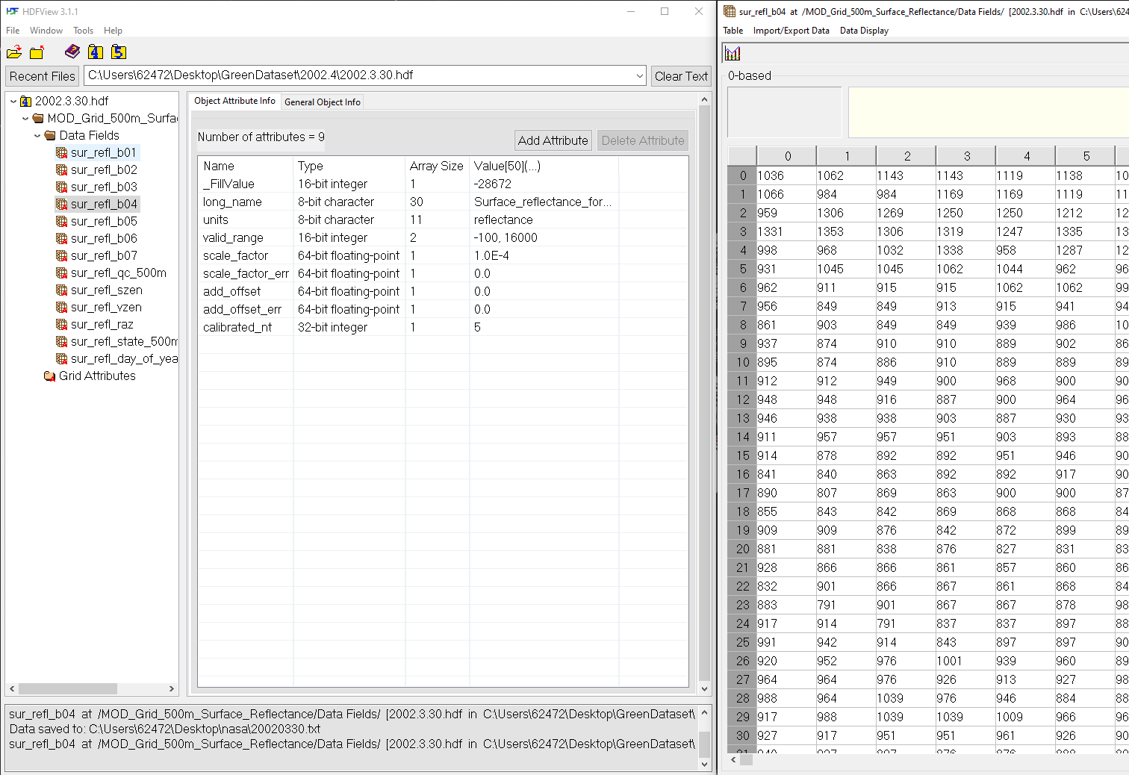
Approach & Method
We used the band 4 data (the green one) from four groups in the spectrum of Surface Reflectance from NASA database EARTHDATA. The reflectance wavelength of vegetation is between 520-560 nm. So an increase in the reflectance rate is interpreted as growth of vegetation and vice versa.

Slide 4
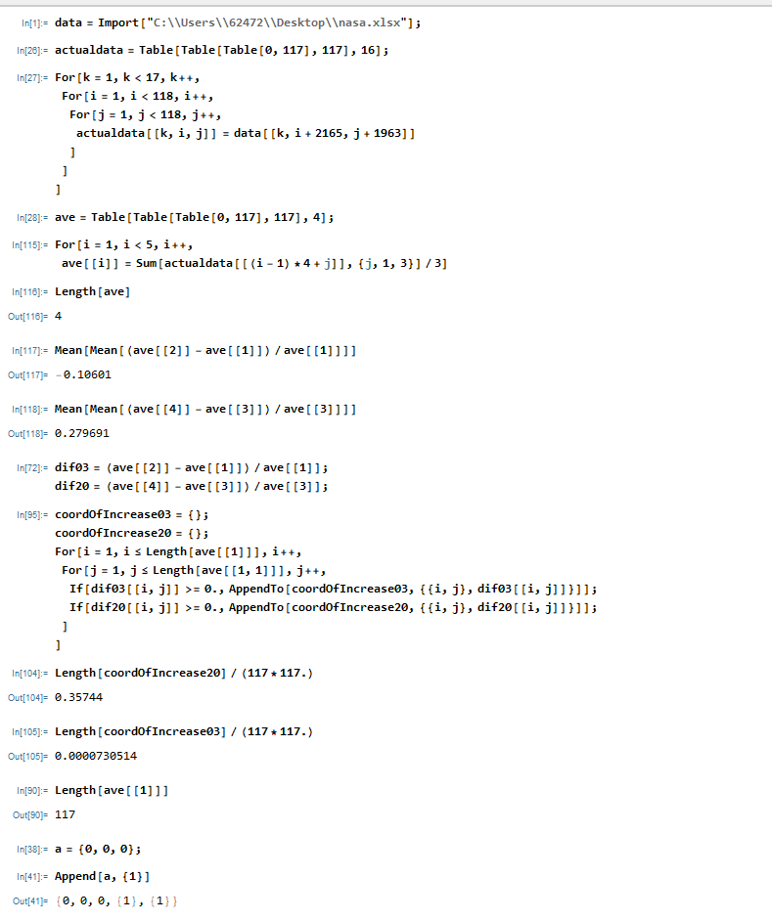
Analysis & Evaluation
Using Mathematica, we processed the raw data obtained from the database and selected the data points that correspond to the city range of Wuhan.
We used Mathematica's built in functions to find the percentage difference of the surface reflectance. The results are then plotted to visualize the impact of the two pandemics on surface reflection rate.

Slide 5
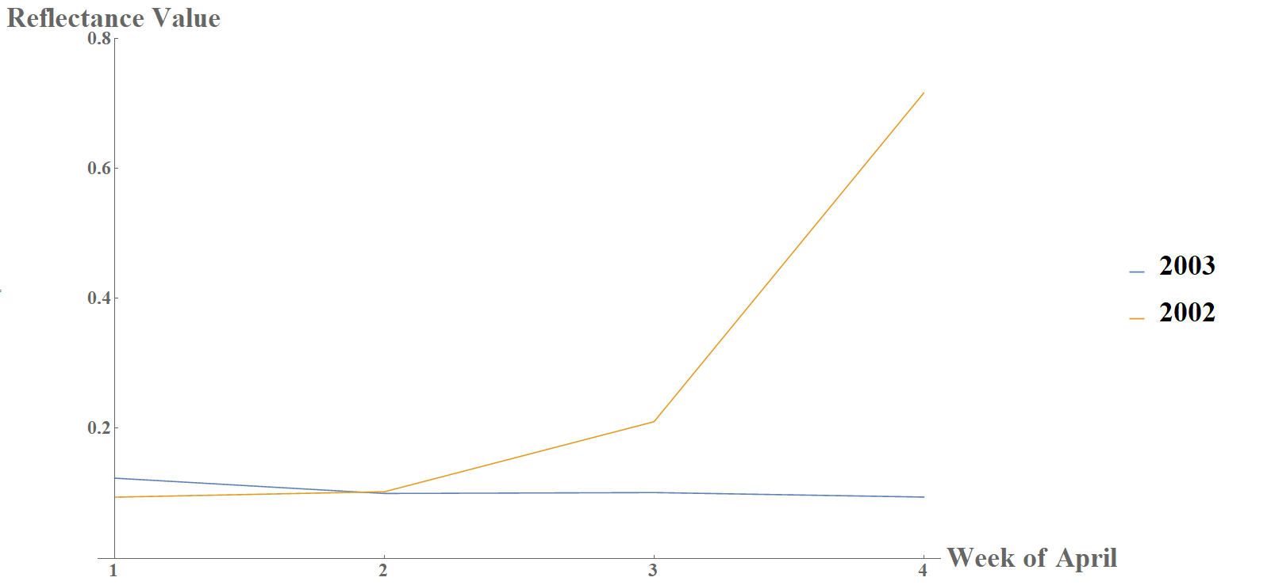
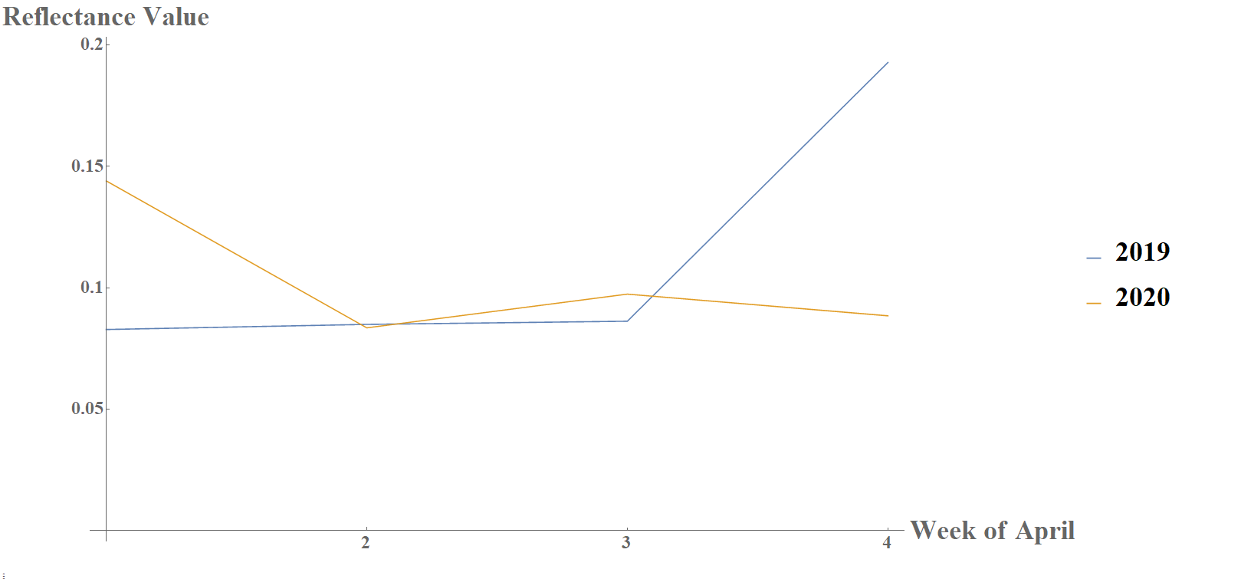
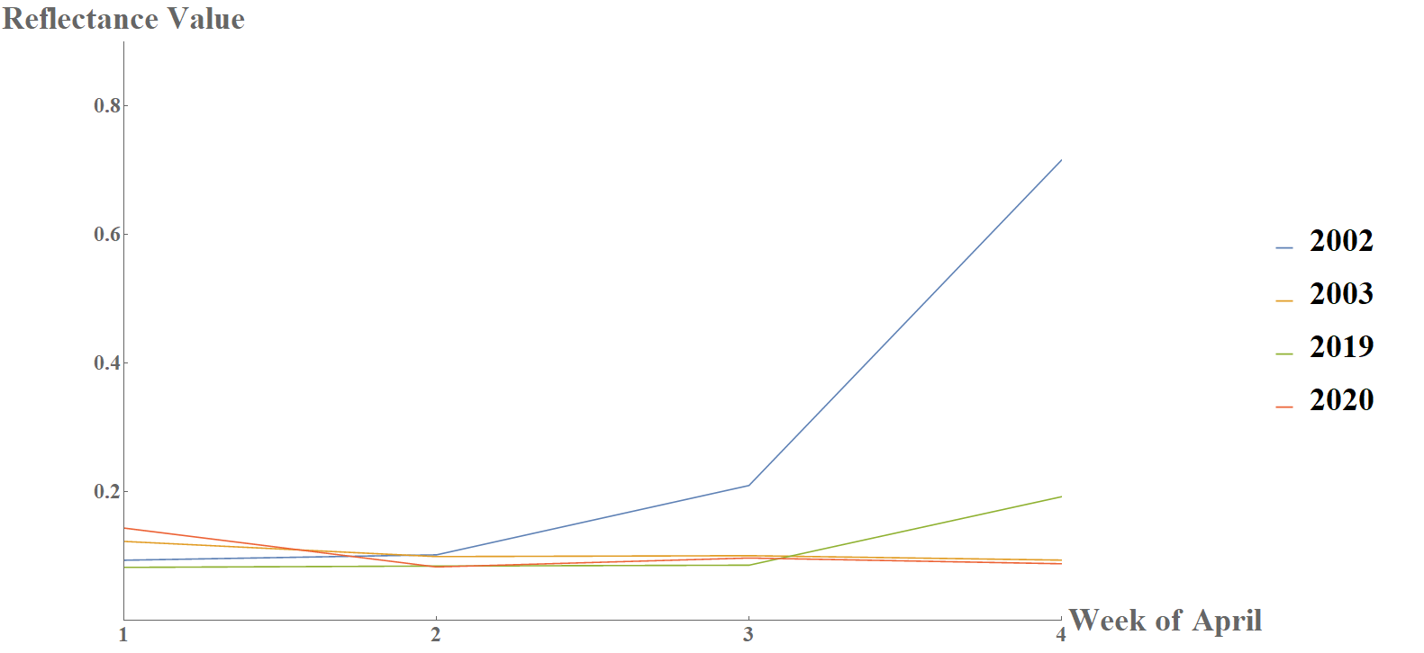
SARS
Conclusion
Our results show that the rate of the surface reflectance decreases during 2002-2003 is different from that during 2019-2020. However, we have discovered that:
The trends of the impacts from the two pandemics on the surface reflectance are similar
Prior to the outbreaks of the two pandemics, Wuhan implemented large-scale tree-planting and this can be demonstrated in the reflectance peaks seen in the last week of both datasets, such as the surface reflectance increase that resulted from massive tree-planting in March 2002
We can infer from the results that the two pandemics led to decrease in human intervention and conclude that human intervention in building a green environment is meaningful and detrimental
COVID-19
SARS and COVID-19

