Slide 1
Algorithm
-Yilian Zhang

Slide 2
How hard it is?
Well-defined, ordered set of steps for solving a problem is called an algorithm
Task: pay the gas bill
Open the computer
Access the gas company website
Log in the account
Click make payment button
Logout
Anything missing?

Slide 3
Picobot- Roomba Problem - https://www.cs.hmc.edu/picobot/
Clean up ---- pretty easy?
if your parents gave you a vacuum cleaner and told you to vacuum your room without missing a spot, you’d probably do a pretty great job without even thinking too much about it. Shouldn’t it be straightforward to convey your strategy to a robot?
Robot - Limit
it can only sense what’s directly around it.
Picobot is totally unfamiliar with the environment it is supposed to clean

Slide 4
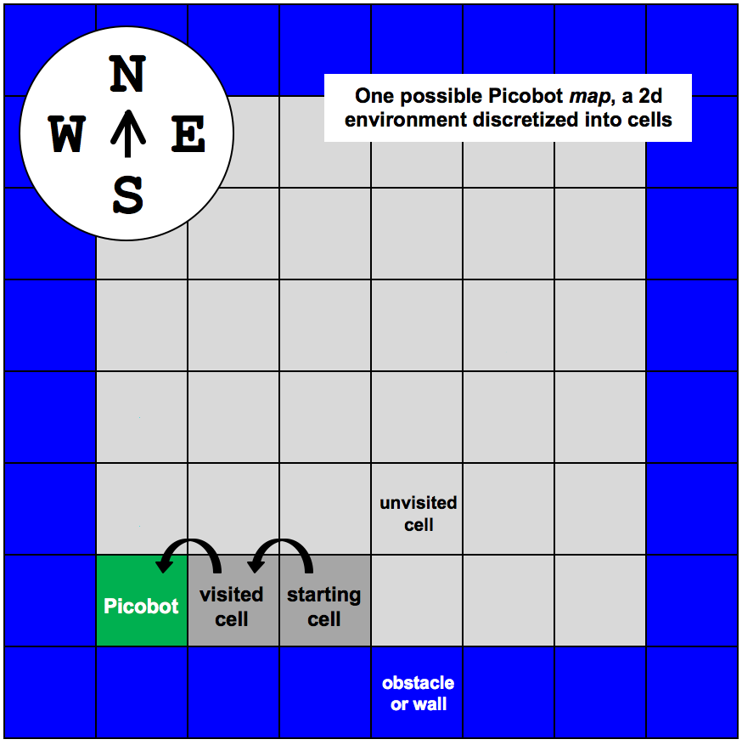
Environment -NEWS

Slide 5
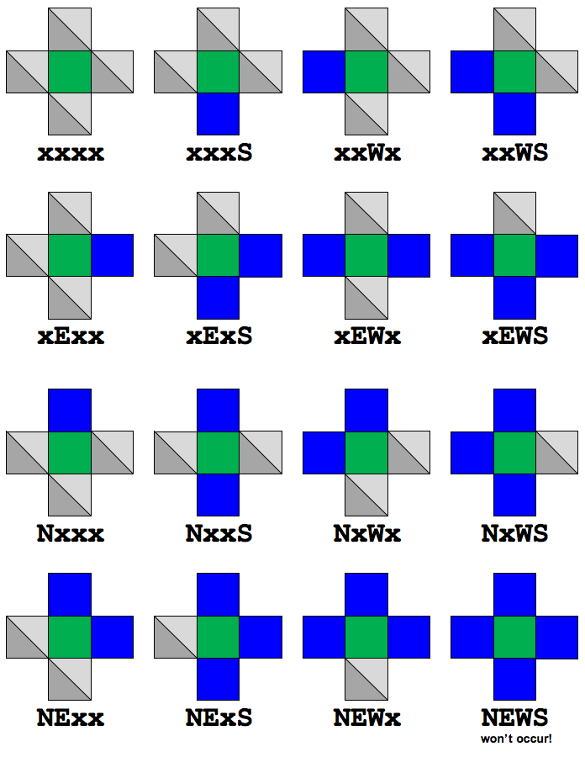
Environment – How to represent

Slide 6
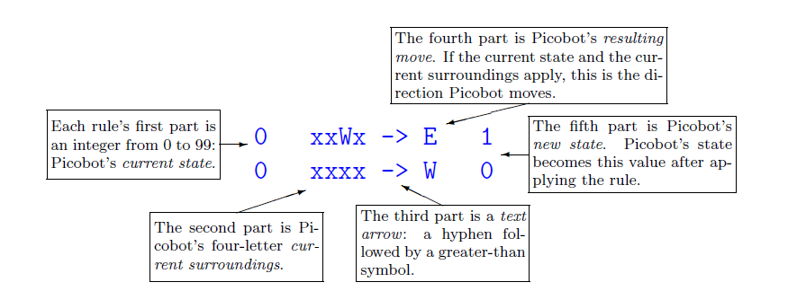
Algorithm--- Rules- Picobot moves according to a set of rules of the form StateNow Surroundings -> MoveDirection NewState
State : refer to the internal information that describes what a computer is doing.
“I am eating”
“I am going north”

Slide 7
Command and Rules
state 0 ------------ Going West
state 1 ------------Going East
If Picobot is moving west and there is no wall to the west, then keep moving west.
0 **x* -> W 0
If Picobot is moving west and there is a wall to the west, then start moving east.
0 **W* -> E 1
If Picobot is moving east and there is no wall to the east, then keep moving east.
1 *x** -> E 1

Slide 8
Example: To clean an empty room
State 0 ------ move to the NE corner of the room
State 1 ------ move to south
State 2 ------ move to north
State 0 : Move all the way to north
0 X*** -> N 0
Move all the way to east
0 NX** -> E 0

Slide 9
Example: To clean an empty room
State 1:
From NE corner, move all the way south.
0 NE** -> S 1
1 ***X -> S 1
Once reach the south wall, move to west
1 ***S -> W 2

Slide 10
Example: To clean an empty room
State 2:
Move all the way to the north
2 X*** -> N 2
Once reach the north wall, move the west
2 N*** -> W 1
REPEAT………….

Slide 11
Find out another solution
More Information: https://www.cs.hmc.edu/twiki/bin/view/CSforAll/IntrotoPicobot
Your Task
Your task is to design one set of rules that will allow picobot to completely cover an empty square room.
Link to picobot page : https://www.cs.hmc.edu/picobot/

