Slide 1
Git and Git Pages
-Yilian Zhang

Slide 2
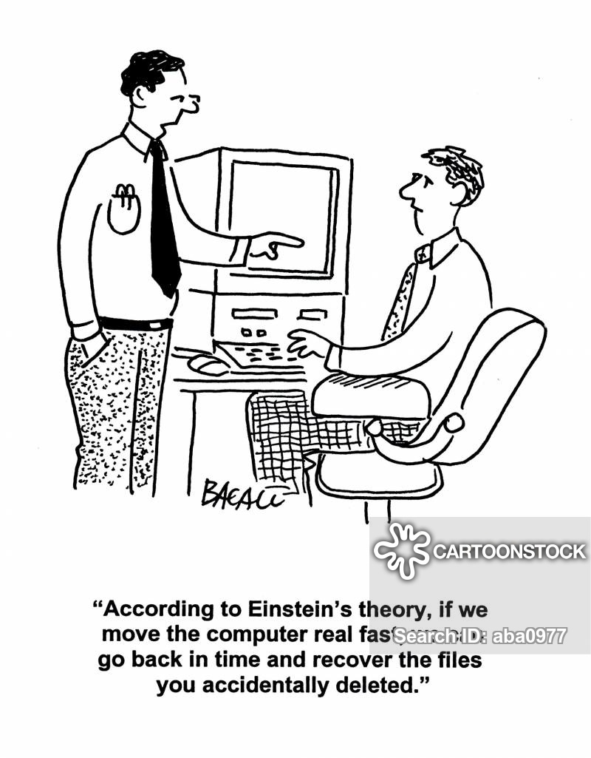
Files – Lost , Changed

Slide 3
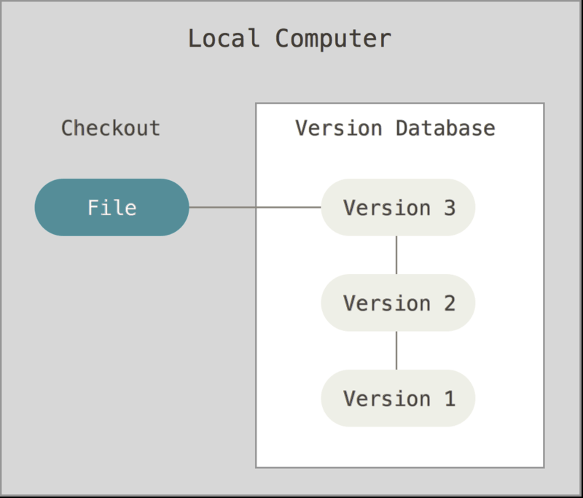
Version Control
Do you care ?
system that records changes to a file or set of files over time
Is it same as backup?
Notes:
Local Version Control Systems
Centralized Version Control Systems
Distributed Version Control Systems
--------------- Any difficulties on trying to recover old changes in programming
----------- accidently override the old files
----- Want to try some new changes but afraid the change will mess up the whole system. – branch & merge

Slide 4
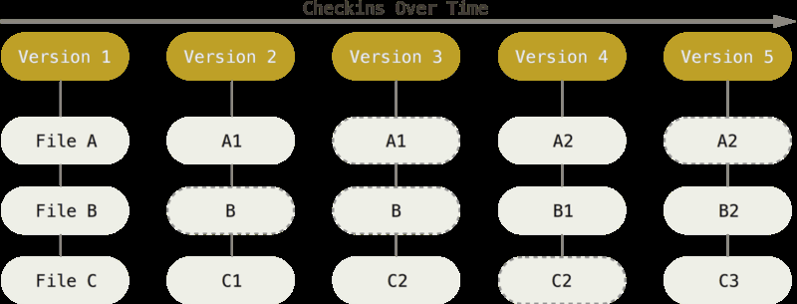
What is GIT? Industry standard tools
open source distributed version control system that takes a snapshot of data.
Data === Stream of snapshots

Slide 5
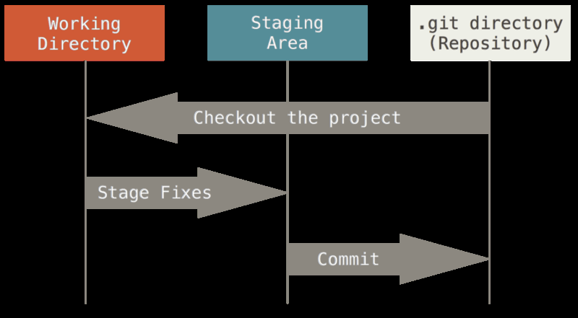
Three States- Working, Staging, Repository
You modify files in your working tree.
You selectively stage only those changes to the staging area.
You do a commit and stores that snapshot permanently to your Git directory.

Slide 6
Install Git, Python and Microsoft visual studio code- If you plan to use your own laptop.
https://gitforwindows.org/
Python 3.7 ---- https://www.python.org/downloads/
Visual Studio Code ---https://code.visualstudio.com/download
And Python Extension
Python by Microsoft extension . -- https://marketplace.visualstudio.com/items?itemName=ms-python.python

Slide 7
GitHub
Hosting Service for Git repository.
Popular software development platform
Track changes, foster contribution/collaboration, showcase
Web-based graphical interface
You can do simple editing on the web.
Back up for your codes – similar to Google photos

Slide 8
Remote Repository v.s Local Repository – DOWNLOAD
Download a project from Remote Repository and its entire version history
Get a local folder
On your J:/drive
Create folder CSCI125
Open the PowerShell window at the folder
Open Shift and right click, pick open power window shell here. – You are in CSCI125 folder
git clone remoteDirectory localDirectory

Slide 9
Try it if you are comfortable with command line -- Step 1.
Download your homework0 project from github.
Login github
Find the url of your github project.
Now you should see all files are downloaded into homework0.
git clone https://github.com/intro-comp-science-003/homework0-USERNAME homework0

Slide 10
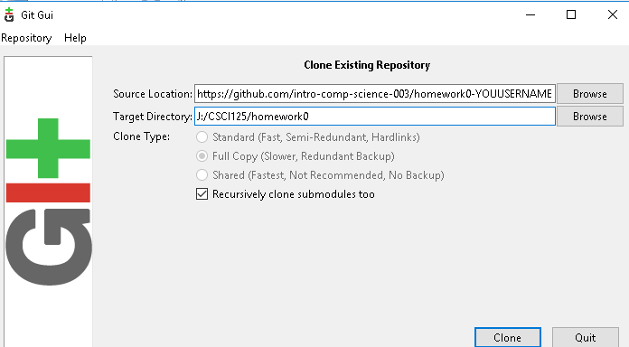
Try it if you like GUI --- Step 1
Run Git Gui
Login your github account – copy the link of the repository in source location

Slide 11
Optional: Can you do it?
Clone the remote github repository to
https://github.com/yilianz/CSCI125
your local folder CSCI125/coursematerial

Slide 12
Heart of Computer Science
Solve problem using computers
Computer Systems -- Hardware Support
Programming --- Talk to computer
Data ---- Input/output
Algorithm --- Way to Solve the Problem

Slide 13
Programming Language
Python – Full featured Programming Language yet easy syntax.
Hello World message.
print(“Hello! Welcome to python programming”)

Slide 14
How to write and run a program?
Interpreter ----- Python interpreter
Editor --- Microsoft Visual Studio Code

Slide 15
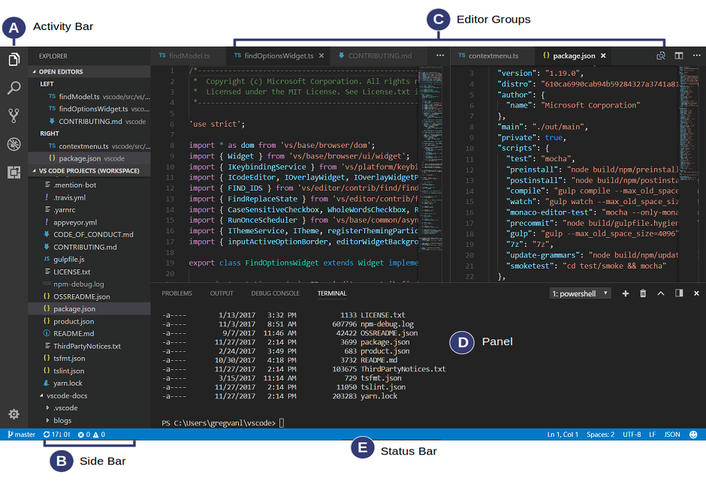
Open Folder
File – Open Folder
Run file
Right click – Run python file in terminal
Save file
CTRL-S

Slide 16
Try it: Step 2
Use visual studio code to modify homework0/test.py
Print a welcome message:
Welcome to python!

Slide 17
Try it --- Upload to the remote github ----- Finish the Homework 0!!
Visual Studio Code, source control
Stage all Changes
Commit all
Push to
You will need to enter your username and password.
Optional: Use command line tools
git add --all
git commit -m "Initial commit"
git push -u origin master

Slide 18
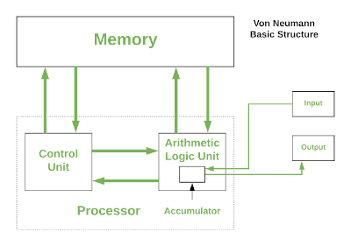
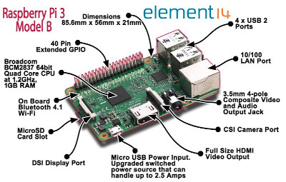
Computer Systems

Slide 19
Github Pages
You get one site per GitHub account and organization,
and unlimited project sites with your GitHub account

Slide 20
Step 1: Remote folder
Create a repository (folder) to hold your web documents.
Your default Github Website: username.github.io
Your repository: username.github.io
For example: yilianz.github.io

Slide 21
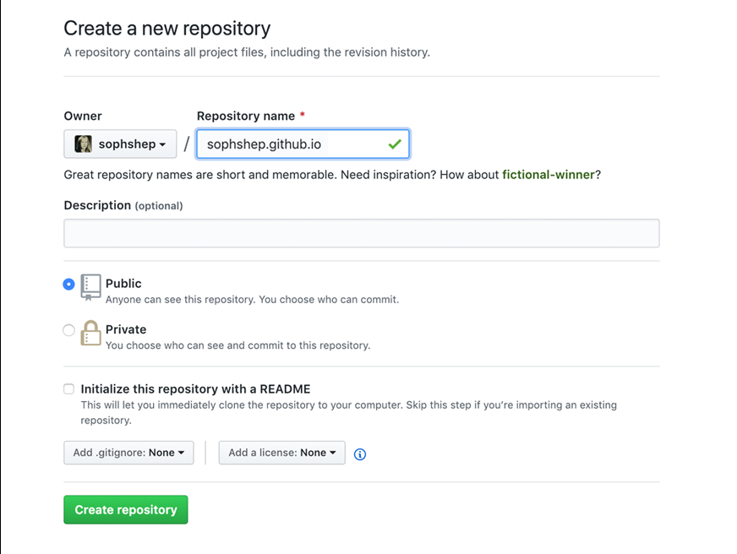

Slide 22
Step 2 Change the ReadMe file
Edit the ReadMe file in your repository username.github.io
and Check your website!
https://username.github.io

Slide 23
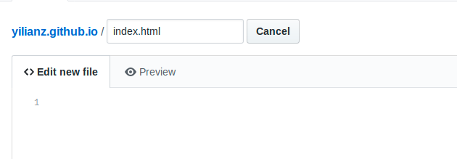
Step3: Create a index.html file

Slide 24
HTML 5
HTML5 (HyperText Markup Language 5)
markup language that specifies the structure and content of documents that are displayed in web browsers
TEXT documents
*Tag based* Extra whitespace and newlines do not matter.

Slide 25
BODY, HEAD & TITLE
<html>
<head>
<title>This is the Title of...</title>
</head>
<body>
<h1>This is the Body of the Page</h1>
<p>Anything within the body of a web
page is displayed in the main
browser window.</p>
</body>
</html>
Notes:
Explain: The overall structure of a page is comprised of two parts: the <head> and the <body>.

Slide 26
BODY, HEAD & TITLE
<html>
<head>
<title>This is the Title of...</title>
</head>
<body>
<h1>This is the Body of the Page</h1>
<p>Anything within the body of a web
page is displayed in the main
browser window.</p>
</body>
</html>
Notes:
Explain: The <title> tag sits inside the <head> element.

Slide 27
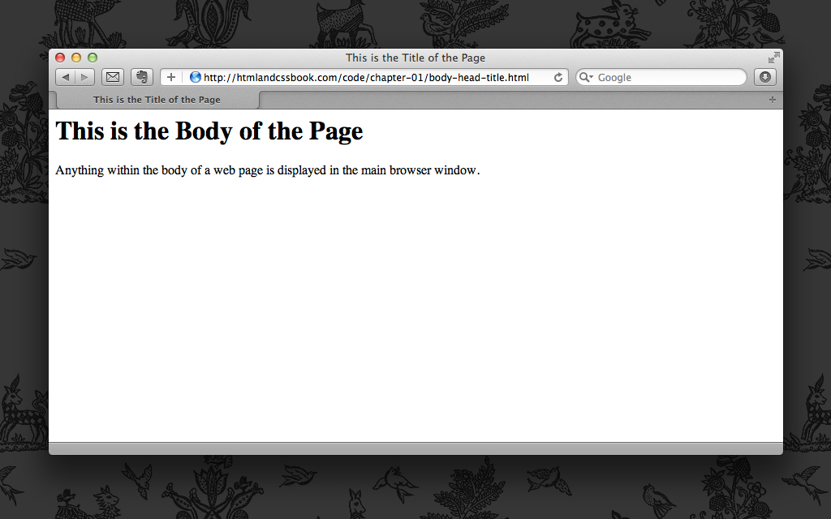
BODY, HEAD & TITLE
Notes:
Explain: This highlights where the content of the <title> tag appears.

Slide 28
BODY, HEAD & TITLE
<html>
<head>
<title>This is the Title of...</title>
</head>
<body>
<h1>This is the Body of the Page</h1>
<p>Anything within the body of a web
page is displayed in the main
browser window.</p>
</body>
</html>
Notes:
Explain: The <body> comes directly after the <head> and everything inside this element is shown in the main browser window.

Slide 29
BODY, HEAD & TITLE
Notes:
Explain: This highlights where the content of the <body> tag appears.

Slide 30
Step 4: Write your first webpage
Edit your index.html page and commit the changes.

