Slide 1
Python-Iteration and Recursion
-Yilian Zhang

Slide 2
Iteration/loops: perform these same repeated tasks
Control Variable that goes through a list generated by range function
**Add the number to sum
sum = 0
for x in range(1,100,2)
sum +=x
print(sum)
Control Variable that goes through a list.
**Print each number
for x in [3, 7, 8]
print(x)
Please be careful that whether the statements is in the loop or outside of the loop. ** range step is integer!!! *

Slide 3


Review Practice: Write loops
Easy version
Hard version
$\frac{1}{2}+\frac{1}{4}+\frac{1}{6}+\frac{1}{8}+……+\frac{1}{100000}$
$\frac{1}{2}+(\frac{1}{2})^{2}+(\frac{1}{2})^{3}+……+(\frac{1}{2})^{20}$
4($1−\frac{1}{3}+\frac{1}{5}−\frac{1}{7}+\frac{1}{9}−……−\frac{1}{9999999}$)

Slide 4
Iteration/loops: Compare lists -Input
Compare two lists and return number of matching items.
1. Get list of movies from topmovie.txt and topmoviesimdb.txt
f = open(“topmovie.txt","r")
list1 = list(f)

Slide 5
Compare lists -- Procedure
2. Procedure: Repeating task
What is matching items?
How to find all matching items?
How to count the number of matching items?

Slide 6
Compare lists - output
How to construct the loop?
For or while
Start and End
3. Print each movie that is in both list and show total number of matching elements
Challenge: If the original raw file is not well constructed, can you still work on it.
Check original file: top100.txt and imdb100.txt

Slide 7
Nested loop: (loop inside of a loop)
What is the outer loop? What is the inner loop?
Example: Write nested loop to print the following shape.
**********
**********
**********
**********
**********

Slide 8
Nested Loop – loop inside of a loop Typical Example: multiplication table
for i in range(1,10):
for j in range(1,10):
ans = i*j
print(f"{i}x{j}={ans}", end=" ")
print()

Slide 9
What is the output of the following loop?
for i in range(5):
for j in range(i,5):
print("*",end="")
print()

Slide 10
What is the output of the following code?
for i in range(5):
for j in range(i+1):
print(i,end="")
print()

Slide 11
Nest loop practice
Simple
Challenge
Produce the following output
*
**
***
****
*****
0....
.1...
..2..
...3.
....4

Slide 12
Need more challenge questions?
Produce the following output
....1
...2
..3
.4
5
....1
...22
..333
.4444
55555

Slide 13
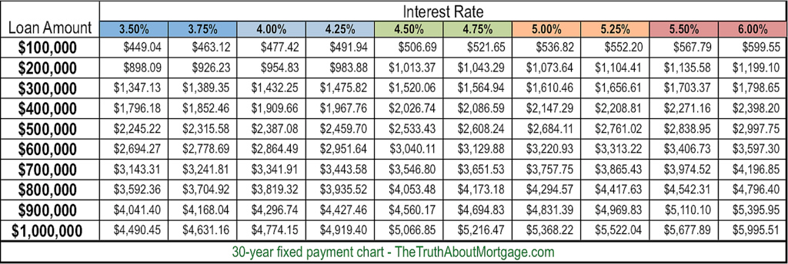
Build table data using nested loop-in real life

Slide 14
Tables in Python – 2D array
Rock Paper Scissors – game table
user
computer
 | Rock | Paper | Scissor
Rock | Draw | Win | Lose
Paper | Lose | Draw | Win
Scissor | Win | Lose | Draw
gamesrule = [["Draw", "Win", "Lose"],["Lose", "Draw", "Win"],[ "Win", "Lose","Draw"]]
gamerule[0][0] --- the result when user is “rock” and computer is “rock”

Slide 15
Challenge:
Can you rewrite the rock paper scissor game without any if statements?

Slide 16
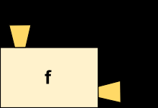
Function -- Revisit
Function is like a machine that takes an input( argument x), and transforms it into an output (return)
Executing a return statement always causes a function to end immediately.
The purpose of function is to wrapping a piece of code for reuse.
Encapsulation and generalization.

Slide 17

Work through Examples
Find the answer: $1+1+\frac{1}{2!}+\frac{1}{3!}+…+\frac{1}{100!}$
Two tasks:
sum
factorial

Slide 18
Work through example
You are given list of scores that you need to drop the lowest scores, and then calculate the average.
You have ten lists of scores that are stored in ten different files.
Three specific tasks
Fetch the data from the file
Find the total
Drop lowest scores and then calculate the average

Slide 19
Function that call function
def f3():
f2()
print("Miny")
f1()
def f4():
print("Eeny")
f3() ----- output
def f1():
print("Moe")
def f2():
f4()
print("Meeny")

Slide 20
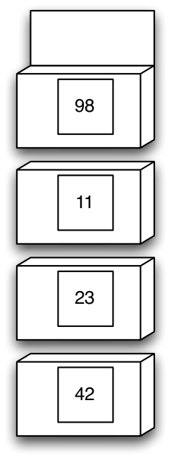
Function call function: demo(13)
def demo(x):
r = f(x+6) + x
return r
def f(x):
r = g(x-1)
x = 1
return r + x
def g(x):
r = x + 10
return r

Slide 21
Recursion Examples: Fibonacci Sequence
Recursion in computer science is a method of solving a problem where the solution depends on solutions to smaller instances of the same problem
A recursive method is any method that calls itself
The Fibonacci Sequence is the series of numbers: 0, 1, 1, 2, 3, 5, 8, 13, 21, 34, ... The next number is found by adding up the two numbers before it
Base Case: Fib(0) = 0, Fib(1) = 1
Fib(n) = Fib(n-1) + Fib(n-2)

Slide 22
Base Case: very important
VERY IMPORTANT
Stops the recursion (prevents infinite loops)
Solved directly to return a value without calling the
same function again

Slide 23
Recursion Practice: Factorial-recursive way.
N! = (N-1)! * N
we advocate trying to write the base case first.
Factorial numbers (i.e., n!) defined recursively:
factorial(0) = 1
factorial(n+1) = factorial(n) * n+1
Examples
4! = 4 * 3 * 2 * 1 --------- 4* 3!

Slide 24
Recursion practice: Sum -- recursive way
Given a number n, find sum of first n natural numbers. To calculate the sum, we will use a recursive function recur_sum().
# Returns sum of first
# n natural numbers

Slide 25
Recursion practice
Write a recursive function to perform exponentiation return x^m, assuming m >= 0

Slide 26
Recursion or Iteration?
Moral: There is usually more than one way to solve a problem!
Iteration (loops to repeat code)
Recursion (nested function calls to repeat code)
Tradeoffs between two options:
Sometimes recursive solution is easier
Recursive solution is often slower

Slide 27
Designing Recursive Algorithms
General strategy: “Divide and Conquer”
Questions to ask yourself
How can we reduce the problem to smaller version of the same problem?
How does each call make the problem smaller?
What is the base case?
Will you always reach the base case?

Slide 28
Recursive way: Challenge problem-Try it yourselves
Write a program to print all the combinations of factors of given number n
Input : 16
Output :2 2 2 2
2 2 4
2 8
4 4

Slide 29
Recursion Example : Reverse a string
def reverse(string):
'''Takes a string as an argument and returns
its reversal.'''
if string == '': # Is the string empty?
return '' # If so, reversing it is easy!
else:
firstSymbol = string[0] # Hold on to the first symbol
return reverse(string[1:]) + firstSymbol

Slide 30
Practice
Write a recursive function to reverse the words in a string, i.e., ”cat is running”becomes ”running is cat”.

Slide 31
Python String method
str.split(sep=None, maxsplit=-1) ---- Return a list of the words in the string, using sep as the delimiter string.
>>> '1,2,3'.split(',')
['1', '2', '3']
>>> '1,2,3'.split(',', maxsplit=1)
['1', '2,3']
>>> '1,2,,3,'.split(',')
['1', '2', '', '3', '']

Slide 32
Python String Method
str.isnumeric() ----- Return true if all characters in the string are numeric characters, and there is at least one character, false otherwise.
str.find(sub[, start[, end]])------ Return the lowest index in the string where substring sub is found within the slice s[start:end]. Optional arguments start and end are interpreted as in slice notation. Return -1 if sub is not found.

Slide 33
More recursion practice
Write a function with the following prototype that returns the sum of the digits of an integer.
int sumOfDigits(int x);
If x is 234, the function should return 2 + 3 + 4, that is, 9.
If x is 12, the function should return 1 + 2, which is 3.
If x is 39, the function should return 12.
If x is negative, ignore the minus sign. For example, -12 and 12 both return 3.

Slide 34
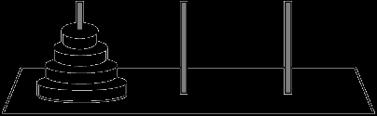
Game problem that can be solved by recursion-Towers of Hanoi
N golden disks on 3 pegs
Only move one disk at a time
A move is taking one disk from a peg and putting it on another peg (on top of any other disks)
Cannot put a larger disk on top of a smaller disk

Slide 35
Towers of Hanoi- recursive idea
Final step is to move the bottom disk from peg 1 to
peg 3
⬧ To do this, the other n-1 disks must be on peg 2
⬧ So, we need an way to move n-1 disks from peg 1 to
peg 2
⬧ Base case: moving the smallest disk is easy (you can
always move it to any peg in one step)

