Slide 1
Git and Git Pages
-Yilian Zhang

Slide 2
Heart of Computer Science
Solve problem using computers
Computer Systems -- Hardware Support
Programming --- Talk to computer
Python
HTML
Data ---- Input/output
Algorithm --- Way to Solve the Problem

Slide 3
Why study security?
2018 Incident Highlights
95% of breaches could have been prevented (ISOC)
3.2% decrease in reported breach incidents (RBS)
5 billion records exposed, a 35.9% decrease (RBS)
$8 billion financial impact of ransomware (CV)
12% rise in business targeted ransomware (Symantec)
$12.5 billion in global EAC/BEC losses since 2013 (FBI)

Slide 4
Recent Case – Capital One Data Breach
When ----- July 19 2019
An individual – believed to be Thompson – gained unauthorized access to a cloud-based server and obtained personal information on Capital One credit card customers and people who applied for the bank's products.
How many
Approximately 100 million people in the United States and 6 million in Canada were affected
What are leaked
About 140,000 Social Security numbers of our credit card customers.
About 80,000 linked bank account numbers of our secured credit card customers.
Customer status data, e.g., credit scores, credit limits, balances, payment history, contact information.
Fragments of transaction data from a total of 23 days during 2016, 2017 and 2018.

Slide 5
What had happened?
Huge dependence on computer and internet
Communication
Entertainment
Transportation
Shopping
Medical
…..
Discussion:
How much of your daily life relies on computers?
Notes:
communication (e.g., email, smartphones), entertainment (e.g., digital cable, mp3s), transportation (e.g., car engine systems, airplane navigation), shopping (e.g., online shopping, credit cards), medicine (e.g., medical equipment, medical records)

Slide 6
Why does this dependency cause problems?
We’re depending heavily on a system for which security is not often a top priority.
Internet is public!
Internet does not have a good model of security at the beginning. It focus on sharing between a small online community for researcher.

Slide 7
Cybersecurity and Challenge
Cybersecurity involves protecting that information by preventing, detecting, and responding to cyber attacks.
Cybersecurity Challenge
A solution to this problem will require both the right technology and the right public policy.

Slide 8
One way to think about it
cybersecurity = security of cyberspace
Notes:
What is cyberspace? Information Systems and Networks

Slide 9
One way to think about it
cybersecurity = security of cyberspace
information systems and networks

Slide 10
One way to think about it
cybersecurity = security of information systems and networks
Notes:
It’s not really the security of the information systems and networks that we care about, it’s that we care about the operations and assets that depend on these information systems.

Slide 11
One way to think about it
cybersecurity = security of information systems and networks
+ with the goal of protecting operations and assets

Slide 12
One way to think about it
cybersecurity = security of information systems and networks with the goal of protecting operations and assets
Notes:
People often think of security as being security against attackers, but as we showed earlier you also need to protect against accidents and failures

Slide 13
One way to think about it
cybersecurity = security of information systems and networks with the goal of protecting operations and assets
security in the face of attacks, accidents and failures

Slide 14
One way to think about it
cybersecurity = security of information systems and networks in the face of attacks, accidents and failures with the goal of protecting operations and assets
Notes:
“Security” still a bit vague here. From earlier definitions we saw that security can mean a number of things – most notably availability, integrity and secrecy
Availability – ability to communicate
Integrity – that what is being communicated is authentic
Secrecy – that communications and information can be kept private

Slide 15
One way to think about it
cybersecurity = security of information systems and networks in the face of attacks, accidents and failures with the goal of protecting operations and assets
availability, integrity and secrecy

Slide 16
One way to think about it
cybersecurity = availability, integrity and secrecy of information systems and networks in the face of attacks, accidents and failures with the goal of protecting operations and assets

Slide 17
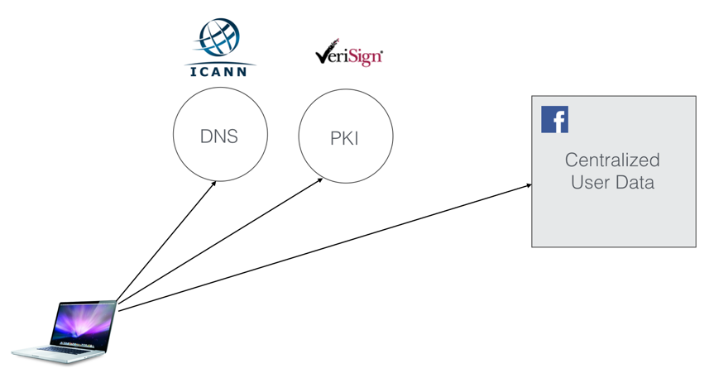
It is hard to secure the internet
“From the time you start your computer to the time you view a website, there are more than 10 parties/companies that you need to trust.”

Slide 18
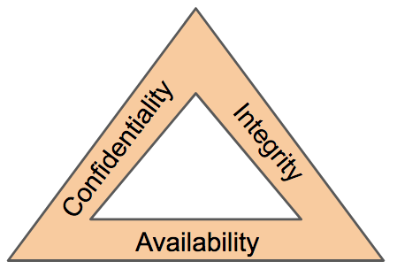
CIA Triad – Model for security community
Confidentiality
Preserving authorized restrictions on information access and disclosure, including means for protecting personal privacy and proprietary information.

Slide 19
Discussion
Are the following a violation of confidentiality?
Not knowing someone’s exact salary but knowing that the salary falls in a particular range or exceeds a particular amount
Knowing that a company is developing a certain new product or that talks are underway about the merger of two companies
Credit companies have access to name of items you purchased at a grocery store. And what about a military food order?

Slide 20
CIA Triad – Model for security community
Integrity
Guarding against improper information modification or destruction and ensuring information non-repudiation and authenticity.
Data Integrity – The property that data has not been altered in an unauthorized manner. Data integrity covers data in storage, during processing, and while in transit.
System Integrity – The quality that a system has when it performs its intended function in an unimpaired manner, free from unauthorized manipulation of the system, whether intentional or accidental

Slide 21
Discussion
Are the following a violation of Integrity?
A number of years ago a malicious macro in a Word document inserted the word “not” after some random instances of the word “is;”
Any other examples?
Do you do checksum when you download a file from internet?

Slide 22
CIA Triad – Model for security community
Availability
ability of a system to ensure that an asset can be used by any authorized parties
What does availability implies?
• Access gets slower and slower; the computer responds but not in a way we consider normal or acceptable.
• The service is completed in an acceptable period of time.
• The data is present in a usable form.

