Slide 1
Python- Introduction
-Yilian Zhang

Slide 2
Python
Python is a general purpose, high level programming language that is used in a variety of application domains.
Syntax of a programming language
Easier than a new foreign Language
BUT
Precise
Accurate
Great attention to details
Formal Python Documentation: https://docs.python.org/3/
Build-in Function: https://docs.python.org/3/library/functions.html
Notes:
Please always remember that you are talking to a machine. No tolerance on any mistake!!!

Slide 3
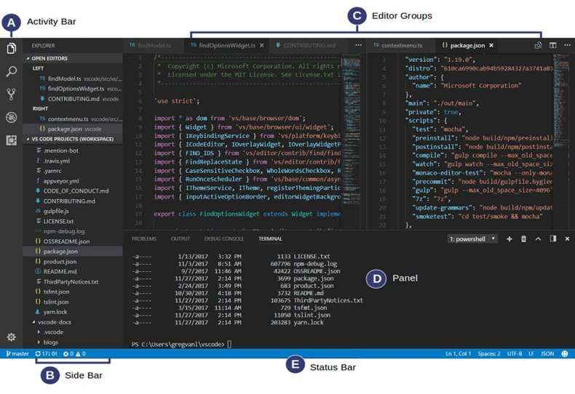
How to write and run a program?
Interpreter ----- Python interpreter
Editor --- Microsoft Visual Studio Code

Slide 4
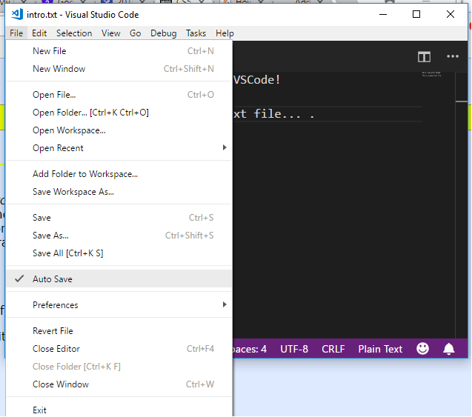
Open Folder
File – Open Folder
Run file
Right click – Run python file in terminal
Save file
CTRL-S

Slide 5
Try it: Please make sure that you have
Editor --- Microsoft Visual Studio Code
Compiler - Python 3
Please create a folder CSCI125
Please create a subfolder practice inside CSCI125.
Open the folder practice using Microsoft Visual Studio Code
Set VSCode to auto save all your files.
Create a new file test.py
Print a welcome message:
Welcome to python!

Slide 6
Talk to python
Start Python Shell/ipython and talk to Python
>>> 3 + 5
8
>>> (3 + 5) * 2 - 1
15
>>> 10 ** 3 <- What is this operator ?
1000
>>> 52 % 10 <- What is this operator ?
2

Slide 7
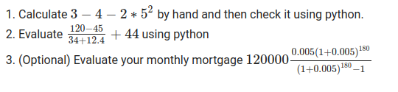
Practice Time
Please practice with me.

Slide 8
Python is more than a calculator
Programming ------ Abstraction is the key.
Word problem: Your taxable income in 2021 is $39801 and your federal income tax rate is 12% as a single filer. How much tax do you need to pay?

Slide 9
Use variable/constant instead of numbers
Another word problem
Your taxable income in 2021 is $29009 and your federal income tax rate is 12% as a single filer. How much tax do you need to pay?
** How can you make your program work under different scenarios ?
The first step of abstraction --- variables

Slide 10
Variable
Name of the variable
Value --- a value that is assigned to the variable
Myage = 17
Myage = 19
The statement that assigns value to a variable is called assignment statement
Storage location ---- In memory

Slide 11
Assignment statement
Python’s usage of “=“ is not the mathematical usage of the equal sign.
Assignment Statement: The left hand side must be a variable
Age = Age + 1 # Solve the equation? No
# Calculate right-hand side first and give the left hand side variable a new value.
Increase Age by 1.

Slide 12
Assignment statement
first = 'Sue'
last = 'Wong'
name = first + ' ' + last
--------------------------------------------------------------------------------------------
height = 12
area = width * height #problem with the code?

Slide 13
Review Question 1: Poll #1
What is the output of the following code?
a = 5
b = 2
a = a + b
print(a)
A: 5 B: 2 C: 7 D: 4

Slide 14
Review Question 2: Poll #2
What is the output of the following code.
type(“12.34”)
A: str B: int C: float

Slide 15
Review Question 3: Poll #3
What is the output of the following code.
x = “12.70”
x = x + 5
print(x)
A: 12.705 B: 17.70 C: Error

Slide 16
Review Question 4: Poll #4
What is the output of the following code.
x = “12.70”
x = x + “5”
print(x)
A: 12.705 B: 17.70 C: Error

Slide 17
The standard Input/Output
print --- output to stdout
print(“hello \n”) # print with a new line \n​
input -- input from stdin
>>> s = input('let us know your salary ') ​ # s is a string type
We need
File input/output
Graphic User Interface (GUI) I/O

Slide 18
Input Statement Practice
Get input ----- the price of milk
Get input --- today’s temperature
Get input --- The school you attended
Get input --- age of student
Get input ---- Exam start time
Get input --- T-shirt size

Slide 19
Convert variable to appropriate type
Type conversion
Convert string to int --- int(s)
Convert string to float --- float(y)
Convert float/int to string -- str(k)
Example:
s="1000"
c = int(s)
type(c)
y="45.6"
#y = float(y)
x=y+5
print(x)
s="The answer is "
result = 1234.56
# s+result
s + str(result)

Slide 20
Python output with format : print(f' ')
>>> number = 3.1415926​
>>> print(f'The value of pi is {number}')​
The value o f pi is 3.1415926​
>>> print(f'The value of pi is {number : .3f}')​
The value o f pi is 3.142

Slide 21
Example with print(f' ')
age = 50
print(f'You age is {age}')
name = "yilian"
school = "Emory"
print(f'Welcome to {school},{name}!')

Slide 22
Review
Editor --- Microsoft Visual Studio Code
Compiler - Python 3.9
Please create a folder practice on your J:/CSCI125.
Open the folder practice using Microsoft Visual Studio Code
Set VSCode to auto save all your files.

Slide 23
Review
The standard Input/Output
print --- output to stdout
input -- input from stdin
We will need later
File input/output
Graphic User Interface (GUI) I/O

Slide 24
Python Comments
Comments that contradict the code are worse than no comments. Always make a priority of keeping the comments up-to-date when the code changes!
Each line of a block comment starts with a # and a single space
An inline comment is a comment on the same line as a statement. Inline comments should be separated by at least two spaces from the statement. They should start with a # and a single space.

Slide 25
Program Skills
Sit down and think about the instructions before you start to write any program
You may not skip instructions – computer is not smart enough to guess. Programming is about writing logical instructions.
Get the major steps first
** Please do not feel afraid to try , to type, to run code. Any kinds of errors are fine. **
** You can only learn coding by writing code **

Slide 26
Print a customized “Hello world” message.
Input
Get the input ---- What’s your name?
Process
Combine the hello message with your name
Output
Print the customized message

Slide 27
More Examples -- Computing Gross Pay
Display message: "How many hours did you work?"
Allow user to enter number of hours worked
Store the number the user enters in variables **** TYPE
Display message: "How much are you paid per hour?"
Allow the user to enter an hourly pay rate
Store the number the user enters in variables **** Type
Multiply hours worked by pay rate and store the result in memory
Display a message with the result of the previous step
This well-defined, ordered set of steps for solving a problem is called an algorithm

Slide 28
Try it: Work on the programming exercises.
Input
Algorithm
Output
Any challenge so far ?

Slide 29
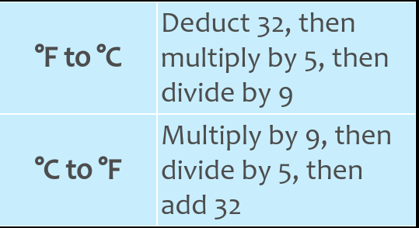
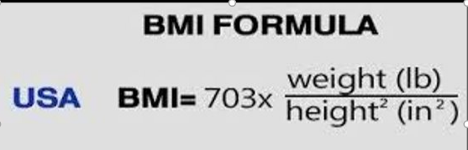
Formulas

Slide 30
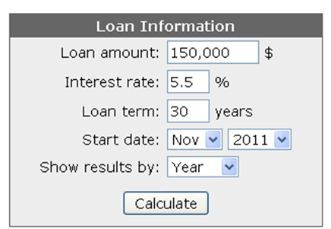
Bonus Exercise
Can you understand the logical behind mortgage calculator?
Monthly interest rate = Interest rate(annual) / 12
Monthly Payment =LoanAmount × (M𝑜𝑛𝑡ℎ𝑙𝑦 𝑖𝑛𝑡𝑒𝑟𝑒𝑠𝑡 𝑟𝑎𝑡𝑒)/(1−(1+M𝑜𝑛𝑡ℎ𝑙𝑦 𝑖𝑛𝑡𝑒𝑟𝑒𝑠𝑡 𝑟𝑎𝑡𝑒)^(−𝑛𝑢𝑚𝑏𝑒𝑟 𝑜𝑓 𝑚𝑜𝑛𝑡ℎ))
Testing data: Monthly payment is 851.68

