Slide 1
Python-More about Loop
-Yilian Zhang

Slide 2


Review
Type of variables
string
int
float
list

Slide 3





Python List
A “package” or a group of other values
>>> toDoList = ['Buy milk','Do hw', 'watch TV','pay bill']
>>> oddNumbers = [1 , 3 , 5 , 7 , 9 , 11]

Slide 4
Python Lists
Length of Lists --- Build in function len
>>> len(toDoList)
4
Access the list ( index starts at 0 )
>>> toDoList[0]
'Buy milk'
>>> toDoList[1]
'Do hw'

Slide 5

Python Lists – Operations on List
+ ------ concatenation
>>> toDoList = ['Buy milk','Do hw', 'watch TV','pay bill']
>>> newList = ['prepare exam I', 'exercise']
>>> toDoList + newList
['Buy milk', 'Do hw', 'watch TV', 'pay bill', 'prepare exam I', 'exercise']
>>> toDoList + newList
['Buy milk', 'Do hw', 'watch TV', 'pay bill', 'prepare exam I', 'exercise']

Slide 6

Python Lists: Slice
Find the to do list items from 3 up to 6 (** NOT including index 6)
>>> toDoList[3:6]
['pay bill', 'prepare exam I', 'exercise']
All items from index 1 to the end
>>> toDoList[1:]
['Do hw', 'watch TV', 'pay bill', 'prepare exam I', 'exercise']
All items from beginning to index 4
>>> toDoList[:4]
['Buy milk', 'Do hw', 'watch TV', 'pay bill']

Slide 7
Python List: Replace item
Change my second to do list item to “watch youtube”
toDoList[1] = “watch youtube”
Question: Why the index is 1 ?

Slide 8
Python List: Remove items
Finish the first two do list items
>>> toDoList[:2] = []
>>> toDoList
['watch TV', 'pay bill', 'prepare exam I', 'exercise']

Slide 9
Python List: Insert items
Insert a new item at index 1
>>> toDoList[1:1]=['not sure']
>>> toDoList
['watch TV', 'not sure', 'pay bill', 'prepare exam I', 'exercise’]
You can also use append function to append the item to the list.

Slide 10
Poll #1 What is the index?
Given list
letters = ['a','b','c','d','e','f','g’]
You need to print ‘d’. What is the index of item ‘d’?
print(letters[ ??])
A. 4 B. 3 C. 5

Slide 11

Poll #2 What is the output?
Given list
letters = ['a','b','c','d','e','f',’g’]
index = len(letters) -1
print(letters[index])
A. f B. g C. a

Slide 12
Lists Slice --- poll #3 What is the output
letters = ['a','b','c','d','e','f','g’]
print(letters[1:3])
A. [‘a’] B. [‘a’,’b’,’c’] C. [‘b’,’c’] D. [‘b’, ‘c’, ‘d’]

Slide 13

Length with strings
>>> name = "yilian"
>>> len(name)
6
>>> >>> len('I love spam!')
12

Slide 14
Indexing of String
>>> name = "yilian"
>>> name[0]
'y'
>>> name[1]
'i'
>>> name[4] # what is the output?

Slide 15
Slicing with Strings
>>> bestFood = 'spam burrito'
>>> bestFood[0:3]
'spa'
>>> bestFood[0:4]
'spam‘
>>> bestFood[2:6] #output ?
>>> bestFood[1:] #output?
>>> bestFood[:5] #output?

Slide 16
Lists Slice --- poll #5 What is the output
bestFood = 'spam burrito'
print(bestFood[:6] )
A. spam B. spam b C. pam bu D. urrito

Slide 17
For loop with list – Collect Data into list
artists = []
for i in [0, 1, 2]:
next_artist = input('Enter an artist that you like:')
artists.append(next_artist)
print(f"Thank you! We'll work on your recommendations {artists}")

Slide 18




For Loop with list--- Display data in the list - Two ways.
for item in thelist:
print(item)
for i in range(len(thelist)):
print(thelist[i])

Slide 19
Example: Sent a customized invitation message to a list of friends
friendlist = ["Joe", "Zoe", "Brad", "Angelina", "Zuki", "Thandi", "Paris"]
Your message will look like
"Hi, Joe, Please come to my party on Saturday! Joe, Please do come!"

Slide 20
Python Lists -Review
A “package” or a group of other values
>>> toDoList = ['Buy milk','Do hw', 'watch TV','pay bill']
Length of Lists --- Build in function len
Access the list ----- toDoList[0], toDoList[1]
Concatenation ---- +
Append ----- list.append(item)
Insert ----- list[i:i] = …. Or use insert function list.insert(3, item)

Slide 21
Review Poll What is in the list letter
letter = [ "a", "b" , "c", "d", "e"]
letter[2:4] = []
A: ["a", "d","e" ]
B: ["a", "b", "e"]
C: ["a", "e"]

Slide 22
Python List: Insert items
Insert a new item at index 1
>>> toDoList[1:1]=['not sure'] # or toDoList.insert(1,'notsure')
>>> toDoList
['watch TV', 'not sure', 'pay bill', 'prepare exam I', 'exercise']

Slide 23
Review Poll # What is in the list letter
letter = [ "a", "b" , "c", "d", "e"]
letter.insert(3, "z")
A: [ "a", "b" , "z", "c", "d", "e"]
B: [ "a", "b" , "c", "z", "d", "e"]
C: [ "a", "b" , "c", "z", "e"]
D: [ "a", "b" , "c", "d", "z", "e"]

Slide 24
For Loop with String
Reverse a string using loop
reverse=''
for l in "greatjob":
reverse = l + reverse
print(reverse)

Slide 25
Nested loop: (loop inside of a loop)
What is the outer loop? What is the inner loop?
Example: Write nested loop to print the following shape.
**********
**********
**********
**********
**********

Slide 26
Nested Loop – loop inside of a loop Typical Example: multiplication table
for i in range(1,10):
for j in range(1,10):
ans = i*j
print(f"{i}x{j}={ans}", end=" ")
print()

Slide 27
Do it with me
Print all of the possible choices of throwing two dices using nested loop:
(1,1) (1,2) (1,3) (1,4) (1,5) (1,6)
(2,1) (2,2) (2,3) (2,4) (2,5) (2,6)
(3,1) (3,2) (3,3) (3,4) (3,5) (3,6)
(4,1) (4,2) (4,3) (4,4) (4,5) (4,6)
(5,1) (5,2) (5,3) (5,4) (5,5) (5,6)
(6,1) (6,2) (6,3) (6,4) (6,5) (6,6)

Slide 28
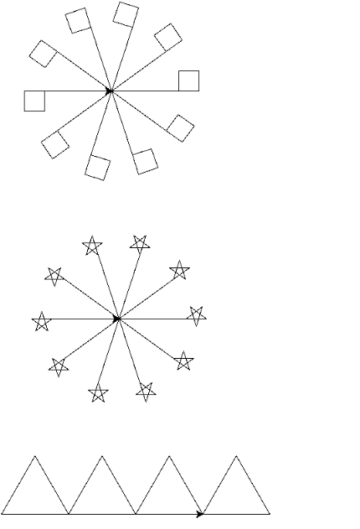
Can you generate the following graphic?

Slide 29
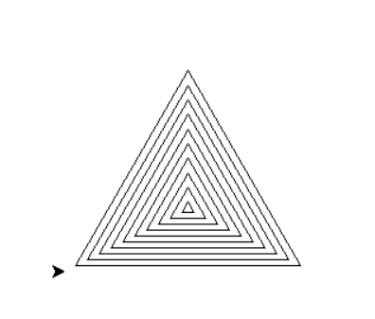
Iteration: what are repeated? Poll #3
Can you generate the following graphic?
Please answer the poll and send me the repeated task in private chat.
for I in _________:
## repeated task ##
A: range(10) B : range(1,10 ) C: range(9)

Slide 30
What is the output of the following loop?
for i in range(5):
for j in range(i,5):
print("*",end="")
print()

Slide 31
What is the output of the following code?
for i in range(5):
for j in range(i+1):
print(i,end="")
print()

Slide 32
Nest loop practice
Simple
Challenge – Late Need If statement
Produce the following output
*
**
***
****
*****
0....
.1...
..2..
...3.
....4

Slide 33
Review of nested loop - poll #4
for i in range( _a=?__):
for j in range(_b=?__):
print("*",end="")
print()
To generate the table of stars above, what should be the value of a and b?
A: a=3 b=5 B: a=5 b = 3 C: a=8 b = 1
* * *
* * *
* * *
* * *
* * *

Slide 34
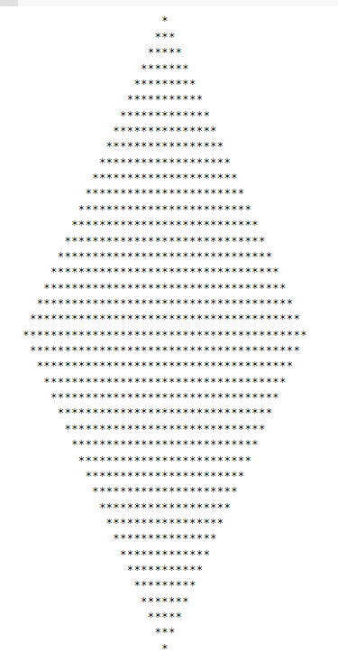
Need more challenge questions?
Can you produce the diamond shape?
m = 20 # layer
# top half of the diamond
for i in range(m):
for j in range(m-i):
print(" ", end="")
for j in range(2*i+1):
print("*",end="")
print()
# bottom half of the diamond
for i in range(m,-1,-1):
for j in range(m-i):
print(" ", end="")
for j in range(2*i+1):
print("*",end="")
print()

Slide 35
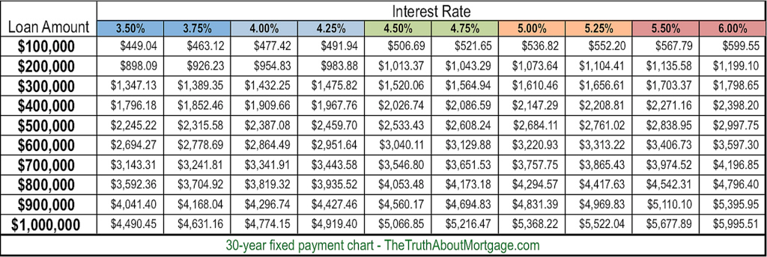
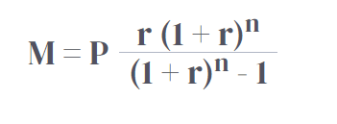
Build table data using nested loop-in real life

