Slide 1
Python-Repetition Structure
-Yilian Zhang

Slide 2
Repetition Structure ( Loop)
Repeated Tasks
Repeat the following four times:
Display a prompt to the user;
Obtain the user’s input; and
Record the user’s answer to a list.

Slide 3
Simple repeating for loop
for _ in range(5)):
print("*%^&*()@"
for _ in range(4):
print("great day! ")
print("!!!!!!")
)

Slide 4
Let's try it
Practice: repeated task
Repeat the following **four** times:​ Display a prompt to the user;​ Obtain the user’s name; and​ Display a customized hello message

Slide 5
Let's try it
Example: Increase your salary by $2000 every year for ten years.
Suppose your initial salary is $34000 Repeat the following **ten** times:​ increasing your salary by $2000

Slide 6
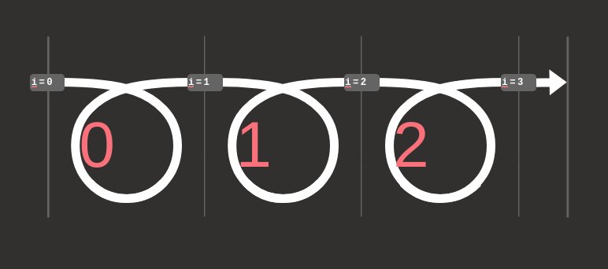
Loop with iteration variables
for i in range(3):
print(f'The loop variable is {i}')

Slide 7
Understand List
range(5)
Is a list [0, 1, 2, 3, 4]
List is a collection of data.
[3, 4, 5]
[“good”, “bad”, “best”]

Slide 8
Poll #1
range(4) is
a. [1, 2, 3, 4] b. [0,1,2,3,4] c. [0,1,2,3]

Slide 9
Examples: Use range(a, b)
range([start], stop[, step]) --- not include the stop!
https://docs.python.org/3/library/stdtypes.html?highlight=range#range
The arguments to the range constructor must be integers
For a positive step, the contents of a range r are determined by the formula r[i] = start + step*i where i >= 0 and r[i] < stop.
For a negative step, the contents of the range are still determined by the formula r[i] = start + step*i, but the constraints are i >= 0 and r[i] > stop.
range(3,6) ----- [ 3, 4, 5]

Slide 10
Poll #2
range(4,7) is
a. [4,5,6] b. [4,5,6,7] c. [4,5,6]

Slide 11
Display squares of number of 1 through 100
for i in range(1,101): # why stop at 101
square = i * i
print(f'The square of {i} is {square}')

Slide 12
Examples: step value
range([start], stop[, step]) --- not include the stop!
start: Starting number of the sequence.
stop: Generate numbers up to, but not including this number.
step: Difference between each number in the sequenced
Display values 0, 10, 20, …, 80, 90, 100
for i in range(0,101,10):
print(i, end=" ") # do not print a newline, end with space

Slide 13
Poll # 3
Fill in the blank:
Print all the odd numbers from 20 to 30:
21 23 25 27 29
for i in ___________:
print(i)
A: range(20,30) B: range(20,30,2) C: range(21,29,2) D: range(21,30,2)

Slide 14
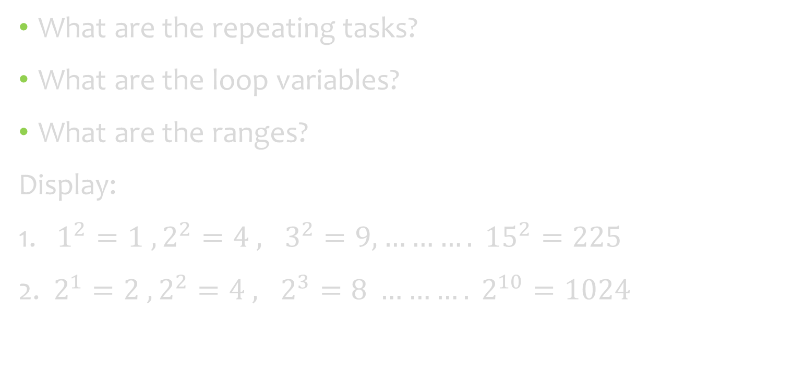
Review: Loop Variable, Range
What are the repeating tasks?
What are the loop variables?
What are the ranges?
Display:
1. $1^{2}=1 , 2^{2}=4 , 3^{2}=9, ………. {15}^{2}=225$
2. $2^{1}=2 , 2^{2}=4 , 2^{3}=8 ………. 2^{10}=1024$

Slide 15
For Loop with step Flowchart
set
counter
to StartValue
Counter =
EndValue
statement(s)
increment
Counter (step)
False
True

Slide 16

Example: Accumulating Answers
Find the sum of $4+5+..+78$

Slide 17

Poll # 4 Fill in the blank
Find the sum of $23+24+..+179$
sum = 0
for i in range(23,180):
__________
print(f'{sum : .3f}’)
A: sum = i B: sum = sum + i

Slide 18
What about factorial?
N ! = 1 x 2 x3 x4 x …. N

Slide 19

Example:

Slide 20

Practice together – Any difference from the previous example? Poll #5
Find the sum of $\frac{1}{2}+\frac{1}{4}+..+\frac{1}{100}$
sum = 0
for i in range(1,51,2):
__________
print(f'{sum : .3f}’)
A: sum += i B: sum += 1/i C: sum += 1/(2*i)

Slide 21
Application: mutual fund investment
If you invest $9500 on a mutual fund with a fixed return 3.50%, display the value of your account from year 1 to year 30.

Slide 22
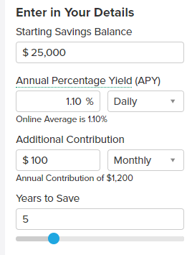
Try it: Simple saving account calculator
Input ??
Algorithm??
Output??

Slide 23
Need Challenge question?

Slide 24
Your first Turtle Program on Visual Studio Code. –wn, alex Object
Please create a file named **turtlepractice.py** and then copy the following codes.
import turtle # Allows us to use turtles
wn = turtle.Screen() # Creates a playground for turtles
alex = turtle.Turtle() # Create a turtle, assign to alex
----------
wn.mainloop() # Wait for user to close window
Notes:
Resource: https://docs.python.org/3.3/library/turtle.html?highlight=turtle

Slide 25
Understand the code
Module turtle
Object alex
Methods .forward .left .speed .color
*An object can have various methods *
*We can have many turtle objects *

Slide 26
Turtle Method
alex.forward(50) # Tell alex to move forward by 50 units
alex.left(90) # Tell alex to turn left by 90 degrees
alex.forward(-30) # alex go backward -30 units
alex.penup() # Do not draw
alex.right(-90) # Tell alex to turn left by 90 degrees
alex.stamp() # Tell alex to stamp the footprint

Slide 27
Many properties that you can change for fun --- check reference page
Title of the window
wn.title(“python graphic”)
Background Color of window
wn.bgcolor("lightgreen")
Line color draw by turtle
maxs.color("hotpink")
Speed of the turtle
alex.speed(10)
Shape of the turtle: turtle, circle, classic, square, triangle
alex.shape(“turtle”)
Move without draw a line
alex.penup()
alex.forward(100)
# alex.setpos(50,50)
alex.pendown()

Slide 28
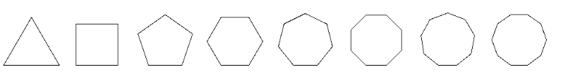
For loop on graphic
Draw a square with side 50 .
for i in range(4):
maxs.forward(50)
maxs.left(90)
Can you draw a equilateral triangle, pentagon, Hexagon…. ?

Slide 29

Write program to draw a star shape – Free try time. Be creative!

Slide 30
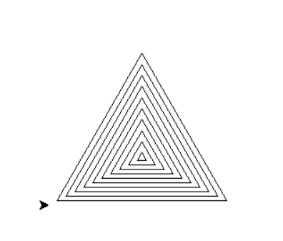
Iteration: what are repeated? Poll #5
Can you generate the following graphic?
Please answer the poll and send me the repeated task in private chat.
for I in _________:
## repeated task ##
A: range(10) B : range(1,10 ) C: range(9)

