Slide 1
Python-Iteration and Recursion
-Yilian Zhang

Slide 2
Iteration/loops: perform these same repeated tasks
Control Variable that goes through a list generated by range function
**Add the number to sum
sum = 0
for x in range(1,100,2)
sum +=x
print(sum)
Control Variable that goes through a list.
**Print each number
for x in [3, 7, 8]
print(x)
Please be careful that whether the statements is in the loop or outside of the loop. ** range step is integer!!! *

Slide 3
Work through example (for loop and if)
Create a simple calculator that can take two numerical input and one operator, then perform the operation and display the answer. It will repeat the operation for four times.

Slide 4
Better way to read input? When should I stop?
expression = input() # read the whole line as one expression
num1, op, num2 = expression.split()
# use string split method to split them along space

Slide 5
Any problem with your simple calculator?
Hard to use?
No user input validation
No error message/instruction for user
**Input Validation is important for secure coding **

Slide 6
Python Errors and Exceptions
Handling Exceptions
try: # run everything in try clause first
num1, oper,num2 = expression.split()
except ValueError: # if exception ValueError occurs.
print("Oops! The format is not correct.")
continue

Slide 7
While loop- indefinite iteration
In many cases, we can’t know how many iterations we need
Example: Repeat until receiving certain input.
newPref = input("Please enter the name of an artist or band that you like: " )
while newPref != '':
prefs.append(newPref)
newPref = input("Please enter an artist or band that you like, or just press enter to see recommendations: ")
print('Thanks for your input!')

Slide 8
Calculator redo-- with while loop
Create a simple calculator that can take two numerical input and one operator, then perform the operation and display the answer. It will repeat forever unless use enter “exit”.

Slide 9
Infinite loop- break
While loop will continue forever if the expression is always true
while True:
go = input("Do you want to continue yes or no ?")
if go!="yes":
break # run forever
while expression:
pass

Slide 10
For loop and While loop
For Loop =====➔
While loop
for i in range(2,10):
print(i)
i = 2
while i<10:
print(i)
i+=1

Slide 11
You try it.
For loop
?? While loop
for i in range(3,12,2)
print(i)

Slide 12
While loop --- be careful
Poll#1 infinite loop yes or no
-------------------------------------------
i=0
while i<10:
print(i)
i+=1
i=0
while i > 10:
print(i)
i+=1

Slide 13
While loop --- be careful
Poll#1 infinite loop yes or no
-------------------------------------------
i = 9
while i<10:
print(i)
i -= 1
i=9
while i > 10:
print(i)
i -=1

Slide 14
Tables in Python – 2D array
Rock Paper Scissors – game table
How to store tabular data?
user
computer
 | Rock | Paper | Scissor
Rock | Draw | Win | Lose
Paper | Lose | Draw | Win
Scissor | Win | Lose | Draw
gamesrule = [["Draw", "Win", "Lose"],["Lose", "Draw", "Win"],[ "Win", "Lose","Draw"]]
gamerule[0][0] --- the result when user is “rock” and computer is “rock”

Slide 15
Poll #3 What is the output?
mytable = [ [1, 2, 3] , [2,3,4] ]
print(mytable[0][1])
A: 1 B: 2 C: 3 D: 4

Slide 16
Challenge:
Can you rewrite the rock paper scissor game without any if statements?

Slide 17
Side Note: __main__ — Top-level code environment
__main__ is the name of the environment where top-level code is run.
if __name__ == '__main__':
# Execute when the module is not initialized from an import statement.
...

Slide 18
Work through example - risk of covid-19
“Is It Safe for Me to Go to Work?” Risk Stratification for Workers during the Covid-19 Pandemic -May 26, 2020, at NEJM.org by Marc R. Larochelle, M.D., M.P.H.
Please create an interactive Python program that can automatically counsel patients about continuing to work in the midst of the pandemic that is based on their occupational risk of contracting SARS-CoV-2 and their risk of death if they are infected.
Use list!

Slide 19


Slide 20
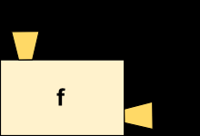
Function -- Revisit
Function is like a machine that takes an input( argument x), and transforms it into an output (return)
Executing a return statement always causes a function to end immediately.
The purpose of function is to wrapping a piece of code for reuse.
Encapsulation and generalization.

Slide 21

Work through Examples: Can you use function to work on iteration questions?
Find the answer: $1+1+\frac{1}{2!}+\frac{1}{3!}+…+\frac{1}{100!}$
Two tasks:
sum
factorial

Slide 22
Function that call function
def f3():
f2()
print("Miny")
f1()
def f4():
print("Eeny")
f3() ----- output
def f1():
print("Moe")
def f2():
f4()
print("Meeny")

Slide 23
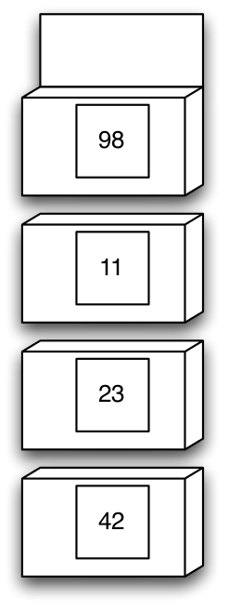
Function call function: demo(13)
def demo(x):
r = f(x+6) + x
return r
def f(x):
r = g(x-1)
x = 1
return r + x
def g(x):
r = x + 10
return r

Slide 24
Recursion Examples: Fibonacci Sequence
Recursion in computer science is a method of solving a problem where the solution depends on solutions to smaller instances of the same problem
A recursive method is any method that calls itself
The Fibonacci Sequence is the series of numbers: 0, 1, 1, 2, 3, 5, 8, 13, 21, 34, ... The next number is found by adding up the two numbers before it
Base Case: Fib(0) = 0, Fib(1) = 1
Fib(n) = Fib(n-1) + Fib(n-2)

Slide 25
Base Case: very important
VERY IMPORTANT
Stops the recursion (prevents infinite loops)
Solved directly to return a value without calling the
same function again

Slide 26
Recursion Practice: Factorial-recursive way.
N! = (N-1)! * N
we advocate trying to write the base case first.
Factorial numbers (i.e., n!) defined recursively:
factorial(0) = 1
factorial(n+1) = factorial(n) * n+1
Examples
4! = 4 * 3 * 2 * 1 --------- 4* 3!

Slide 27
Recursion practice: Sum -- recursive way
Given a number n, find sum of first n natural numbers. To calculate the sum, we will use a recursive function recur_sum().
# Returns sum of first
# n natural numbers

Slide 28
Recursion practice
Write a recursive function power(x, m) to perform exponentiation return x^m, assuming m >= 0

Slide 29
Recursive function on graphic : Make turtle t draw a Koch fractal of ’order’ and ’size’. Leave the turtle facing the same direction.
def koch(t, order, size):
if order == 0: # The base case is just a straight line
t.forward(size)
else:
koch(t, order-1, size/3) # Go 1/3 of the way
t.left(60)
koch(t, order-1, size/3)
t.right(120)
koch(t, order-1, size/3)
t.left(60)
koch(t, order-1, size/3)

Slide 30
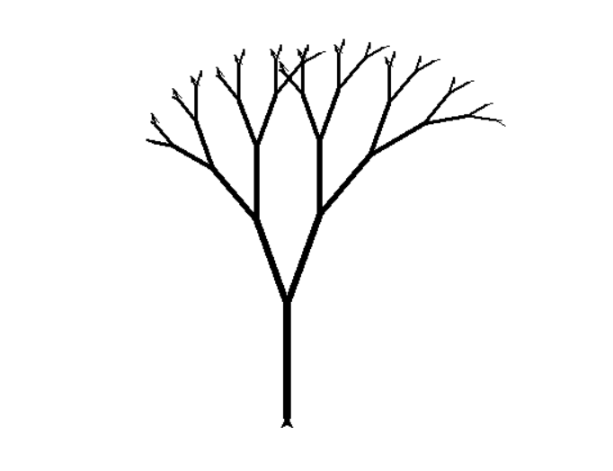
How about a tree?

Slide 31
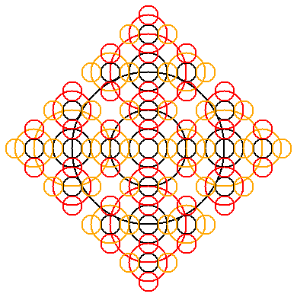
Challenge Question
Can you use recursive function that generate the following graph?

Slide 32
Recursion or Iteration?
Moral: There is usually more than one way to solve a problem!
Iteration (loops to repeat code)
Recursion (nested function calls to repeat code)
Tradeoffs between two options:
Sometimes recursive solution is easier
Recursive solution is often slower

Slide 33
Designing Recursive Algorithms
General strategy: “Divide and Conquer”
Questions to ask yourself
How can we reduce the problem to smaller version of the same problem?
How does each call make the problem smaller?
What is the base case?
Will you always reach the base case?

Slide 34
Recursive way: Challenge problem-Try it yourselves
Write a program to print all the combinations of factors of given number n
Input : 16
Output :2 2 2 2
2 2 4
2 8
4 4

Slide 35
More recursion practice
Write a function with the following prototype that returns the sum of the digits of an integer.
int sumOfDigits(int x);
If x is 234, the function should return 2 + 3 + 4, that is, 9.
If x is 12, the function should return 1 + 2, which is 3.
If x is 39, the function should return 12.
If x is negative, ignore the minus sign. For example, -12 and 12 both return 3.

Slide 36
Recursion Example : Reverse a string
def reverse(string):
'''Takes a string as an argument and returns
its reversal.'''
if string == '': # Is the string empty?
return '' # If so, reversing it is easy!
else:
firstSymbol = string[0] # Hold on to the first symbol
return reverse(string[1:]) + firstSymbol

Slide 37
Practice
Write a recursive function to reverse the words in a string, i.e., ”cat is running”becomes ”running is cat”.

Slide 38
Python String method -Revisit
str.split(sep=None, maxsplit=-1) ---- Return a list of the words in the string, using sep as the delimiter string.
>>> '1,2,3'.split(',')
['1', '2', '3']
>>> '1,2,3'.split(',', maxsplit=1)
['1', '2,3']
>>> '1,2,,3,'.split(',')
['1', '2', '', '3', '']

Slide 39
Python String Method
str.isnumeric() ----- Return true if all characters in the string are numeric characters, and there is at least one character, false otherwise.
str.find(sub[, start[, end]])------ Return the lowest index in the string where substring sub is found within the slice s[start:end]. Optional arguments start and end are interpreted as in slice notation. Return -1 if sub is not found.
You can join the item of a list into a single string
‘ ‘.join([“I”,”am”,”fine”])

Slide 40
Poll #4 What is the output?
name = “mary johnson”
name.find(“john”)
a. 4 b. 5 c. 6 d. - 1

Slide 41
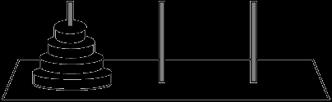
Game problem that can be solved by recursion-Towers of Hanoi
N golden disks on 3 pegs
Check animation here ---- http://towersofhanoi.info/Animate.aspx
Only move one disk at a time
A move is taking one disk from a peg and putting it on another peg (on top of any other disks)
Cannot put a larger disk on top of a smaller disk

Slide 42
Towers of Hanoi- recursive idea
Final step is to move the bottom disk from peg 1 to peg 3
To do this, the other n-1 disks must be on peg 2
So, we need a way to move n-1 disks from peg 1 to peg 2
Base case: moving the smallest disk is easy (you can always move it to any peg in one step)

