Slide 1
Security Introduction
-Yilian Zhang

Slide 2
Heart of Computer Science
Solve problem using computers
Computer Systems -- Hardware Support
Programming --- Talk to computer
Python
HTML
Data ---- Input/output
Algorithm --- Way to Solve the Problem

Slide 3
Why study security?
2018 Incident Highlights
95% of breaches could have been prevented (ISOC)
3.2% decrease in reported breach incidents (RBS)
5 billion records exposed, a 35.9% decrease (RBS)
$8 billion financial impact of ransomware (CV)
12% rise in business targeted ransomware (Symantec)
$12.5 billion in global EAC/BEC losses since 2013 (FBI)

Slide 4
Recent ransomware attack case – COLONIAL PIPELINE
When ----- April 29 2021
Hackers – DarkSide - gained unauthorized access to Colonial pipeline network through a VPN account.
What ---- May 7 2021
Ransom note appeared on internal network. Colonial shut down the entirety of its gasoline pipeline system. The outage led to long lines at gas station.
How
VPN account did not use multifactor authentication.
Hacker used a compromised username and password to hack the system. The compromised password was leaked on the dark web. However, it is not known how the hackers obtained the correct username.
Impact
Data on the company's information technology network was stolen.
Hacker did not breach Colonial’s operational technology network -- the system of computers that control the actual flow of gasoline. No damage on pipeline. Service resumed on May 12.
Colonial paid the hackers, who were an affiliate of a Russia-linked cybercrime group known as DarkSide, a $4.4 million ransom shortly after the hack.
Reference: https://www.bloomberg.com/news/articles/2021-06-04/hackers-breached-colonial-pipeline-using-compromised-password

Slide 5
What had happened?
Huge dependence on computer and internet
Communication
Entertainment
Transportation
Shopping
Medical
…..
*** Remote Working ***
Discussion:
How much of your daily life relies on computers?
Can you survive a day without internet?
Notes:
communication (e.g., email, smartphones), entertainment (e.g., digital cable, mp3s), transportation (e.g., car engine systems, airplane navigation), shopping (e.g., online shopping, credit cards), medicine (e.g., medical equipment, medical records)

Slide 6
Why does this dependency cause problems?
We’re depending heavily on a system for which security is not often a top priority.
Internet is public!
Internet does not have a good model of security at the beginning. It focus on sharing between a small online community for researcher.

Slide 7
Cybersecurity and Challenge
Cybersecurity involves protecting that information by preventing, detecting, and responding to cyber attacks.
Cybersecurity Challenge
A solution to this problem will require both the right technology and the right public policy.

Slide 8
One way to think about it
cybersecurity = security of cyberspace
Notes:
What is cyberspace? Information Systems and Networks

Slide 9
One way to think about it
cybersecurity = security of cyberspace
information systems and networks

Slide 10
One way to think about it
cybersecurity = security of information systems and networks
Notes:
It’s not really the security of the information systems and networks that we care about, it’s that we care about the operations and assets that depend on these information systems.

Slide 11
One way to think about it
cybersecurity = security of information systems and networks
+ with the goal of protecting operations and assets

Slide 12
One way to think about it
cybersecurity = security of information systems and networks with the goal of protecting operations and assets
Notes:
People often think of security as being security against attackers, but as we showed earlier you also need to protect against accidents and failures

Slide 13
One way to think about it
cybersecurity = security of information systems and networks with the goal of protecting operations and assets
security in the face of attacks, accidents and failures

Slide 14
One way to think about it
cybersecurity = security of information systems and networks in the face of attacks, accidents and failures with the goal of protecting operations and assets
Notes:
“Security” still a bit vague here. From earlier definitions we saw that security can mean a number of things – most notably availability, integrity and secrecy
Availability – ability to communicate
Integrity – that what is being communicated is authentic
Secrecy – that communications and information can be kept private

Slide 15
One way to think about it
cybersecurity = security of information systems and networks in the face of attacks, accidents and failures with the goal of protecting operations and assets
availability, integrity and secrecy

Slide 16
One way to think about it
cybersecurity = availability, integrity and secrecy of information systems and networks in the face of attacks, accidents and failures with the goal of protecting operations and assets

Slide 17
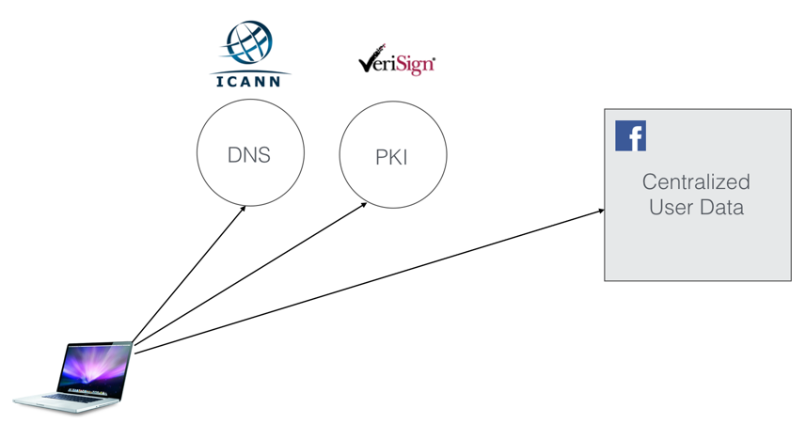
It is hard to secure the internet
“From the time you start your computer to the time you view a website, there are more than 10 parties/companies that you need to trust.”

Slide 18
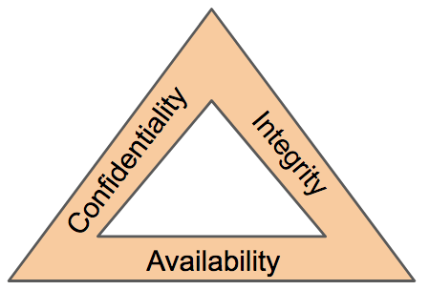
CIA Triad – Model for security community
Confidentiality
Preserving authorized restrictions on information access and disclosure, including means for protecting personal privacy and proprietary information.

Slide 19
Discussion
Are the following a violation of confidentiality?
Not knowing someone’s exact salary but knowing that the salary falls in a particular range or exceeds a particular amount
Knowing that a company is developing a certain new product or that talks are underway about the merger of two companies
Credit companies have access to name of items you purchased at a grocery store.
And what about a military food order?

Slide 20
CIA Triad – Model for security community
Integrity
Guarding against improper information modification or destruction and ensuring information non-repudiation and authenticity.
Data Integrity – The property that data has not been altered in an unauthorized manner. Data integrity covers data in storage, during processing, and while in transit.
System Integrity – The quality that a system has when it performs its intended function in an unimpaired manner, free from unauthorized manipulation of the system, whether intentional or accidental

Slide 21
Discussion
Are the following a violation of Integrity?
A number of years ago a malicious macro in a Word document inserted the word “not” after some random instances of the word “is;”
Any other examples?
Do you do checksum when you download a file from internet?

Slide 22
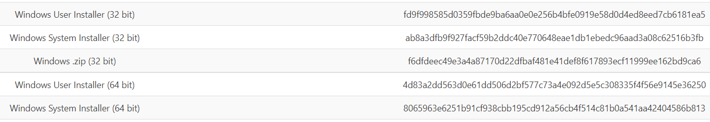
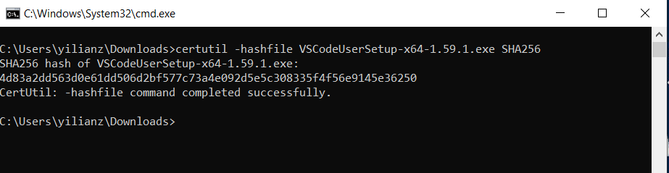
Quick Example on check-sum utility
1. Download a file on https://code.visualstudio.com/Download#
2. Find the checksum value of original file on website
3. Use the window build in utility to compute SHA256. Compare two values.

Slide 23
CIA Triad – Model for security community
Availability
ability of a system to ensure that an asset can be used by any authorized parties
What does availability implies?
• Access gets slower and slower; the computer responds but not in a way we consider normal or acceptable.
• The service is completed in an acceptable period of time.
• The data is present in a usable form.

