Slide 1

AI Project Meeting
10 Dec 2024

Slide 2
Outline
Introduction to Agile Development
Kanban Demo
Tasks

Slide 3
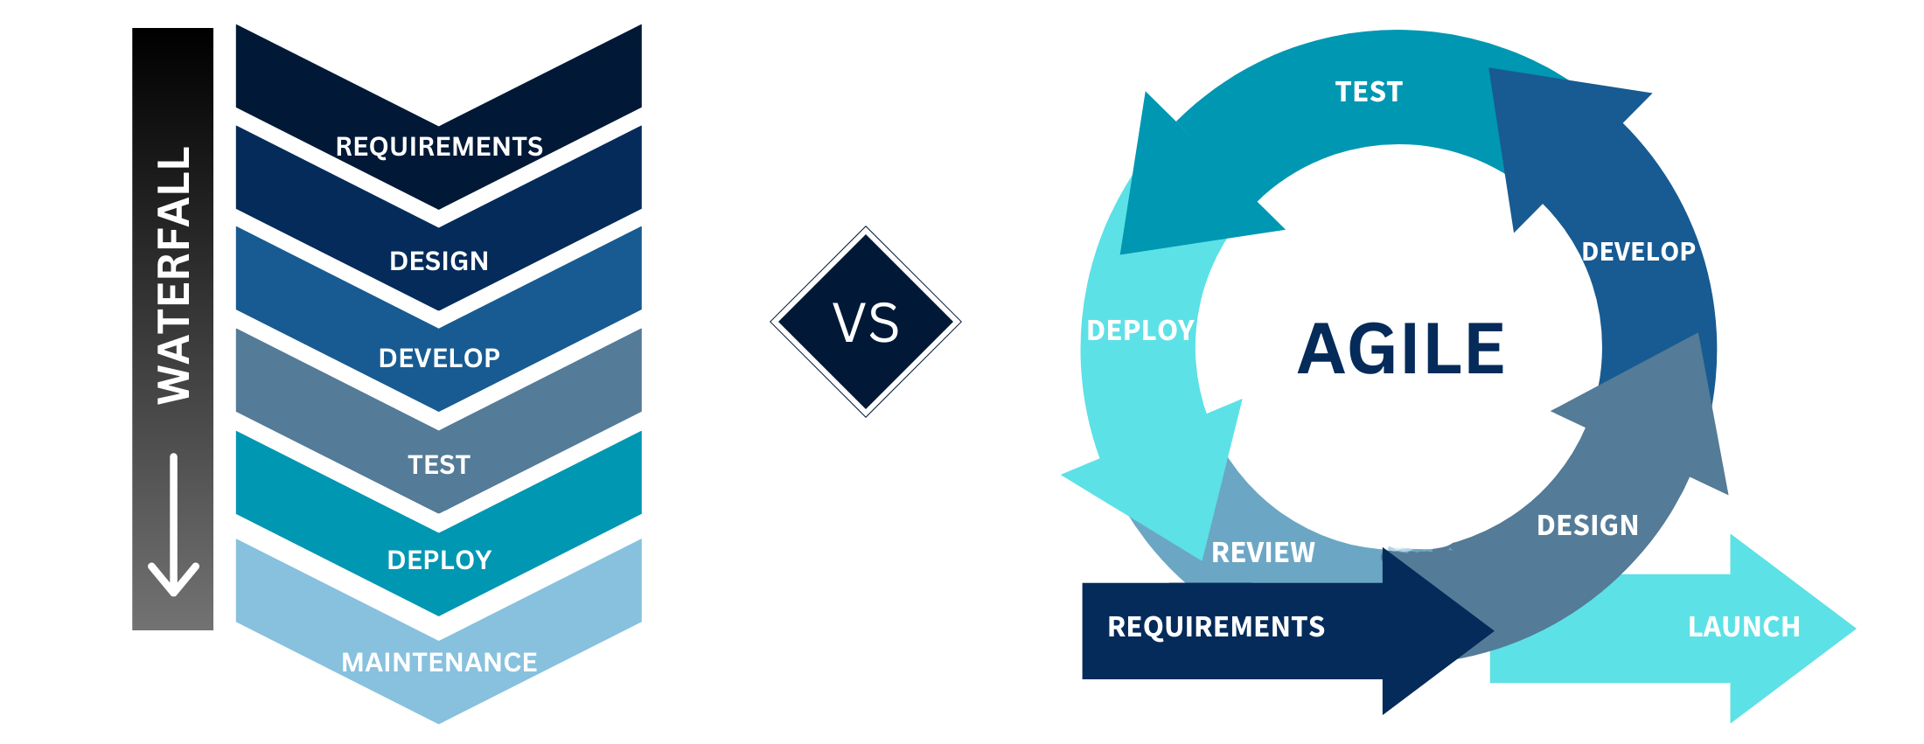
Introduction to Agile Development
Overview
Iterative Development: Work is delivered in small, incremental cycles (sprints), allowing for continuous improvement and feedback.
Adaptive Planning: Plans are flexible and can adjust based on project needs or feedback.
Continuous Delivery: Regular updates deliver working software frequently.
Image source: https://www.craftsilicon.com/transforming-the-way-we-work-scrum-waterfall-or-just-go-agile-part1/

Slide 4
Introduction to Agile Development
How does it work?
Sprint Planning: The team defines sprint goals and selects tasks from the product backlog to accomplish during the sprint.
Development and Testing: Team members work on the planned tasks, including coding, testing, and integration.
Review and Demo: At the end of the sprint, the team presents completed work to stakeholders for feedback.
Retrospective: The team reflects on the sprint to identify successes and areas for improvement.
Backlog Refinement (ongoing): Updates and prioritisation of the product backlog prepare for future sprints.
Image source: https://www.craftsilicon.com/transforming-the-way-we-work-scrum-waterfall-or-just-go-agile-part1/

Slide 5
Kanban Demo
https://github.com/users/yilil/projects/1/views/2

Slide 6

Tasks
Fill catchup meeting survey
https://schej.it/e/eBcaE
@me in the group chat after you have completed this
Get a Gemini API Key
https://ai.google.dev/gemini-api/docs/api-key
Create a simple QA bot with Gemini (any model is fine)
Create a simple google webpage (see the example provided):
https://www.youtube.com/watch?v=nGIg40xs9e4
Refer to “0:00 – 13:25” in the video

