Slide 1
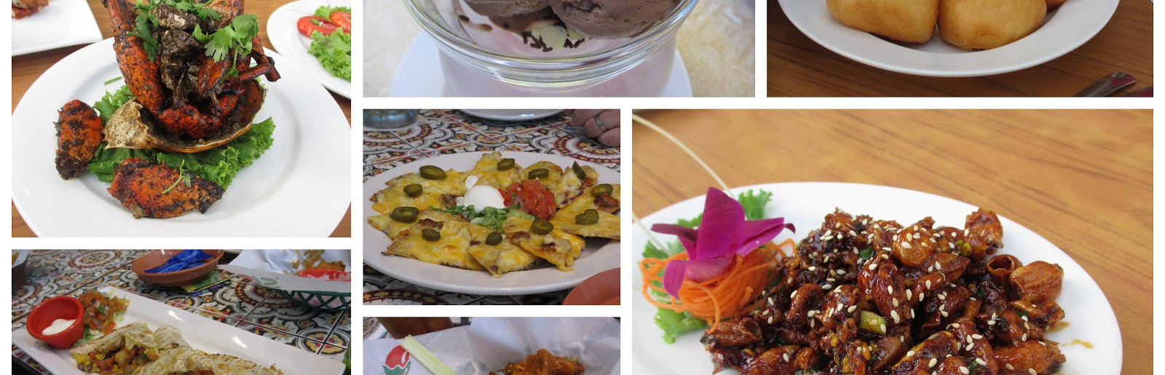
Goodie Foodie
This Photo by Unknown author is licensed under CC BY-NC-ND.
T28

Slide 2
Intro to the Team
Team member 1: Loman Chan Shum
Team member 2: Elam He
Team member 3: Hui Qiu
Team member 4: Hsin Yu Ivy Tsai
Team member 5: Tung Po Alex Tsang

Slide 3
Project Description
users with an interest in cooking.
share their cooking experience
viewing other posts, tracking their ingredients’ expiration dates, and buying groceries online.
Suppliers will be notified if their inventory is running low and to view orders.
The delivery staff will also be able to see the orders they are to deliver.

Slide 4
Scope
search or view recipes. Users can also create, edit, view, and delete posts.
Users can also do online grocery shopping.
whether the suppliers can restock their ingredients in a timely manner is not within our control.
Our objective is to make cooking enjoyable for everyone

Slide 5
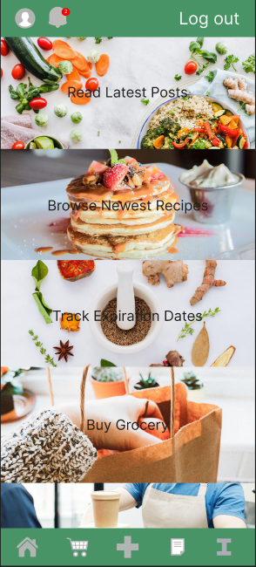
Mockup Demo
https://www.figma.com/file/g7v1M4450nrJYZ3Lkwp17S/Goodie-Foodie-App?node-id=0%3A1&t=aRJnaPxUzzupmC0J-0

Slide 6
Technological Requirements
Technological Requirements
IDE - Android Studio
Programming Languages - Java
Database – SQLite
Framework—react native
Advantages and disadvantages for all of those requirement?
Notes:
Android advan
All team members have learnt basics in class.
It has simulators that show real-time reviews of the app.
It has an intelligent code editor there is so many short key to make your coding faster so it can reduce your time to make an android app.
Includes testing tools. You can easily run a single test or a specific group of tests on one or more devices. The test results are shown directly inside Android Studio.
Android has several powerful constructs that make responsive, flexible user interfaces fairly easy.
Android Studio Disadvan
It requires a minimum system of i3 processor with 4 gigs of RAM to run properly.
System lags easily.
The Emulator is slow compared to other third-party android emulators.
The installation process is long
Java
Android Studio is just an development environment where you uses Java which all team members are quite familiar with
All team members have learnt and have been practicing for at least 2 years.
Java Disadvan
Java occupies more memory and is also slower compared to C. The memory management of Java is poor. Java uses a garbage collector, but it hampers the performance adversely.
Java has many complex syntaxes. Sometimes, it becomes hard to remember those complex syntaxes.
Database – SQLite
All team members have learnt and used SQLite before.
SQLite is the mostly preferred way to store data for android applications
It is lightweight and easy to start with.
It does not require a lot of database admin and is also light on required resources.
Better performance, Reading and writing from an SQLite database is often faster than reading and writing individual files from disk
Database – SQLite disadvan
It is limited to the machine it is stored on. It does not allow remote work on another PC.
SQLite is not applicable for large applications with lots of data, server-based DBMS is preferred.
SQLite has a limited data size, so it is not suitable for bigger database users.
Framework—react native
Allows developers to develop apps and deploy them on multiple platforms like Android, iOS, Web.
One of the community-driven technologies with lots of documentation and references.
Code reusability is great for developers to have more time on logic rather than typing and syntax.
It offers ready-made solutions and a vibrant library for developers to enhance the mobile app development process easily.
Framework—react native Disadvan
It is extremely hard to debug.
It is hard to determine user interface. If your mobile app requires features such as multiple screen transitions and interactions then choosing React Native for your app development might not be the right choice for you
The framework is still immature. React Native is in every sense faster and newer. But in quest to be quick, the framework tends to lose its credibility and becomes too immature for Android and iOS apps.

Slide 7
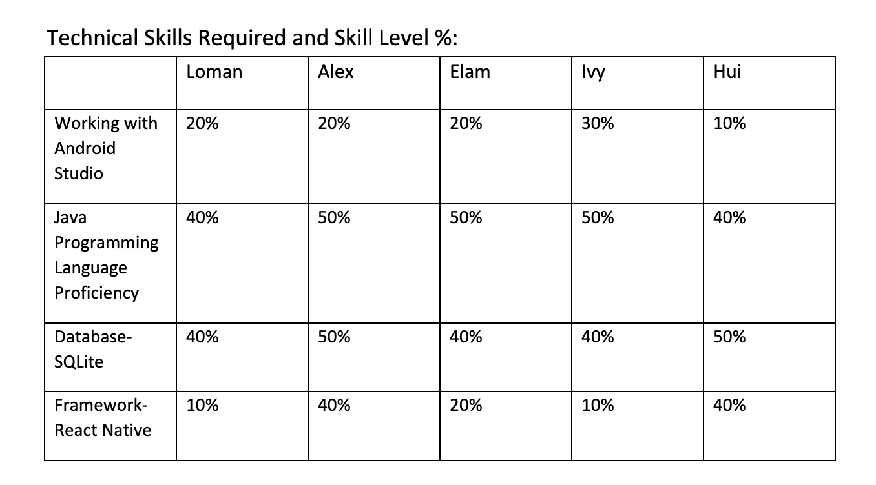
Learning Plan: Technical Skills

Slide 8
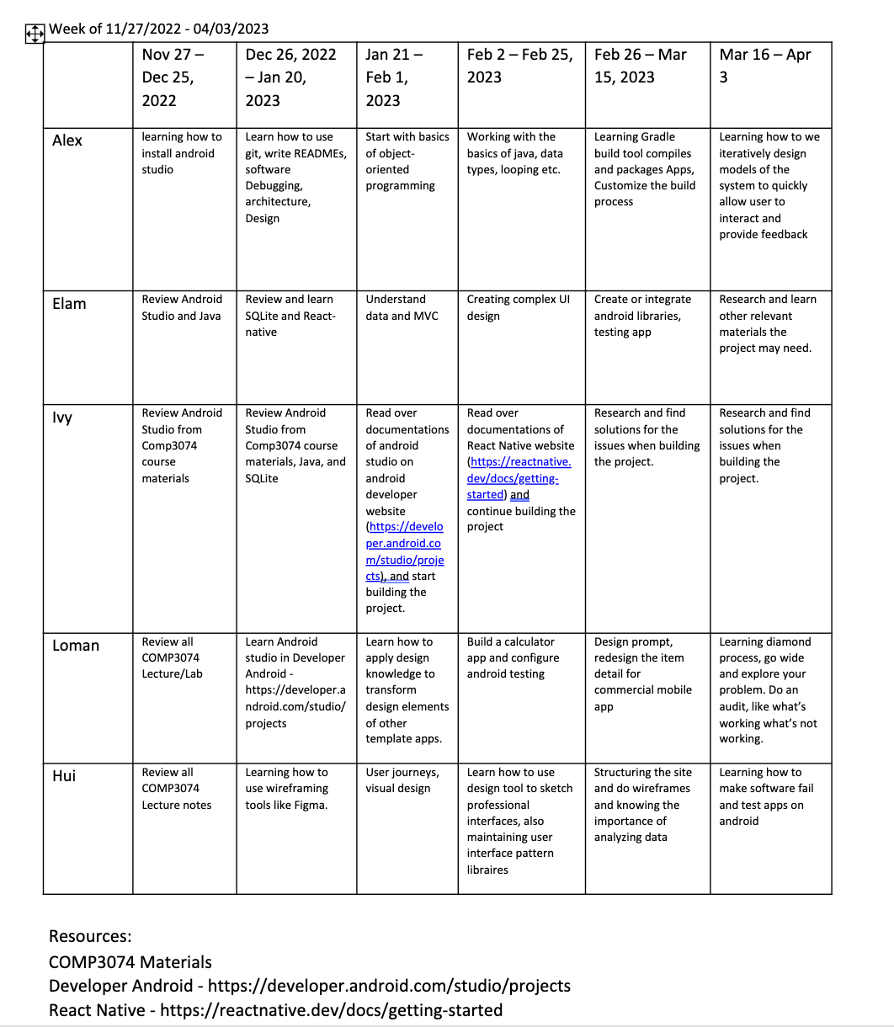
Learning Plan: Plan of Date

Slide 9
Thank you
Team 28

