Slide 1
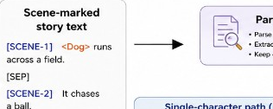
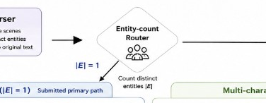
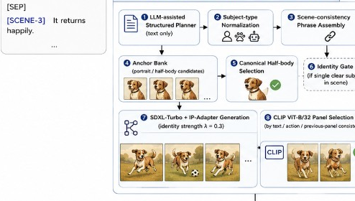
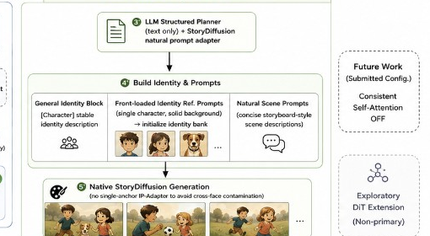


Auto Story Pipeline — extracted regions
Input · scene-marked story text
Parser & entity-count router
Single path · Anchor + SDXL-Turbo + IP-Adapter λ=0.3
Multi path · StoryDiffusion (no single-anchor IP-Adapter)
Output · N story panels
Sidebar · Future work · DiT (exploratory)

Slide 2
