Slide 1
SageAttention3 Performance Profiling
CogVideoX-2b on RTX 5090 D | SageAttention3 vs SDPA Baseline
GPU Device: NVIDIA GeForce RTX 5090 D • 32 GB VRAM • Blackwell Architecture
Async CUDA Event Timing • 5 Inference Steps (Smoke Mode)

Slide 2
Profiling Configuration
Parameter | Value
GPU | NVIDIA GeForce RTX 5090 D (32 GB)
Driver | 580.105.08
Model | CogVideoX-2b
Model dtype | float16
Num frames | 49
Inference steps | 5 (smoke mode)
Guidance scale | 6
Prompt | "A dog is running in the park."
Warmup iters | 3
CPU offload | Disabled
Profiling | Async CUDA event timing

Slide 3
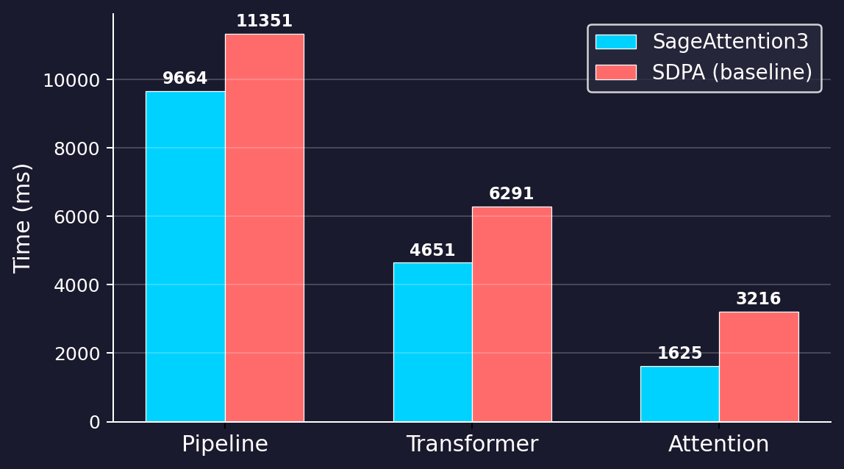
Head-to-Head: SageAttention3 vs SDPA
GPU time comparison across pipeline stages
KEY METRICS
Sage3 SDPA
Pipeline 9664 ms 11351 ms
Transformer 4651 ms 6291 ms
Attention 1625 ms 3216 ms
Avg Attn/call 10.84 ms 21.44 ms
Pipeline: 14.9% faster
Attention: 49.5% faster

Slide 4
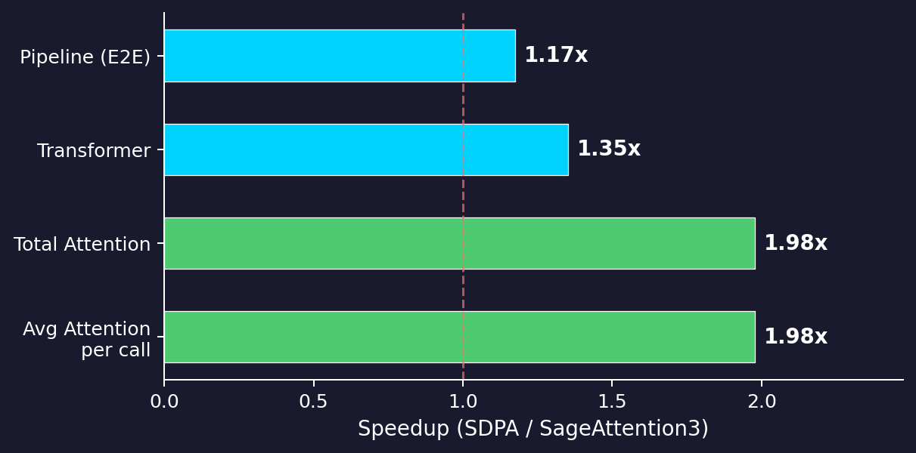
Speedup Analysis
SageAttention3 speedup over SDPA baseline
HIGHLIGHTS
• 1.98x attention kernel speedup
• 1.17x end-to-end pipeline speedup
• 1686 ms saved per inference
• 150 attention calls, 5 transformer fwd passes

Slide 5
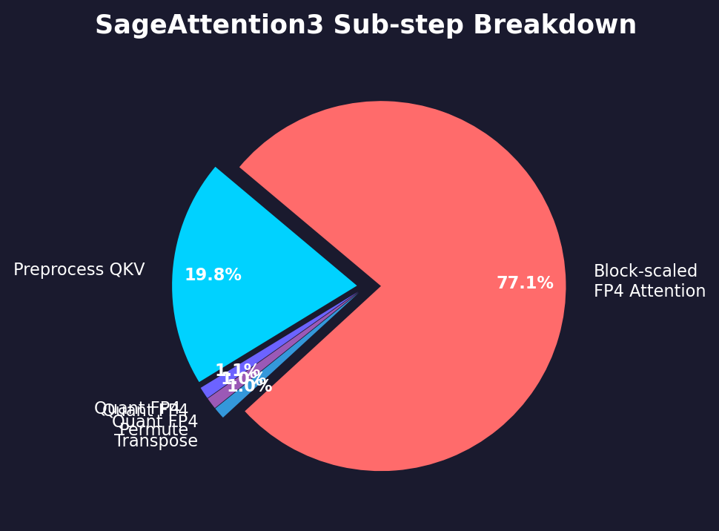
SageAttention3 Kernel Breakdown
Where does the attention time go?
Sub-step | Time (ms) | % of Attn
Preprocess QKV | 317.1 | 19.5%
Quant FP4 | 16.9 | 1.0%
Quant FP4 Permute | 16.3 | 1.0%
Quant FP4 Transpose | 16.4 | 1.0%
Block-scaled FP4 Attn | 1232.2 | 75.8%
TOTAL | 1598.9 | 100%
Block-scaled FP4 attention dominates at 75.8%, while quantization overhead is only ~3%.

Slide 6
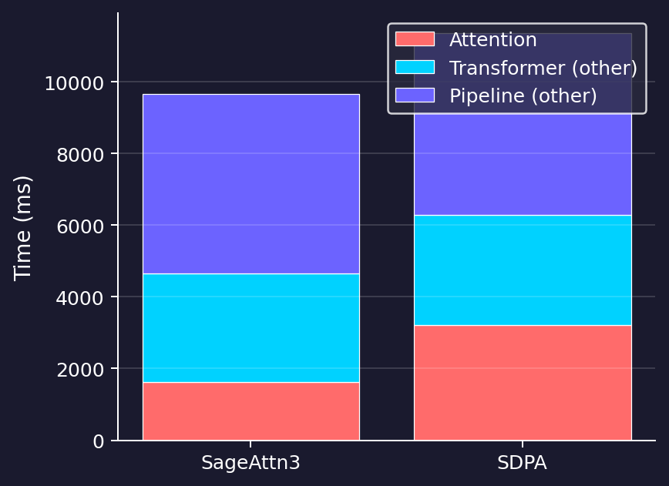
Pipeline Time Decomposition
Stacked view: Attention vs Transformer (other) vs Pipeline (other)
SageAttention3
Attn / Pipeline: 16.8%
Attn / Transformer: 34.9%
Transformer / Pipeline: 48.1%
SDPA (Baseline)
Attn / Pipeline: 28.3%
Attn / Transformer: 51.1%
Transformer / Pipeline: 55.4%
SageAttention3 reduces attention's share from 51.1% to 34.9% of transformer time, freeing GPU cycles for other operations.

Slide 7
Key Takeaways
1
2.0x Attention Speedup
1
SageAttention3's block-scaled FP4 kernel cuts attention time from 3216 ms to 1625 ms (49% reduction).
2
1.17x End-to-End Pipeline Speedup
2
Full pipeline runs in 9664 ms vs 11351 ms, saving 1686 ms per inference.
3
Minimal Quantization Overhead
3
FP4 quantization (scale, permute, transpose) accounts for only ~3% of attention time — the bulk (75.8%) is the optimized FP4 kernel.
4
Attention No Longer the Bottleneck
4
Attention drops from 51.1% to 34.9% of transformer time, shifting the bottleneck to other pipeline stages.
5
Production-Ready on Blackwell (RTX 5090 D)
5
Profiled on RTX 5090 D with async CUDA event timing, confirming real-world performance gains for video generation workloads.

