Slide 1

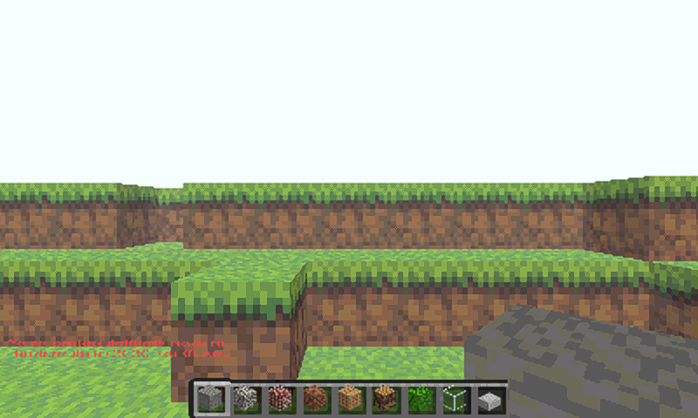
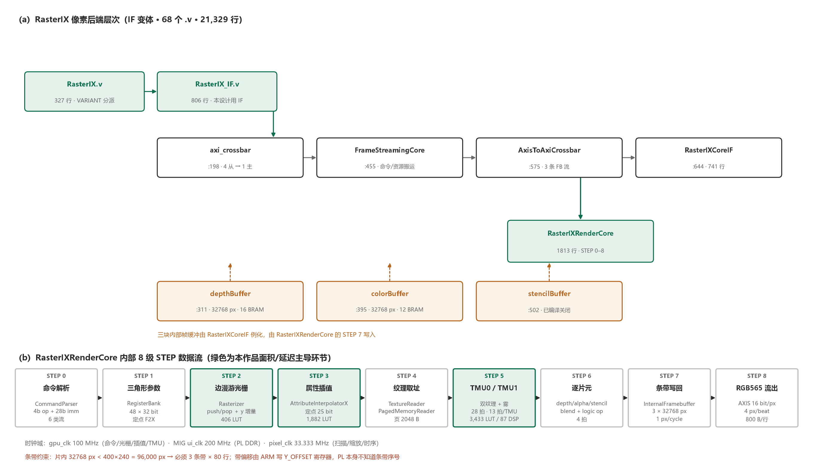
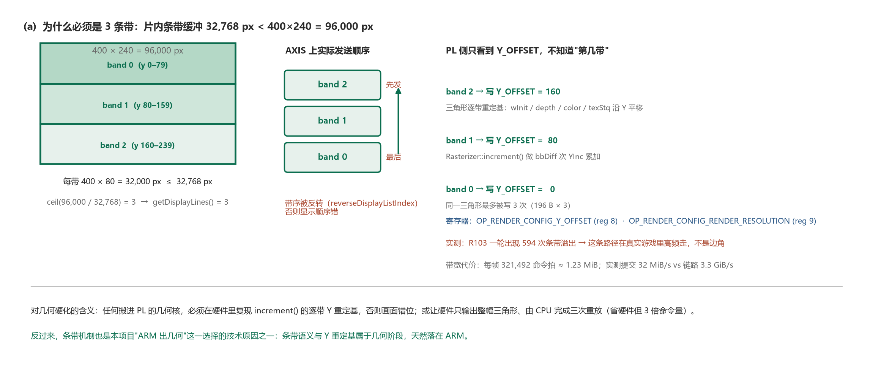



ON BOARD TEST ON AMD ZYNQ ULTRASCALE+
Real-Time Rendering, Stylization
and Super-Resolution Fusion on XCZU3EG
AMD Zynq UltraScale+
XCZU3EG · xczu3eg-sfvc784-1-i
Vivado 2026.1 · Vitis HLS 2026.1
INTRODUCTION
System Architecture
On-board launcher
ClassiCube + on-chip SR
A full geometry pipeline does not fit in a small FPGA, yet real 3D content still needs one. We split the workload by cost, not by habit: the A53 cores keep every geometry stage, the programmable logic keeps only fixed-function rasterization and display.
C
MEASURED ON SILICON
R
R
Render / display
400×240 → 800×480
E
E
SR long run, view 32
57.089 fps
A
S
SR long run, view 16
60.106 fps
T
U
Same-scene 20 s ABBA
36.83 → 47.83 fps
I
L
Whole-device LUT / DSP
64,901 / 325
V
T
BRAM after CNN reclaim
189.5 / 216
Fig.1 RasterIX pixel back-end hierarchy and its 8-stage STEP pipeline
E
Route WNS / WHS
+0.306 / +0.010 ns
CNN inference, median
12.873 ms
The sole hand-off is a 192-byte integerised triangle descriptor — not a vertex stream. Everything the PL receives is already rasterisable.
ARM side — all geometry
EIGHT GAMES, SR ENABLED — 8 / 8 PASSED
vertex unpack → MVP transform → per-TMU texcoord matrix → fixed-function lighting →
frustum + user clip → perspective divide → viewport → culling → primitive assembly →
edge function, bbox, 1/area, colour / depth / texture gradients → 3-band split →
pack into 192-byte descriptors
launch → frame → normal exit → bitstream restore, each game with its own private library and hardware profile. ClassiCube 58.9 / 60.1 fps · Touhou 49.1 / 50.7 · Tux Racer 60.1 · Neverputt 60.0 · Quake 53.7 · Quake III 27.9 · Neverball 24.8 · Java 19.9 (SR processing rate, not game FPS)
THREE CONSTRAINTS DROVE EVERY DECISION
·
Device budget
WHAT IS PROVEN — AND WHAT IS NOT
70,560 LUT / 360 DSP / 216 BRAM — no room for a second GPU
Proven on hardware
·
Strip buffer
8/8 games with SR · 384,000-px whole-frame equality · 36-frame A/B/A with 4,423,680 B byte-identical · four ownership layers fault-injected and passed
96,000 px exceeds the 32,768-px on-chip strip by 3×
·
Scan beat
PL side — pixels only
Examined and declined
LCD 60.125 Hz is a fixed clock, independent of produced frames
SR + CNN in one bitstream: 74,339 > 70,560 LUT, placement fails · full geometry in PL: 91,645 LUT vs 32,510 available (2.82× over)
·
Measured wall
command parser → incremental edge-walk rasterizer → attribute interpolation + F2X →
dual TMU + fog (28 cycles) → per-fragment depth / alpha / stencil / blend →
3 × 32,768-px strip framebuffer → RGB565 out
SR + CNN together need 74,339 LUT — placement fails
Stated boundaries
KEY CONTRIBUTIONS
1080p output not validated (DP link reports disconnected) · 60.125 Hz scan is not 60 produced frames per second · no stable-60 claim
① Command-level split ② Line-streamed SR (EASU12 + RCAS5)
③ In-place CNN storage ④ Four-layer frame ownership
Sources: RasterIX (commit 9269a01, GPLv3) · FidelityFX-FSR1 EASU12 / RCAS5 (commit a21ffb8f) · INT8 student network 3→8→8→3 @ 160×96 · Vivado 2026.1 · every figure traces to a routed report or an on-board counter paired with a monotonic clock.

