Slide 1
Disparities of Quality of Services between Urban and Non-Urban Home Health Care Agencies
Author: Yili Zhang and Gunes Koru

Slide 2
Objectives
Investigate differences of urban and non-urban HHAs in selected measures
Examine if rurality has an impact on utilization outcomes
Identify significant measures affect utilization outcomes for urban and non-urban HHA respectively

Slide 3
Methods
Data collection:
Rural-Urban Commuting Area Codes from University of Washington
Data of quality of measures for HHAs from year 2016-2019 published by CMS
Data from year 2016-2019 was chosen because there is a potential discrepancy in data of season 3 and 4 in year 2015, which is, maybe column names of admitted in hospital and receive urgent care in ER are switched by mistake.
Two data sets are merged by zip code, each HHA was designated to rurality with two levels: urban and non-urban

Slide 4
Methods
Measures change by year in the datasets downloaded, only measures exists in all datasets are selected:
1 characteristic measure
Type of HHA
6 service offered measures
Off.nursing
Off.physical
Off.occupational
Off.speech
Off.medical
Off.hha
7 clinical process measures
Timely
Taughtdrugs
Checkfall
Checkdepression
Flutshot
Pneumococcal
Taughtfootcare
7 clinical outcome measures
Betterwalking
Betterbed
Betterbathing
Lesspain
Betterbreathing
Betterhealing
Betterdrug
2 utilization outcome measures
Admitted
ER

Slide 5
Methods
Objective 1
Calculate count and percentage of characteristic measure and service offered measures
Calculate mean, median, standard deviation, and Wil-Cox value for clinical process, clinical outcome, and utilization outcome measures

Slide 6
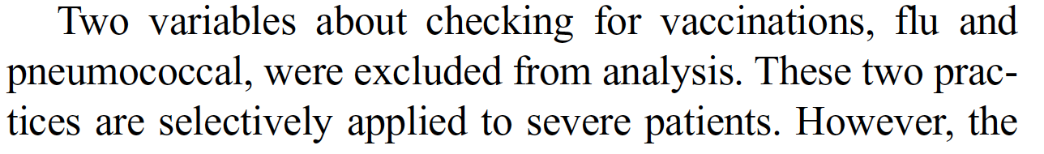
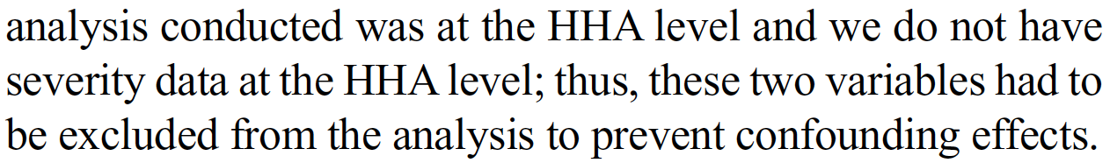
Methods
Objective 2
Create regression tree models with admitted and ER being the predict variable
The models are with 1 depth level to see if RUCA is the top measure on the node
Measures selected in regression tree models are service offered measures and clinical process measures except flushot and pnumococcal
There are two reasons to remove these two measures:
Statements in previous paper Facilitating Focused Process Improvement Efforts in Home Health Agencies to Improve Utilization Outcomes Effectively and Efficiently. Reference:
The high standard deviations of these two variables confirmed the above statement

Slide 7
Methods
Objective 3
Create regression tree models for the two unitization outcomes for urban and non-urban HHAs respectively
Same prediction variables selected as in models created in objective 2, because these services and processes can be improved/changed. Other variables such as type of HHA, cannot be changed easily, and clinical outcomes variables does not provide guidance for HHAs, so they are excluded.
Off.nursing
Off.physical
Off.occupational
Off.speech
Off.medical
Off.hha
Timely
Taughtdrugs
Checkfall
Checkdepression
Taughtfootcare
Complex parameter (cp) are selected with lowest 10-fold cross-validation error
Models are trimmed to have level of depth = 2, thus, to investigate the most significant measures that have impacts on response variable

Slide 8
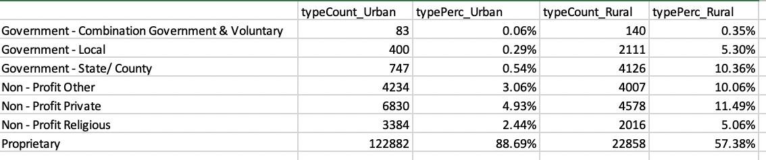
Results: Objective 1
Table of characteristic measure
Urban HHA are mostly proprietary type
Non-urban HHA are also mostly in proprietary type but has more percentage in all other types than urban HHA

Slide 9
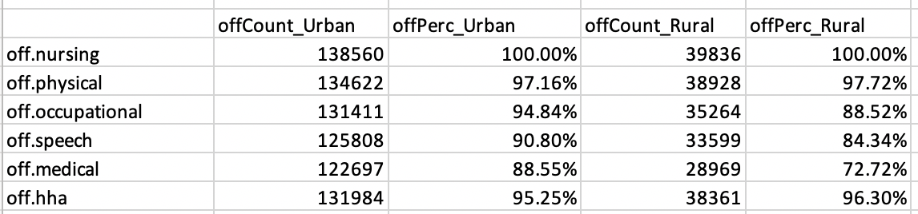
Results: Objective 1
Table of service offered measures
All HHAs in both urban and non-urban area offer nursing services
More urban HHAs offer occupational, speech, and medical services than non-urban HHAs
More non-urban HHAs offer physical and hha services than urban HHAs

Slide 10
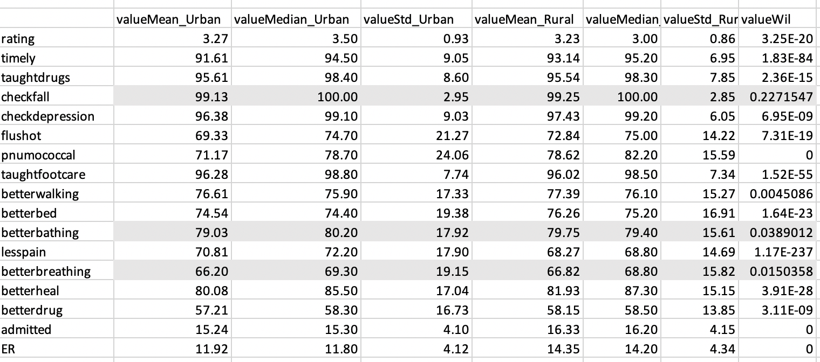
Results: Objective 1
Table of clinical process measures, clinical outcome measures, and utilization outcome measures

Slide 11
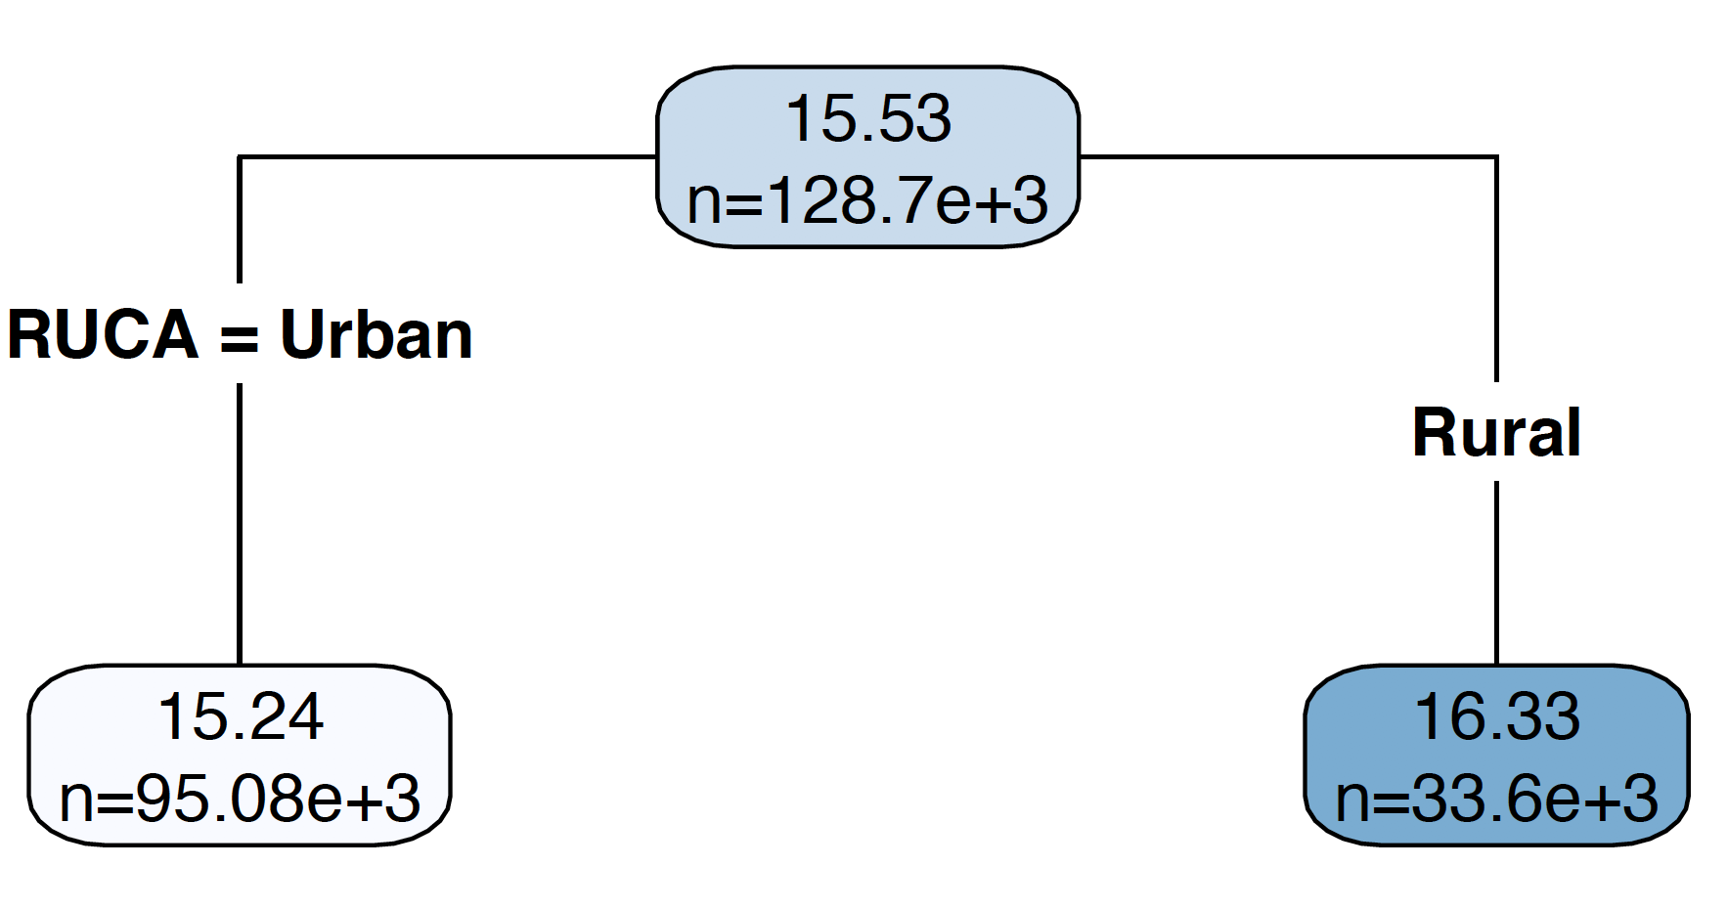
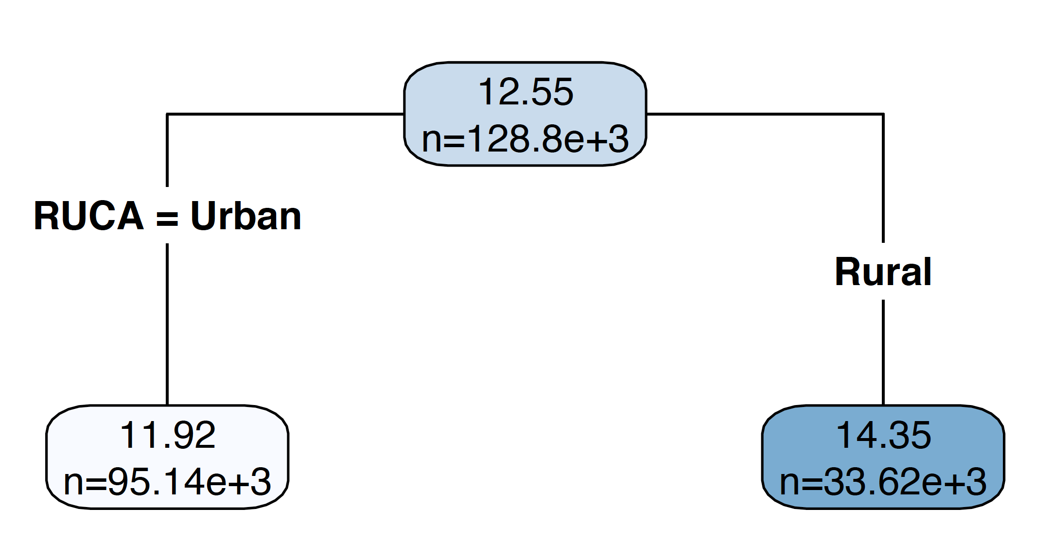
Results: Objective 2
Rurality is important to effect utilization outcomes
The first node has different observations because records with NA value in response variable are omitted
Admitted as response variable
ER as response variable

Slide 12
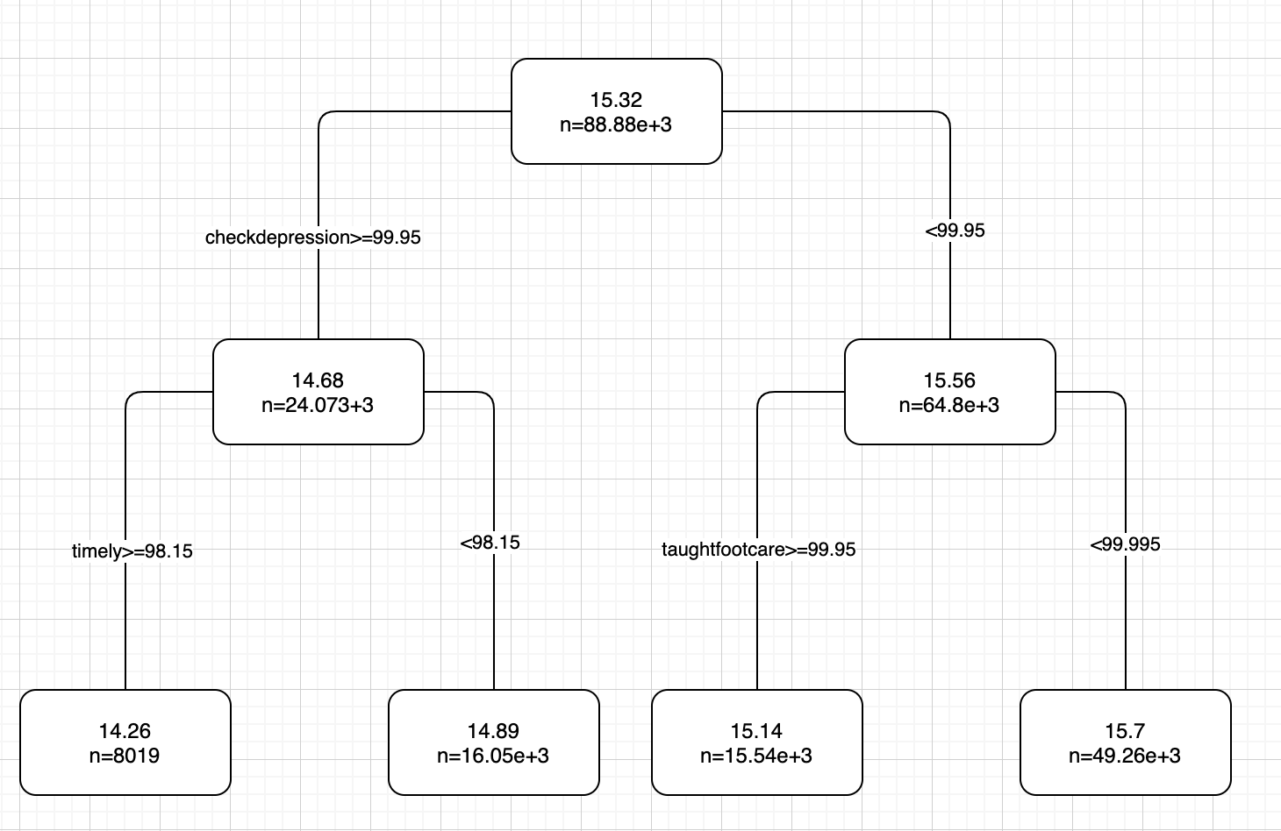
Results: Objective 3
Higher Checkdepression, timely and taughfootcare rates can lower admission rate in urban area
Most urban HHAs have not reached best rate: (checkdepression=99.95 and timely = 98.15) vs median 99.1 and 94.5
Regression tree with admission as response variable for urban data

Slide 13
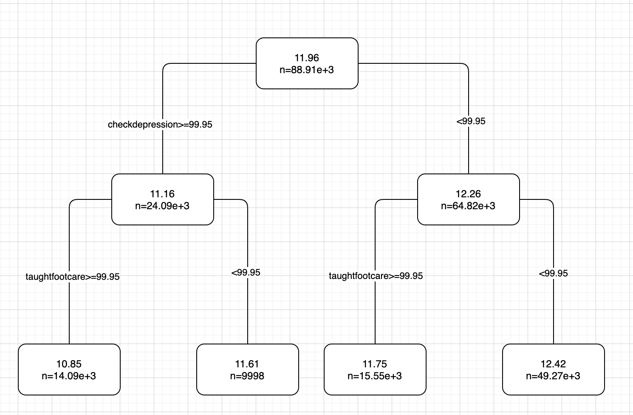
Results: Objective 3
Higher Checkdepression and taughtfootcare rates can lower ER rate in urban area
Most urban HHAs have not reached best rate: (checkdepression=99.95 and taughtfootcare = 99.95) vs median 99.1 and 98.8
Regression tree with ER as response variable for urban data

Slide 14
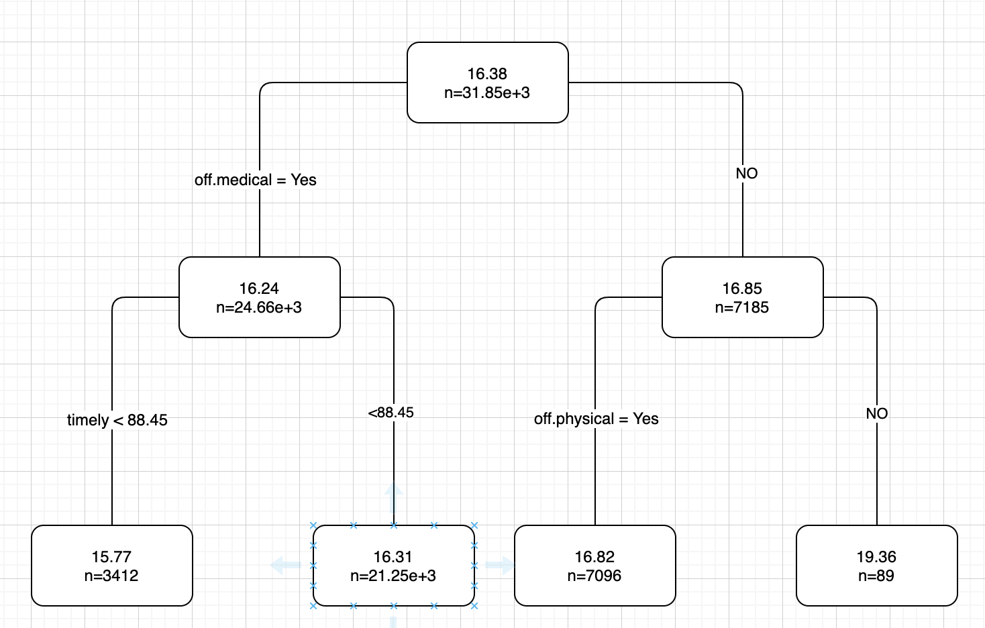
Results: Objective 3
Higher off.medical, off.physical rates and lower? (it needs a good explanation) timely rate can lower admission rate in non-urban area
72.72% of non-urban HHAs offer medical service and 92.72% non-urban HHAs offer physical service
Regression tree with admission as response variable for non-urban data

Slide 15
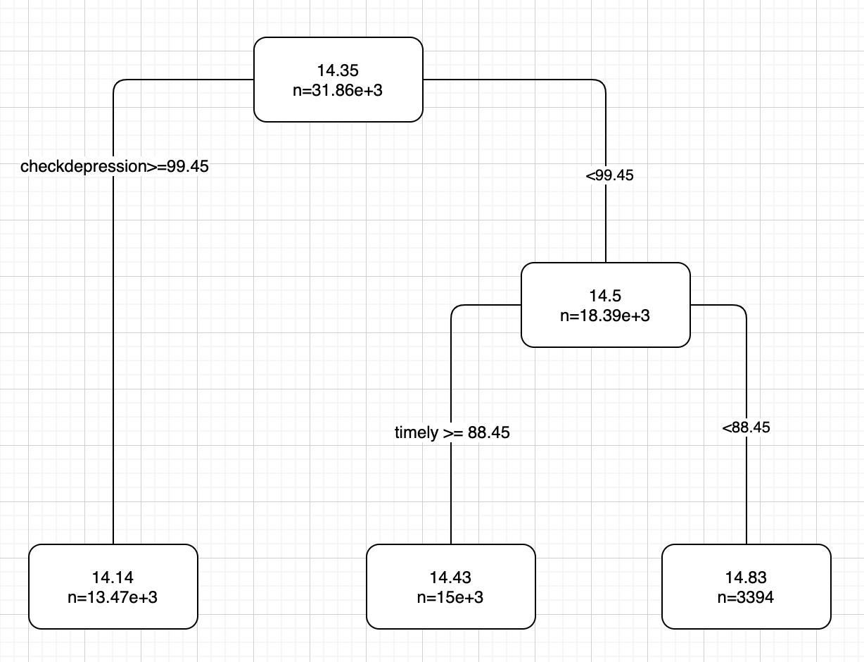
Results: Objective 3
Higher Checkdepression and timely rates can lower ERrate in non-urban area
Most non-urban HHAs have not reached best rate: (checkdepression=99.95) vs median 99.2
but reached (timely = 88.45) vs median 98.5
Regression tree with ER as response variable for non-urban data

